Slide 1

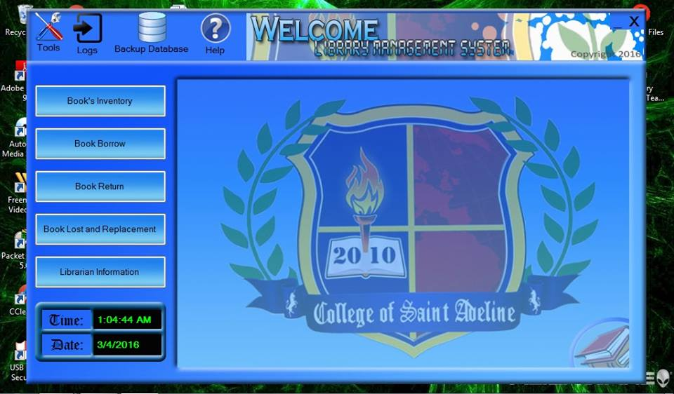
LMS
LIBRARY MANAGEMENT SYSTEM
BSIT 2ND SEMESTER SOFTWARE
ENGINEERING PROJECT ON
LIBRARY MANAGEMENT SYSTEM
PRESENTED BY
Aragon, Janreign
Capacia, John Julio
Flores, Donna Mae
Hiramis, John Brian
Paz Pablo, Virgilio

Slide 2
LMS
LIBRARY MANAGEMENT SYSTEM
TABLE OF CONTENT
Title of the System?.................................................................1
Process Description?.................................................................3
Introduction?.............................................................................4
Table Design?.............................................................................5
Project Details?........................................................................6
Conclusion?................................................................................7
Advantages of (LMS)?...............................................................8
Scope and Limitation?...............................................................9

Slide 3
LMS
LIBRARY MANAGEMENT SYSTEM
PROCESS DESCRIPTION
We have a login page from where its user can access. Provided for working staff members, student and also Admin. Accounts will be manage by Admin and to access the library resources, student have to register by using their own personal information regarding to registration form. After successful registration they will be provided the login facility. Student can search books by using unique identity or by author name, title of the books and also provided by books details such as where it is located.
If any student lost their books, it should be informed to library working staff member or in the Admin where they can made changes to their account and take appropriate actions. For receiving books from the Library Management System student have to use their code which provide by working staff member under by Admin to scan and add particular books into their account.

Slide 4
LMS
LIBRARY MANAGEMENT SYSTEM
INTRODUCTION
Library Management System is a program that manage collection of data or information which includes ;
Adding new user, issuing, returning and reissuing books.
Updating new user, issuing, returning and reissuing books.
Deleting new user, issuing, returning and reissuing books.
Collecting for book back.
Searching for book users.
In our project we will be able to classify user as staff or students. Classifying users allow the books issue controls, fine rates base on the classification. Example for students we will able to issue two books at the fine or penalty for late returning. What more we can change this setting based on our needs but we have to set this value just one and not every time the program begun. We have used setting class to implement this.

Slide 5
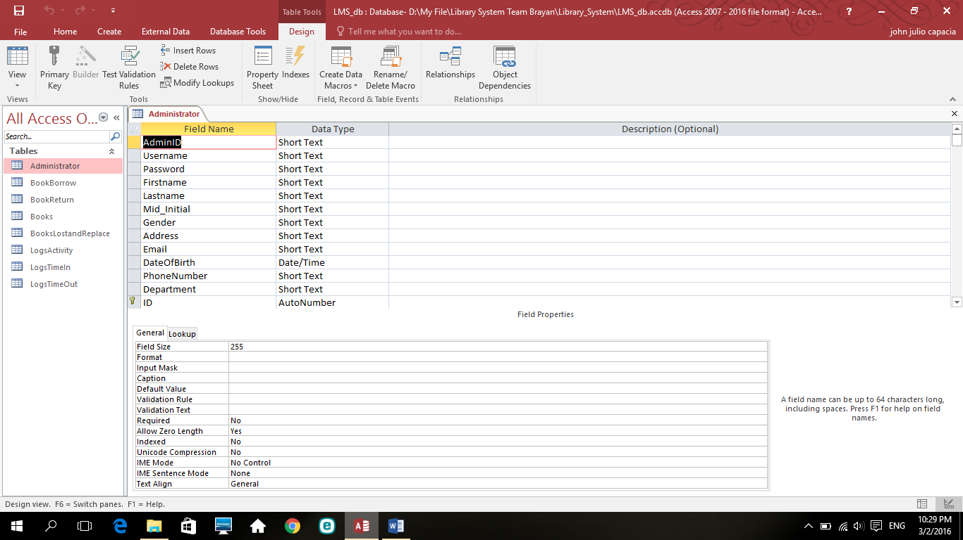
LMS
LIBRARY MANAGEMENT SYSTEM
TABLE DESIGN
ADMINISTRATOR
Admin id
Username
Password
First name
Last name
Mid initial
Gender
Address
Email
Date of birth
Phone number
Department

Slide 6
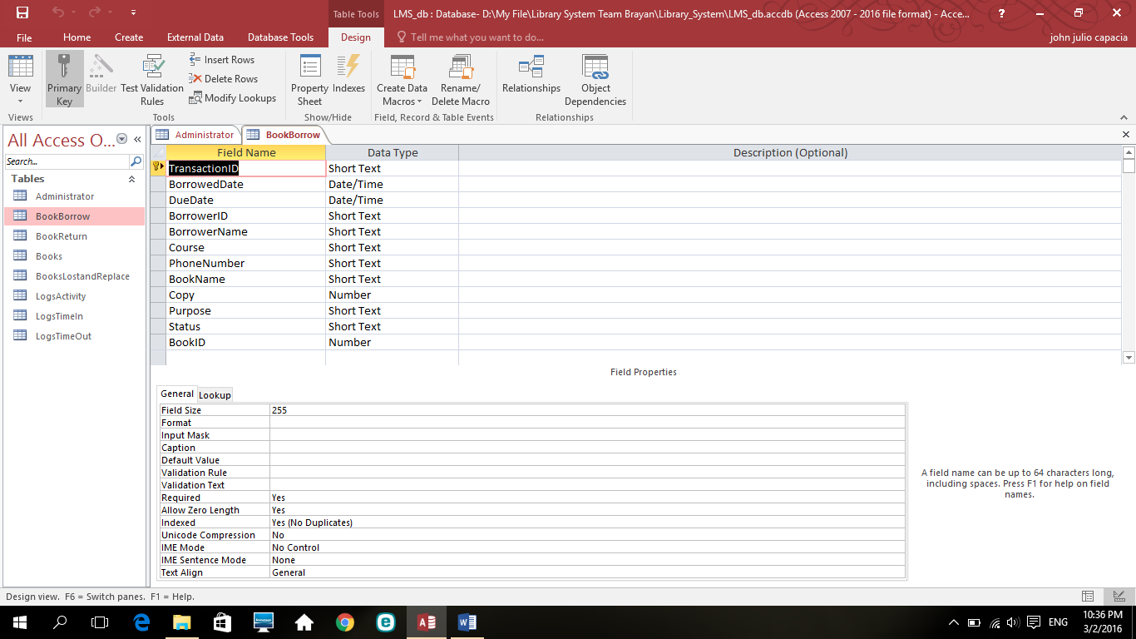
LMS
LIBRARY MANAGEMENT SYSTEM
TABLE DESIGN
BOOK BORROW
Transaction ID
Borrowed date
Due date
Borrow ID
Borrow name
Course
Phone number
Book name
Copy
Purpose
Status
book id

Slide 7
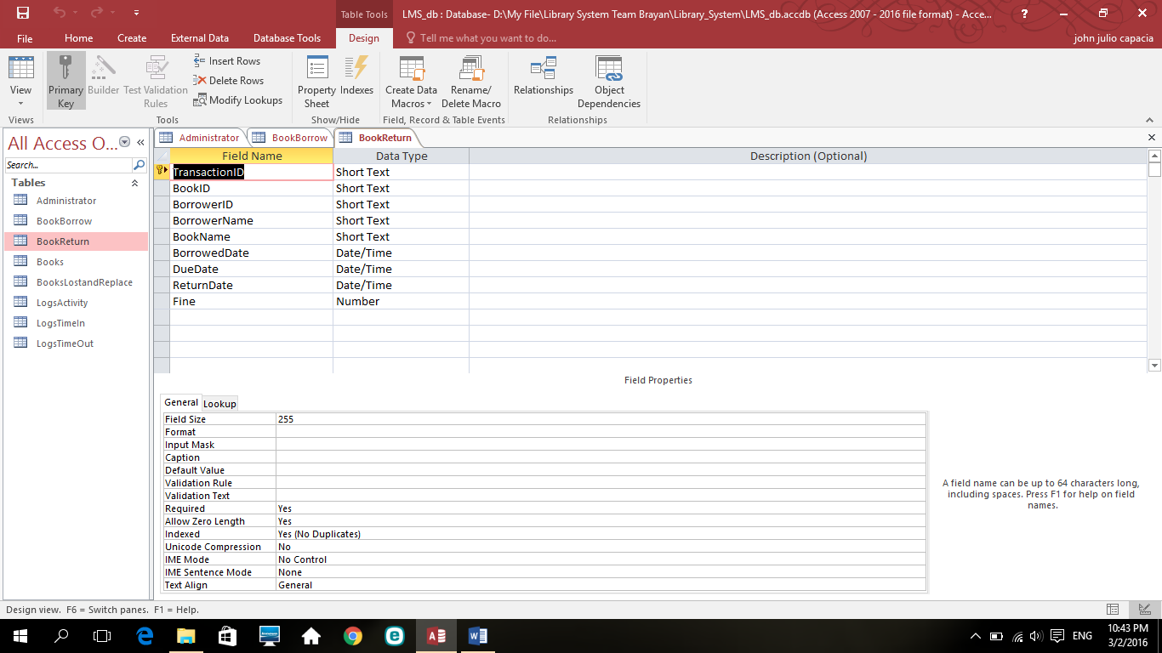
LMS
LIBRARY MANAGEMENT SYSTEM
TABLE DESIGN
BOOK RETURN
Transaction ID
Book id
Barrowed ID
Borrower name
Book name
Borrowed date
Due Date
Return Date
fine

Slide 8
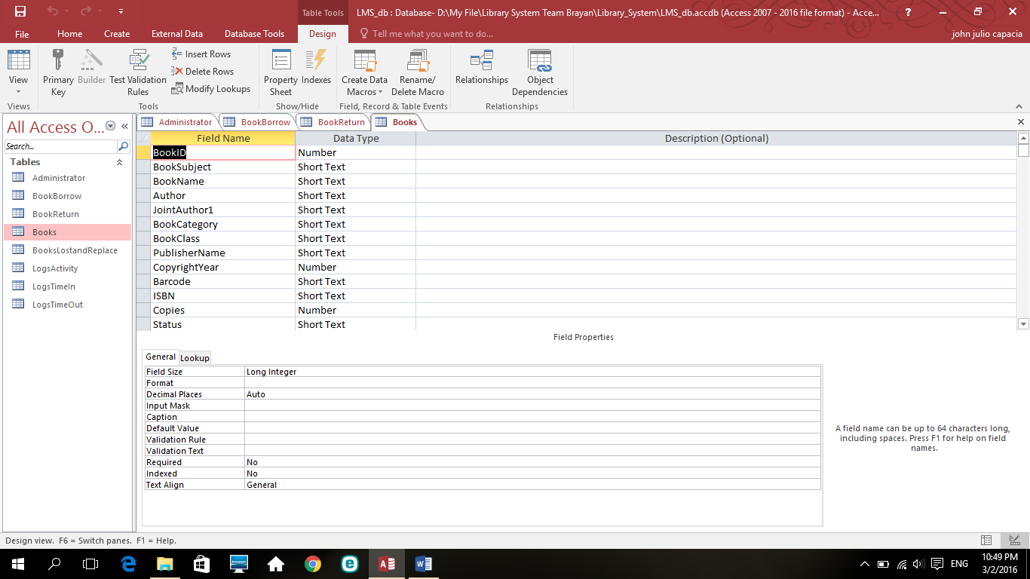
LMS
LIBRARY MANAGEMENT SYSTEM
TABLE DESIGN
BOOKS
Book ID
Book Subject
Book Name
Author
Joint Author 1
Book Category
Book Class
Publisher Name
Copyright Year
Barcode
ISNB
Copies
Status

Slide 9
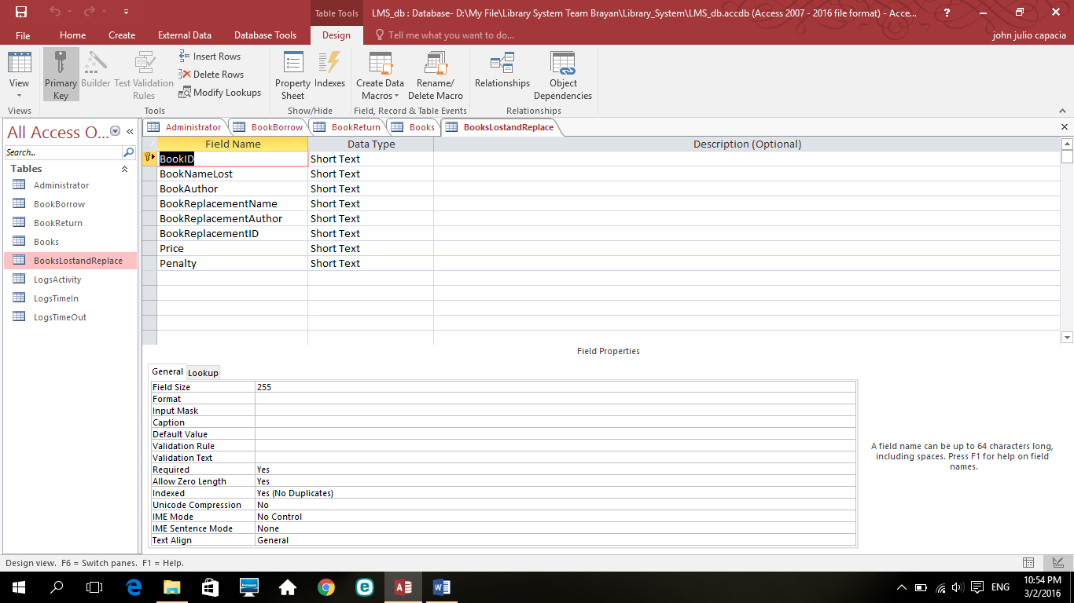
LMS
LIBRARY MANAGEMENT SYSTEM
TABLE DESIGN
BOOK LOST AND REPLACEMENT
Book ID
Book name lost
Book author
Book replacement name
Book replacement author
Book replacement ID
Price
Penalty

Slide 10
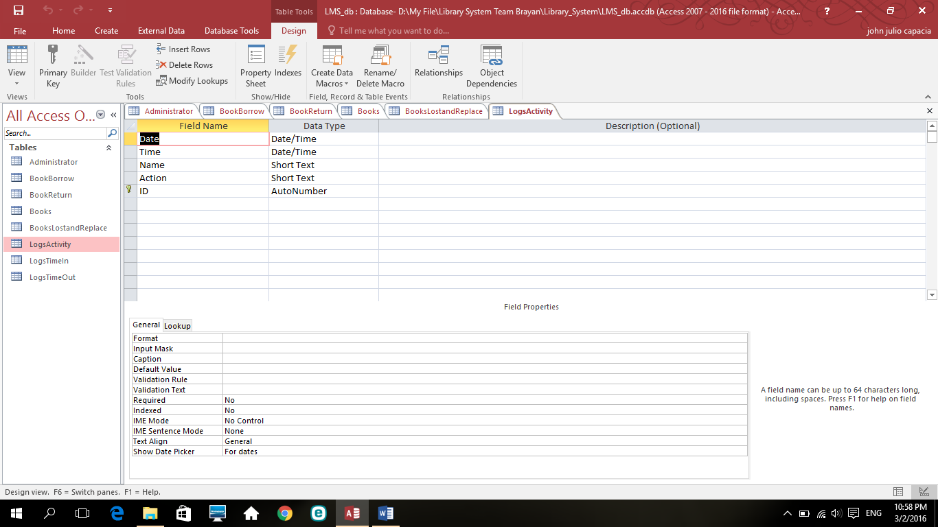
LMS
LIBRARY MANAGEMENT SYSTEM
TABLE DESIGN
LOGS ACTIVITY
Date
Time
Action
ID

Slide 11

LMS
LIBRARY MANAGEMENT SYSTEM
TABLE DESIGN
LOGS TIME IN
Date
Time
Name
Action
ID

Slide 12
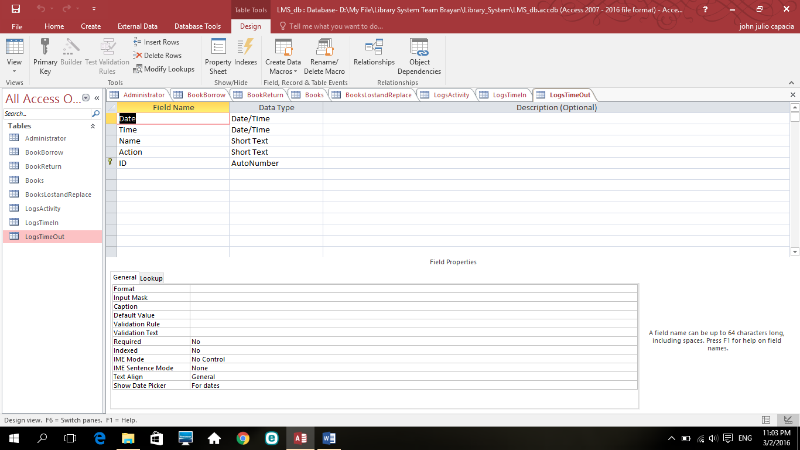
LMS
LIBRARY MANAGEMENT SYSTEM
TABLE DESIGN
LOGS TIME OUT
Date
Time
Name
Action
ID

Slide 13
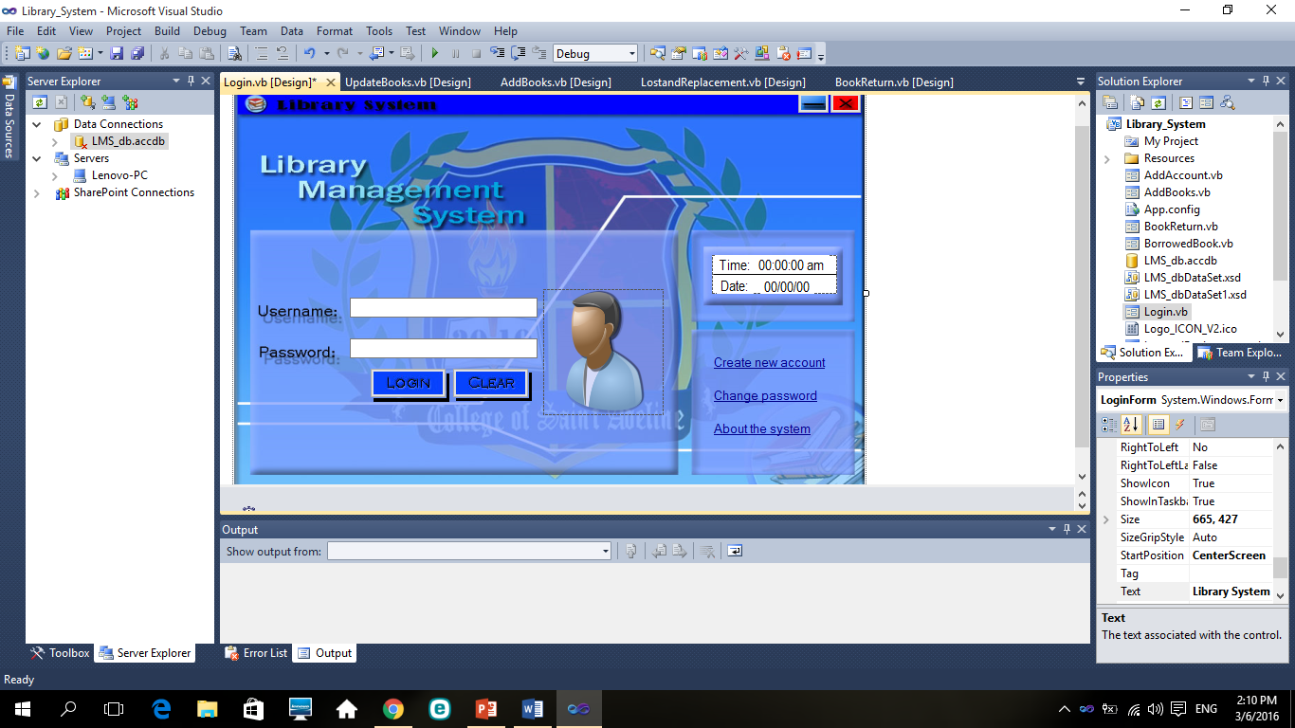
LMS
LIBRARY MANAGEMENT SYSTEM
PROJECT DETAILS
LOGIN FORM
Username
Password
Login
Clear
Time
Date
Create New User
Change Password
About The System

Slide 14
LMS
LIBRARY MANAGEMENT SYSTEM
PROJECT DETAILS
MAIN FORM
Tools
Logs
Back Up Database
Help
Book Inventory
Book Borrow
Book Return
Book Lost and Replacement

Slide 15
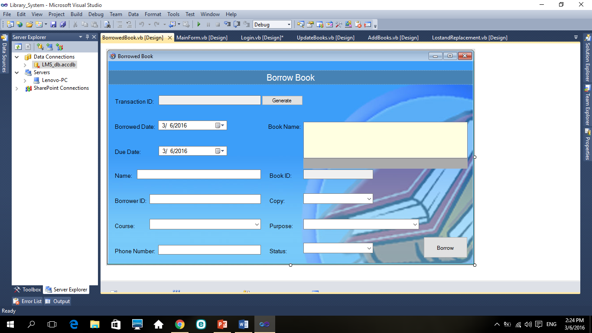
LMS
LIBRARY MANAGEMENT SYSTEM
PROJECT DETAILS
BOOK BORROW
Transaction ID
Borrowed date
Due date
Borrow ID
Borrow name
Course
Phone number
Book name
Copy
Purpose
Status
book id
Borrow

Slide 16
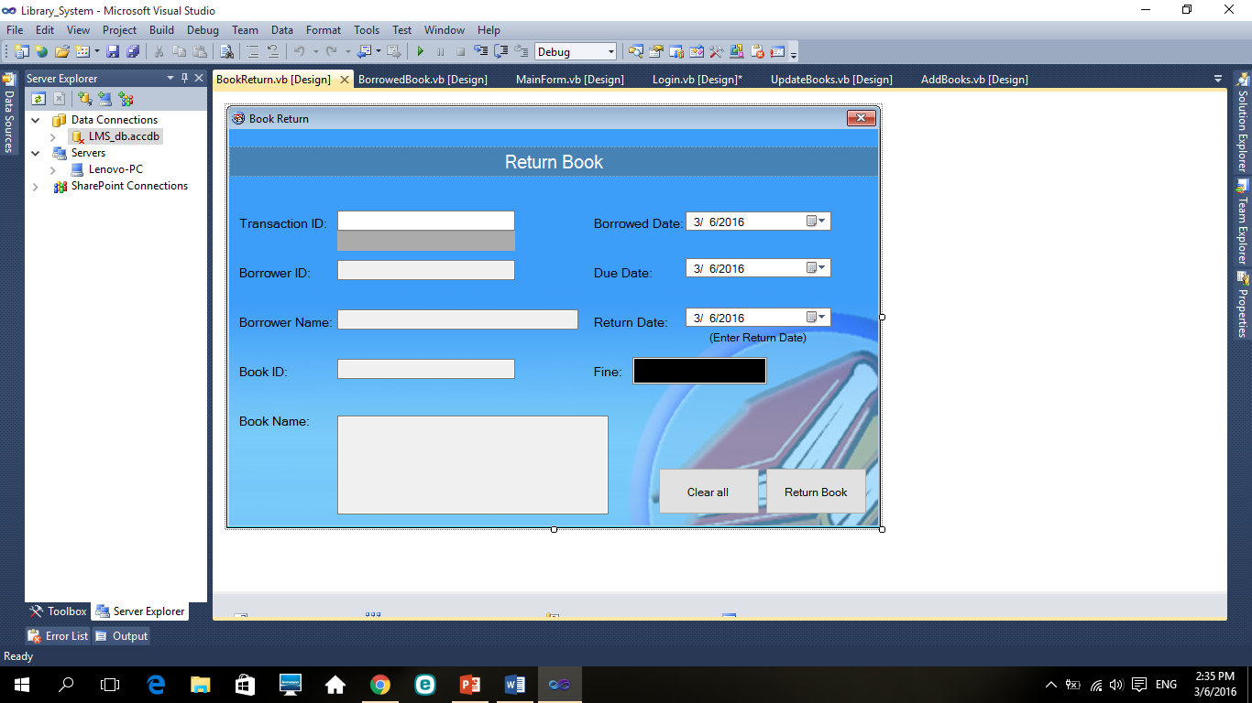
LMS
LIBRARY MANAGEMENT SYSTEM
PROJECT DETAILS
BOOK RETURN
Transaction ID
Book id
Barrowed ID
Borrower name
Book name
Borrowed date
Due Date
Return Date
Fine
Clear All
Return Book

Slide 17
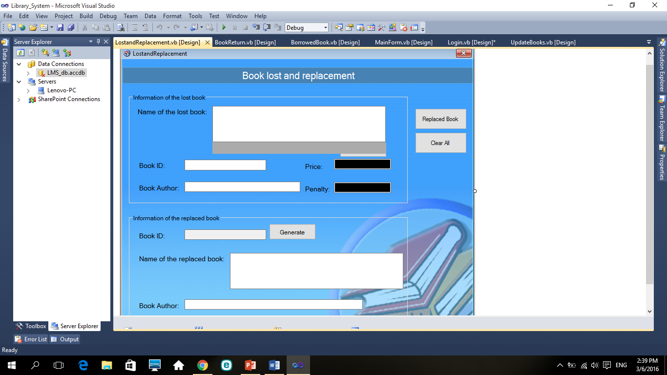
LMS
LIBRARY MANAGEMENT SYSTEM
PROJECT DETAILS
BOOK LOST AND REPLACE
Information of the lost book
Name of the Book Lost
Book ID
Book Author
Price
Penalty
Information of the replaced book
Book ID
Name of the Replaced Book
Book Author
Generate
Replaced Book

Slide 18
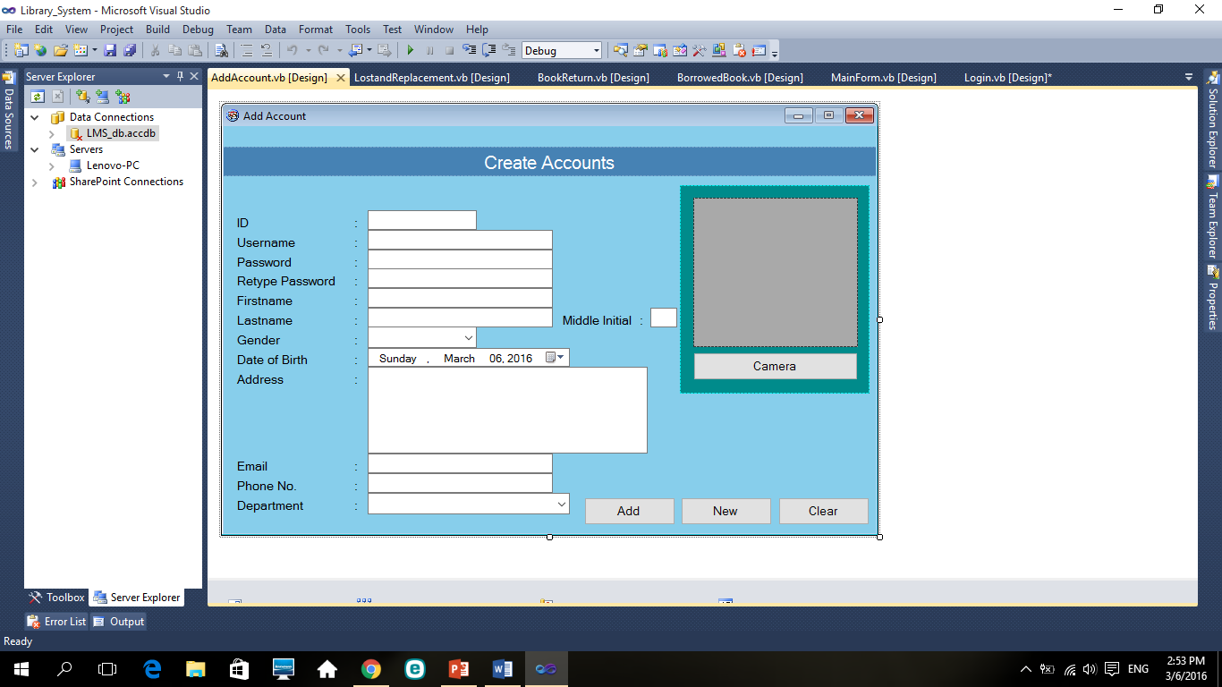
LMS
LIBRARY MANAGEMENT SYSTEM
PROJECT DETAILS
ADD ACCOUNT
ID
Username
Password
Retype Password
First Name
Last Name
Gender
Date of Birth
Address
Phone Number
Department
Camera
Add
New
Clear

Slide 19
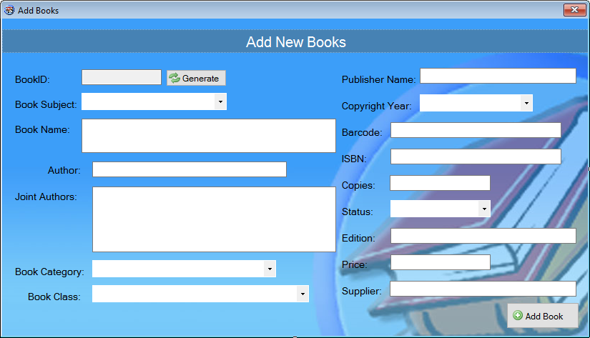
LMS
LIBRARY MANAGEMENT SYSTEM
PROJECT DETAILS
ADD BOOKs
Book ID
Books Subject
Book Name Author
Book Category
Book Class
Publisher Name
Copyright Year
Barcode
ISBN
Copies
Status
Edition
Price
Supplier
Add Book

Slide 20
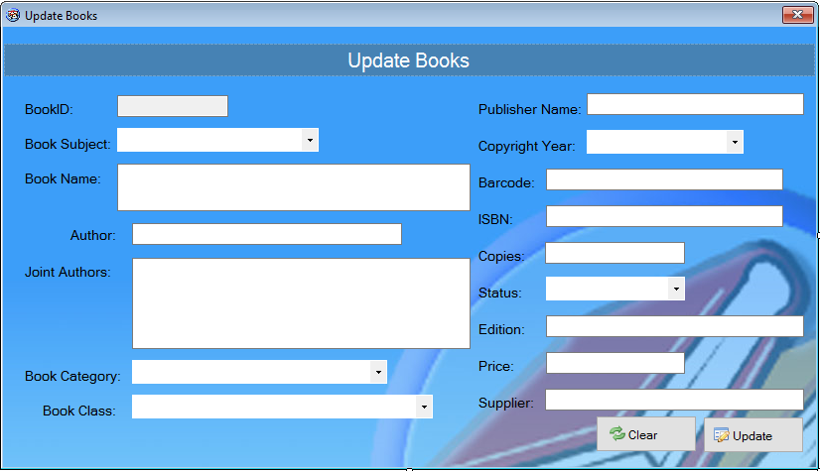
LMS
LIBRARY MANAGEMENT SYSTEM
PROJECT DETAILS
UPDATE BOOK
Book ID
Book Subject
Book Name
Author
Joint Author
Book Category
Book Class
Publisher Name
Copyright Year
Barcode
ISBN
Copies
Status
Edition
Price
Supplier
Clear
Update

