Slide 1
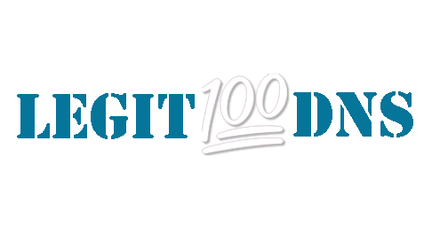
Chrome Browser Extension
CS-6387-50 - Topics in Software Engineering - Cybersecurity
Benjamin Ray

Slide 2
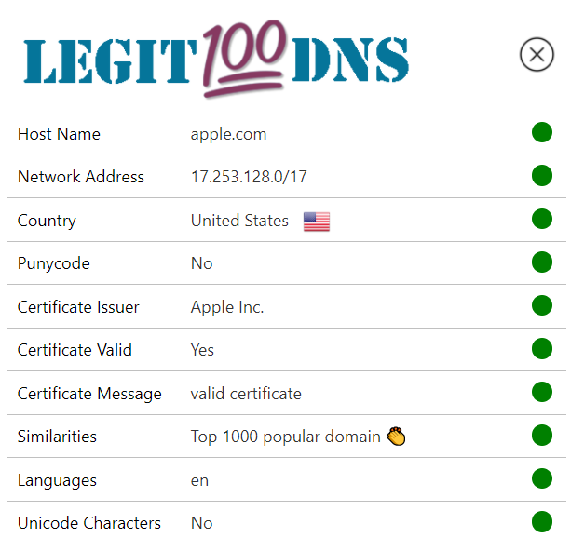
Architecture
Location API IPinfo.io
Certificate API Check SSL
topdomains.json
Domain
Location
Info
Domain
Certificate
Info
Measure Levenshtein Distance
Domain
□ Network Address □ Host Country □ Languages Supported
□ Certificate Issuer □ Certificate Valid □ Certificate Message
□ Similarities
□ Punycode □ Unicode Characters
JavaScript
Domain

Slide 3
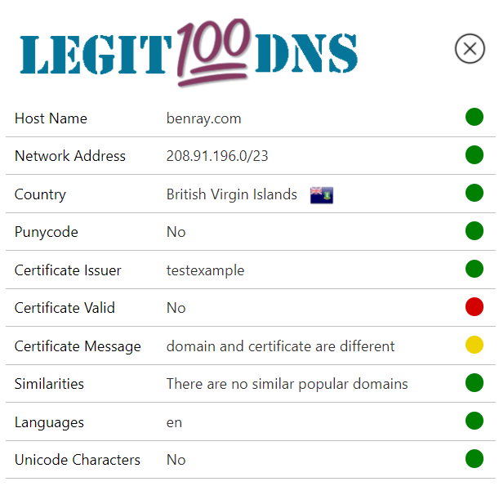
Color Codes
Used on each metric to indicate safety level
Green – Most likely safe
Yellow - Take caution, may be a risk
Red – Something seems suspicious

Slide 4
Hostname
The domain/hostname is identified by taking the URL of the current request and removing domain prefixes and paths
Domain suffix though included
For Example, https://developer.chrome.com/docs/extensions/ will get reduced to chrome.com

Slide 5
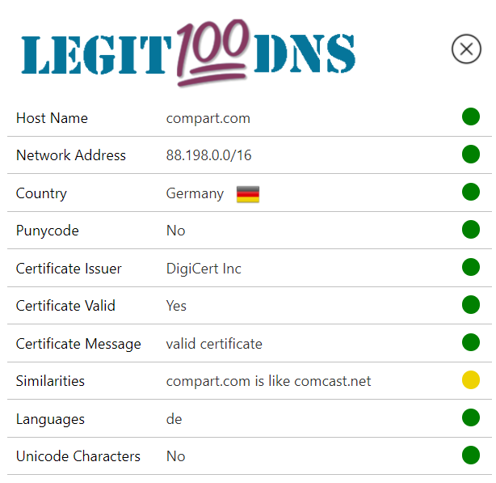
Network Address
Retrieved from the location API from ipfind.io,
Network path provides the user information about the IP and network on which it’s hosted.

Slide 6
Country
Country of which the domain is hosted
Flag is displayed
Could provide user with caution if domain is not hosted where expected

Slide 7
Certificate Information
Retrieved from Check SSL via rapidapi.com
Checks if domain issuer is legitimate (VeriSign, etc.)
Checks if certificate is self signed
If issuer and Subject are Same, self-signed
Custom message from API

Slide 8
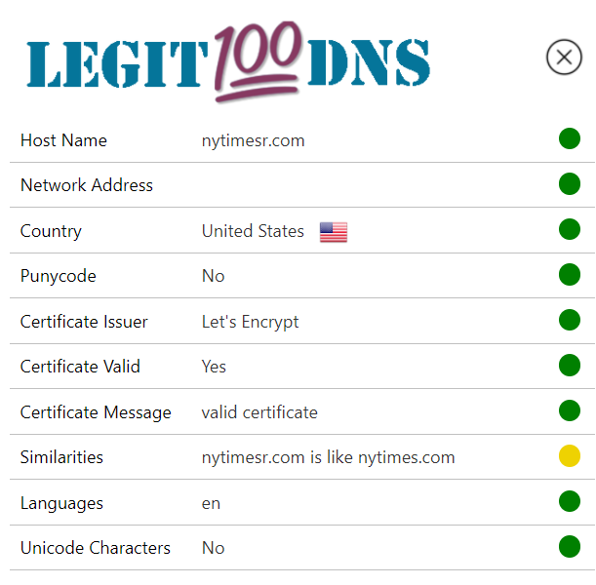
SiMilarIties
Top 1000 domains are loaded from json
JavaScript function calculates Levenshtein Distance
If distance is between 1 and 3, yellow warning shown
Works better with longer domain names

Slide 9
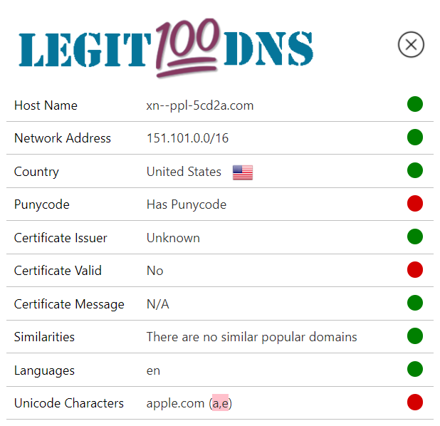
Unicode Characters/Punycode
Detect non-ASCII characters in the domain name string (JavaScript)
If Non-ASCII characters exists Chrome redirects to ASCII version
Punycode decoded to show the Unicode characters (JavaScript)
List the special characters from the domain in brackets (Ex. Cryllic)
Using Unicode in domains isn’t always bad (International domains)
If Unicode exists Red circle is shown

Slide 10
Questions?

