Slide 1

MOVIeNite
A Web application that allows users to search for movies
and create their own personalized List for Future movie viewing.
The movie search uses The OMDb (Open movie database) API which IS
Free to use with a personalized Key.
ThE application is built using React JS, SASS, CSS, and HTML on a NODE.JS SERVER.
CS 5278 Final Project
Benjamin Ray
8/4/21

Slide 2


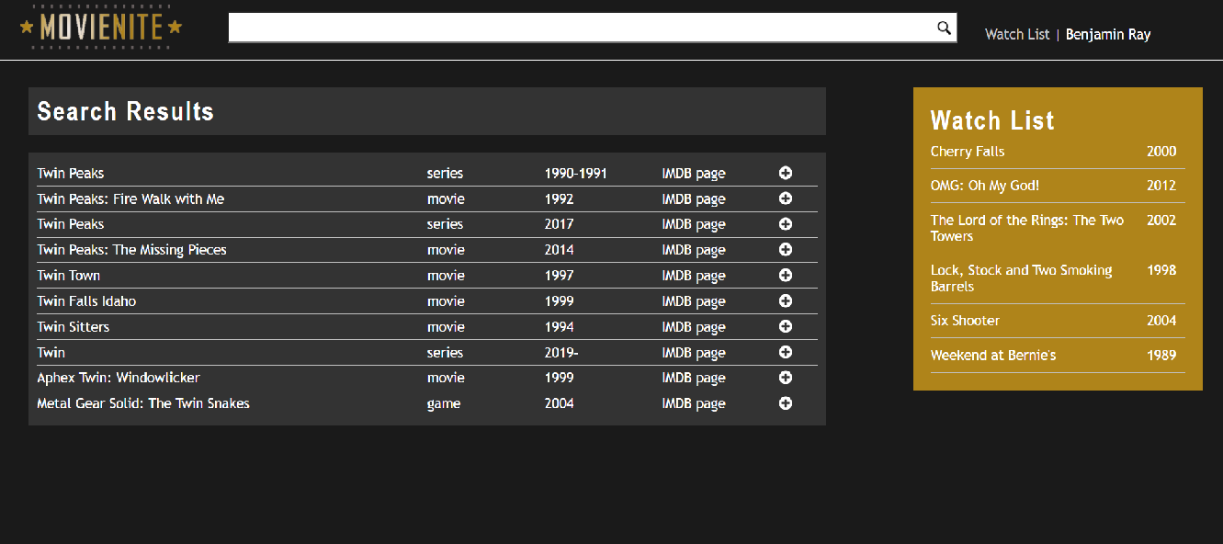
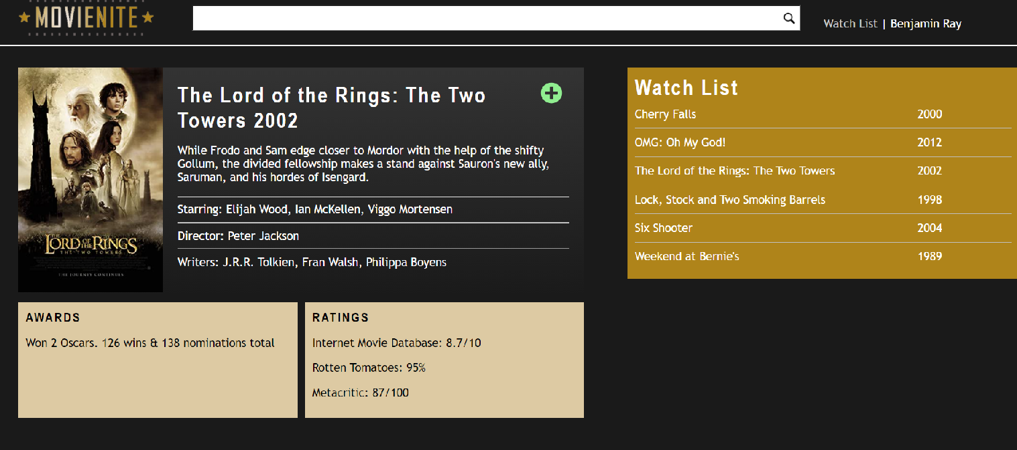
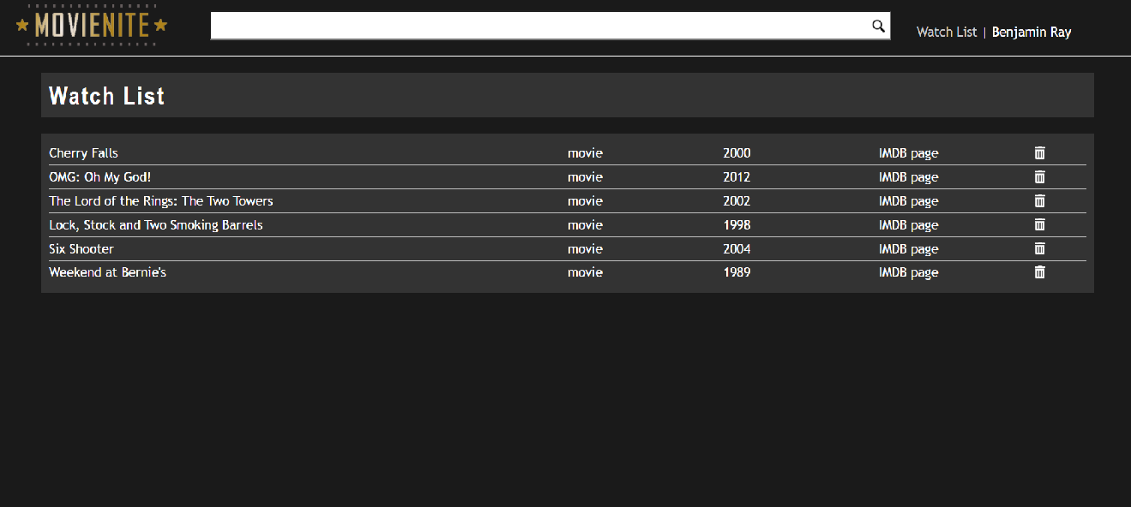

ARCHITECURE
OMDb
OMDb API
The Open Movie Database
Local Storage
GET Movies by Title
GET Movie by Title or IMDB IDB
Create
Update
Delete
Search
Movie Details
Watch List

Slide 3
REQUIREMENTS
Ability to search for Movies based on Title of Movie using the OMDb.
Select a movie and search for details of the movie using OMDb including:
Actor
Title
Awards
Year Released
Director
Ability to add a select to a personalized “Watch List”.
Ability to manage “Watch List” (Add, Update, Delete).
Ability to store user’s “Watch List” data.

Slide 4

Technologies Used
React JS
Redux
JavaScript
SASS
HTML
node.JS

Slide 5
Patterns:
Observer Pattern - In Redux, when using the connect() method makes it possible for components to listen (or connect) to any part of the state tree. When the state changes, the components will update.
Constructor - Binding event handler methods to an instance. Initializing local state by assigning an object to this.state
Module - The module structure for Redux is all about dividing code by domain areas and eliminating dependencies between the modules.
Singleton – Redux Store is technically a Singleton when exporting store instances from modules.

Slide 6
Challenges
Time Constraints – Started project later than I should (mid-July).
Defining scope of project. (MVP vs. special features).

