Slide 1

Piggs Peak Project
Cross-platform Application

Slide 2
Contents
Introduction
Functionality
Challenges
Conclusion

Slide 3
Introduction
Because of the poverty in Swaziland, many families are not able to afford to send their children to school.
Hampton – Piggs Peak Partnership is a 100% non-profit organization that helps by covering the school tuition fees.
The tuition covers the basic admission fee as well as the cost for exams, uniforms, and textbooks

Slide 4

Our Mission
Streamline the process of sponsoring students by eliminating paper application forms.
Build a cross-platform application that helps staff interview current and potential students.
Build a database to store students, schools, fees, etc.

Slide 5




Functionality

Slide 6
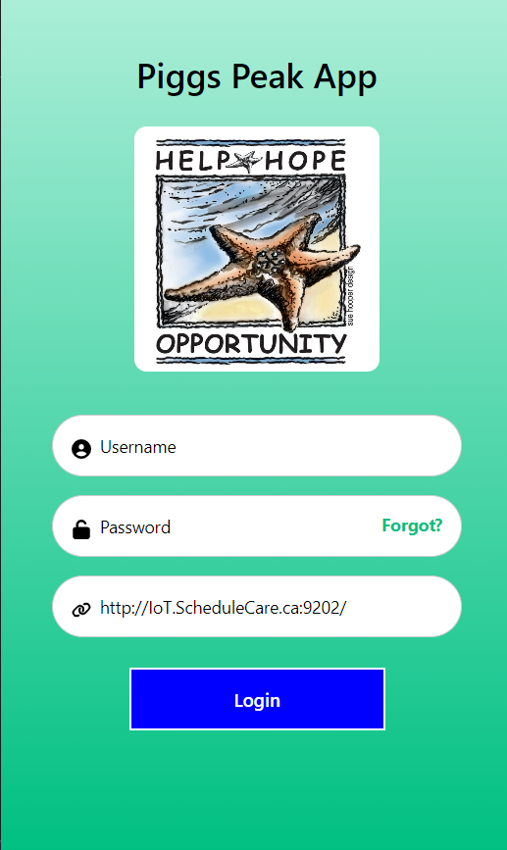
Login Page
Logging in securely with a username and an encrypted password.

Slide 7
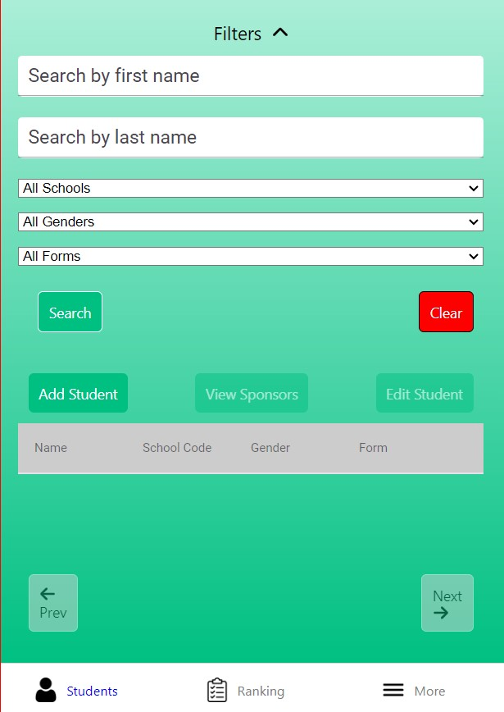
Home Page – Student Dashboard
Search for students by name, school, gender or form number.
School selection defaults to user’s preferred school.

Slide 8
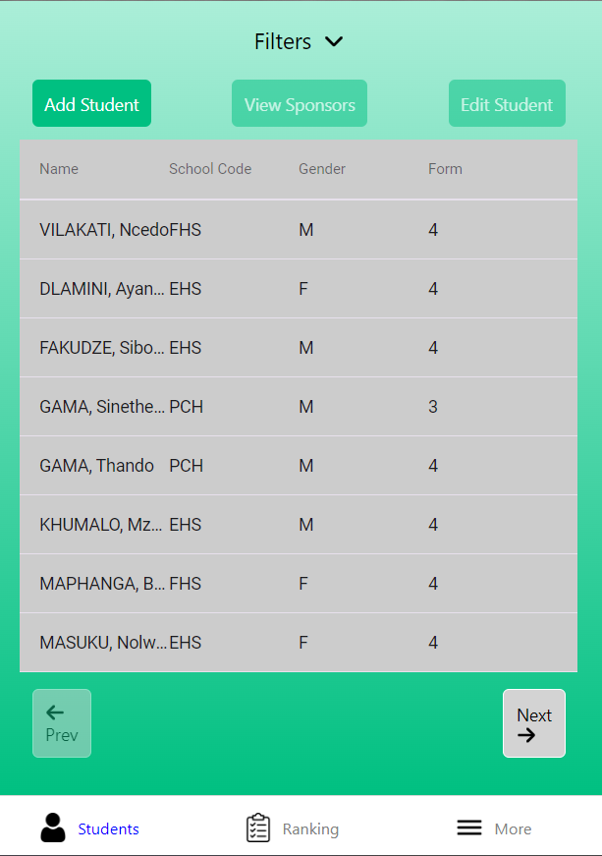
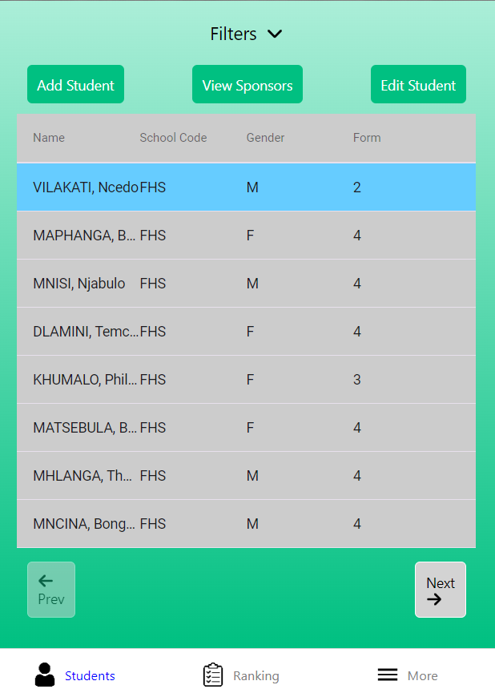
Student Dashboard Search

Slide 9
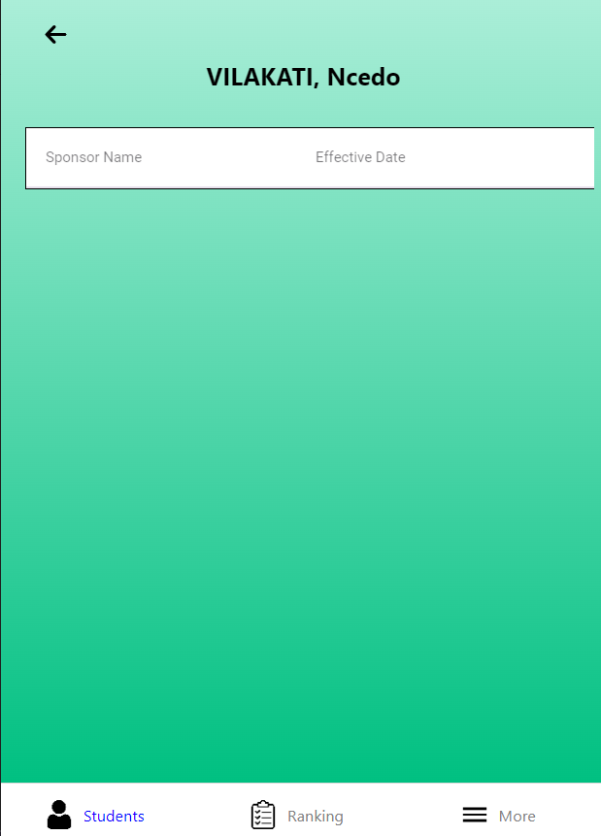
View Student Sponsors
If a student is sponsored, the sponsor data fills the sponsor table

Slide 10
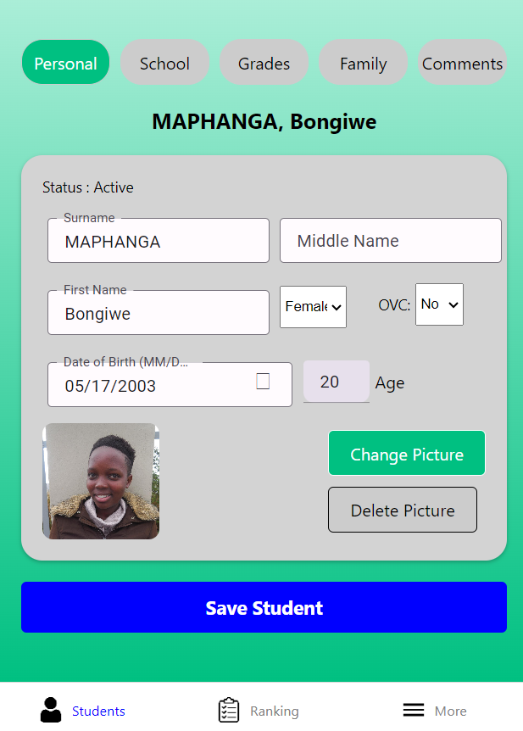
Editing a Student
Edit personal information
View current status
View student picture

Slide 11
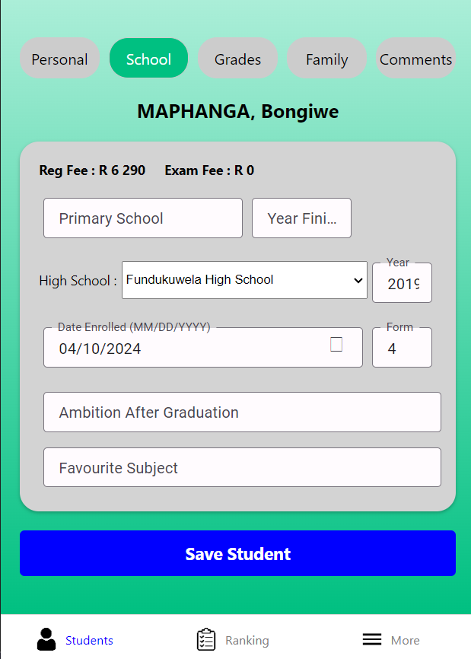
Editing a Student
View registration and examination fees
Edit school information

Slide 12
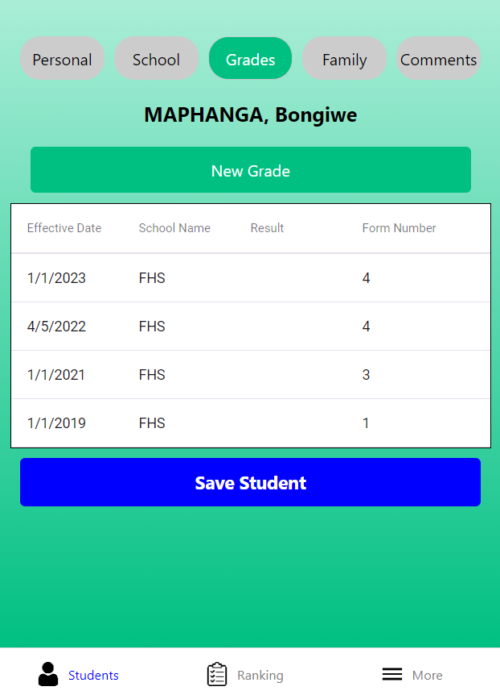
Editing a Student
View all grade information
Add new grade for student

Slide 13
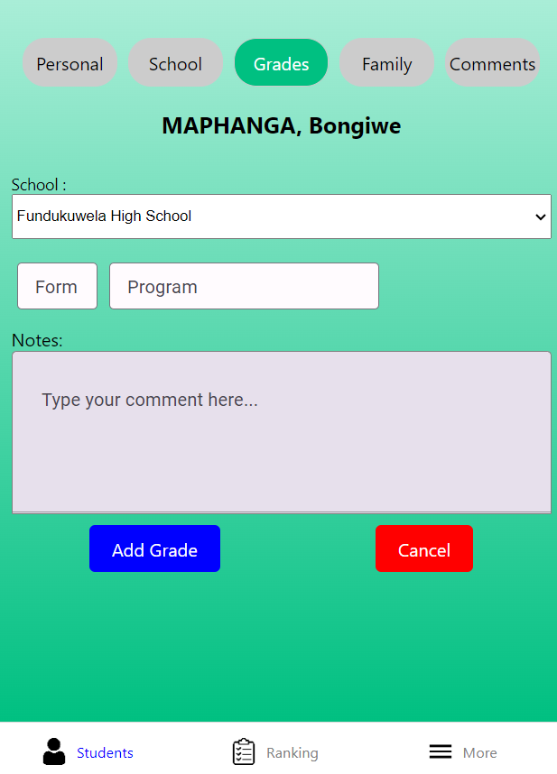
Add New Grade

Slide 14
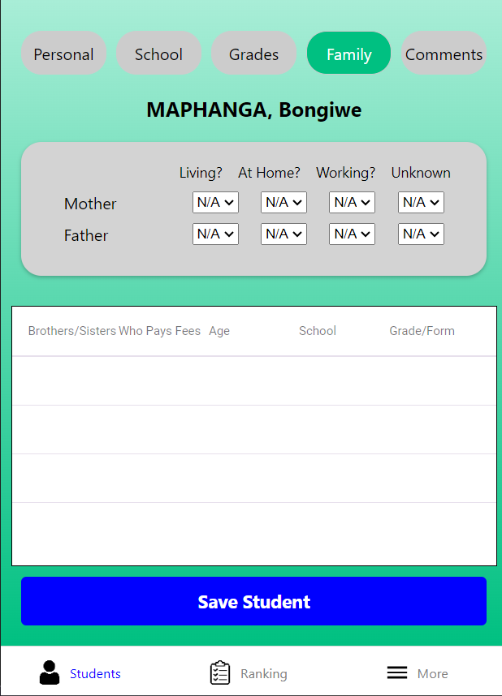
Editing a Student
Edit family information

Slide 15
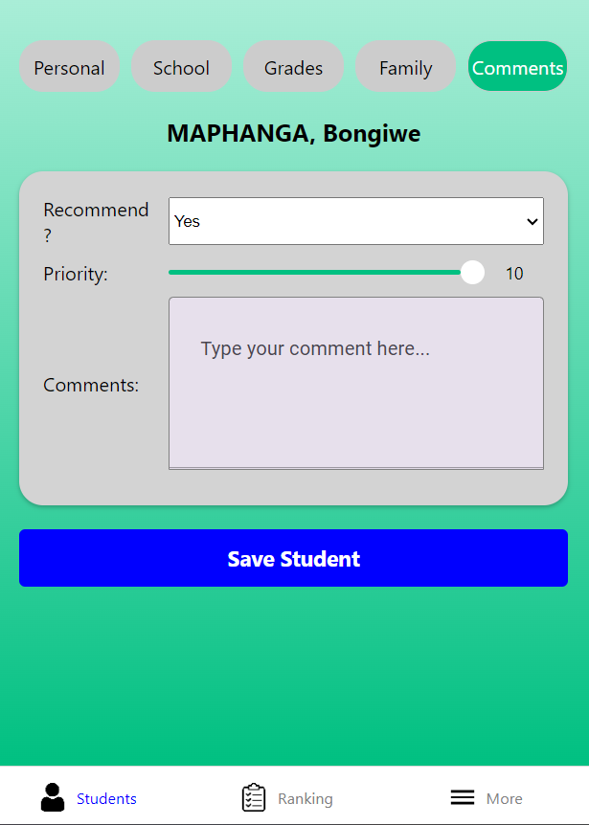
Editing a Student
Add comments
Set priority level and recommendation

Slide 16
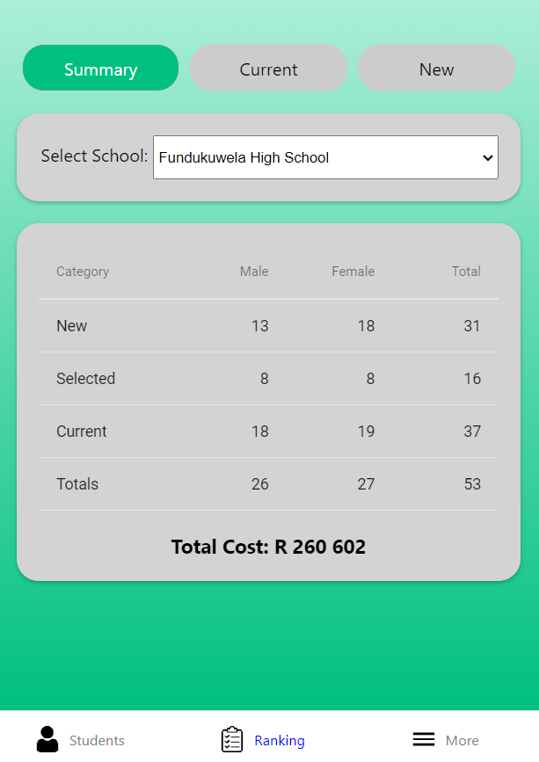
Ranking Page - Summary
Select a school (default to user preference).
View new, selected and current students for selected school.
Students sorted by gender
View total costs in South African Rand for all students

Slide 17
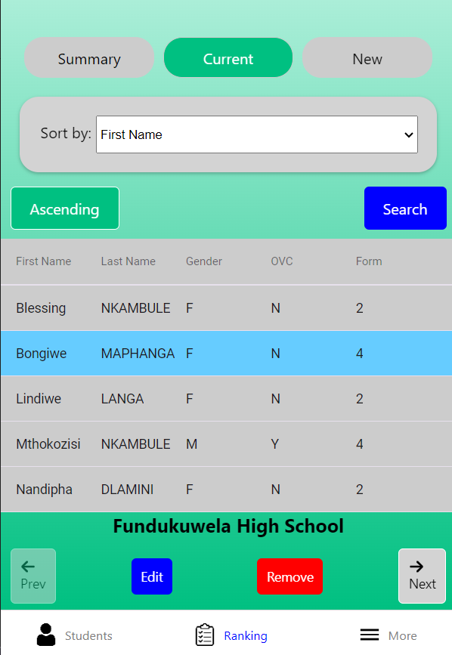
Ranking Page - Current
View all current students for the selected school
Sort students by name, gender, and form number by ascending or descending.
Select a student to edit their details or change their status

Slide 18
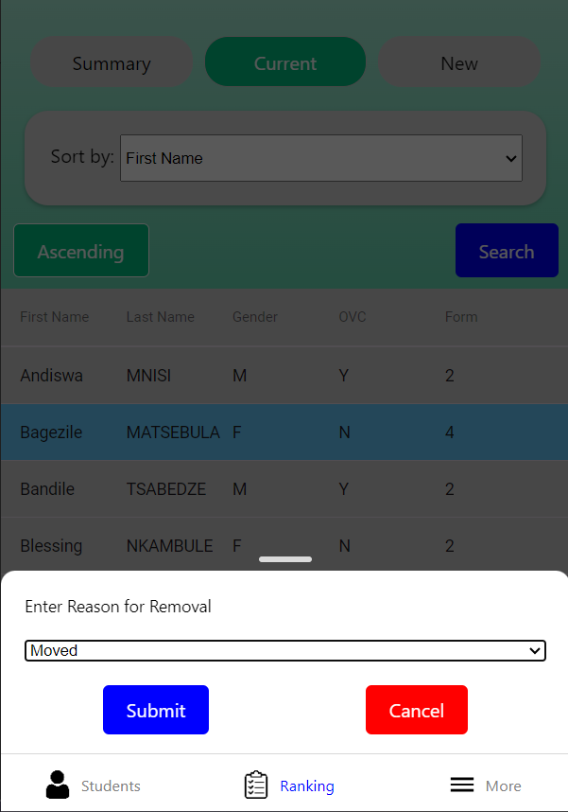
Ranking Page – Current (Remove)
Select reason for removal of selected student.
Remove with submit or return with cancel.

Slide 19
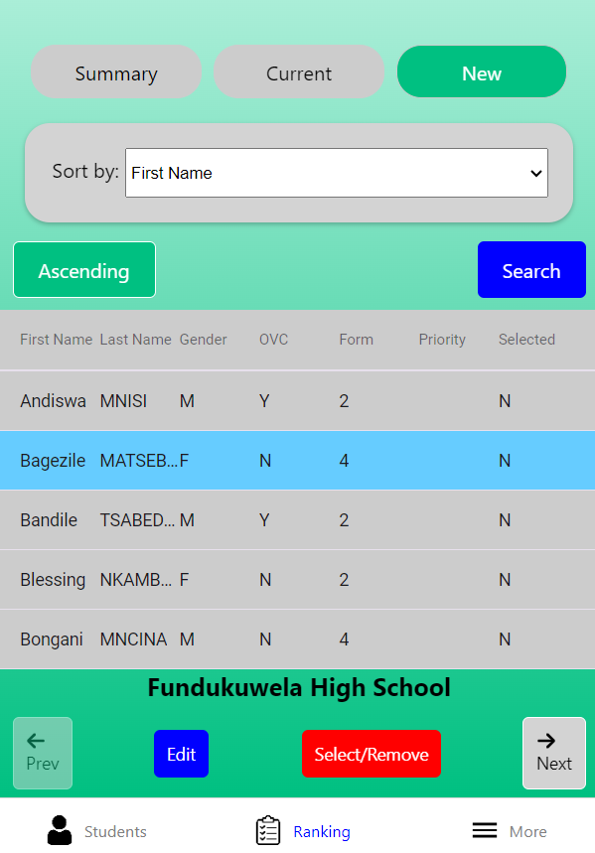
Ranking Page - New
View all new students for the selected school.
Sort students by name, gender, priority, and form number by ascending or descending.
Select a student to alter their “Selected” status.

Slide 20
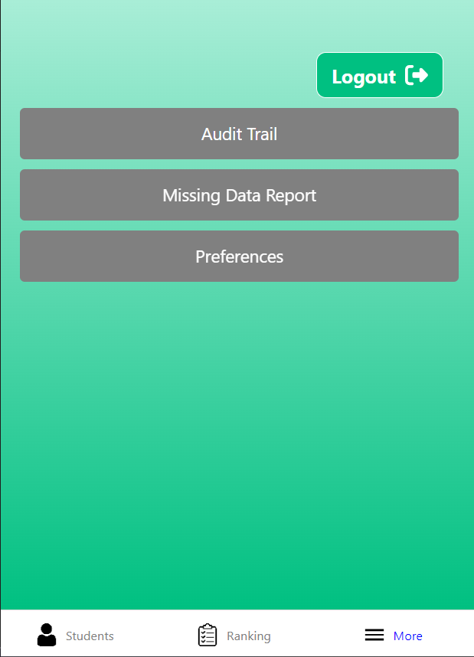
More Page
Current user can logout or change school preference

Slide 21
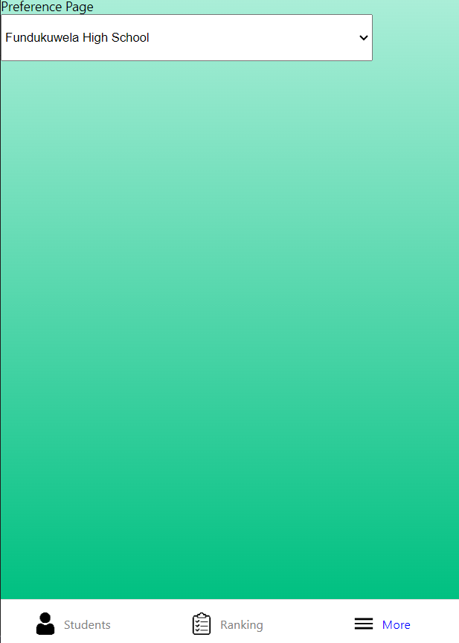
More Page - Preference
Select preferred school to load on searches

