Slide 1
Establishing a Just, Learning Culture Module 8.2 - CSD380
Brayan Covarrubias

Slide 2
What is Just Culture?
"Just culture" refers to balancing individual accountability with a focus on learning from error
Requires trust – employees must believe error reporting is honest, safe, reliable
Must address underlying barriers
Without addressing, organizations default to fear-based reporting, blame, and hiding mistakes rather than learning

Slide 3
Blame and Attribution Bias
Errors are naturally be attributed to personal flaws for those involved, rather than system conditions
Rooted in a mistaken belief that individuals had more control over the situation than they actually did
Less experienced workers report greater fear of shame or blame, less likely to trust reporting systems
To overcome, it requires –
Avoiding quick judgements
Using systematic approach to understand actions
Apply knowledge and understand human factors

Slide 4
Outcome Bias
The incident's severity often drives how an individual is treated
The quality of the decision isn't considered
Worse outcomes justify harder consequences
Even when actions were reasonable given the point of time of the incident
To overcome, it requires applying a "substitution test"
Ask what someone else would've done in the same situation
Equally experienced, without knowledge of the outcome

Slide 5
Lack of Transparency
Employees are often poorly informed on how their actions will be evaluated
Whether following a safety incident or how consequences will be decided
Organizations frequently lack consistent process for assessing individual actions
Leads to an increase in unpredictable outcomes, higher chances of being perceived "unfair"
Being open on how errors are handled is one of the strongest factors of trust
To overcome, it requires –
Ensuring assessment process is open and known, while applied consistently across cases

Slide 6
Trust Deficits
A variety of factors can impact whether employees trust the reporting system
Management style and walk-rounds
Visible professionalism
Encouraging open discussion between employee and supervisor strengthens reporting behavior
Lack of clear reporting system, unclear role definitions, decreases confidence in reporting

Slide 7
Dysfunctional Culture as a Whole
"Command-and-control" and bureaucratic cultures punish those who raise problems
Discouraging sharing info or being open to collaboration
Employees will cover up mistakes if failure is treated as something to avoid, rather than learn
Culture is difficult to define and change – not process or tooling, rather level of values and behavior
"Just culture" barriers appear anywhere blame is the default response for error

Slide 8
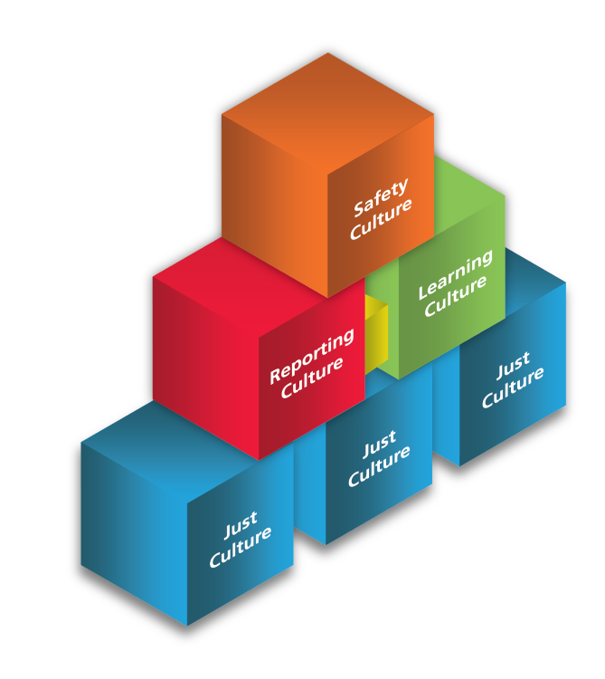
References
DevOps Institute – https://www.devopsinstitute.com/8-key-challenges-in-adopting-devops-part-1/
Health Quality Alberta – https://justculture.hqa.ca/overcoming-barriers-to-a-just-culture/
PubMed – https://pubmed.ncbi.nlm.nih.gov/35588066/
JustCulture

