Slide 1
The Technology Value Stream
Module 1.2 - Brayan Covarrubias
Sourced from "The DevOps Handbook"

Slide 2
The Technology Value Stream
In DevOps, every new feature or product starts as a business hypothesis
Business hypothesis – an educated guess of a certain feature or product will please customers or increase revenue
Value stream makes up the entire pipeline from an abstract hypothesis to a live feature/product
From a user's initial idea to final product

Slide 3
The Technology Value Stream (cont.)
The clock officially starts when a feature becomes a commitment by –
Having a concept move out of the "brainstorming" phase
Formally accepted into Development Team's committed backlog – begins spending resources, time, and focus
Value is realized when code is safely running in production, actively serving end-user
Leaving sitting code or features in staging or pending approval costs money with no revenue
Similar to unsold inventory in a retail store's backroom

Slide 4
Focus on deployment Lead time
Deployment Lead Time – a critical window for engineers
Starts when an engineer checks a code change into version control – i.e. Git
Ends when change is successfully deployed in production
DevOps aims to overlap development phases by –
Working in small batches
Managing testing, deployment, operations, development, and debugging all at the same time
In contrast to traditional development months, followed by testing months

Slide 5
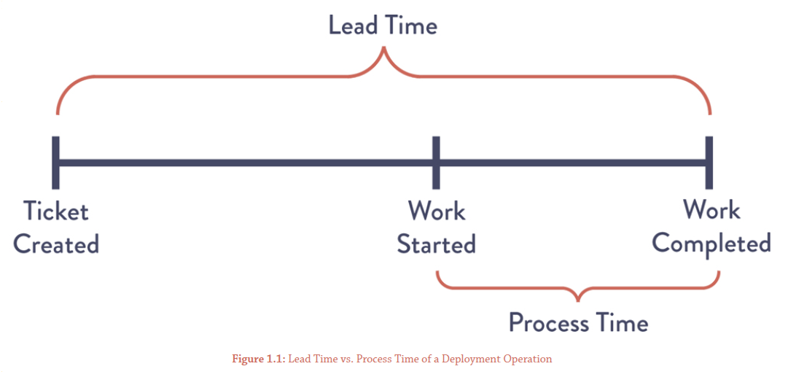
Lead Time vs. Processing Time
Lead Time – what the customer sees
Total time from user request to feature completion
Ex. Customer asks for feature, receives it 30 days later.
Processing Time – also known as touch time
Actual time an engineer spends actively coding or testing requested feature
Ex. Developer sits down and writes code for 2 hours
Waiting in queues can needlessly increase lead time, even if processing is short
Waiting for approvals, testing environments, deployment windows, etc.
Optimizing engineers only speeds processing time (2 hrs.), not lead time (30 days)
Example of Lead Time vs. Process Time – Sourced from "The DevOps Handbook" textbook

Slide 6
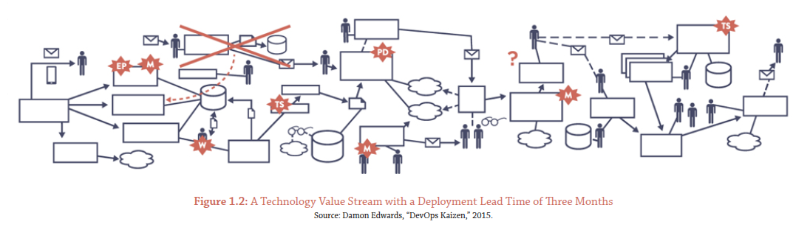
Deployment Lead Times Stall
Deployments can take months in tightly coupled, monolithic architectures
Code is tangled together, testing requires massive integration environments, teams fight for use
Including lots of manual testing, various approval processes – common in large, traditional organizations
Isolated development can cause integration hell
Software grouped in large batches risks unable to build, feature conflicts, or test failures
Example of a large organization deployment – Sourced from "The DevOps Handbook" textbook

Slide 7
The DevOps Ideal
DevOps aims to optimize workflows for fast feedback, frequent integrations, and modular architecture
Developers can make small changes, have automated systems check instantly
Deploy in small batches – easier to spot bugs
Loosely coupled architecture allows teams to update their specific features independently
Allows for faster development time, less bottlenecks

