Slide 1

CubeSat – Control - Report Out
Ben Sherman
Trace Shafer

Slide 2
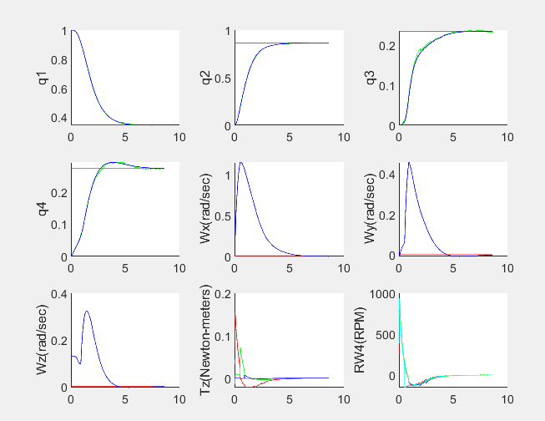
CubeSat MATLAB Simulation
Go to Drop Box -> CubeSat -> Control -> Simulation -> Simulation
Once MATLAB opens you can run it.
All files needed to run the program are within the Simulation folder.
It is a LQR controller that has gain scheduling implemented with an EKF observer

Slide 3
B-dot
There is a working Rust code that has B-dot running, file to large to fit in Dropbox

Slide 4
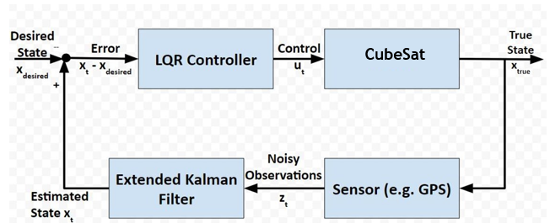
Recommended Improvements
Using Nonlinear Dynamic Inversion (NDI) Controller (Will need to figure out equations, but think it will be better suited for the CubeSat as it has nonlinearities)

