Slide 1
NLP: Let the Machine Do the Reading
Transformers

Slide 2
Overview
NLP is in the midst of a golden era thanks in part to the Transformer model which has truly changed the way we work with text data.
By the end of this week you will be able to:
Learn how the Transformer idea works
Implement a Transformer-based model
Use a Transformer model to perform text classification

Slide 3
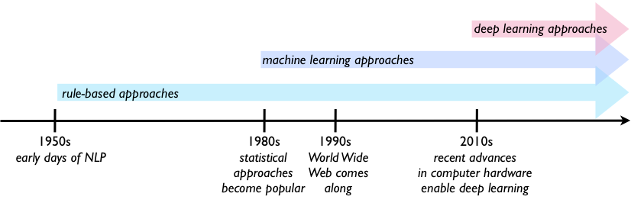
What is a Transformer?
New deep learning models are introduced at an increasing rate
Most competitive neural sequence transduction/transformation models have an encoder-decoder structure
Sequence-to-Sequence (Seq2Seq) learning and attention prevailed in NLP
The Transformer follows this overall architecture using stacked self-attention and point-wise, fully connected layers for both the encoder and decoder

Slide 4
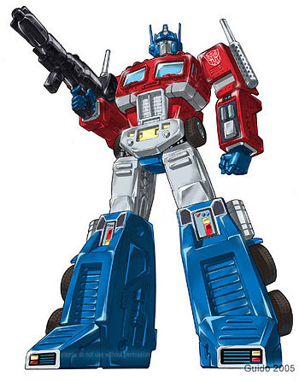
Transformers are everywhere!
Used to solve most if not all kinds of NLP tasks
A novel neural network architecture that’s based on a self-attention mechanism for language understanding
Sometimes even the wisest of man or machine can make an error

Slide 5
How does a Transformer work?
“When reading this text, you always focus on the word you read but at the same time your mind still holds the important keywords of the text in memory in order to provide context.”

Slide 6
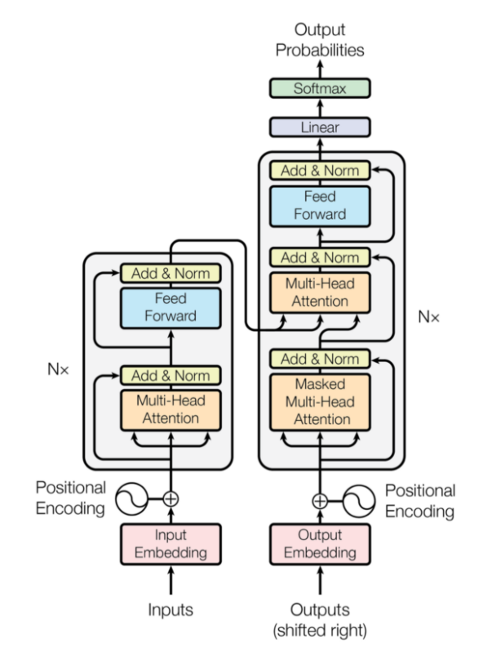
The Transformer - Model Architecture
Encoder is on the left, Decoder is on the right
Each has stacks of modules (Nx)
Main layers:
Multi-head attention and
Feed forward
Inputs and outputs are embedded into an n dimensional space
Important: positional encoding of the different words

Slide 7
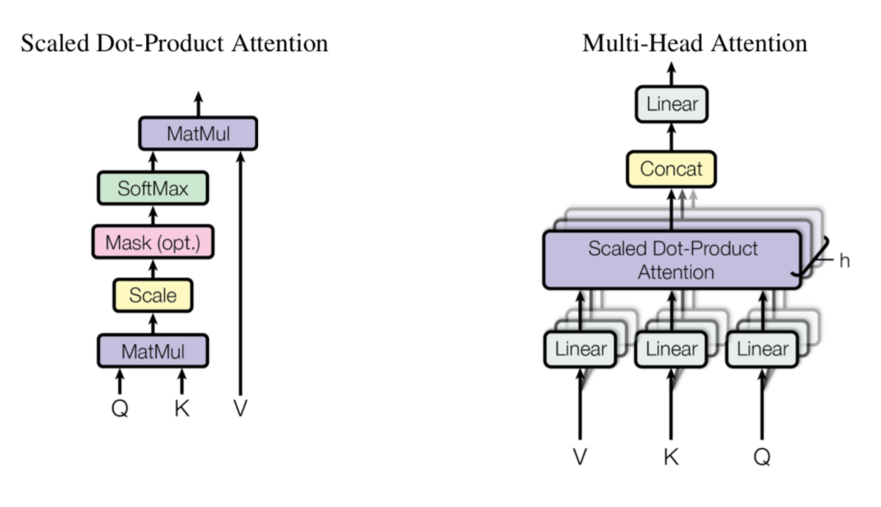
A Closer Look - Multi-Head Attention Layer

Slide 8
Language Models
Seq2Seq model, Encoder-Decoder, Attention Mechanism, Transformers, BERT

Slide 9
Agenda
Language Modeling
Seq2Seq Models
RNN and Encoder - Decoders
Attention Mechanism
Transformers
Self-Attention Mechanism

Slide 10
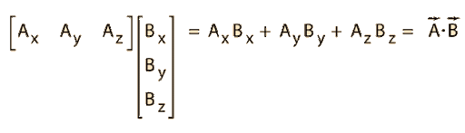
Dot Product

Slide 11
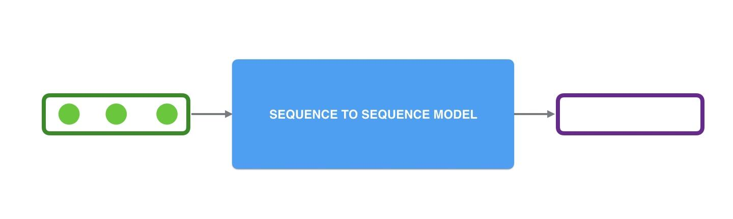
Seq2seq Model

Slide 12
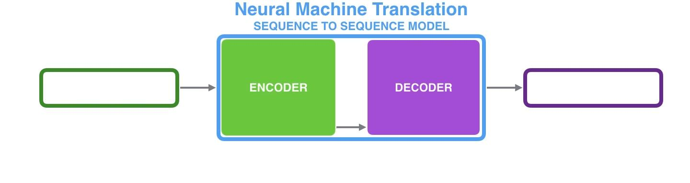
Seq2seq Model

Slide 13
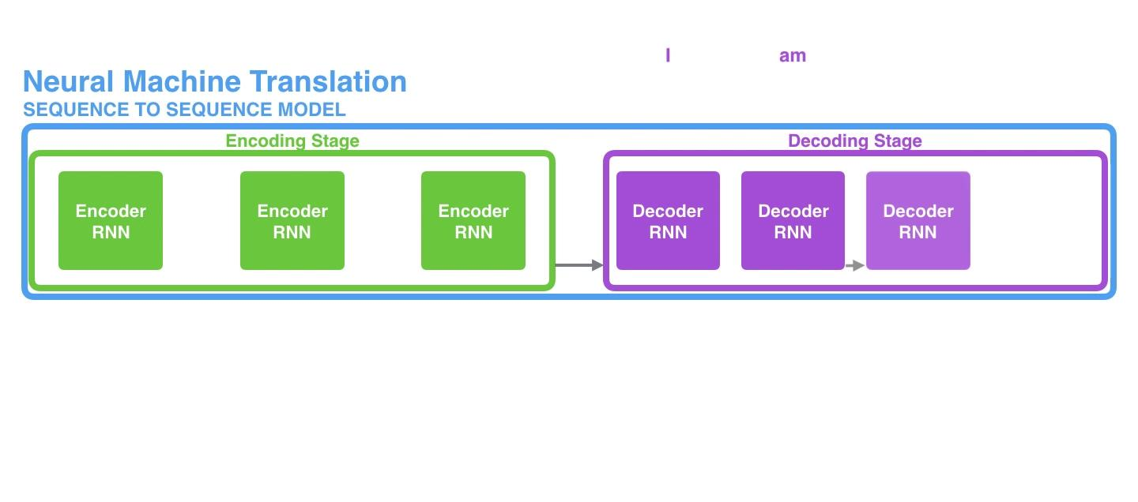
Seq2seq Model

Slide 14
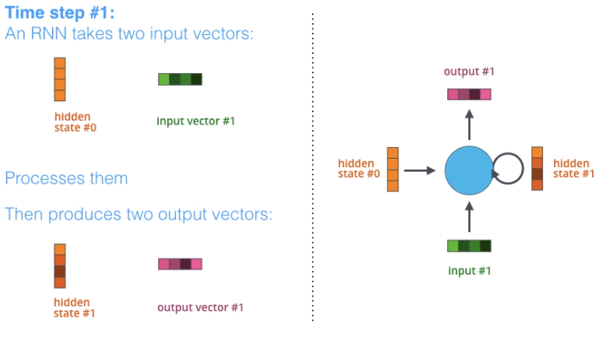
Recurrent Neural Networks

Slide 15
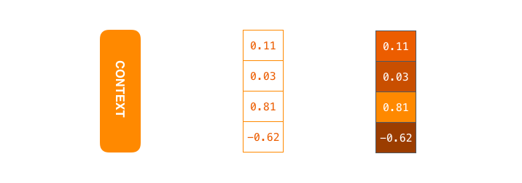
Context Vector
Fixed Length
Array of Numbers

Slide 16
Context Vector
French
Vocabulary
Apple
Banana
I
..
..
Am
..
..
A
…
..
Student
Hire
-ed
-ing
I am hired at google
I am hir ed at google
400 45 67 650 10 800 0 0 0 0

Slide 17
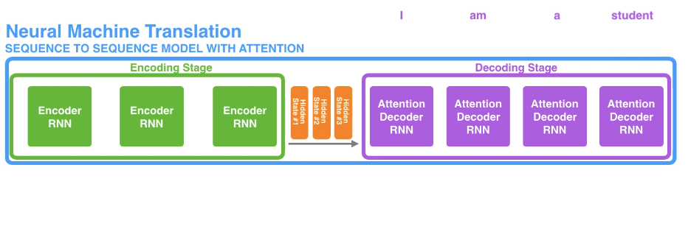
Seq2Seq with Attention Mechanism

Slide 18
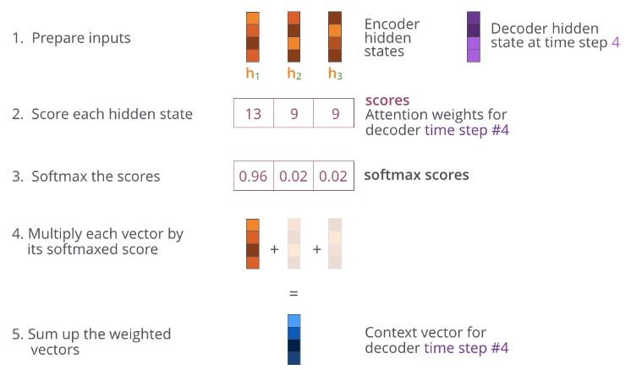
Attention Mechanism

Slide 19
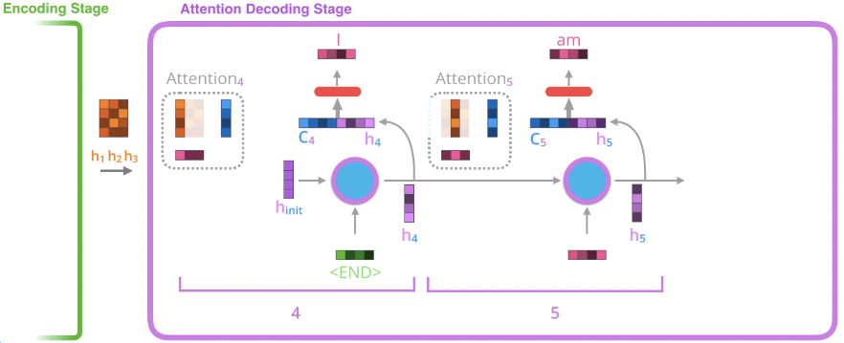
Machine Translation with Attention Mechanism

Slide 20
Transformers
Attention is All You Need

Slide 21
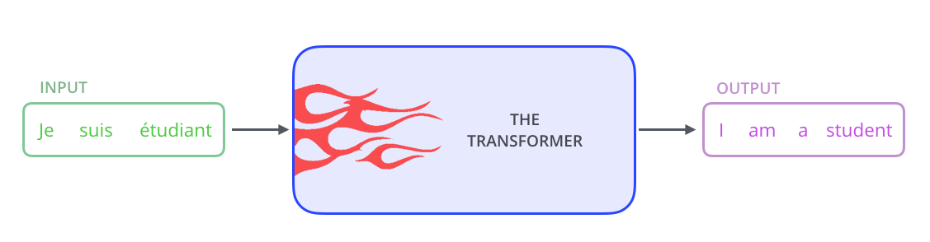
High-Level Look

Slide 22
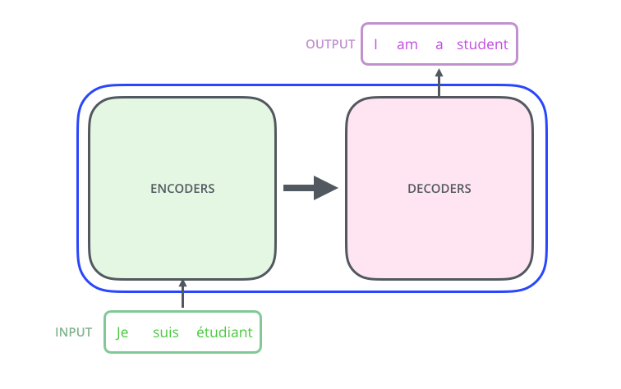
High-Level Look

Slide 23
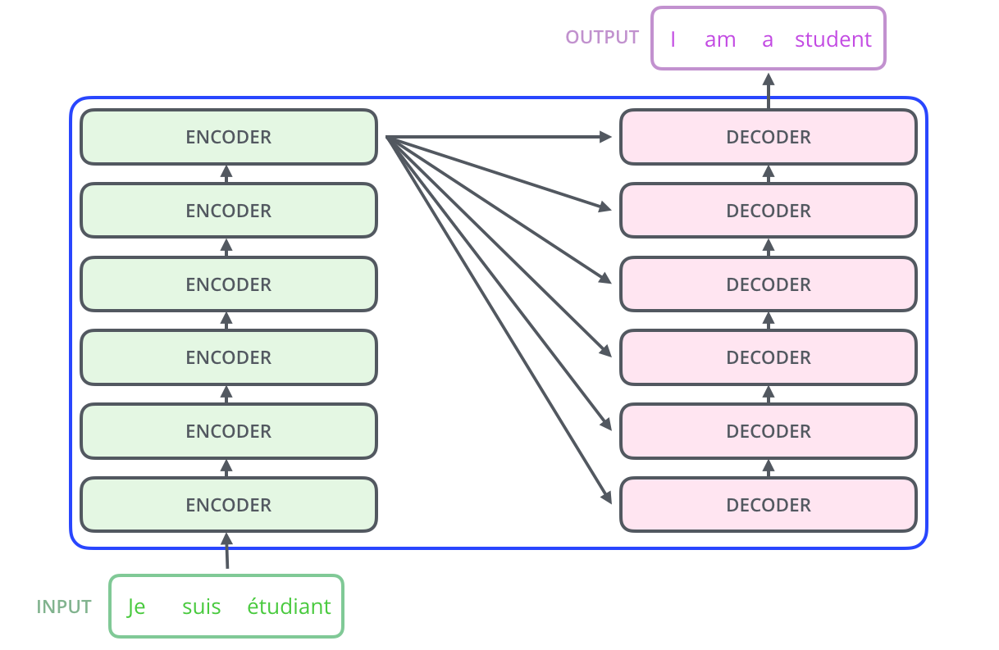
High-Level Look

Slide 24
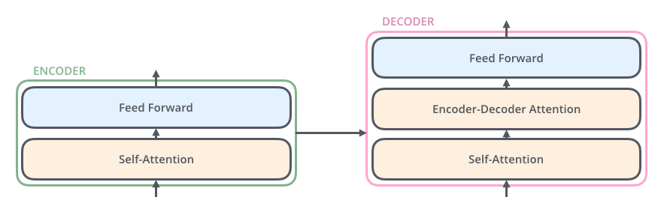
High-Level Look

Slide 25

Word Embeddings

Slide 26
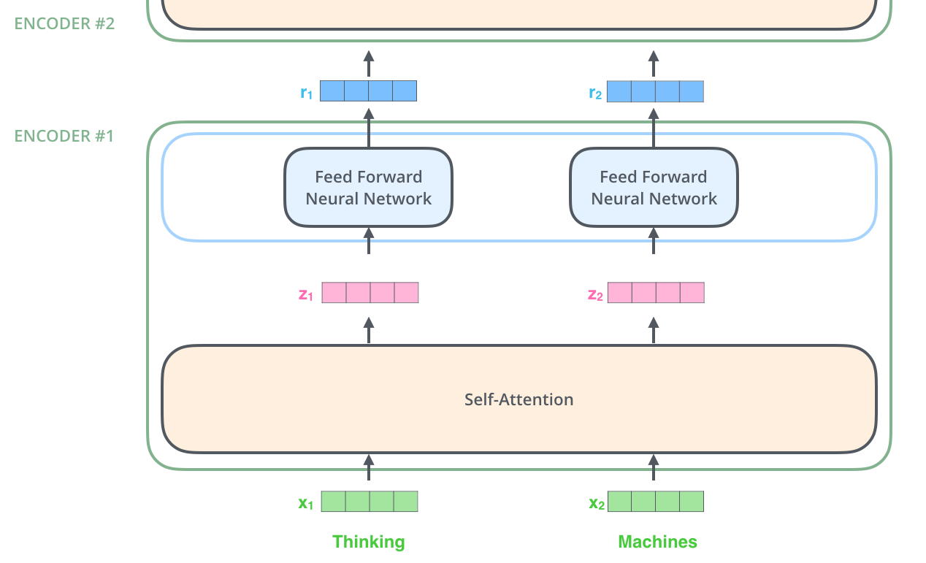
Encoder Block

Slide 27
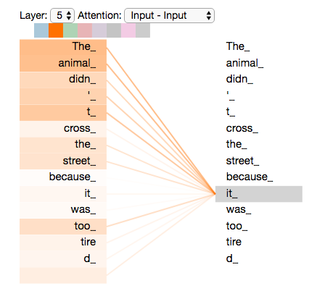
Self Attention

Slide 28
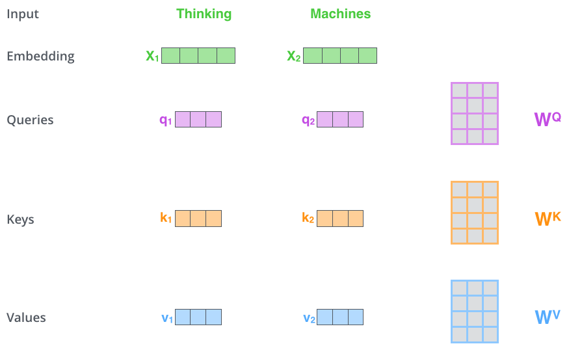
Self Attention in Detail

Slide 29
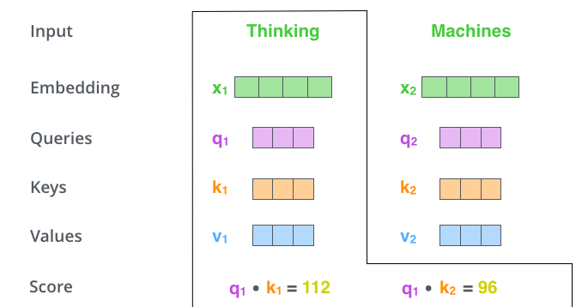
Self Attention in Detail

Slide 30
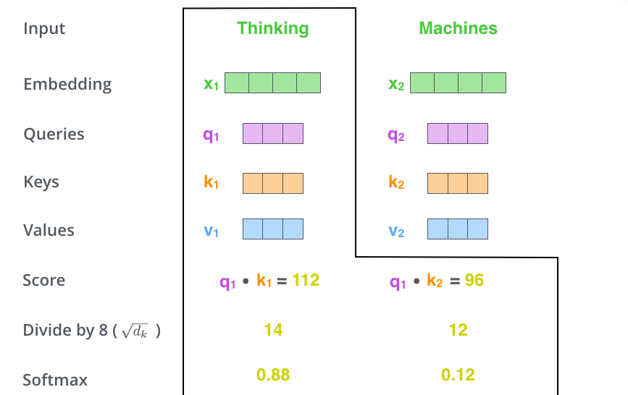
Self Attention in Detail

Slide 31
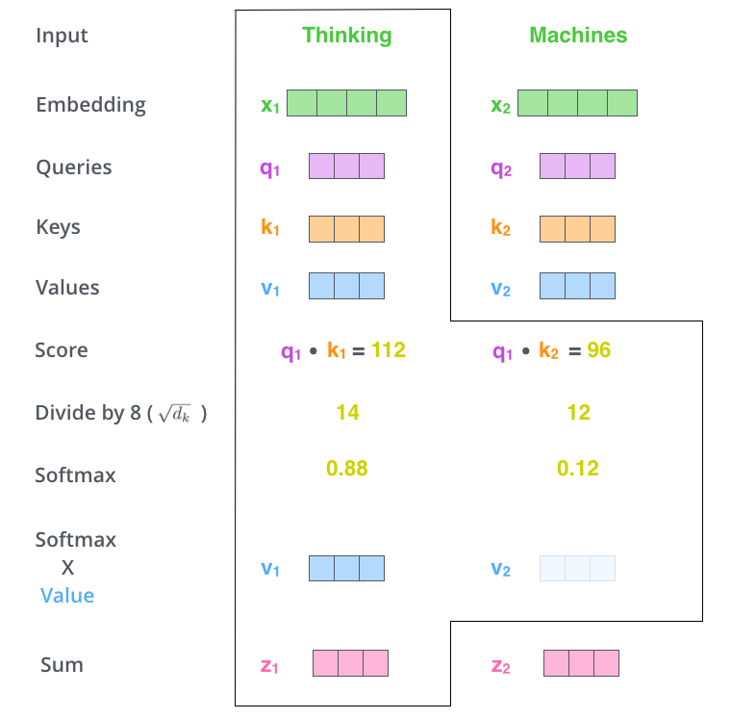
Self Attention in Detail

Slide 32
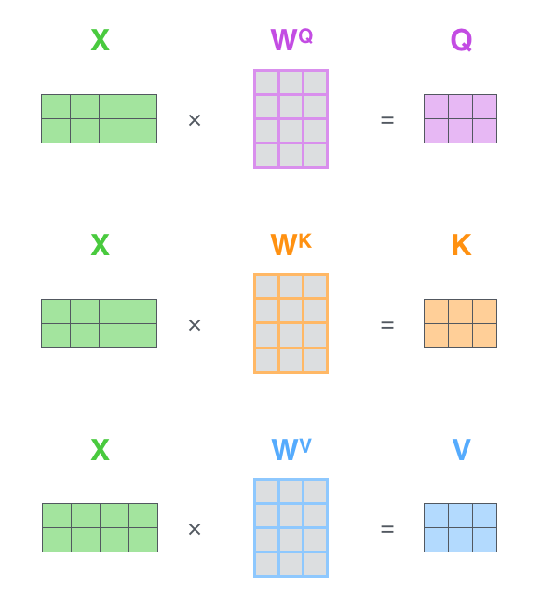
Self Attention in Detail

Slide 33
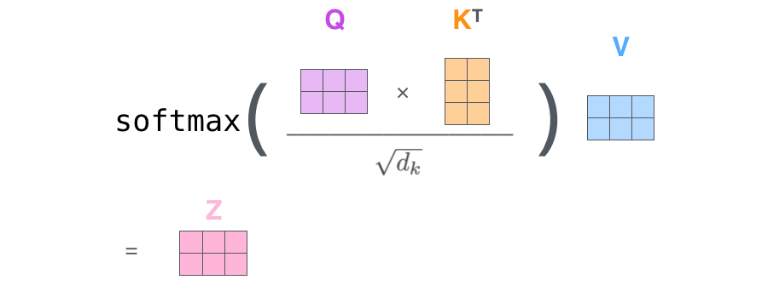
Self Attention in Detail

Slide 34
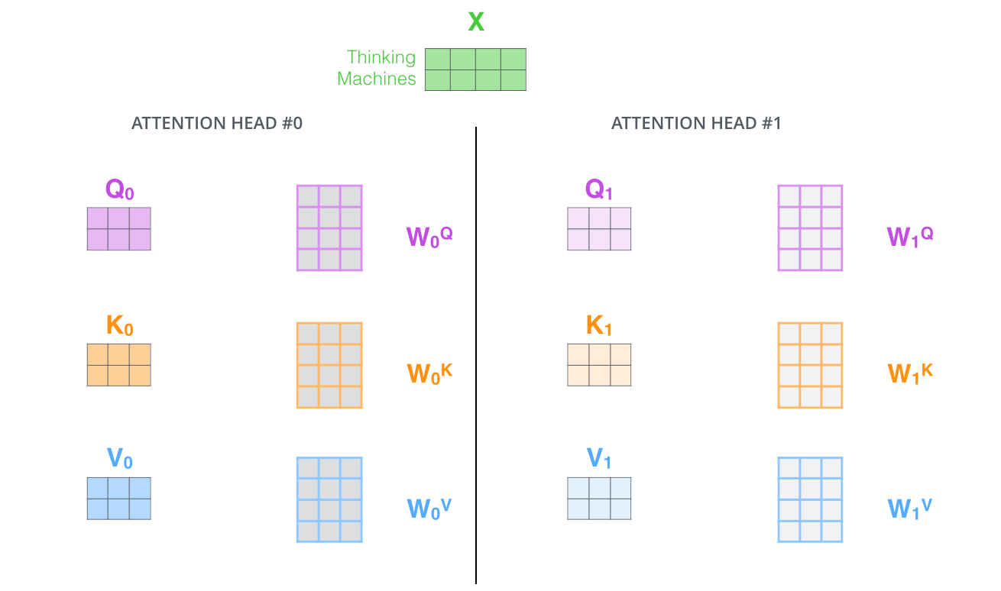
Multi Headed Self Attention

Slide 35
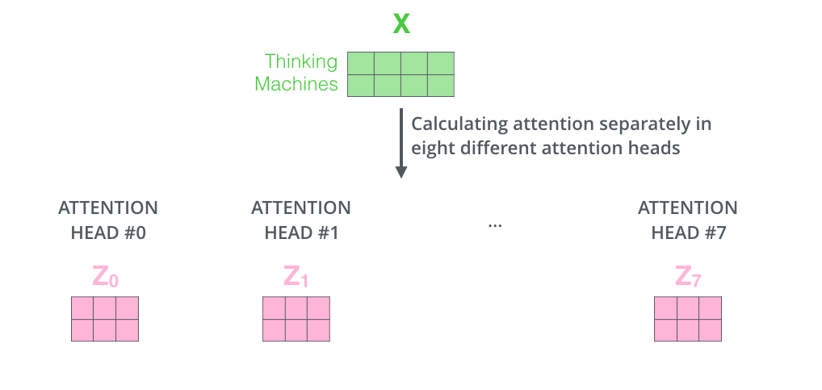
Multi Headed Self Attention

Slide 36
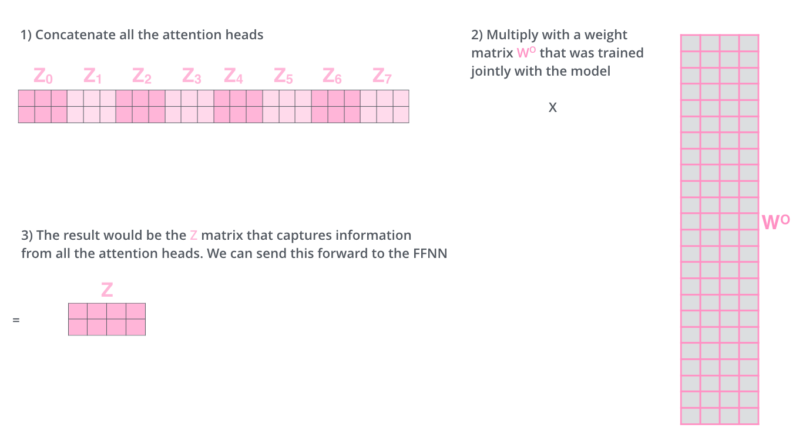
Multi Headed Self Attention

Slide 37
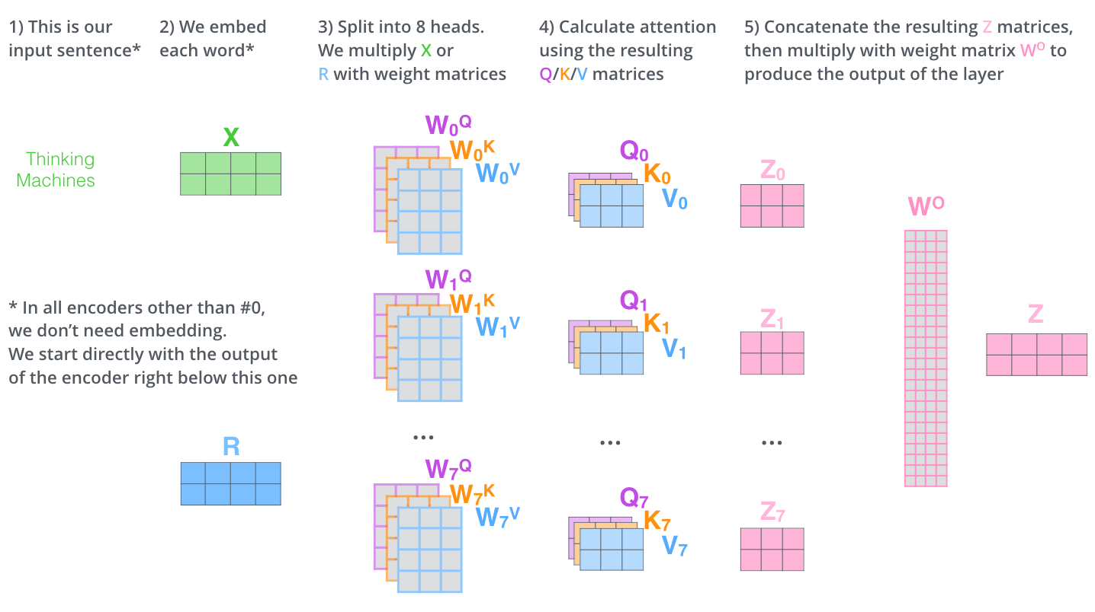
Multi Headed Self Attention

Slide 38
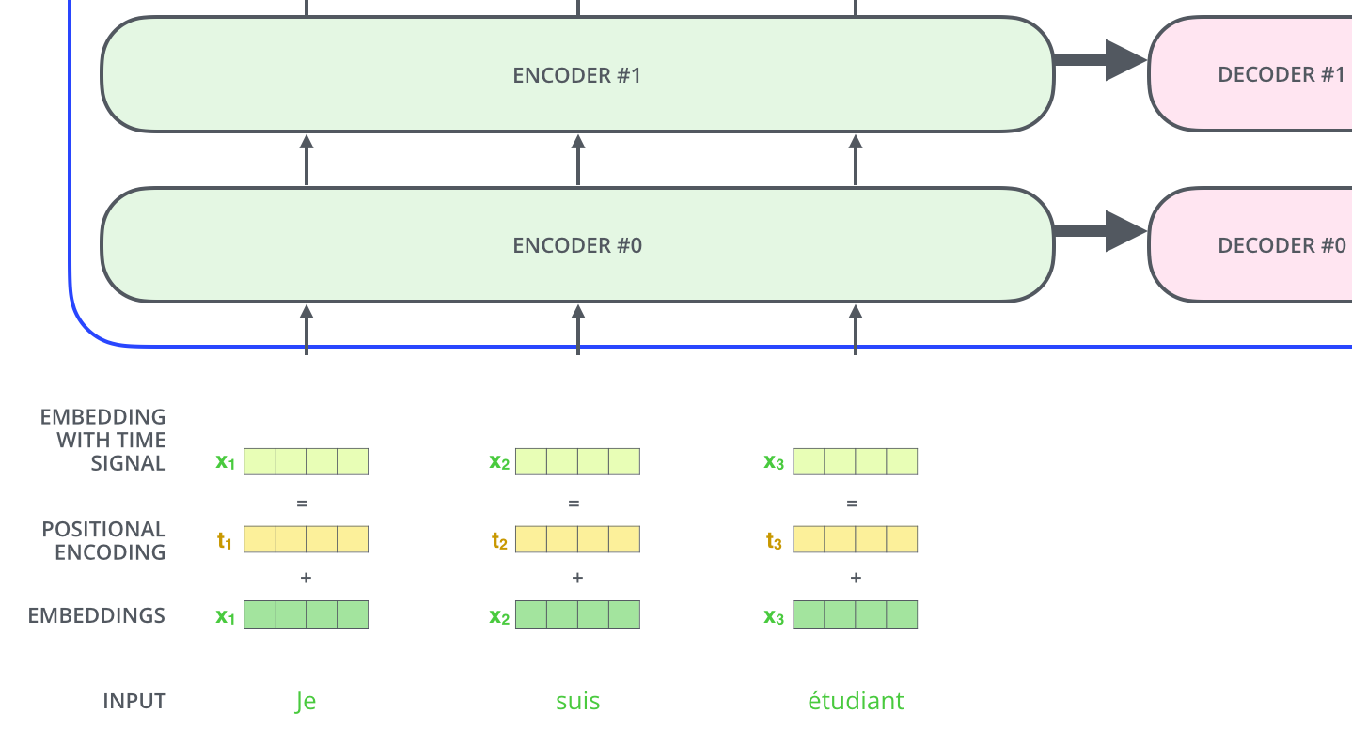
Positional Encoding

Slide 39
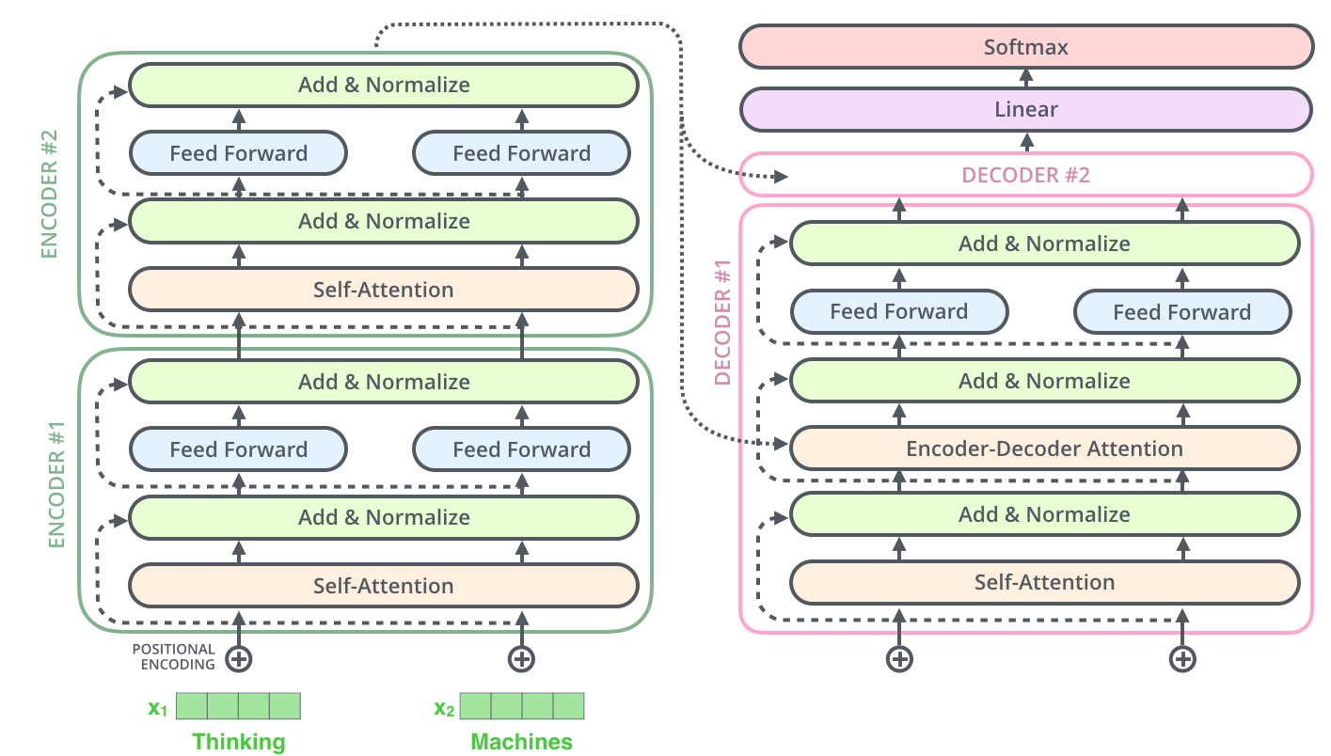
Residuals - Add and Normalize

Slide 40
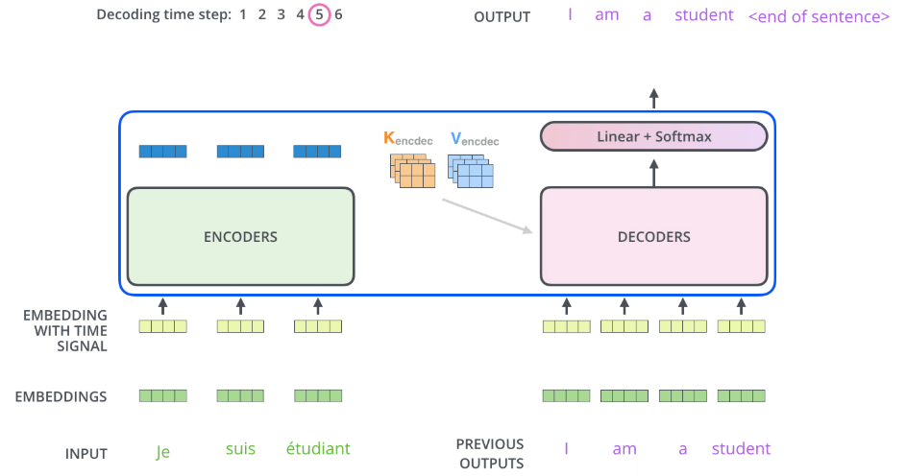
Decoder

Slide 41
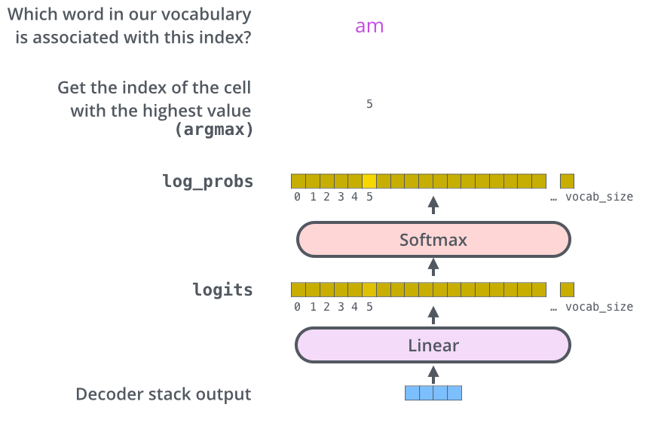
Softmax Output

Slide 42

Output

Slide 43
References and Links
Intro to Pytorch
Paper: Attention is all you need
Blog: The Illustrated Transformer
Transformers
BERT
CIFAR10

