Slide 1
Baigiamasis_darbas
File created on: 3/7/2022 3:09:52 PM

Slide 2
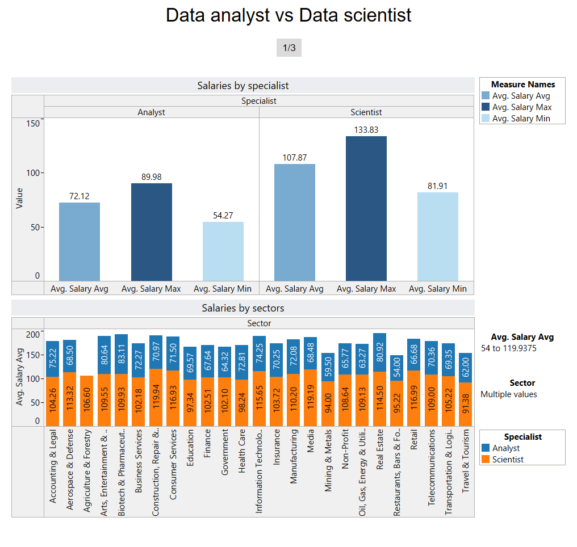

Slide 3
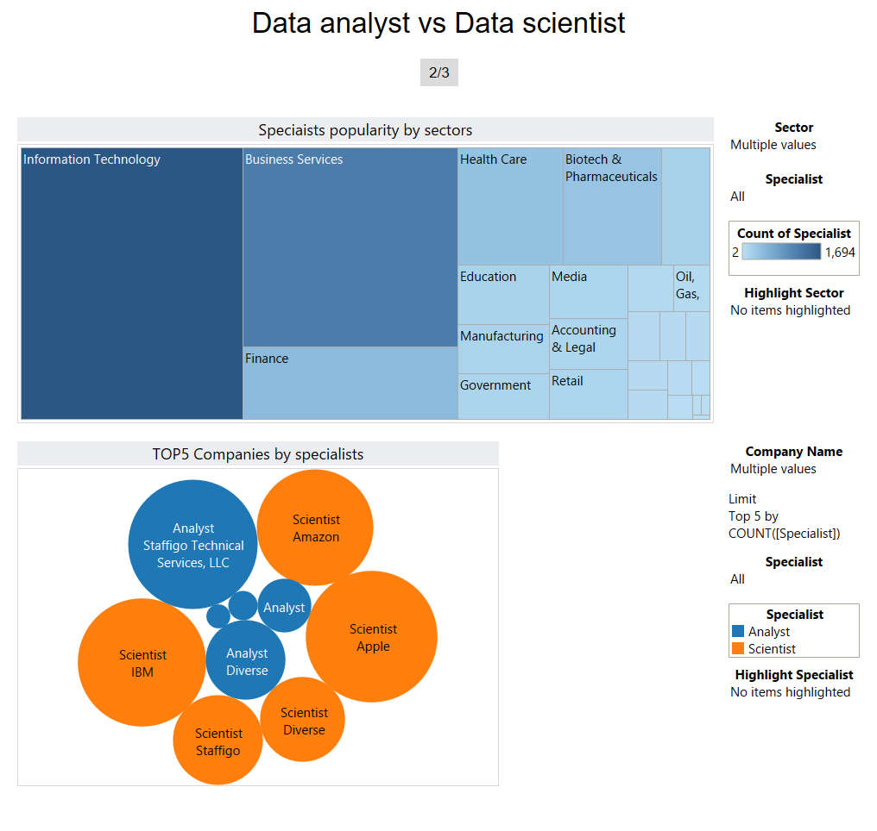

Slide 4
