Slide 1

A thermomechanical analysis of the pixel-hybrid module
Leonardo Ribeiro
1

Slide 2
Introduction
Induced thermal stresses (thermal expansion, coupled components)
Assess single module’s resistance to the thermal cycle
Compare results for different geometries and designs
2

Slide 3
Methodology
Finite Element Analysis (FreeCAD+Gmsh+CalculiX)
Results can be compared to UTS of materials
Checking references (University of Glasgow’s simulation)
https://indico.cern.ch/event/718423/contributions/3002908/attachments/1651899/2642467/FEA_simulations_of_thermal_induced_stresses_in_RD53.pdf (Liam Cunningham’s presentation)
3

Slide 4
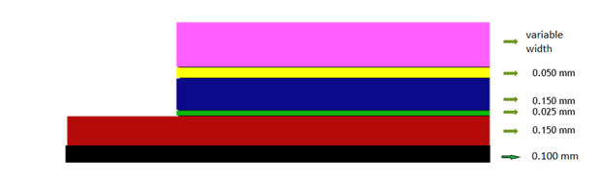
The Model
The Box Model
6 boxes
Top to bottom: PCB (multiple layers of Copper, Kapton, or a mixture thereof), glue (Araldite),sensor (Silicon), bump bonds (20% silver-tin, 80% air), RD53 chip (Silicon) and thermal gel (SE4445)
Material properties were taken from Glasgow’s presentation when available or MatWeb database otherwise
0.210 mm
0.050 mm
0.150 mm
0.025 mm
0.150 mm
4

Slide 5
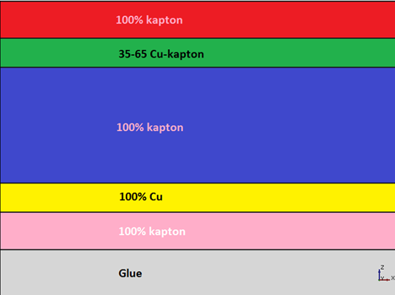
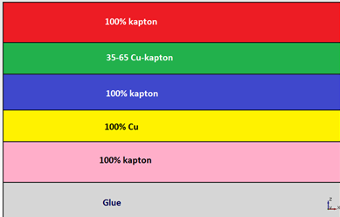
PCB Layers
0.15 mm
0.07 mm
0.1 mm
0.02 mm
Single Thin
Single Thick
5

Slide 6
The Model (Setup)
Homogeneous materials
Interpolation of thermal and mechanical properties
All relevant dimensions taken from mechanical design sketches
AT2-IP-EP-0009.v3 document (https://edms.cern.ch/ui/#!master/navigator/document?D:100324417:100324417:subDocs)
6

Slide 7
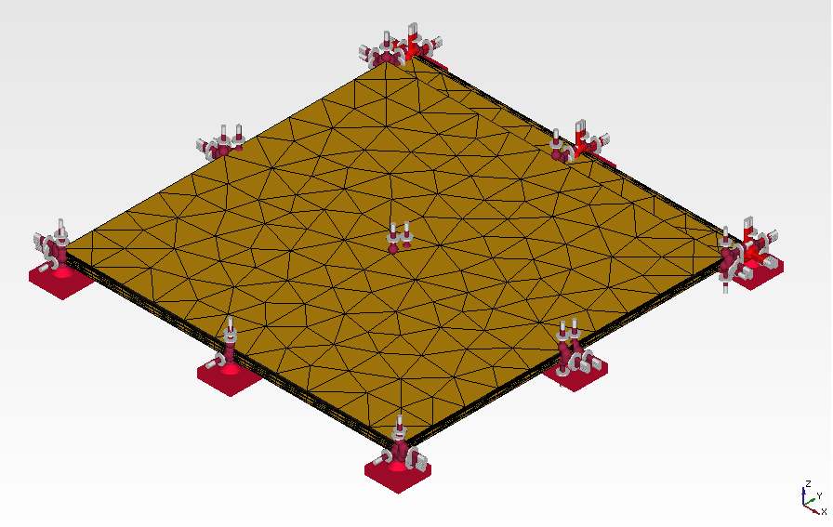
The Model - Constraints
Ambient temperature going from 300 K to -213 K
Mechanical constraint at thermal glue’s bottom
Heat flow allowed and taken into account
7

Slide 8
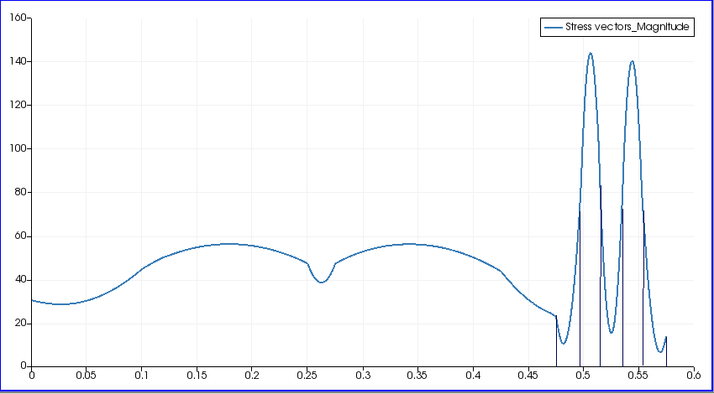
General results
Single Thin - Stress (MPa) v height (mm)
8

Slide 9
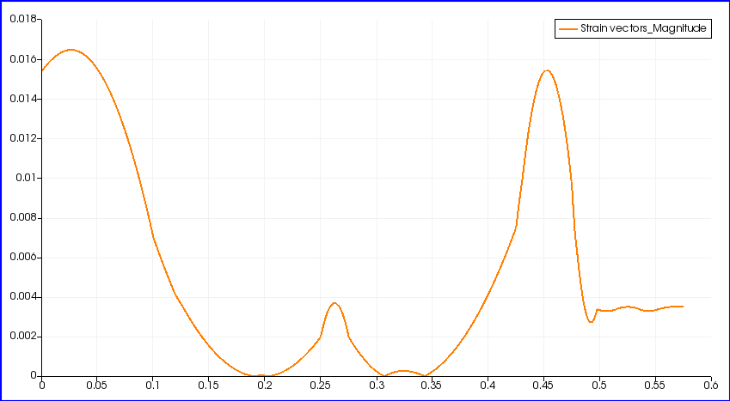
General results
Single Thin - Strain v height (mm)
9

Slide 10
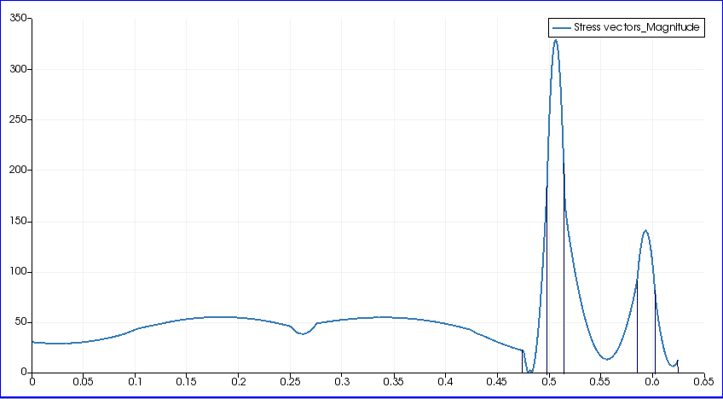
General results
Single Thick – Stress (MPa) v height (mm)
10

Slide 11
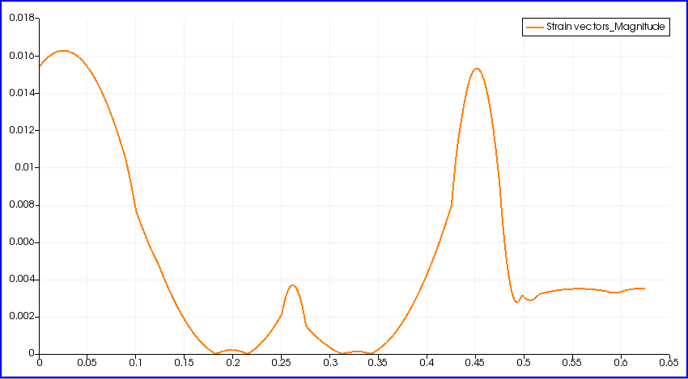
General results
Single Thick – Strain v height (mm)
11

Slide 12
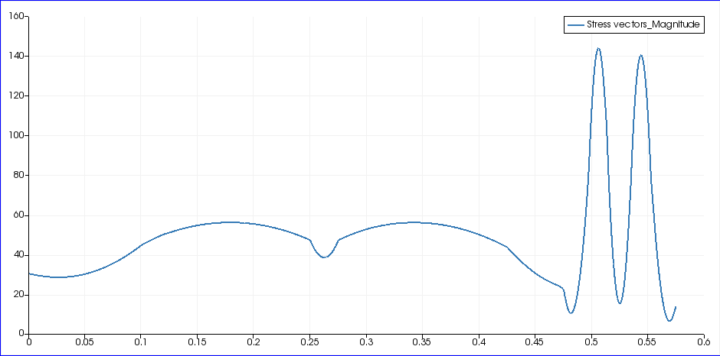
Cross-checking
Single Cross-Check – Stress (MPa) v height (mm)
12

Slide 13
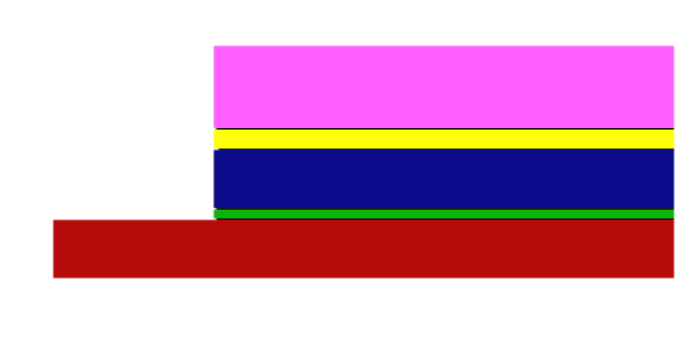
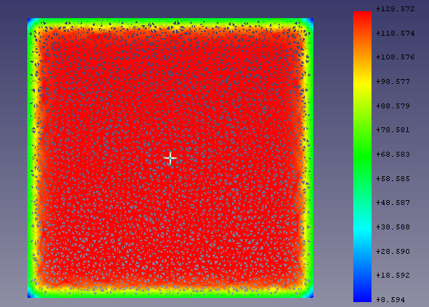
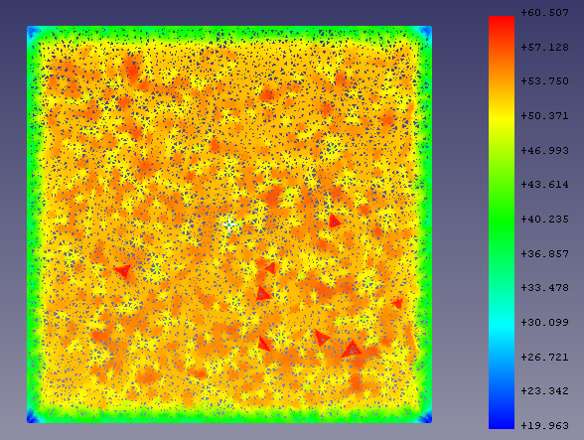
Quantitative challenges
0.5 mm
0.3 mm
Limited post-processing options
Huge fluctuation within each layer, even for high element density
Cuts at heights of 0.5 mm on the left, 0.3 mm on the right
13

Slide 14
Quantitative challenges
Maximum stresses were too high due to fluctuations
Results not symmetric about origin as expected
Currently developing post-processing code (Python)
Creates a box around reference point (RP)
Averages all points around RP based on distance
Iterates for every point
Box is not allowed to cross material boundaries
14

Slide 15
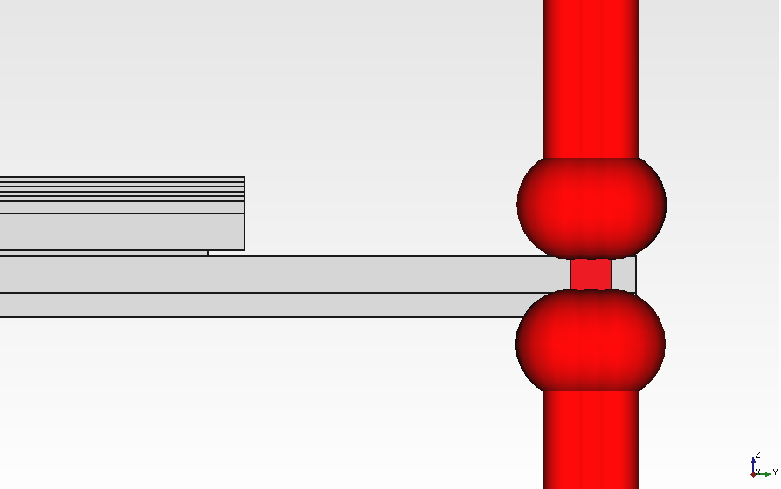
Heat source
Next step: introduce a heat source in RD53 (Joule heating of 4W on edge)
15

