Slide 1
Project ATLAS A thermomechanical analysis
Leonardo Ribeiro

Slide 2
Introduction
Modules operate between -60 C and RT
Induced thermal stresses (thermal expansion, coupled components)
Module’s resistance to the thermal cycle

Slide 3
Methodology
Finite Element Analysis (FreeCAD)
Results can be compared to UTS of materials
Checking references (University of Glasgow’s simulation)

Slide 4
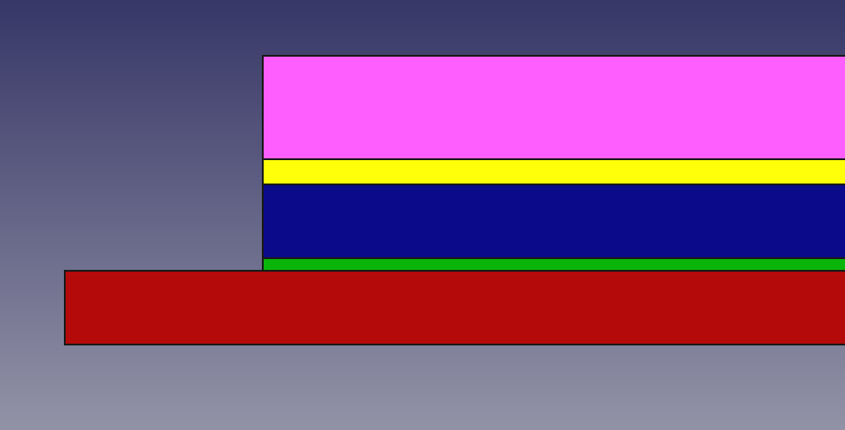
The Model
#1:The Box Model
5 boxes
Top to bottom: PCB flex (Copper and Kapton), glue (Araldite),sensor (Silicon), bump bonds (Aluminum) and RD53 chip (Silicon)

Slide 5
The Model
Homogeneous materials
Ambient temperature going from 20 C to -60 C
Mechanical constraint at RD53’s bottom
All relevant dimensions taken from mechanical design sketches
Heat flow allowed and taken into account

Slide 6
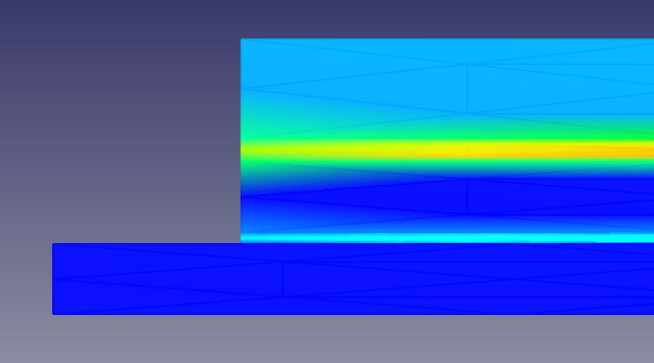
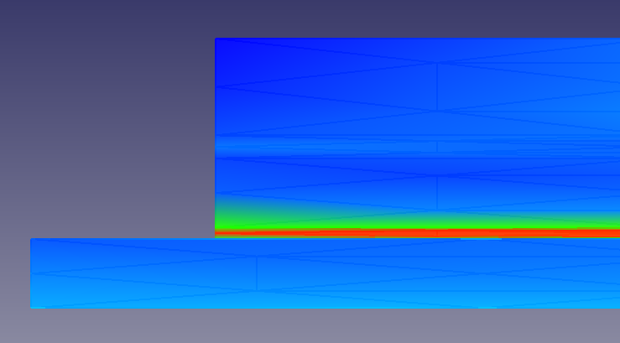
General results
Strain on the left, maximum stress on the right
Magnitudes – see next slides

Slide 7
Qualitative
Soft glue expands the most, absorbing the forces between sensor and PCB
Stress concentrated at bump bonds (low UTS)

Slide 8
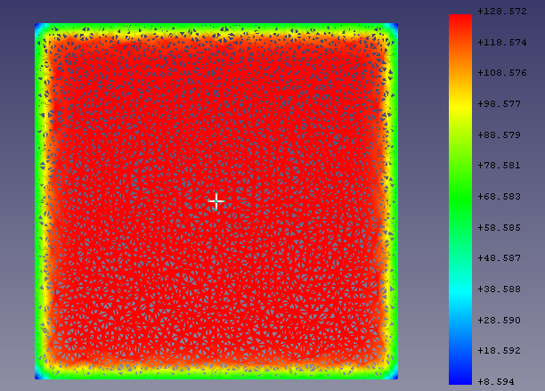
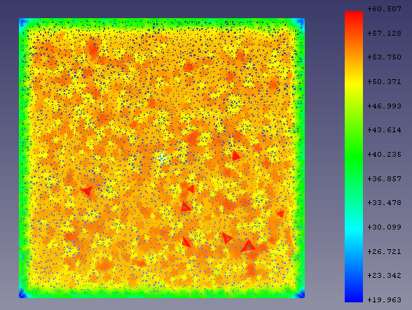
Quantitative challenges
Limited post-processing options
Huge variation within each layer, even for high element density
0.5 mm on the left, 0.3 mm on the right

Slide 9
Quantitative challenges
Maximum stresses were too high due to deviations
Results not symmetric about origin as expected
Better post-processing needed

Slide 10
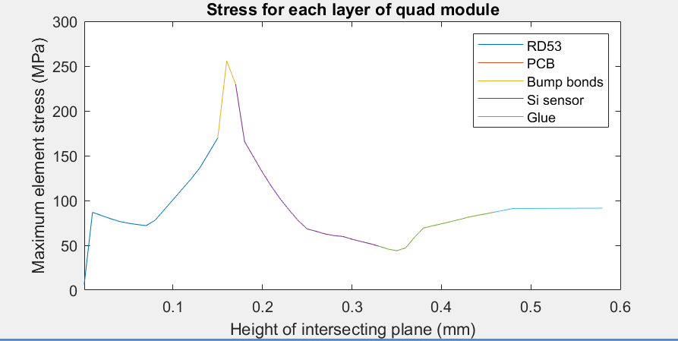
Stress profile
Estimate based on cuts
Software constraint on step size (100 microns)

Slide 11
Comparative analysis
LBNL
Glasgow (Cunningham)
Stress concentrated at bump bonds
Magnitude of stresses still unclear
Semi-continuous stress profile
Model – glue as a box
Maximum stress at Silicon sensor
Magnitudes calculated or estimated
One data point per layer
Model – glue pattern

Slide 12
Conclusion
Despite uncertainties, major disagreement at location of concentrated stress
Allowing room for all cited errors, results still diverge significantly only at bump bonds

Slide 13
Next steps
Finish data post-processing
Contact Glasgow team and look for source of disagreement
Refine model and move to single module
Shape of bonds
PCB details
Heat source at RD53
Wire bonds

