Slide 1
Autonomous Bumper Cars
DGMD E-17
Spring 2021
Brian Bauer, David Kalbfleisch, Iman Ismail

Slide 2
Introduction
We bring bumper cars into the 21st century by simulating the carnival game with autonomous vehicles in a closed arena. The challenges include friend-or-foe determination, path planning, obstacle avoidance, and score maximization strategies. Vehicles shall receive points for hitting other vehicles and lose points for being hit. Head-to-head collisions won't score. The best-case outcome will include the ability for humans to challenge the AIs.

Slide 3
Basic Goals
The bumper car arena shall be rectangular with rounded corners to prevent cars from getting stuck, and the arena shall contain 2 or more bumper cars that start at random locations and headings. (Yes!)
Each game lasts for a predetermined length of time. (Yes!)
The arena shall contain various obstacles (polls, boxes, etc.) to make the game more interesting. (Yes!)
All cars are a team of one. Each car attempts to maximize its score, and the car with the highest score wins.(Partially)
At any moment, a given car is in the "attack" state or the "defend" state. (Not quite)

Slide 4
Extended Goals
Target motion or target angle analysis to determine foe position and velocity. This enables intercepting the foe at its future position rather than just pointing its current position. (Started, very early)
Human interaction – allow people to play against the bots (Can be done, but not a good user experience)
Bot teams – carts should not attach members of their own team (Nope!)
Real robots, such as the JetBot (Nope!)
Reinforcement learning to create Ais that execute the given strategy with maximum effect. (Nope!)

Slide 5
Software and Development Tools
Gazebo 11
ROS2 Foxy
Blender 2.92
Python
GitHub

Slide 6
Graphics and Visual Modeling
Presented by David Kalbfleisch

Slide 7


Graphics and Visual Modeling

Slide 8
Graphics and Visual Modeling
Gazebo is a FOSS robotics simulator with native support for Simulation Description Format (SDF), an XML specification for defining a simulation.
Gazebo, and other robotics simulators, are basically high-precision game engines. Gazebo displays visual elements and handles physics (collisions,etc.).
Gazebo, through SDF, also simulates real world sensors robots are likely to have: cameras, LIDAR, RADAR, GPS, etc.

Slide 9
Graphics and Visual Modeling
Blender is a FOSS 3D digital content creation (DCC) suite. It is commonly used to make 3D meshes, and it can export content in many standard file formats, including Collada.
Gazebo works with the Collada format.
Blender can export directly to SDF via the Phobos add-on, but Phobos has not been updated to work with Blender versions after 2.79b. This project used Blender 2.92 (current stable release).

Slide 10
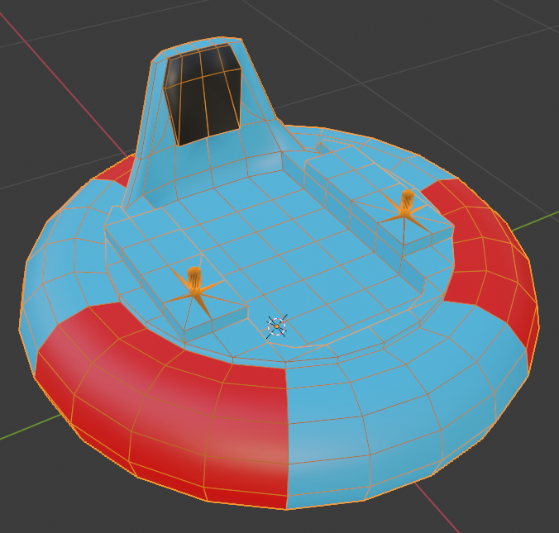
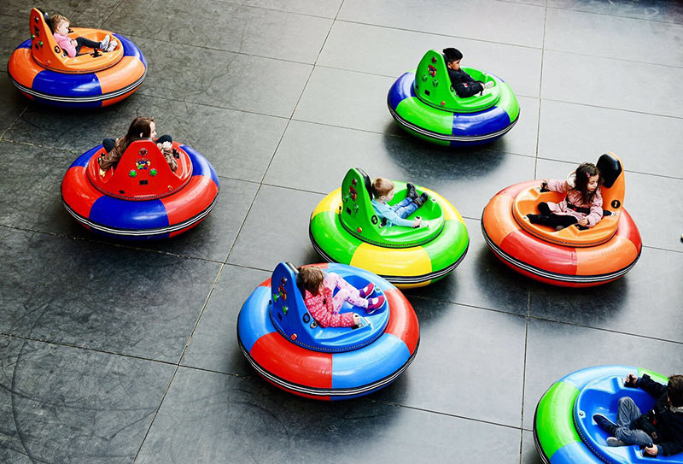
Graphics and Visual Modeling

Slide 11
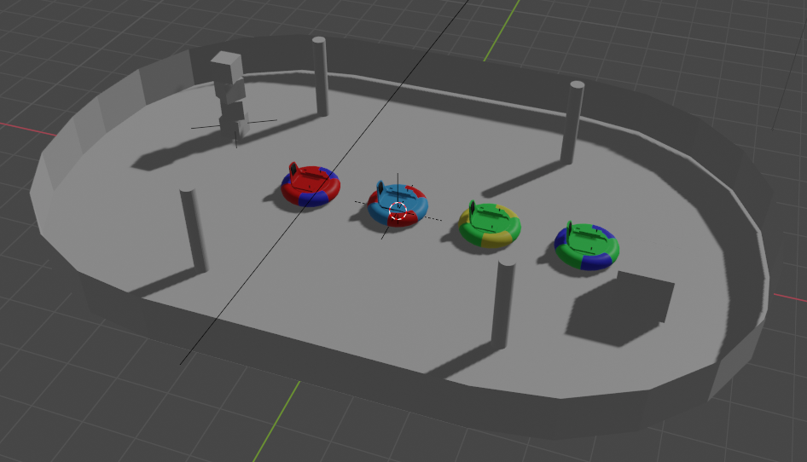
Graphics and Visual Modeling
The world in Blender: 4 carts, an arena with obstacles, and a light.

Slide 12
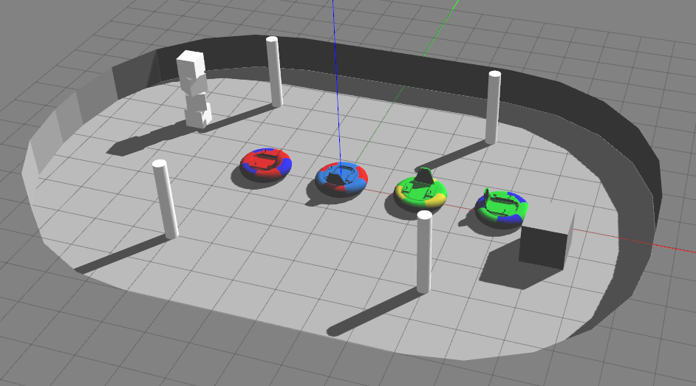
Graphics and Visual Modeling
This is the same world in Gazebo. It has been augmented in SDF with sensors and collision boundaries.

Slide 13
Graphics and Visual Modeling
<sdf version="1.7">
<model name="camera_array">
<link name="camera_front">
<pose>0 0 0 0 0.17 0</pose>
<gravity>0</gravity>
<sensor name="camera_front_sensor" type="camera">
<always_on>1</always_on>
<update_rate>6</update_rate>
<camera>
<horizontal_fov>0.69</horizontal_fov>
<image>
<width>800</width>
<height>600</height>
<format>R8G8B8</format>
</image>
<clip>
<near>0.1</near>
<far>4</far>
</clip>
<noise>
<type>gaussian</type>
<mean>0.0</mean>
<stddev>0.007</stddev>
</noise>
</camera>
<plugin name="front_camera_controller" filename="libgazebo_ros_camera.so">
</plugin>
</sensor>
</link>
…
</model>
</sdf>

Slide 14
Graphics and Visual Modeling
<sdf version="1.7">
<model name="TorusCart lightblue red">
<link name="cart">
<pose>0 0 0.02 0 -0 0</pose>
<gravity>0</gravity>
<visual name="visual cart">
<geometry>
<mesh><uri>meshes/TorusCart_lightblue_red.dae</uri></mesh>
</geometry>
</visual>
<collision name="collision cart">
<pose>0 0 0.313281 0 -0 0</pose>
<geometry>
<cylinder>
<radius>0.65</radius>
<length>0.626562</length>
</cylinder>
</geometry>
</collision>
</link>
...
<!-- Include cameras. -->
<include>
<uri>model://camera_array</uri>
<name>cameras</name>
<pose>0 0 0.64574 0 -0 0</pose>
</include>
</model>
</sdf>

Slide 15
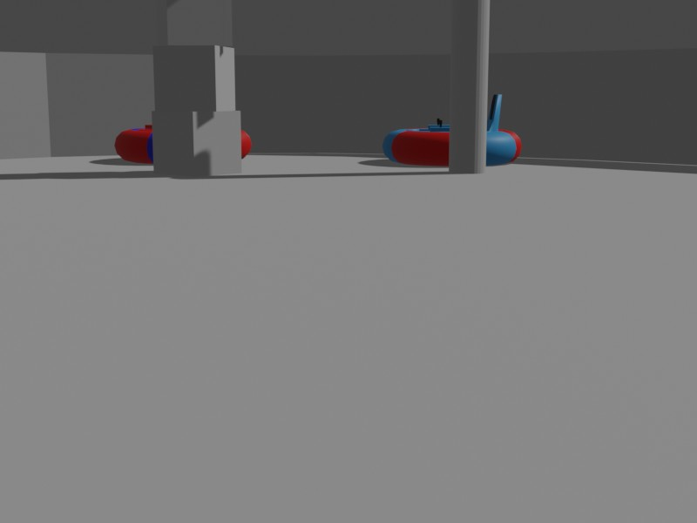
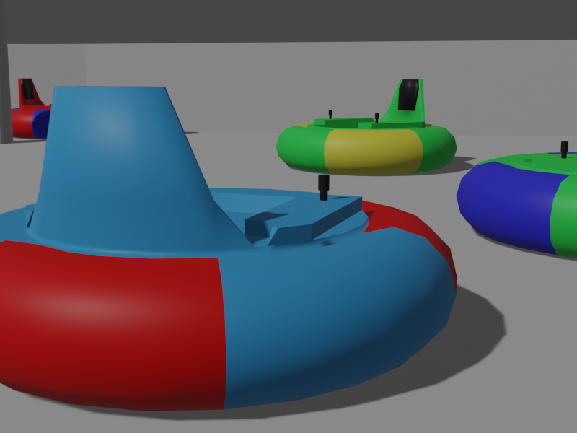
Graphics and Visual Modeling
We created training images manually by moving the camera around the scene and rendering stills. We also created a training video to test the classifier.

Slide 16
Neural Network Development and Training
Presented by Iman Ismail

Slide 17
(ConvNet/CNN) is a Deep Learning algorithm which can take in an input image, assign importance (learnable weights and biases) to various aspects in the image and be able to classify one from the other.
The pre-processing of CNN is much lower as compared to other classification algorithms.
What is Neural Network?
Is a simulation for how the human brain thinks
It has many applications in the field of Artificial intelligence
Consists of neurons that are connected to each other
Convolutional Neural Network Development and Training

Slide 18

Architecture of CNN

Slide 19
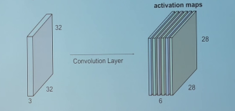
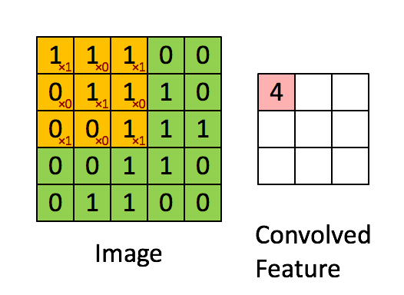
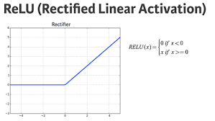
Convolutional Layer

Slide 20
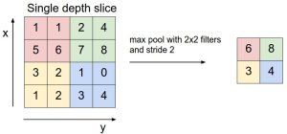
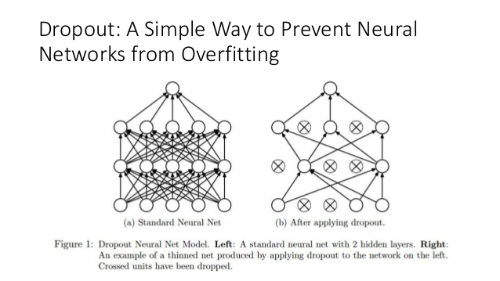
Pooling Layers

Slide 21
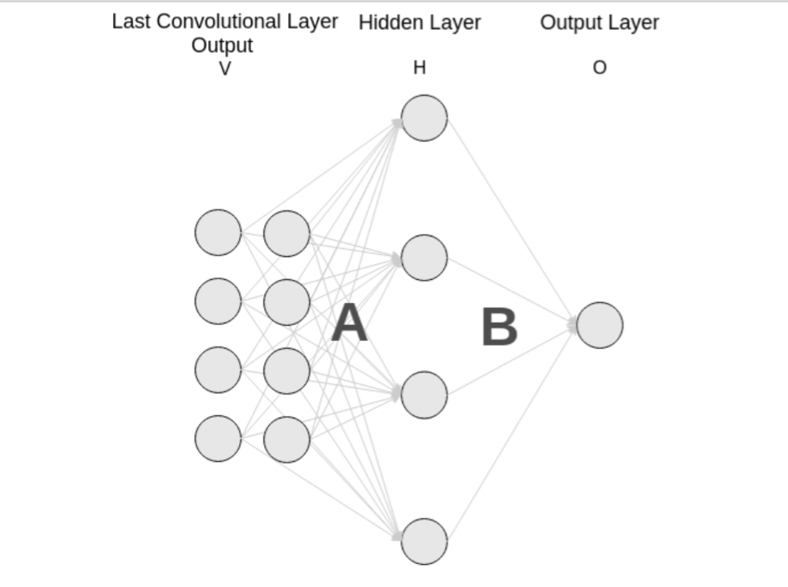
Fully Connected Layer
Softmax Layer

Slide 22
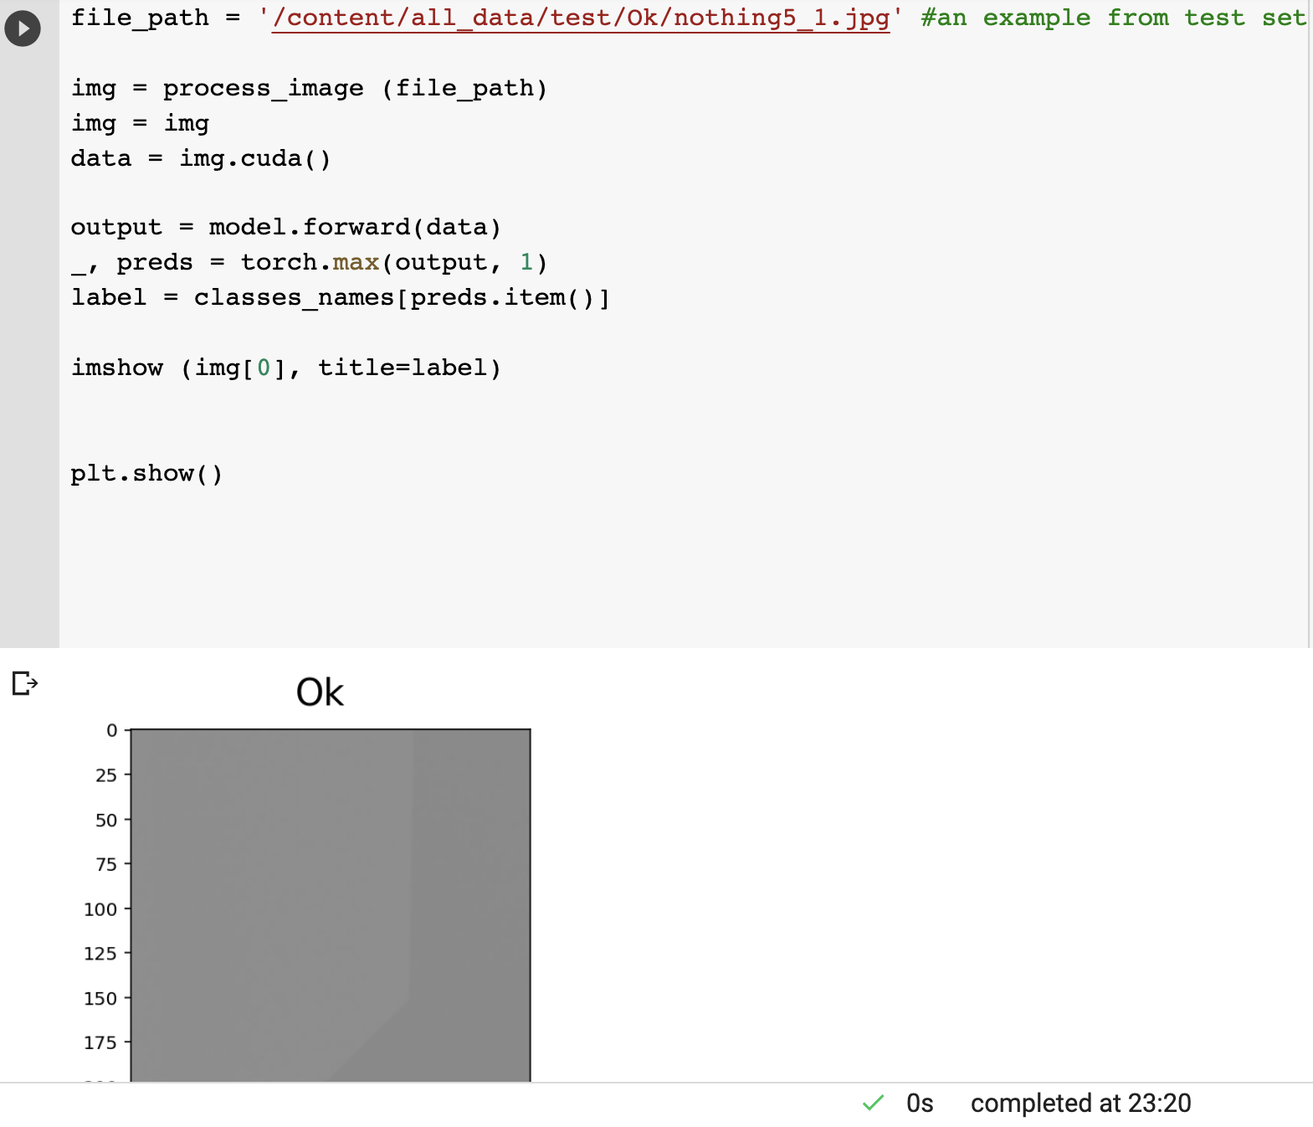
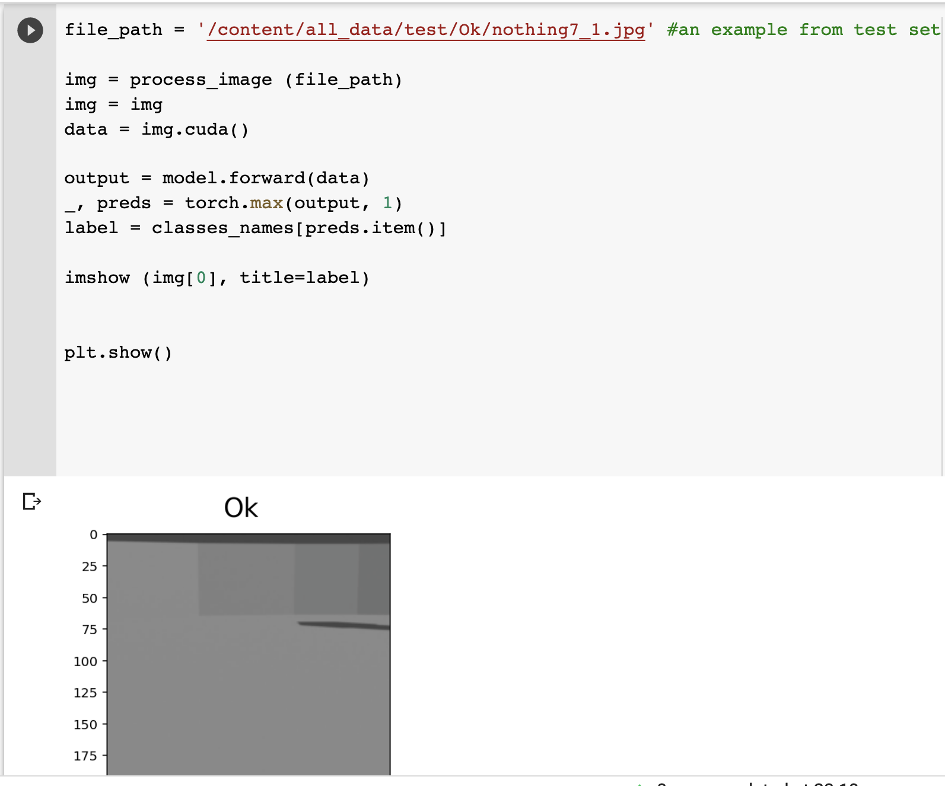
CNN Model: Model: Resnet 34 Number of Epochs: 16 Accuracy: 95%
Classification Results: Ok Class

Slide 23
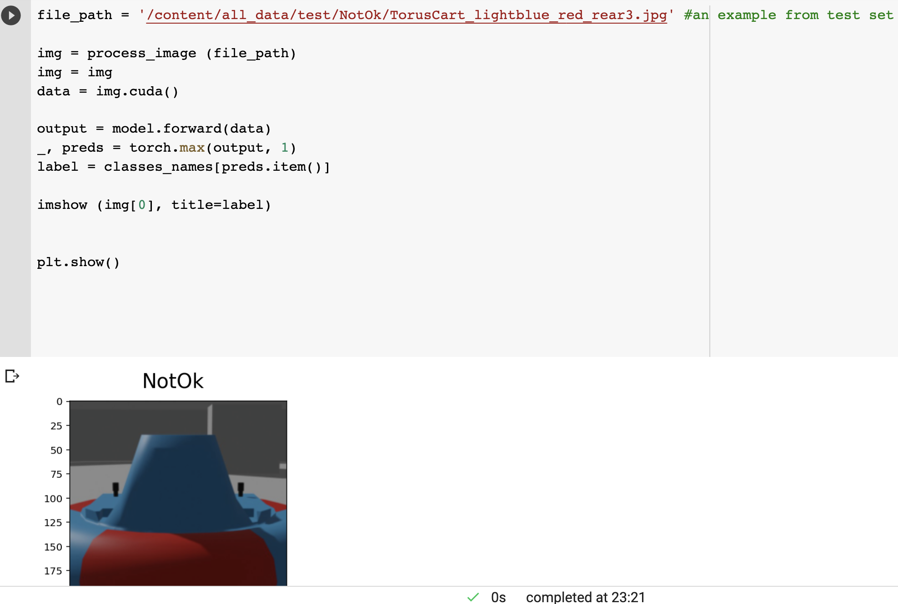
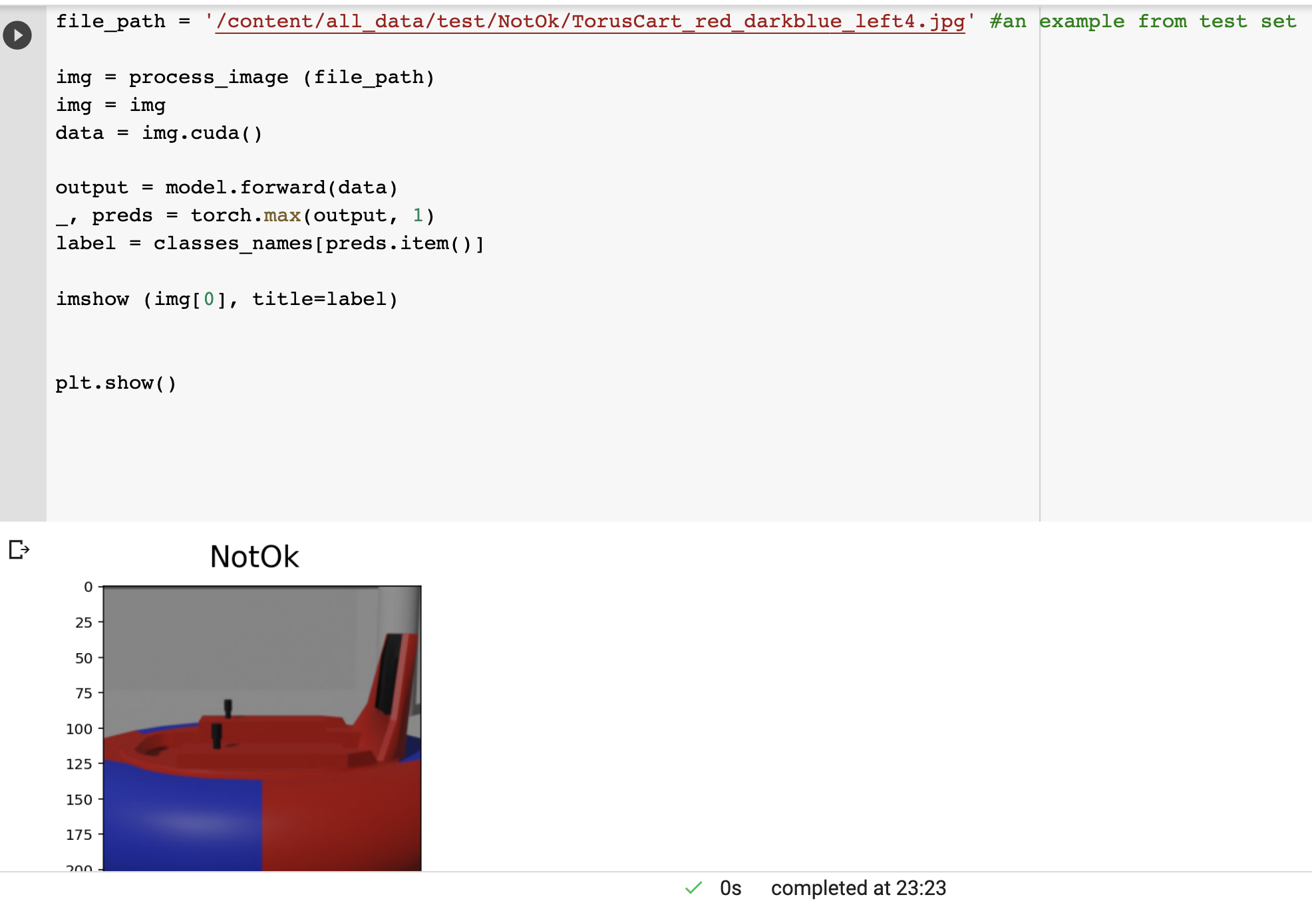
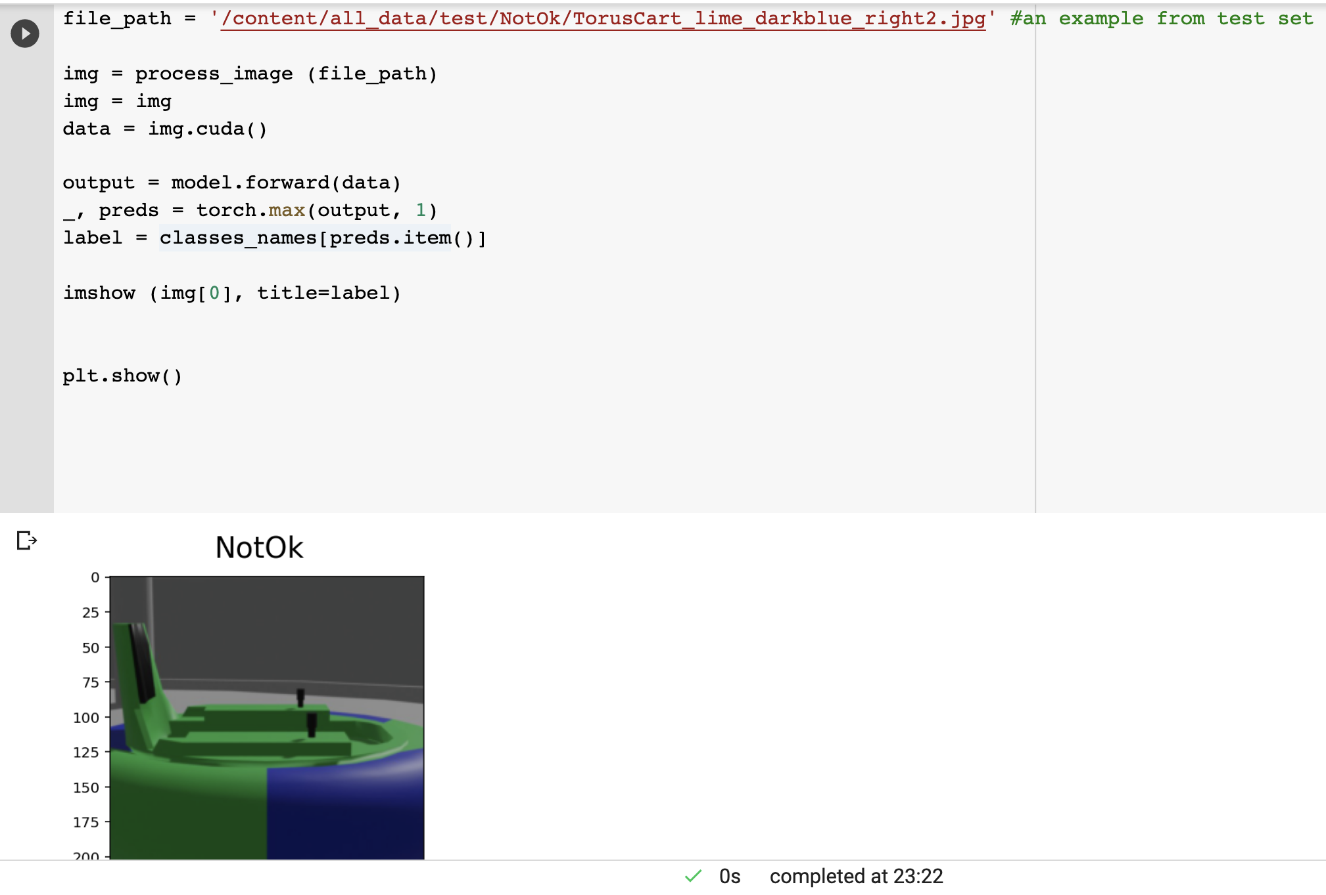
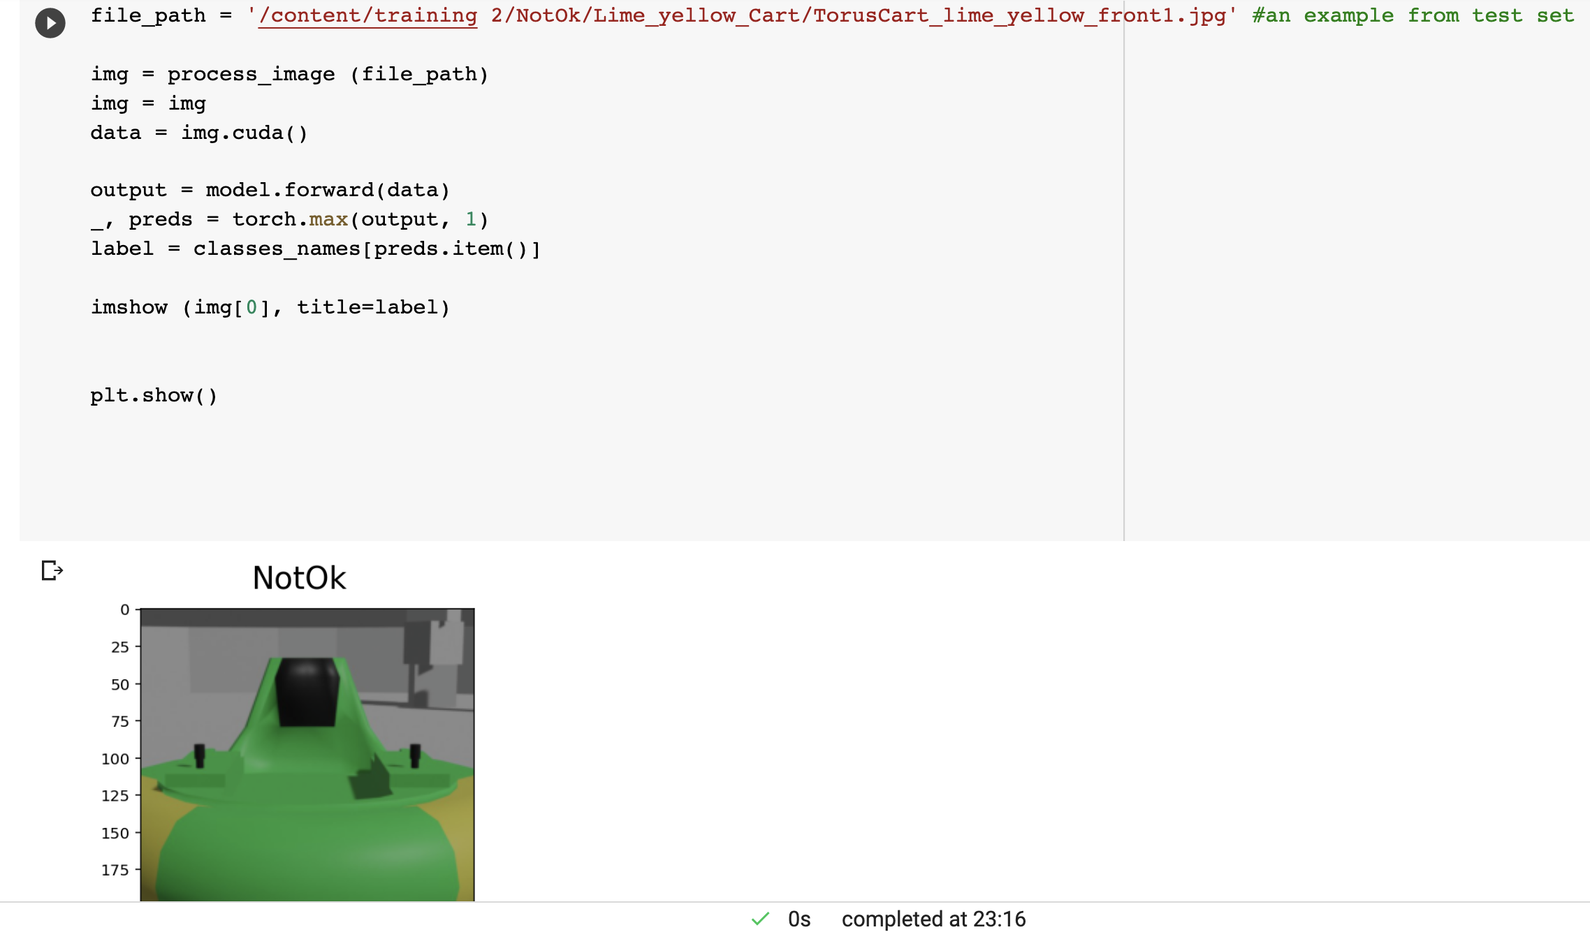
Not Ok Class:

Slide 24
Project Infrastructure & Software
Presented by Brian Bauer

Slide 25
Notes:
This is all created by executing a single command
All of this runs on one computer, but it is designed such that each blue box can become a physical cart – or an independent computer.
Each python program (called bumper_car_controller.py) loads its own copy of the trained model used for classification
Each instance of bumper_car_controller.py makes decisions independently and only for the cart that it is attached to.
This allows us to extend the functionality in the future
Each cart can be instructed to load a different model
Each cart can be instructed to run a different decision-making algorithm
We can test different options by running them against each other
<number>

Slide 26
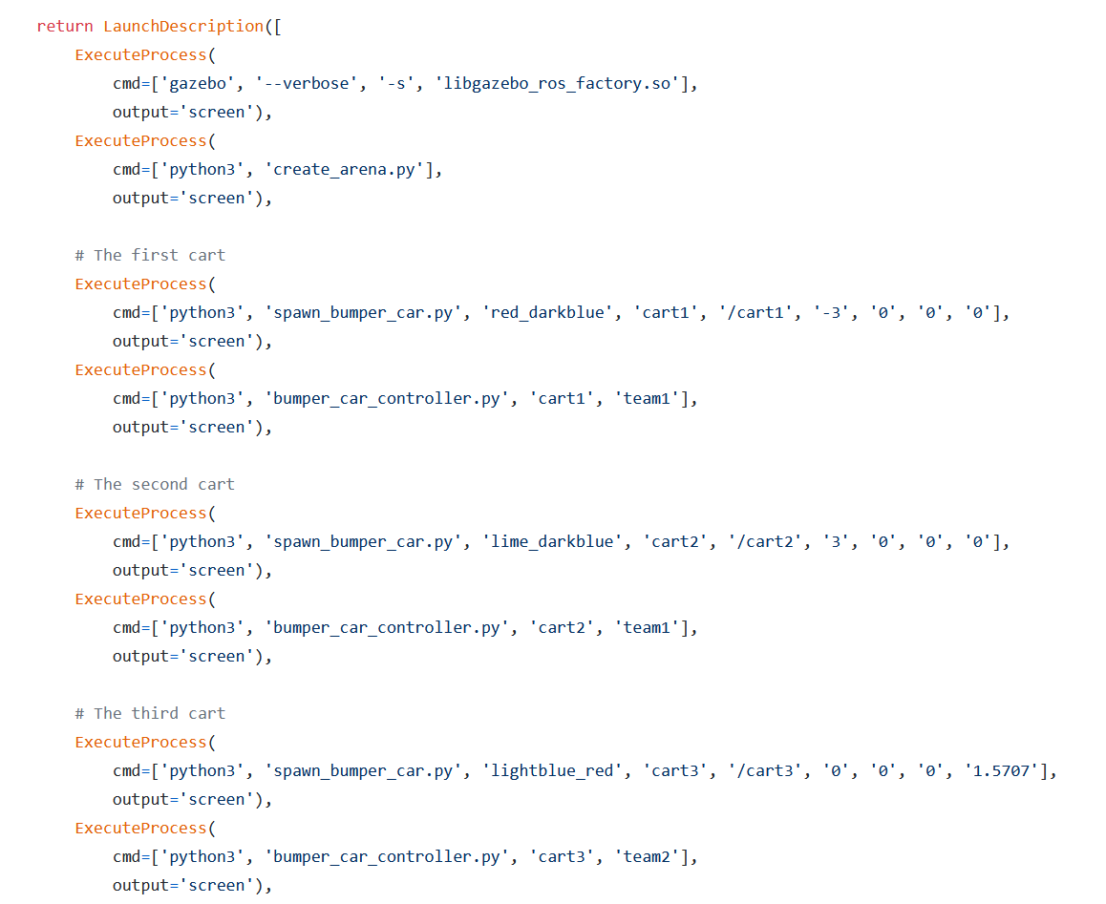
Notes:
This approach follows the recommended style for launching multiple entities using ROS2. First, we create an empty world, place the arena inside of it, create each cart, and then launch the python controller for it.
There are tradeoffs involved with using the approach. It is technically possible to issue commands to Gazebo via ROS2 that can set an exact placement of the sun (our light source) as well as intensity and color balance. Unfortunately, I never figured this part out and I believe that this caused our trained model to have a reduced accuracy level.
The opposite approach is to create a Gazebo world file. This makes the placement of entities in Gazebo simple with plenty of configuration ability. Unfortunately, that configuration ability didn’t extend to reusing our cart model code while maintaining unique ROS2 namespaces. It appears that in ROS1 this was possible. Based on documentation, a future version of ROS2 may restore this.
Additionally, the python controller code can’t be launched automatically via a Gazebo world file. What you would have to do is create a custom gazebo plugin. This is possible but not anywhere near as easy as writing a plain vanilla python program that includes rclpy (the ROS2 interface). To make matters worse, that custom plugin would be useless if you wanted to transfer to a physical bumper car.
<number>

Slide 27
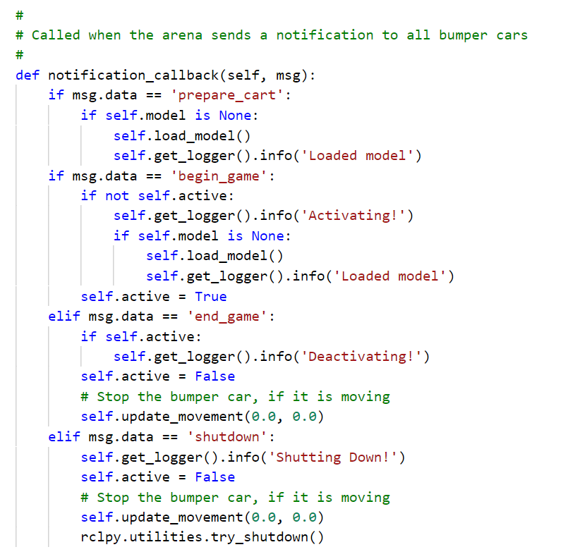
Notes:
This is our controlling “state machine” for our bumper car controller. Each instance of the controller subscribes to a ROS2 notification channel. This means that every cart receives all messages at approximately the same time. The ideal situation is to tell the cars to prepare themselves by preloading their model, but if not they will load it when we tell the cars to start playing their game. They will stop playing when they are told that the game is over. We can start and stop games as many times as we wish, but when we are done we need to tell the controller software to shut down. Quitting gazebo without telling the controllers to shutdown will cause them to become zombie processes that must be cleaned up using the unix kill command. Letting AI bots battle each other and then killing zombies – who ever said school wasn’t fun???
<number>

Slide 28
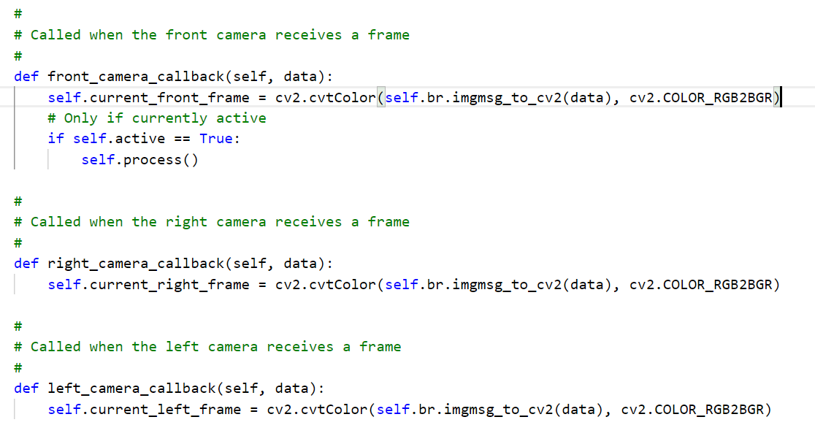
Notes:
Each camera is constantly publishing frames of video over ROS2. Our controller has subscribed to received them. We are only storing the most recent frame for each of the cameras and only doing our processing when a frontal frame arrives. In the future, this will be more performant and we will be processing upon receiving any frame from any camera. Notice that we are using the ROS-to-OpenCV bridge library to convert the frames.
<number>

Slide 29
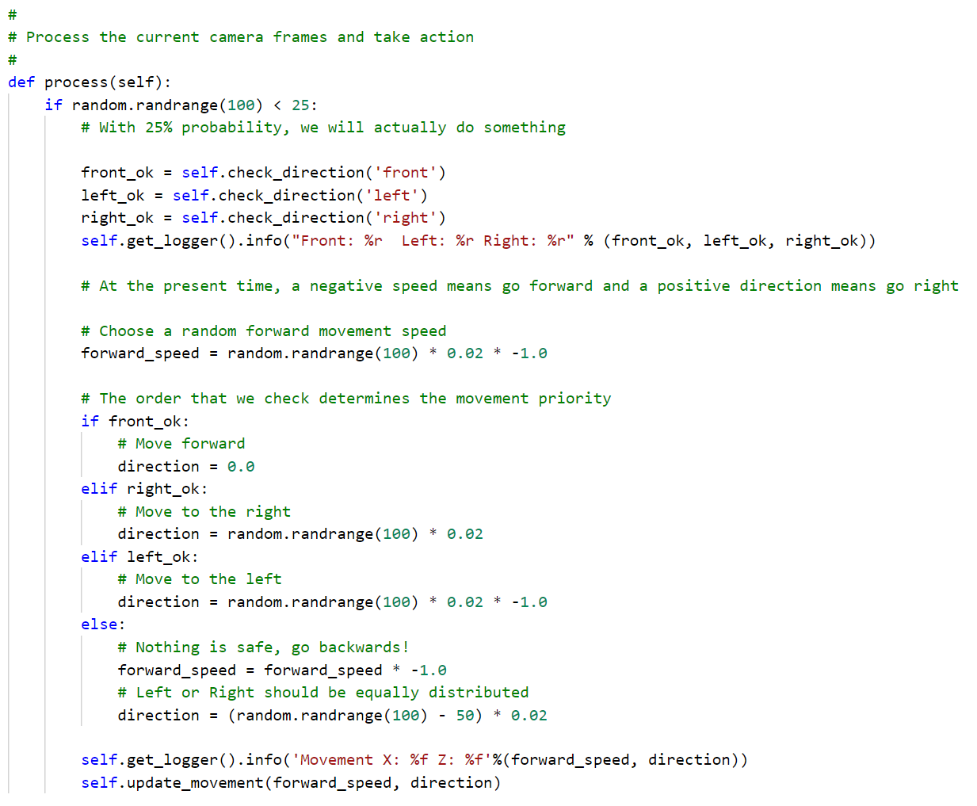
Notes:
This is our very rudimentary decision-making algorithm. For performance reasons we are only handling a random subset of the frames for performance reasons. As performance increases, we can raise the probability that we will act on a frame slowly until it reaches 1. Our trained model is used to determine if it is safe to move left, right and forward and once we know this we choose the direction of travel based on a priority system. If nothing is safe, the car will attempt to go backwards to safety but not in a straight line. In the future, we will make this far more robust and also allow for different model and algorithm choices.
Our experience showed that cars frequently backed themselves up into the wall. As I mentioned before, I think the lighting difference impacts the model accuracy. We can also limit the distance each camera can see, which would cut down on the number of obstacles and cars that a car would see. This comes at the cost of being less and less like a real-world scenario however. We probably need a larger arena and a more complicated model that considers the distance to obstacles and cars.
<number>

Slide 30
Conclusion and Final Remarks
We have created a framework that would support iterative improvements.
A real world implementation would replace Gazebo with a physical agent (robotic cart) running ROS2.

