Slide 1
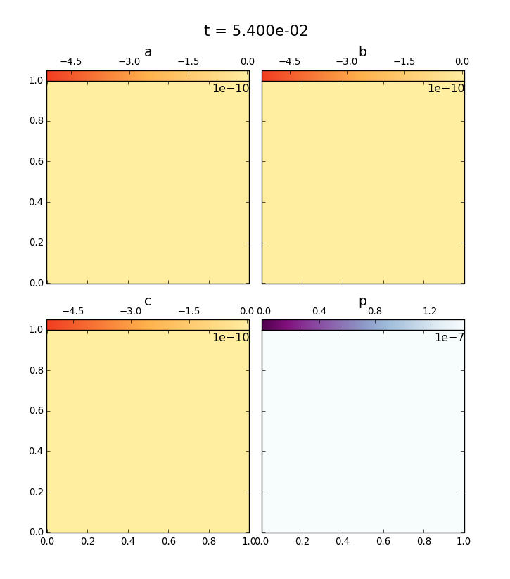
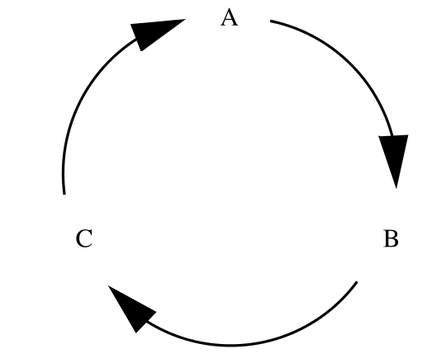
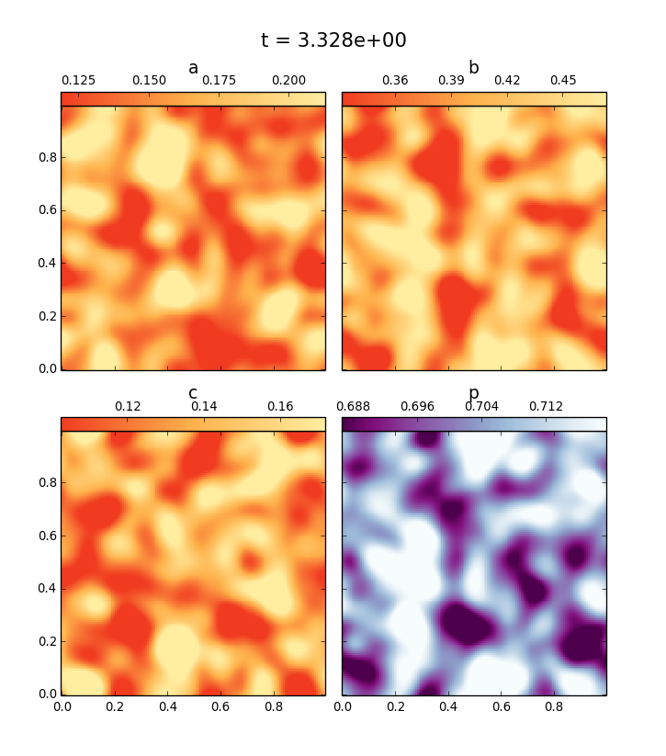
Dog eat dog
Modeling cyclic predation with Dedalus
PDE
SPDE
Baylee Bordwell – ASTR 5540 – Fall 2014

Slide 2

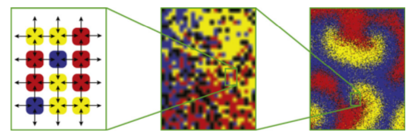
The Model: Langevin Equation
Diffusion
“Migration”
Noise
Birth
Death

Slide 3
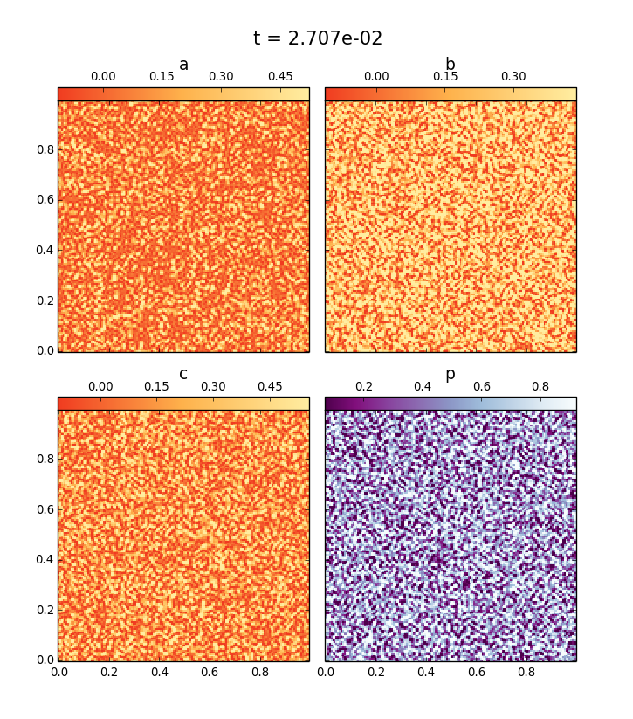
Dispersed Populations
Quickly migrating population
Slowly migrating population

Slide 4
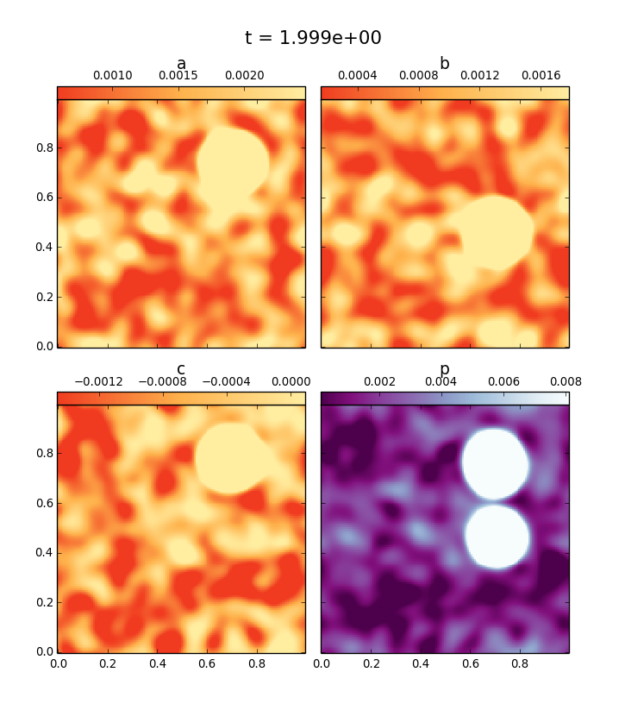
Localized Populations
Quickly migrating population

