Slide 1
Introduction to Erlang and Processes (Actors)

Slide 2
History
Created in 1986 specifically to address the needs of the Telecom industry
Joe Armstrong
Robert Virding
Mike Williams
It has a dynamic type system
Compiled language, source files .erl are compiled to beam (Bogdan/Björn's Erlang Abstract Machine)
Was proprietary to Ericsson until 1998 when it became open source
Erlang/OTP are maintained by a unit within Ericsson
https://www.erlang.org/
The original goal according to Armstrong: "We wanted to tailor a program language for telecom systems and the results became this programming language that we now know as Erlang," Armstrong says. "Eventually, hundreds of thousands of people would begin using it but that wasn’t our aim initially. We simply wanted to create something to replace PLEX to program the AXE system.”
Original reference implementation used Prolog as it interpreter, then switched to the BEAM virtual machine in early 90s.
Joe Armstrong: “If Java is 'write once, run anywhere', then Erlang is 'write once, run forever

Slide 3
Philosophy
Everything is a process.
Processes are strongly isolated.
Process creation and destruction is a lightweight operation.
Message passing is the only way for processes to interact.
Processes have unique names.
If you know the name of a process you can send it a message.
Processes share no resources.
Error handling is non-local.
Processes do what they are supposed to do or fail.

Slide 4
Data Types
Integers
Atoms
Never garbage collected
Always lowercase
Can be named anything if they are single quoted
No values
Floats
References
Binaries
Pids
Reference to erlang process
Ports
open_port BIF for external coms
Funs = function closures
Tuples
Lists
Maps
Strings
Records

Slide 5
Syntax
Statements end with a period
; means more to come
Flat structure, no concept of a package
Modules must be named the same as the file
Export defines public methods on a module
c(module_name) compiles your module
f() lets you clear a variable or all variables from the repl
tuples {}
lists []
no strings, only list of unicode characters
map #{ "key" => 42 }.
modules should focus on clean logical separations
-import(Module, [Function1/Arity, ..., FunctionN/Arity]).
-define(sub(X,Y), X-Y). and used like ?sub(23,47)
useless:module_info().
vsn(VersionNumber)

Slide 6
Basic Examples: Pattern Matching
-module (pattern_match).
-export ([convert_length/1]).
% Atoms are lower case and can't have a value
convert_length({centimeter, X}) ->
{inch, X / 2.54};
convert_length({inch, Y}) ->
{centimeter, Y * 2.54}.
trait UOM
case object centimeter extends UOM
case object inch extends UOM
// basic pattern match
def convert_length(value: (UOM, Double)): (UOM, Double) = {
val (u, d) = value
u match {
case centimeter => (u, (d / 2.54))
case inch => (u, (d * 2.54))
}
}

Slide 7
Basic Examples: RECURSION
-module(factorial).
-export([fac/1]).
fac(0) -> 1;
fac(N) -> N * fac(N - 1).
def factorial(n: BigInt): BigInt = {
if (n == 0) 1
else n * factorial(n - 1)
}
@annotation.tailrec
def factorialRecursive(n: BigInt, result: BigInt = 1): BigInt = {
if (n == 0) result
else factorialRecursive(n - 1, result * n)
}

Slide 8
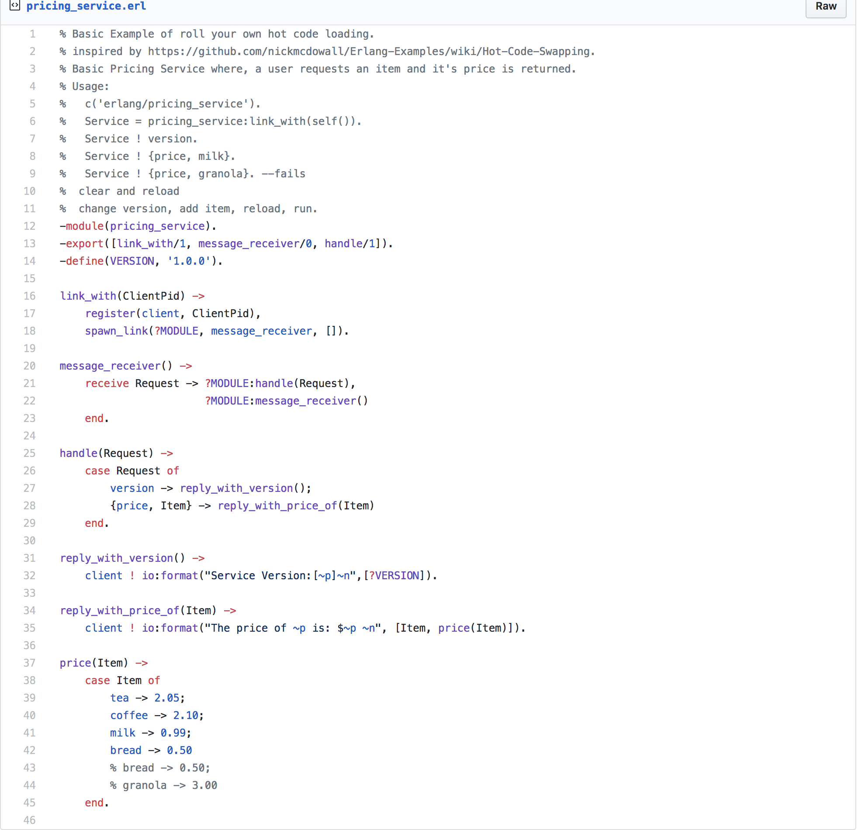
Basic Examples: HotloadING

Slide 9
Actors
Processes are actors, they are a primitive unit of computation. Receive a message and do a behavior based on that message.
Processes have mailboxes
They can do 1 of 3 things
Create (spawn) new processes
Send messages to other processes
Designate what to do with next message
Everything run within a process is isolated, no shared state. There is a supervisor that can be notified when the child process crashes and determines how to handle that.

Slide 10
Roulette
Client
(console)
Server
(roulette)
Monitor
(doctor)

Slide 11
Roulette Game
-module(doctor).
-export([loop/0]).
loop() ->
process_flag(trap_exit, true),
receive
new ->
io:format("Creating and monitoring process.~n"),
% spawning a the roulette process
register(revolver, spawn_link(fun roulette:loop/0)),
loop();
{'EXIT', From, Reason} ->
io:format("The shooter ~p died with reason ~p.", [From, Reason]),
io:format("Restarting.~n"),
%spawn the process anew.
self() ! new,
loop()
end.
-module(roulette).
-export([loop/0]).
% send a number, 1-6
loop() ->
receive
3 -> io:format("bang.~n"),
exit({roulette, die, at, erlang:time()});
_ -> io:format("click.~n"),
loop()
end.

Slide 12
Playing The GAme
c('roulette/doctor').
c('roulette/roulette').
Doc = spawn(fun doctor:loop/0).
Doc ! new.
revolver ! 1.

Slide 13
OTP (Open Telecom Platform)
OTP is to Erlang as Akka is to Scala
OTP is a set of abstractions for building fault tolerant applications
It revolves around the idea of an application which has behaviors
The standard library has behavior abstractions for
Supervisors
Servers
State Machines
Event Handlers

Slide 14
OTP EXample
c(kitty_gen_server).
{ok, Pid} = kitty_gen_server:start_link().
Pid ! <<"Test handle_info">>.
Cat = kitty_gen_server:order_cat(Pid, "Cat Stevens", white, "not actually a cat").
kitty_gen_server:return_cat(Pid, Cat).
kitty_gen_server:order_cat(Pid, "Kitten Mittens", black, "look at them little paws!").
kitty_gen_server:order_cat(Pid, "Kitten Mittens", black, "look at them little paws!").
kitty_gen_server:return_cat(Pid, Cat).
kitty_gen_server:close_shop(Pid).

Slide 15
Erlang Remote
On pi
erl -name pong@192.168.100.22
c(remote_pong).
remote_pong:start_pong().
On Mac
erl -name ping@local_ip_address
c(remote_pong).
remote_pong:start_ping({'pong@192.168.100.22'}).
remote_pong:start_ping({'pong@192.168.100.22', 5}).

Slide 16
Akka Remote Exchange
sbt "runMain com.bbrownsound.remote.HelloRemote" -- provides a simple echo service
sbt "runMain com.bbrownsound.local.LocalRemote" -- connects the remote server and exchange messages

