Slide 1
What is this black magic: an intro to macros & annotations in scala
Brandon Brown

Slide 3
What are macros?
Macros are a form of metaprogramming
Macros can allow for the generation of code at compile time
They are magic

Slide 4
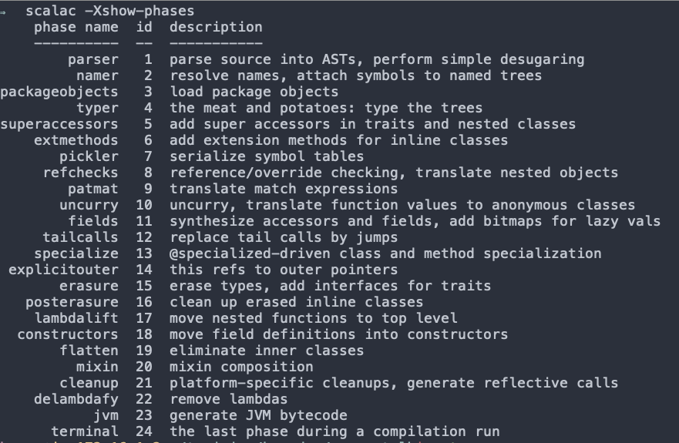
Compiler Phases
The compiler works in phases to turn your beautiful code into the bytecode that can run in the JVM.
https://www.iteratorshq.com/blog/scala-compiler-phases-with-pictures/
Not surprisingly, macros and implicits are some of the main causes for long compilation times.
https://www.scala-lang.org/blog/2018/06/04/scalac-profiling.html

Slide 5
Example AST
Source
def helloWorld(x: Int): String = s"Hello: ${x}”
AST
Defn.Def(
List(),
Term.Name("helloWorld"),
List(),
List(List(Term.Param(List(), Term.Name("x"), Some(Type.Name("Int")), None))),
Some(Type.Name("String")),
Term.Interpolate(Term.Name("s"), List(Lit.String("Hello: "), Lit.String("")), List(Term.Name("x")))
)

Slide 6
History of macros in scala
Scala 2.10 was the first version to include macros. Original plan was to reach stability by 2.12 (spoiler alert, it didn’t happen).
Prior to 2.13 macros are enabled via the Macro Paradise compiler plugin as well as either using the scala.language.experimental.macros import or adding the compiler setting -language:experimental.macros.
2.13 will introduce the -Ymacro-annotations compiler flag to allow the compiler to handle them directly
Macros are still considered experimental.
The quest to standardize the api around macros has led to the creation of scala meta

Slide 7
So Why Use Macros?
They can reduce boilerplate in your code base.
Example: Json Read/Writes
https://github.com/playframework/play-json/blob/d268629b0b17139bea7c2c98cb4fa73bfa8c017a/play-json/shared/src/main/scala/play/api/libs/json/Json.scala
https://github.com/playframework/play-json/blob/e19cb02869856f65d00559e513a0dc48f281a35b/play-json/shared/src/main/scala/play/api/libs/json/JsMacroImpl.scala
Validate Code
Example: scala.annotation.tailrec
https://github.com/scala/scala/blob/2.13.x/src/library/scala/annotation/tailrec.scala
https://github.com/scala/scala/blob/6b4d32c3f518d21a798e8d3cf4a8c35866afa8e2/src/compiler/scala/tools/nsc/transform/TailCalls.scala

Slide 8
Blackbox macros
Macros that faithfully follow their type signatures are called blackbox macros as their implementations are irrelevant to understanding their behaviour (could be treated as black boxes).
scala.reflect.macros.blackbox.Context

Slide 9
Whitebox macros
Macros that can’t have precise signatures in Scala’s type system are called whitebox macros(whitebox def macros do have signatures, but these signatures are only approximations).
scala.reflect.macros.whitebox.Context

Slide 10
Annotations
Annotations are about associating meta information
They can be used for example to issue warnings or flat out fail compilation.
@deprecated
@tailrec
They can also lead to black magic.
Anyone familiar with JavaEE will be familiar with annotations as another form of meta programming
The beauty of them is that they can be used along with macros to help you reduce boiler plate and do some cool things

Slide 11
Examples

Slide 12
Process Timer
Goal add timing information for methods
Easily accomplished without a macro, but painful to comment out

Slide 13
Obfuscation
Goal prevent logging of sensitive fields
Accomplished via override the generated toString Method

Slide 14
Questions?
https://github.com/brbrown25/macro-talk

