Slide 1
R course 2022
Tutorial #4 Nov 15th
Notes:
דיבר שעה שלמה על merge cbind rbind

Slide 2

Plan for today
Go over solution for exercise #1.
Save output of for loops.
Combine data frames.
Lists.
The apply function family.
Go over new exercise #4.

Slide 3
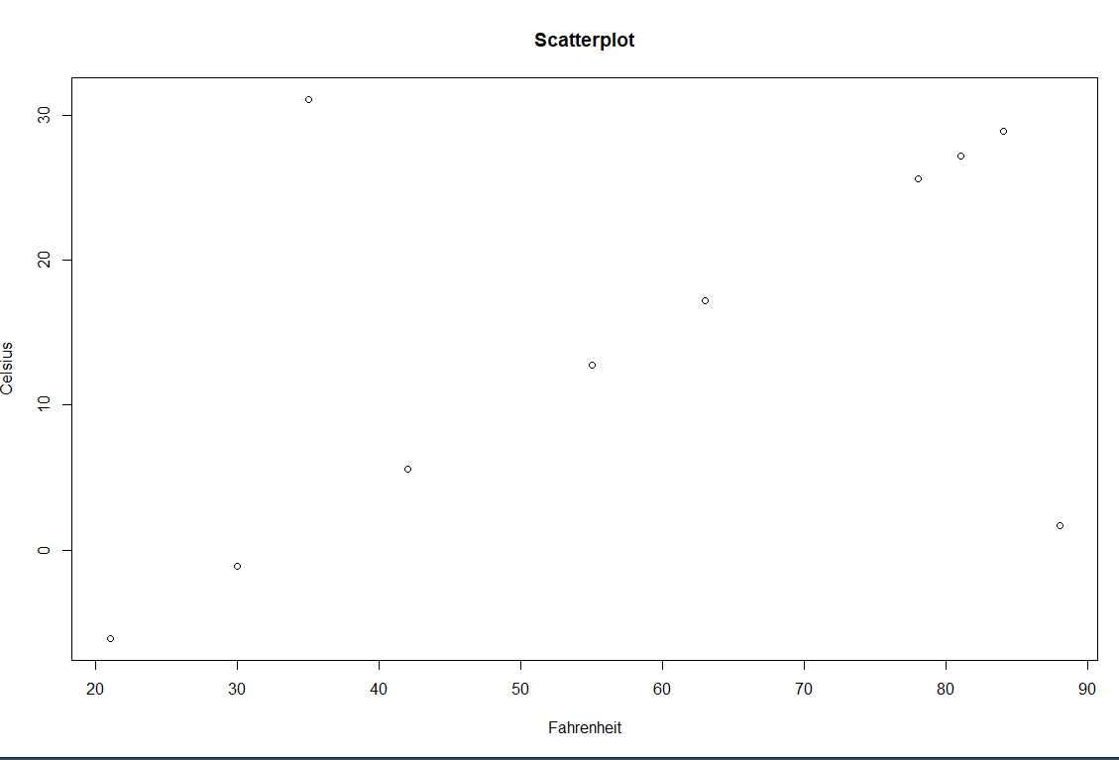

EX1 take home message – always plot your data
Code based solution
Notes:
Student credit: Yosef Maimon

Slide 4

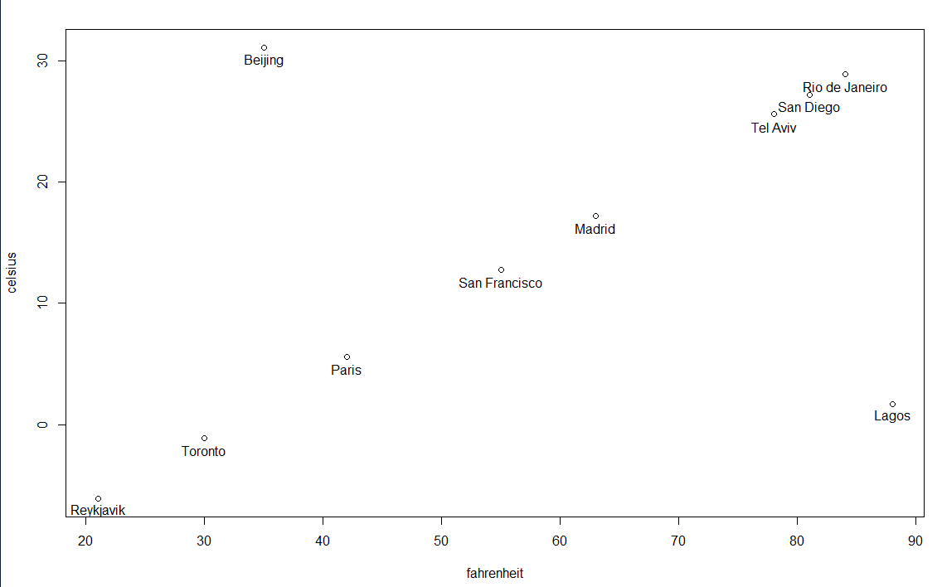
Better option – look at the plot!
More lazy = better.
Unbiased view of the data. i.e. you will find the problem without a priori information.

Slide 5
Combining data frames
Not caring about the column\row order:
cbind()
rbind()
If the order in meaningful and neglected you can mess up your data.
Performing precise merging according to an ID column (even when the two df are not in the same order)
merge()

Slide 6
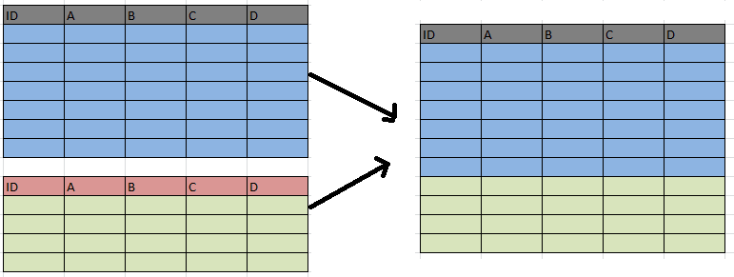
rbind() - row bind
rbind(DF1, DF2)
The function is quite flexible and can be used to combine objects of different types as long as they have the same number of columns.

Slide 7
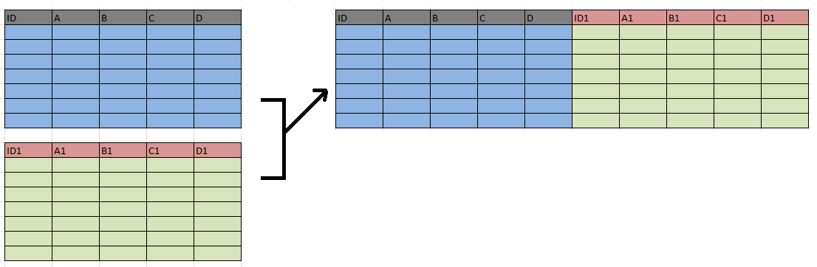
cbind() - column
cbind(DF1, DF2)
Also quite flexible and can be used to combine objects of different types, as long as they have the same number of rows.

Slide 8

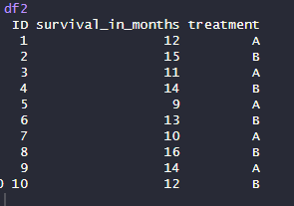
merge()
The most common use for merge is when I have a df with an ID column and I want to merge it with a second df with more information and the same ID’s.
We need a common ID column to merge by.
Notes:
DF1 – The data I has before I did my exp
DF2 - After

Slide 9
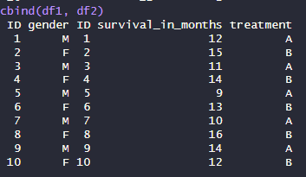
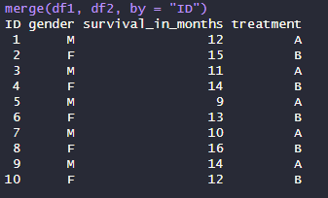
cbind VS merge
cbind
merge

Slide 10
The list
Lists in R are versatile data structures that can hold elements of different types, including vectors, matrices, data frames, and even other lists. In other words, lists are kind of a “kitbag” that you can use to store multiple objects of any type in one place. Provides versatility.
One example: If you want a function to iterate over several objects, you can put them in a list (we’ll see examples).
Notes:
# Create a list with various data classes
my_list <- list(
integer_vector = c(1L, 2L, 3L),
numeric_vector = c(1.5, 2.8, 3.1),
character_vector = c("apple", "banana", "orange"),
logical_vector = c(TRUE, FALSE, TRUE),
data_frame = data.frame(ID = c(1, 2, 3), Name = c("Alice", "Bob", "Charlie")),
factor_vector = factor(c("low", "medium", "high"), ordered = TRUE, levels = c("low", "medium", "high"))
)
# Display the list
print(my_list)

Slide 11
Lists can contain anything
Mylist = list(1,2,3,4) # all items are numeric
Mylist = list( 1, ”A”, TRUE ,c(1,3,2) , c(“A”,”B”,”X”,”D”,”H”) ) # many types

Slide 12
Subsetting and naming lists
One [] – cuts out a part of the list and keeps a shorter list
Class( Mylist[1:3] )
list
Two [[]] - The element is extracted out of the list
Class( Mylist[[3]] )
. The class depends on the extracted element class.
Lists can have names too
names(Mylist) = c(…)
Named lists can be accessed by name or by the dollar sign:
Mylist[[“name”]]
Mylist$name

Slide 13
Additional list operations
Adding things to a list
If the list has a length of 5, and you want to add the next element:
Mylist[[6]] = “new”
Replacing items in a list:
mylist[[2]] = 10 # replacing one element
mylist[1:2] = list(4,2) # replacing several elements
unlist() makes a list into a vector if possible, very usefull sometimes
as.list() converts a vector to a list

Slide 14
Class exercise
1. make a list with your name, year of birth and a logical variable saying whether you like grapefruit.
2. Print the class of the second element of the list.
3. Change the third element of the list to FALSE.

Slide 15
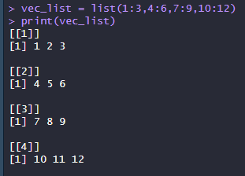
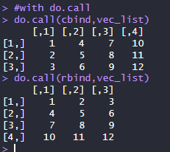
The do.call() function
Do.call is used to pass a list of arguments to a function.

Slide 16
Assigning a list object from a loop
Keep in mind: You need to create a list in advance in order to save the output of each loop iteration into it.
1. Create an empty list:
To_store = list()
2. Using it in a loop:
For (x in (1:3)){
keep = x*2
To_store[[x]] = keep
}

Slide 17
BREAK!

Slide 18
The ‘apply’ functions
The “apply” family functions is a collection of functions that replace loops for iterating in R, efficiently and with short and easy syntax.
There are different “apply” functions for different outputs and inputs.
We will go over the basic “apply” types
apply()
sapply()
lapply()
tapply()

Slide 19
apply() – for two dimensional data
Iterates on either the rows or the columns of a data-frame / matrix
Input: data-frame / matrix
Output: usually a vector
syntax: apply ( input_df, margin, FUN = a_function )
Margin:
1 for iterating on rows
2 for iterating on columns

Slide 20

Custom R functions
Apply(x = …, margin = 1, FUN = function(x){…})

Slide 21
lapply() – outputs a list
The “l” stands for lists
Input: list/vector
Output: list
lapply() will iterate of each element in the list and perform a function
Syntax:
lapply ( input_list, FUN = a_function )
With a for loop it would be:
For ( element in input_list ) {
out = a_function(element)
new_list[new] = out
}

Slide 22
sapply()
S stands for simplify
Works very similar to lapply() but simplifies the output (by R logic of simplicity). E.g. df is more simple than a list.
Sapply(x, FUN, simplify = F) == lapply

Slide 23
tapply()
Good for dividing you data by a parameter, performing operations on the groups separately
Vector1 = student_grades
Vector2 = student_type (PhD, MSc, other)
Calculate the mean grade for each student type:
tapply( vector1, vector2, mean )
Inputs: a numeric vector and a categorical vector/factor
Output: array? (practically a vector)

Slide 24
#### class exercise ##########
apply ################
using the built in data set: mtcars
1. get the mean of each column
2. calculate the minimum of each row divided by the maximum of each row# excluding the `vs` and `am` columns
tapply ###############
using the built in data set: PlantGrowth
1. calculate the mean weight of each group

