Slide 1

Class 1
Schraga Schwartz, Igor Ulitsky & Yaron Antebi
Weizmann Institute of Science
Teaching assistants:
Einav Somech, Edo Kiper & Rotem Tal

Slide 2
To do:
Download & Install R:
https://cran.r-project.org/bin/windows/base/
Download & Install Rstudio:
https://www.rstudio.com/products/rstudio/download/#download
Download this presentation:
http://tinyurl.com/WeizRcourse

Slide 3
Why ?

Slide 4


Slide 5

R’s strengths
Data management & manipulation
Interactive
Statistics
Graphics
Programming language
Active user community
Free!

Slide 6
R’s weakness
Not so user friendly
Minimal GUI.
No commercial support
Substantially slower than programming languages (e.g. perl, java, C++).

Slide 7
(Usually crappier) alternatives to R
Excel
Matlab

Slide 8
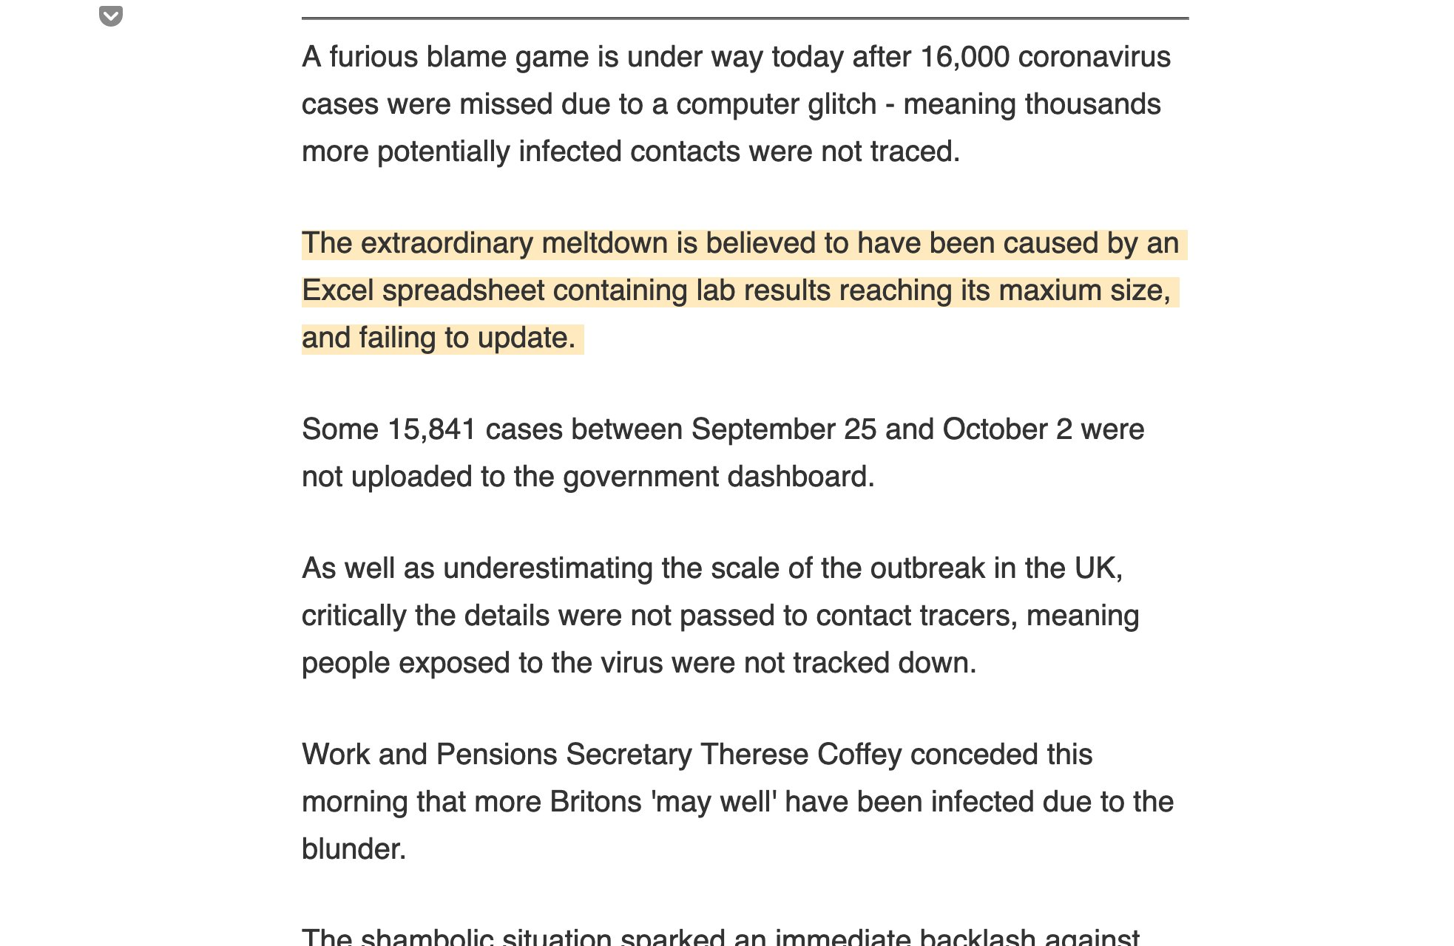
Microsoft Excel is a Sin Against Science

Slide 9
Alternatives that can have advantages with respect to R:
C++/Java
Python

Slide 10

Things that you should learn yourself (at some point)
Basic UNIX commands
Pipelines and automation
Basic scientific art
Basic software installation etc.

Slide 11
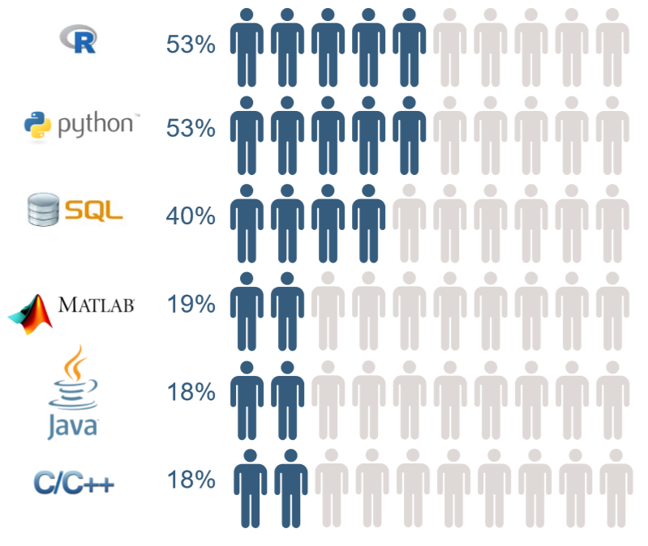
How to get data science & machine learning/AI jobs

Slide 12
When does R (typically) come into the picture?
Data in a table format

Slide 13
Goals in this course
Programing in R (Schragi)
Genomic and multidimensional data analysis (Schragi)
Data modelling and statistical analysis (Yaron)

Slide 14
The course will be of little use if you:
Don’t make it to classes
Don’t carry out the assignments
Don’t plan to do some analysis of data over the next year

Slide 15
Course Requirements
Small weekly exercise. Qualitative grading scheme. No individual feedback. Submission mandatory.
Two larger exercises (mid & end of semester). Quantitative grading, with corrections.
Tutorials: Tuesday, 12:00 - 14:00
Attendance NOT mandatory.
Full description: here

Slide 16

chatGPT?
chatGPT use is strictly forbidden for mid and final exercises

Slide 17


InstRuctors
Einav Somech
Edo Kiper
Rotem Tal

Slide 18
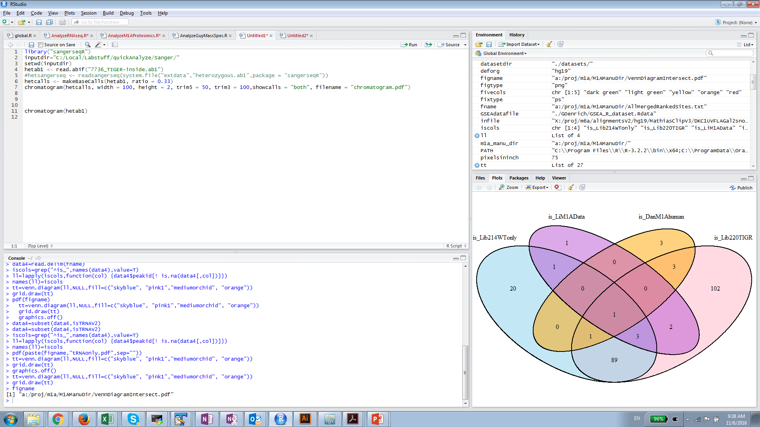
Rstudio: The working environment for R

Slide 19
How
?

Slide 20
R as a calculator
Calculator
+, -, /, *, ^, log(), exp(), sqrt(), …:
(17*0.35)^(1/3)
log(10)
exp(1)
3^-1

Slide 21
Variables in R
Variables are assigned using either “=“ or “<-”
x=12.6
x
[1] 12.6

Slide 22
Classes
Different variables can be of different classes (e.g. numeric, character, logical)

Slide 23
Vector
A vector is a sequence of data elements of the same type (e.g. a sequence of numbers, or a sequence of characters).

Slide 24
Creating a numeric vector
Such a vector may be created:
1. Using the c() (short for concatenate) function:
y=c(3,7,9,11)
> y
[1] 3 7 9 11
2. Using the rep(what,how_many_times) function:
y=rep(3,30)
3. Using the “:” operator, signifiying “a series of integers between”
y=1:30

Slide 25
Logical (Boolean) vectors
A boolean variable can be either TRUE or FALSE.
b=c(TRUE,FALSE,TRUE,FALSE,TRUE,TRUE)
Notes:
compare output of summary for numerics vs. factors

Slide 26
Vector manipulation
n=c(1,4,5,6,7,2,3,4,5,6) #creates a vector with the numbers in the brackets, stores it in y
length(n) #number of elements
n[3] #extract 3rd element in y
n[-2] #extract all of y but 2nd element
n[1:3] #extract first three element of y
n[c(1,3,4)] #extract first, third, and fourth element of y

Slide 27
Vector manipulation…
n+1 #add 1 to all elements in y
n*2 #multiply by two all elements in y
sum(n)
mean(n)
median(n)
var(n)
min(n)
max(n)
log(n) #extract logs from all variables in y

Slide 28
Functions in R
- Functions are chunks of code which (can) receive something as input (termed: arguments), and (can) produce something as output (termed: return value).
A function can be recognized by the round brackets "()" following the function name.
The arguments of the "mean" function is a vector of numbers; the return value is their average.

Slide 29
Basic visualization of numbers
barplot(n)
plot(n)
hist(n)
boxplot(n)
pie(n)

Slide 30
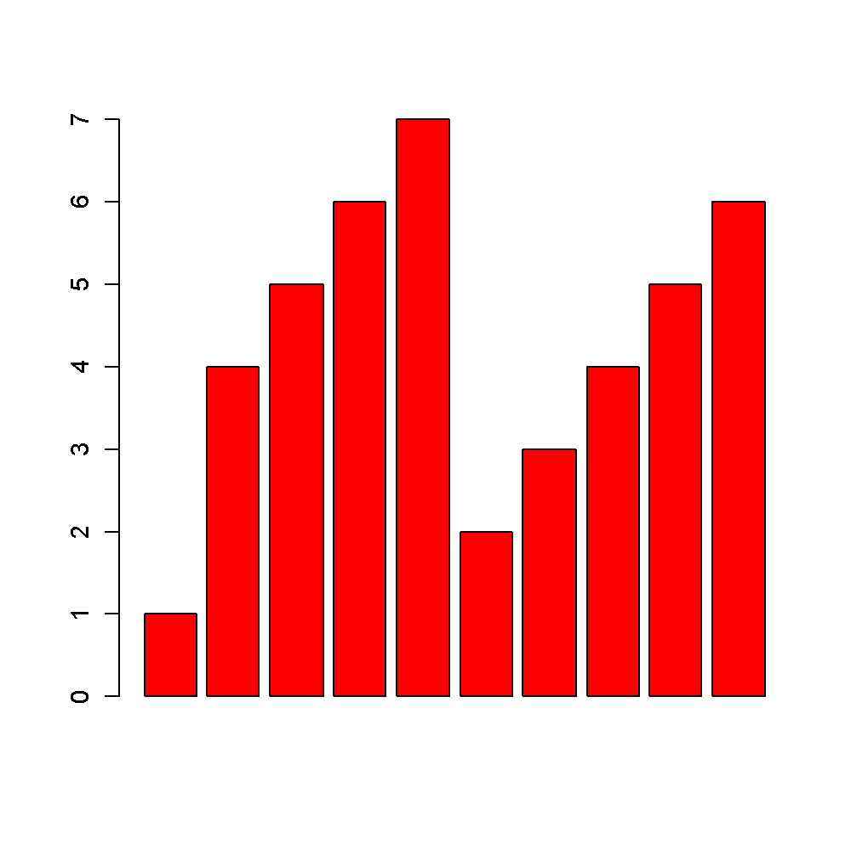
barplot(n,col="red")

Slide 31
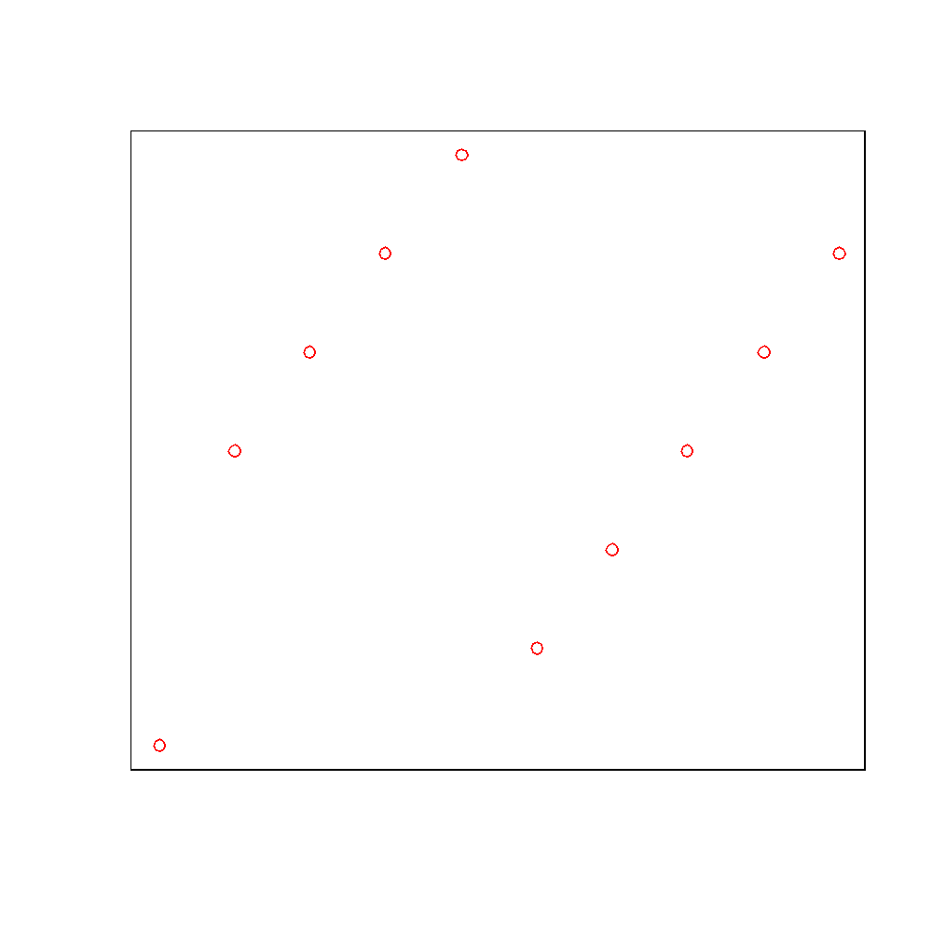
plot(n,col="red")

Slide 32
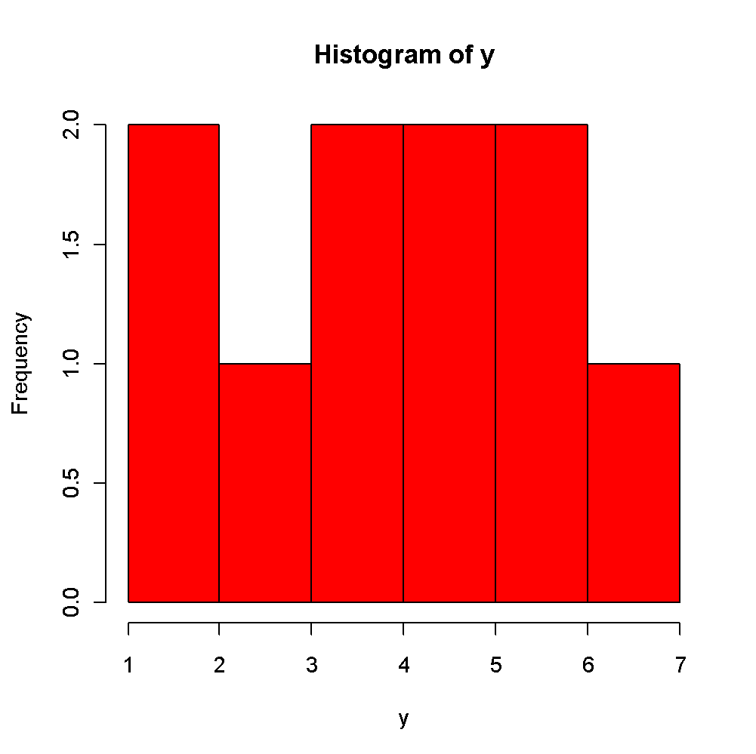
hist(n,col="red")

Slide 33
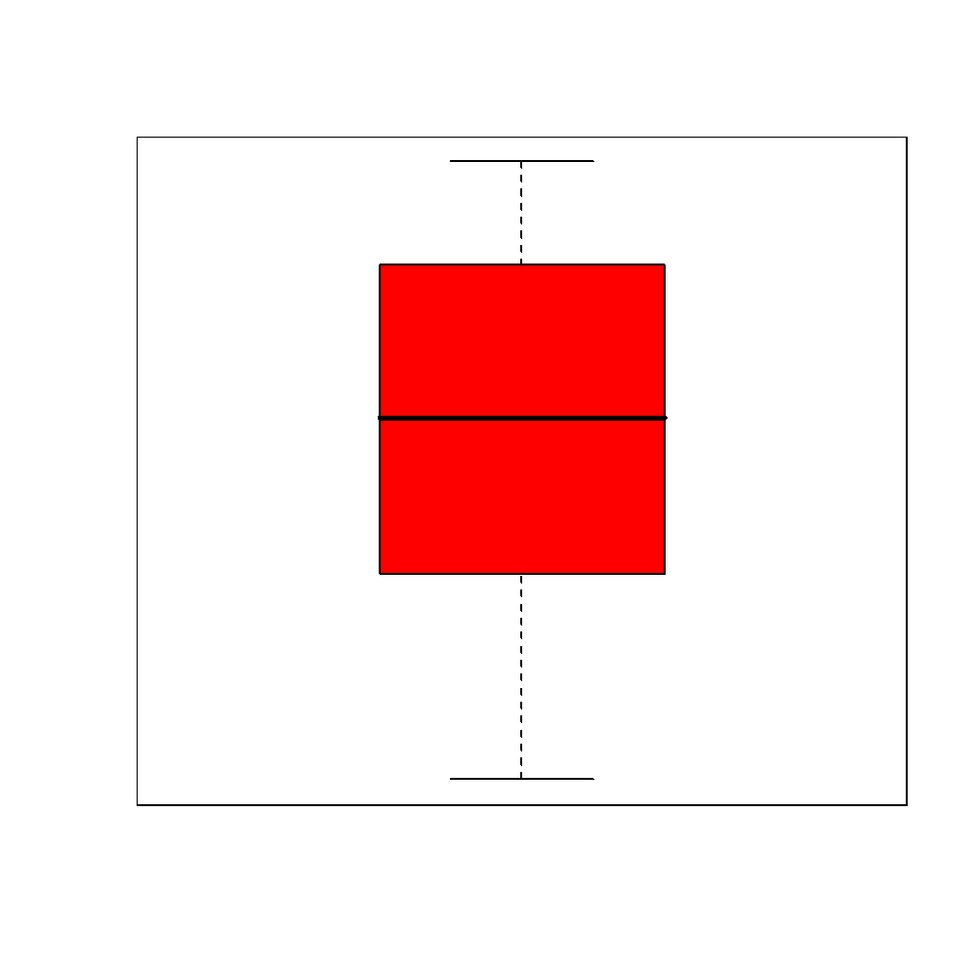
boxplot(n,col="red")

Slide 34
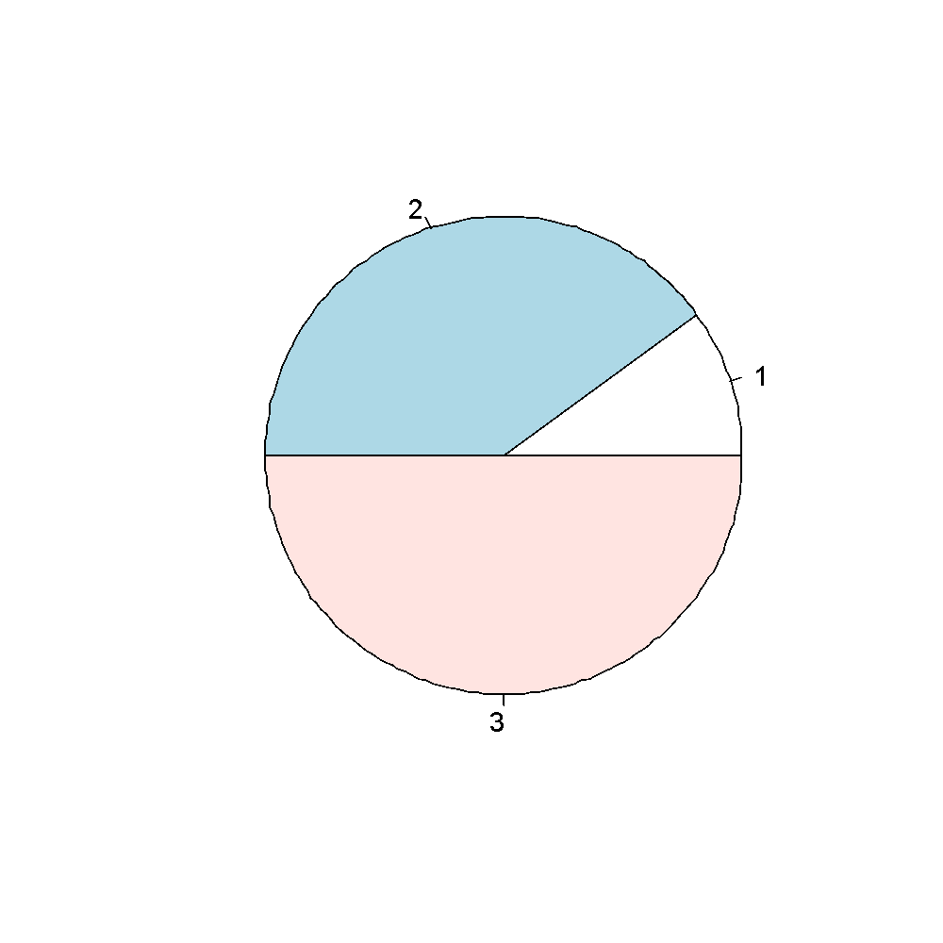
pie(n[1:3])

Slide 35

Help in R
Click ? + function_name.
? barplot
Help pages contain the following components:
function_name(package) – if the package is not installed, this is the time to install it and call it (using "library")
Description: brief overview
Usage
Description of arguments (input)
Details: more information
Value: value returned by the function (output)
See also: great way to learn new stuff you didn't even know you wanted to do!
Examples: Can be copy-pasted as is! Highly informative!

Slide 36
Other vectors
Character vectors:
n=1:7
nms=c("miriam","schragi","chaim","jochanan","ephraim","avraham","yemima")
names(n)=nms #giving names to each value in numeric vector y
n["schragi"]
Class Exercise: Redraw some of the previous plots with modified n!

Slide 37
The paste() function
Concatenates different characters into a single character, separated by the variable defined by sep argument (default: sep=" ")
paste("To","err","is human.","To R is","divine!",sep="_")

Slide 38
Factor vectors (We love factors!)
f=as.factor(c("stupid","stupid","smart","stupid","imbecile","smart","smart","imbecile"))
levels(f) #possible values a variable in y can have
summary(f) #provides the number of time each factor occurs
Class Exercise: Compare summary(n), summary(b), and summary(f) – note difference in output!

Slide 39
Logical (Boolean) vectors
A boolean variable can be either TRUE or FALSE.
b=c(TRUE,FALSE,TRUE,FALSE,TRUE,TRUE)
sum(b) #number of "TRUE" elements
Notes:
compare output of summary for numerics vs. factors

Slide 40
Logical operations
& AND
| OR
! NOT
a=TRUE
b=FALSE
a&B #FALSE
a|b #TRUE
! a #FALSE
! a | b #FALSE
! a | ! b #TRUE

Slide 41
Logical operations
a=c(TRUE,TRUE,FALSE,TRUE)
b=c(FALSE,TRUE,FALSE,FALSE)
a&b #FALSE,TRUE,FALSE,FALSE
a|b #T,T,F,T
! a #F,F,T,F

Slide 42
Conditional operators
> greater than
< less than
== equals
!= not equals

Slide 43
Conditional operators
n=3
n>2 #TRUE
n<3 #FALSE
n==2 #FALSE
n!=2
Note: difference between “=“ (assignment) and “==“ (conditional)

Slide 44
Conditional operators
n=c(3,3,4,5)
n>2 #TRUE,TRUE,TRUE,TRUE
n<4 #TRUE,TRUE,FALSE,FALSE
n==3 #TRUE,TRUE,FALSE,FALSE
n!=3 #FALSE,FALSE,TRUE,TRUE
n!=3 & n<5 #FALSE,FALSE,TRUE,FALSE

Slide 45
Subsetting within vectors
Using a numeric vector referencing the position
Using a character vector referencing the names
Using a logical vector

Slide 46
Subsetting using logical operations
n=c(1,3,12,9,10,12) #numeric vector
ind=c(T,T,F,F,F,T)
n[ind] #c(1,3), numeric vector
n>5 #F,F,T,T,T,T
n[n>5]

Slide 47
Quick class experiment
n=c(1,3,12,9,10,12)
extract all elements from vector n that are both greater than 5 and below 10
extract all elements that are either below 5 or over 10
extract all elements that are below 12 and not equal to 3

Slide 48
Reminder
Please ask questions!!

Slide 49
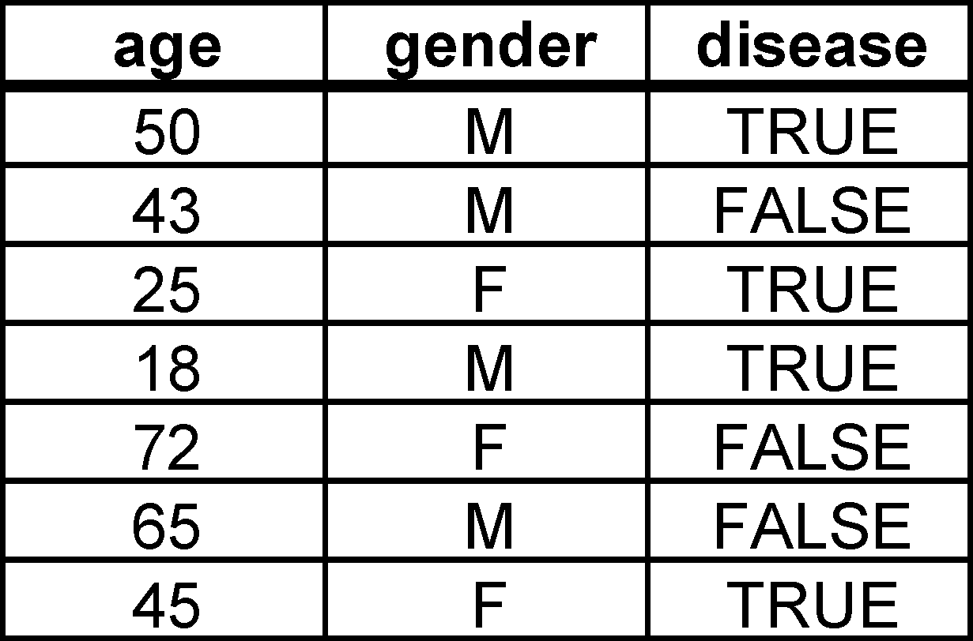
The data.frame Class (We also love data.frames!)
A data.frame is simply a table
Each column may be of a different class (i.e. one column may be numeric, another may be a character, a third may be boolean and a fourth may be a factor)
All rows in a given column must be of the same class
The number of rows in each
column must be identical.
Notes:
show an example.

Slide 50
Matrix class
Same idea as data.frame, but…
All variables are numeric
In data.frames, variable are typically meaningful only across columns; In matrix, both rows and columns are meaningful.
m=as.matrix(iris[,1:4])
Note: in a matrix you access columns names using colnames(m), in data.frame simply using names(data.frame)

Slide 51
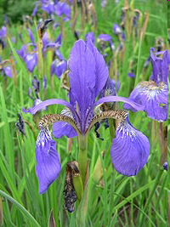
Iris database
Petal (עלה כותרת)
Sepal (עלה גביע)

Slide 52
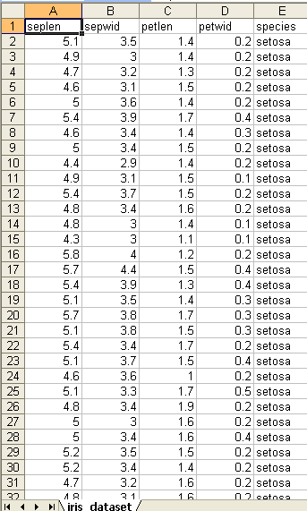
The iris dataset

Slide 53
The fascinating questions
What are typical lengths and widths of sepals and petals?
Do these change from one family of irises to another?
Do longer petals tend to be wider?
Do longer petals tend to correlate with longer (or wider) sepals?
Do such correlations change from one family of irises to another?

Slide 54
Playing with data frames - I
1. Set the work directory to the directory you're working in:
setwd("C:/Local/Labstuff/R course/2019Course")
(Note: getwd() tells you which directory you're in)
2. Load the table you want to work with (make sure you saved it as tab delimited file!):
ir=read.table(file="iris_dataset.txt",sep="\t",header=T) #loads iris_dataset.txt into variable "ir". Assumes that the file is tab delimited, and that the first line is a header.

Slide 55
Playing with data frames II
class(ir) #shows the class of ir
dim(ir) #returns the number of rows and columns in ir
ir[1,2] #first line, second column in ir
ir[1,] #all columns in first line in ir
ir[,1] #all rows in first column of ir
ir$seplen #same as above
ir[,"seplen"] #same as above
ir[,c("seplen","sepwid")] OR ir[,1:2] #first two columns of ir
summary(ir) #each of the columns is summarized according to its class
Notes:
1 by 1

Slide 56
Playing with data frames - III
ir$seplen>6 #returns a boolean vector with TRUE and FALSE values depending on whether seplen is greater than 6
ir[ir$seplen>6,] #returns a subset of ir containing all columns of all rows in which seplen is greater than 6
ir[ir$seplen>6,c("seplen","sepwid")] #returns same rows as above, but only "seplen" and "sepwid" columns
ir[ir$seplen>6 & ir$sepwid >3,c("seplen","sepwid")] #returns same columns as above, but only rows in which seplen is greater than 6 and sepwid is greater than 3

Slide 57
Class 3

Slide 58
Reload the iris dataset
#set work directory to the directory in which you stored the dataset
setwd("C:/Local/Labstuff/R course/2019Course")
#read-in the dataset
ir=read.table(file="iris_dataset.txt",sep="\t",header=T) #loads iris_dataset.txt into variable "ir". Assumes that the file is tab delimited, and that the first line is a header.

Slide 59
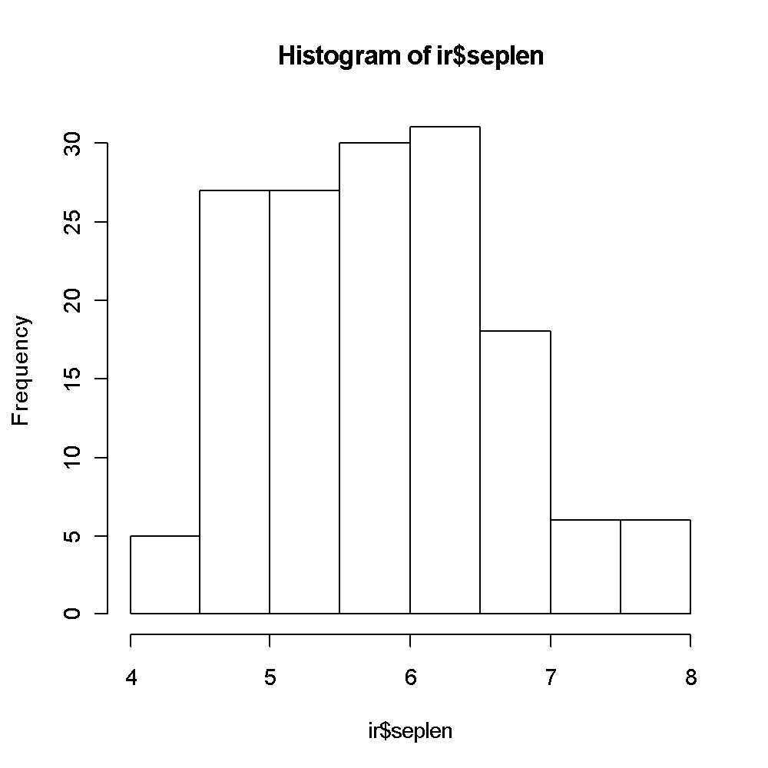
Visualization
hist(ir$seplen) #histogram of seplen

Slide 60
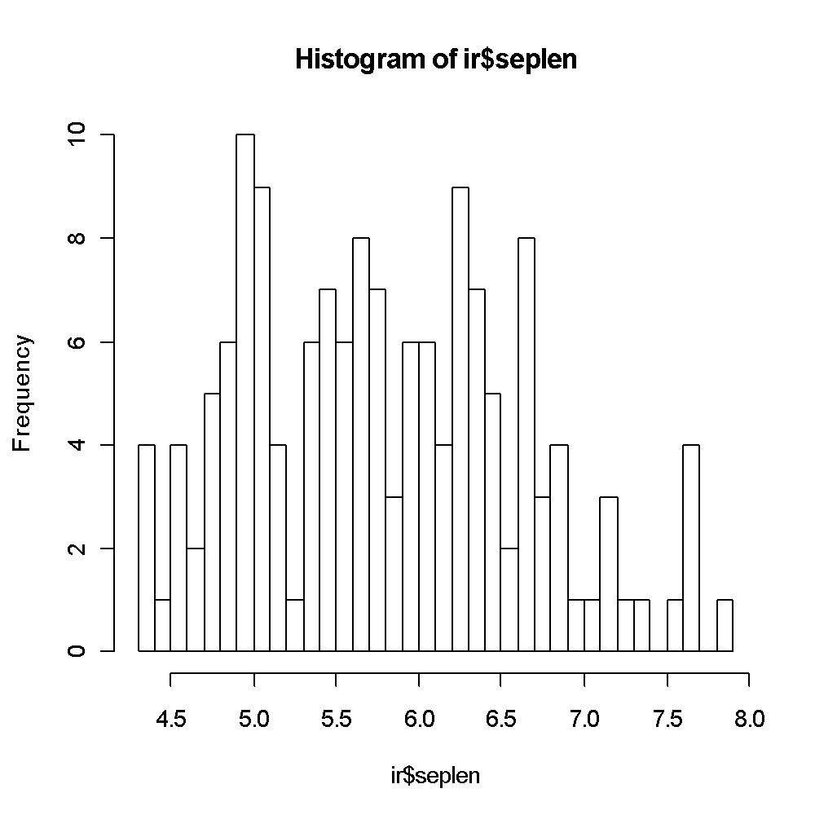
Visualization - II
hist(ir$seplen,30) #histogram of seplen

Slide 61
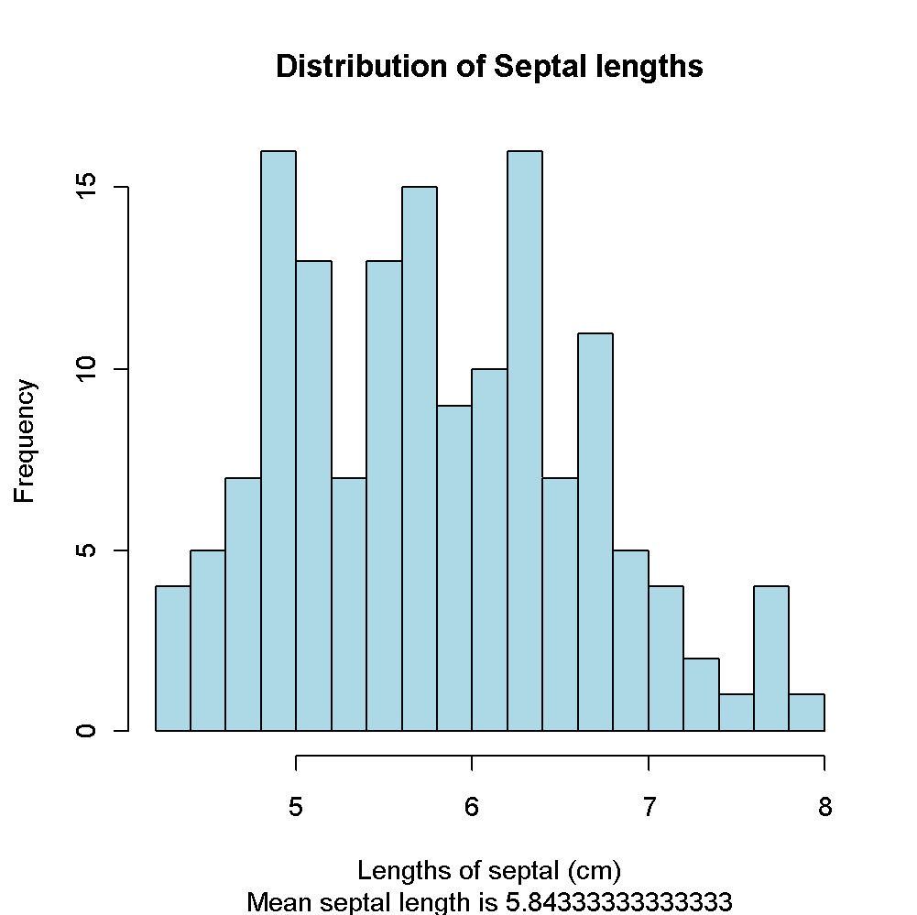
Visualization - III
mean_seplen=mean(ir$seplen)
hist(ir$seplen,20,col="light blue",main="Distribution of Septal lengths",xlab="Lengths of septal (cm)",sub=paste("Mean septal length is",mean_seplen))

Slide 62
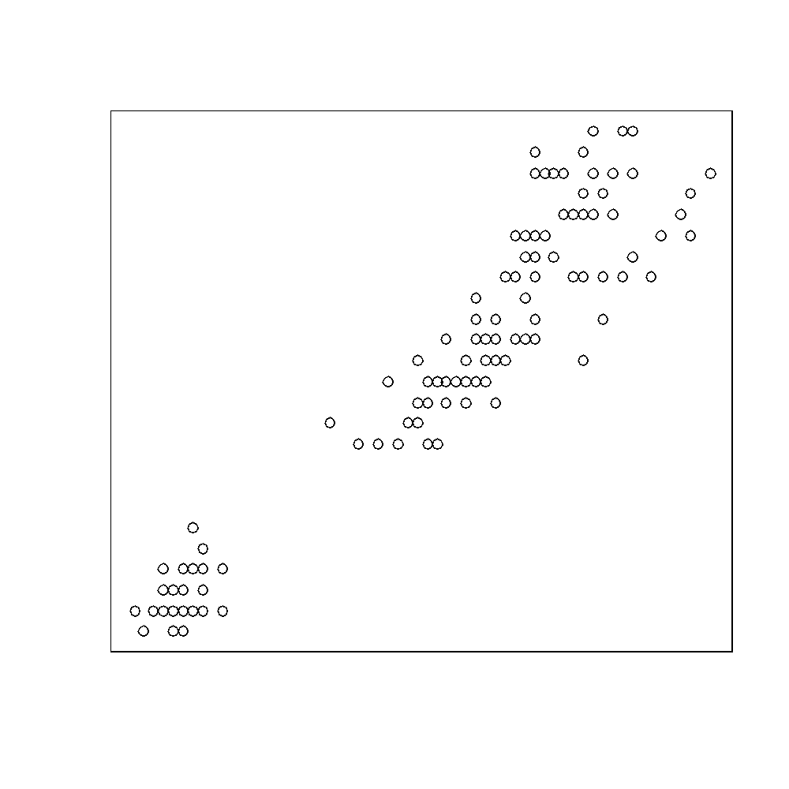
Looking at correlations
plot(ir$petlen,ir$petwid) #plotting one set of numbers as a function of another

Slide 63
Arguments of the plot function
Some parameters of plot() function (get more by typing "? plot.default"):
x – x values (defaults 1:number of points)
y – the distribution
type – type: can be either "l" (line), "p" (points) or more
pch – type of bullets (values from 19-25)
col – color (either numbers of names of colors) – can receive multiple colors
lwd – line width
lty – line type
xlab,ylab – X and Y labels
main, sub – main title (top of chart) and subtitle (beneath the X label)

Slide 64
Class exercise
Do sepal length and petal lengths correlate?
Do sepal width and petal width correlate?
Are these correlations dependent on iris class?

Slide 65
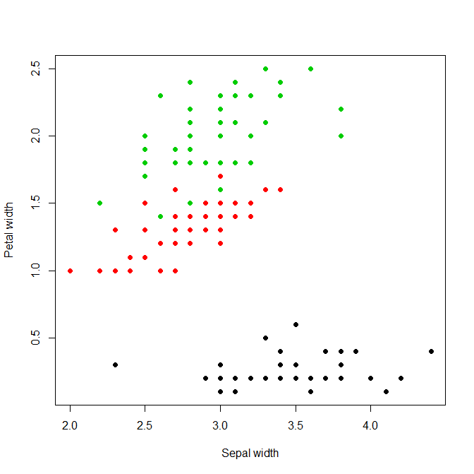
Adding the color dimension to a scatter plot
plot(ir$sepwid,ir$petwid,col=ir$species,pch=19,xlab="Sepal width",ylab="Petal width")
Notes:
‹#›

Slide 66
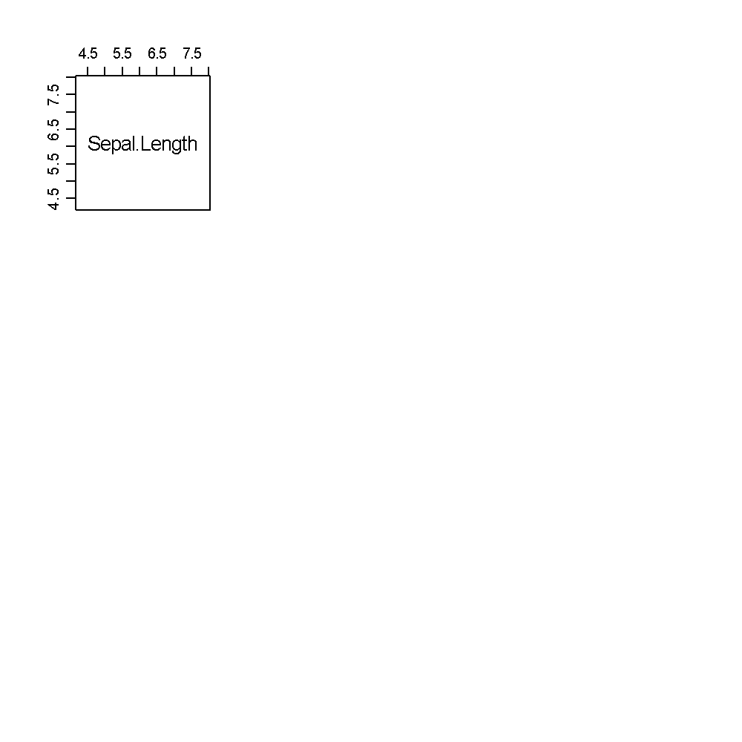
Looking at everything as a function of everything else
pairs(ir[,1:4])
pairs(ir[,1:4],col=ir$species,upper.panel=NULL)

Slide 67
data.frame functions
dim() – provides dimensions of data frame
head() – provides first lines of data frame
nrow(), ncol() – number of rows/columns
names() – returns column names
Note: this function can also be used for assigning new column names.
e.g. names(ir)=c("A","B","C","D","E")
summary() – provides summary of each column, based on the class of the column

Slide 68
Data frame manipulations/subsetting
Subsetting:
ir[1:4,]
ir$petlen
ir[ir$petlen>5 & ir$seplen<3, c("petlen","petwid")]
subset(ir,petlen>5 & seplen<3,select=c("petlen","petwid"))
Ordering a data frame by a column:
order() function – returns a numeric() vector of the sorted indexes. Hence:
ir[order(ir$petlen,decreasing=T),] – sorts by petlen, in decreasing order

Slide 69
Goal
Applying a common task to each row in a dataset
Motivation: For example, calculating a t.test for each row

Slide 70
Functions
(Can) receive arguments as input, and (can) provide output (or return) values
Basic syntax of function:
Function_name=function(arg1,arg2,arg3) {
#commands…
return(returnValue)
}

Slide 71
Reconstructing the mean function
myMean=function(v) {
sumArgs=sum(v)
nArgs=length(v)
return(sumArgs/nArgs)
}
Note: If the end of the function is reached without an explicit ‘return’ statement, the value of the last evaluated expression is returned.

Slide 72
QCing your functions – avoid unexpected behavior in advance
How to handle non-available (NA) values in v?
What if v is an empty vector
What if v is not a numeric vector, but a different class of variable (e.g. a data frame)?

Slide 73
Conditional statements
Basic syntax:
If (logical statement) { expression } else { expression1 }
Example:
b=TRUE
if (b) {
print("b is TRUE")
} else {
print("b is FALSE")
}

Slide 74
Other random examples
if (median(v) < 5) {expr }
if (sum(v)>200) {expr }
if (v[1]==9) {expr }
If (length(v)>200) {expr}

Slide 75
Back to myMean function
myMean=function(v) {
if (class(v)!="numeric") {
print("You seriously screwed up");
return(NA)
} else {
sumArgs=sum(v)
nArgs=length(v)
return(sumArgs/nArgs)
}
}

Slide 76
What about 0 length vector? Nested if statements:
myMean=function(v) {
if (class(v)!="numeric") {
print("You seriously screwed up");
return(NA)
} else {
if (length(v)==0) {
print("Seriously?? Did you truly mean to calculate the mean of an empty vector??")
return(NA)
} else {
sumArgs=sum(v)
nArgs=length(v)
return(sumArgs/nArgs)
}
}
}

Slide 77
But a simpler version, using else if:
myMean=function(v) {
if (class(v)!="numeric") {
print("You seriously screwed up man");
return(NA)
} else if (length(v)==0) {
print("Seriously??")
return(NA)
}
else {
sumArgs=sum(v)
nArgs=length(v)
return(sumArgs/nArgs)
}
}

Slide 78
Questions + Class Exercise
Define function ‘GreatFun’ that receives three arguments: (1) numeric vector ‘SadVector’, (2) a number ‘funFactor’ (3) logical variable ‘MakeHappy’.
Return values: If ‘MakeHappy’ is TRUE, function should return the values of ‘SadVector’ multiplied by funFactor. Otherwise, values of ‘SadVector’ should be divided by funFactor.
Think about relevant QC steps for this function

Slide 79
Class 4

Slide 80
Reload the iris dataset
#set work directory to the directory in which you stored the dataset
setwd("C:/Local/Labstuff/R course/2019Course")
#read-in the dataset
ir=read.table(file="iris_dataset.txt",sep="\t",header=T) #loads iris_dataset.txt into variable "ir". Assumes that the file is tab delimited, and that the first line is a header.

Slide 81
Loops
The idea: Perform the same operation over and over again
for (varname in vector) {
expr;
}
In each iteration through the lap, varname gets assigned a sequential value in vector.

Slide 82
Calculating the means of all the columns in iris
for (col in names(ir)[1:4]) {
mn=mean(ir[,col])
print(paste("Mean of ",col,"is",mn))
}

Slide 83
Calculating the means of sepal length as a function of iris species
for (spec in levels(ir$species)) {
ir1=ir[ir$species==spec,]
mnsep=mean(ir1$seplen)
print(paste("Mean Sepal length of",spec,"is",mnsep))
}

Slide 84
Iteration through data frames is made simpler through dedicated functions
How to extract the median of each variable?
apply(matrix,margin,function,…)
Margin: 1 for rows, 2 for columns
… - additional arguments to function
apply(ir[,1:4],2,myMean)
Discussion: What happens when you try:
apply(ir,2,myMean)
Why?

Slide 85
Other examples
apply(ir[,2:4],2,mean,na.rm=T)
apply(ir[,2:4],2,sum)
apply(ir[,2:4],2,log,2)
apply(ir[,2:4],1,log,2)

Slide 86
Defining a function on the fly
apply(iris[,2:4],1,function(x) {
mean(x)
})

Slide 87
Class: list()
A vector in which each position can store a variable of any type, and of any length.
ll=list(var1num=c(1,3,4,5),var2_log=c(T,F,T,F,T),var3=ir)
ll[[1]] – first element in list
ll$var1num
unlist() – reduces a list to simplest possible vector

Slide 88
lapply
Same idea as apply, but applied to a list/vector:
Return argument is a list
sapply: same idea, but tries to return a more user friendly version of the output (a bit dangerous!!).
lapply(list,function,…)
ll=list(first=c(1,3,5,6,7),second=c(4,2,5,1),third=1:10)
lapply(ll,myMean)
sapply(ll,myMean)

Slide 89
Calculating the means of all the columns in iris and storing the result
Using for loop:
mns=rep(0,4)
names(mns)=names(ir)[1:4]
for (col in names(ir)[1:4]) {
mn=mean(ir[,col])
mns[col]=mn
}

Slide 90
Calculating the means of all the columns in iris and storing the result
Using lapply:
ll=lapply(names(ir)[1:4],function(col) {
mean(ir[,col])
})
unlist(ll)
Using sapply:
sapply(names(ir)[1:4],function(col) {
mean(ir[,col])
})

Slide 91
do.call() – iterative application of a function across an entire list
ll=list(one=c(1,2,3),two=c(4,5,6),three=c(22,33,22))
do.call(rbind,ll)
Output of do.call is a matrix!

Slide 92
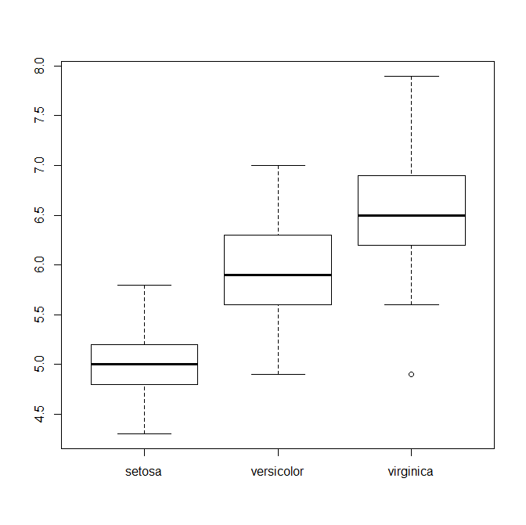
Distribution of x conditioned on y
e.g. Life expectancy as a function of tumor stage?
e.g. chances of winning presidency as a function of vulgarity?
e.g. do iris sepal lengths depend on iris species?
boxplot(ir$seplen~ir$species)

Slide 93
Applying functions to one variable conditioned on another
What are mean/median/maximal sepal length for each iris species?
tapply(ir$seplen,ir$species,mean)
tapply receives three basic parameters: the first parameter is the one whose distribution is of interest to you (typically a continuous variable, e.g. numeric). The second is a factor variable, defining the groups into which variable 1 should be split into. The third parameters is a function which should be applied to the first parameters, as a function of the second.

Slide 94
Goal:
Calculate the mean of sepal and petal width and lengths as a function of species
Output should be in a data frame, containing three rows (for three iris species) and four columns.

Slide 95
Option 1
# Using a for loop. This option requires pre-defining a data.frame # of the correct dimensions prior to the loop
dt=as.data.frame(matrix(1:12,nrow=3))
rownames(dt)=levels(ir$species)
names(dt)=names(ir)[1:4]
for (cl in names(ir)[1:4]) {
for (sp in levels(ir$species)) {
dt[sp,cl]=mean(ir[ir$species==sp,cl])
}
}

Slide 96
Option 2
ll=lapply(levels(ir$species),function(x) {
tt=subset(ir,species==x)
apply(tt[,1:4],2,mean)
})
as.data.frame(do.call(rbind,ll))

Slide 97
Option 3
ll=lapply(names(ir)[1:4],function(cl) {
tapply(ir[,cl],ir$species,mean)
})
do.call(cbind,ll)

Slide 98
Option 4
library(plyr)
ddply(ir,"species",function(x) {
apply(x[,1:4],2,mean)
})

Slide 99
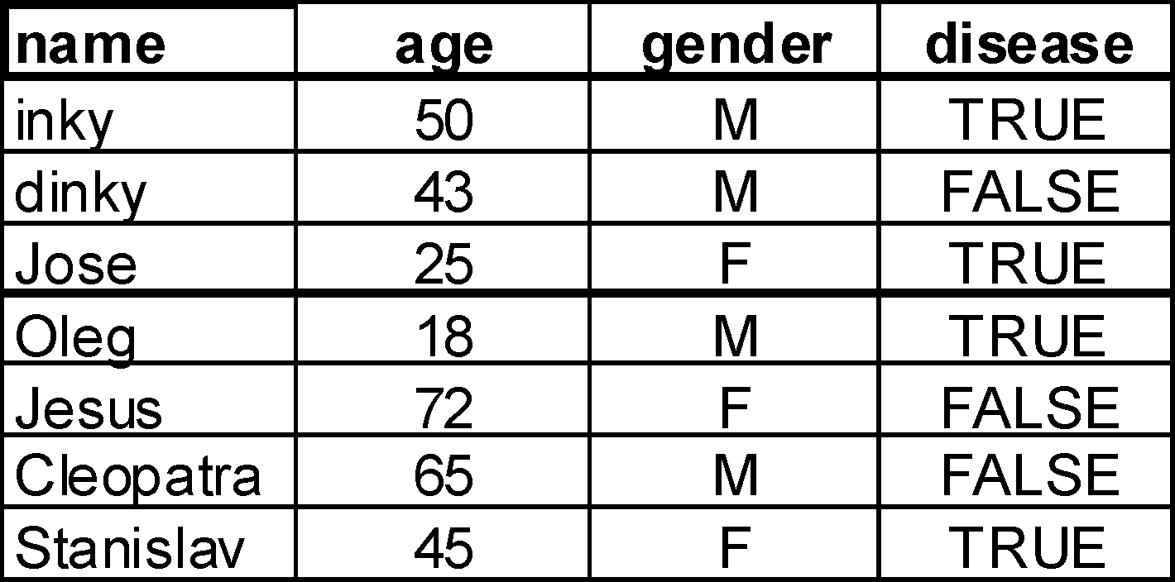
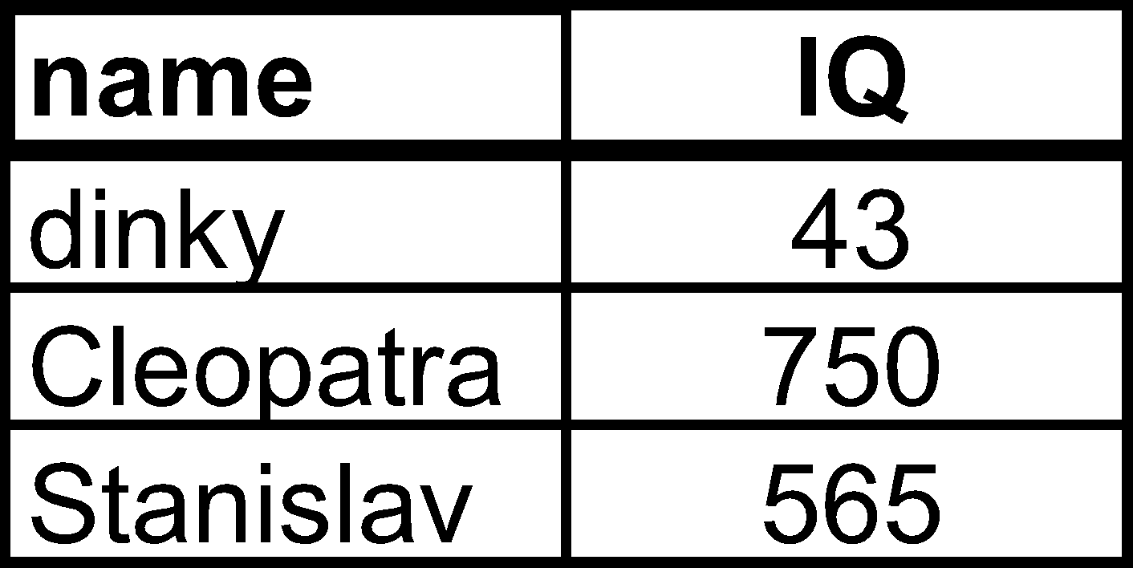
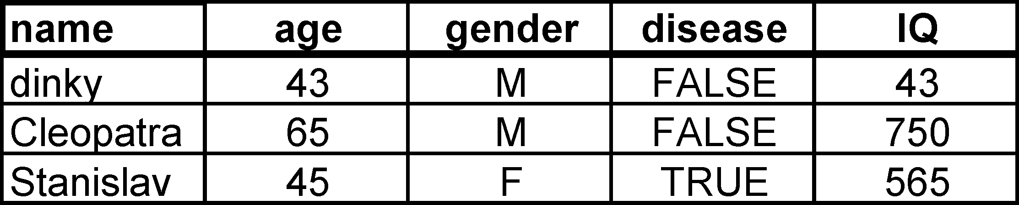
Combining (merging) two tables
a=
b=

Slide 100
merge
ir=iris
names(ir)=c("seplen","sepwid","petlen","petwid","species")
ir$id=paste("id",1:nrow(iris),sep="")
MyObs=data.frame(id=c("id10","id100","id132"),obs=c("Beautiful","Ugly","Beautiful"))
merge(ir,MyObs,by="id")
merge(ir,MyObs)
Note: By default merge will identify the overlapping column name(s) and use them for merging

Slide 101
Merging by more than one variable name
by.x refers to the name of the dataframe in the first argument, by.y to the corresponding name in the second argument.
MyObs3=data.frame(id=c("id10","id100","id132"),species=c("setosa","setosa","virginica"),obs=c("Beautiful","Ugly","Beautiful"))
merge(ir,MyObs3)
merge(ir,MyObs3,by=c("id","species"))
merge(ir,MyObs3,by=c("id"))
merge(ir,MyObs3) #equivalent to by=c("id","species")
merge(ir,MyObs3,by=c("species"))
Note: in cases of multiple matches, all will be returned!!

Slide 102
Merging by different variable names
by.x refers to the name of the dataframe in the first argument, by.y to the corresponding name in the second argument.
MyObs4=data.frame(id2=c("id10","id100","id132"),obs=c("Beautiful","Ugly","Beautiful"))
merge(ir,MyObs4,by.x="id",by.y="id2")
Note: by.x and by.y can receive a vector of arguments, to allow merging based on multiple columns of distinct names between the vectors

Slide 103
How ‘merge’ handles unmatched values
By default they are not returned
use all.x and all.y to control whether they will be returned, with ‘na’ values in the newly added columns
merge(ir,MyObs4,by.x="id",by.y="id2",all.x=T)

Slide 104
rbind, cbind
Combining two data.frames into a single one. Given data.frames a and b:
rbind(a,b) or cbind(a,b)
rbind
cbind
Critical: Dimensions must match, and column names should match for rbind

Slide 105
match() function
MyObs=data.frame(id=c("id10","id100","id132"),obs=c("Beautiful","Ugly","Beautiful"))
relrows=match(MyObs$id,ir$id)
newdt=ir[relrows,]
cbind(newdt,MyObs)

Slide 106
Saving/loading
save(vara,varb,varc,file="path.RData")
load(file="path.RData")
write.table
read.table
read.delim #useful variant of read.table

Slide 107
Organizing your code using Rmarkdown

Slide 108
While we are waiting
Download YeastAnnotation.txt (in the datasets subdirectory) to your favorite work directory.
a=read.delim("YeastAnnotation.txt")

Slide 109
Our goals
Performing efficient textual searches
E.g. find all of the genes annotated with a role in meiosis
Find all genes with a role in DNA repair

Slide 110
grep/grepl
grep(pattern, x) : matches "pattern" in vector x and returns the indices that match
grepl(pattern, x) : matches "pattern" in vector x and returns a logical vector where TRUE = match
grep(pattern, x, ignore.case = FALSE, invert = FALSE, value = FALSE)
value=TRUE 🡪 will return the actual matching substrings and not the indices
invert=TRUE 🡪 returns places where there is no match
fixed=TRUE 🡪 Treats the pattern as a fixed string rather than a regular expression pattern

Slide 111
Examples
grep("meiosis",a$desc)
grep("meiosis",a$desc,value=T)
grep("meiosis",a$desc,value=T,ignore.case=T)
grepl("meiosis",a$desc,value=T,ignore.case=T)
b=a[grep("meiosis",a$desc,ignore.case=T),]

Slide 112
strsplit
Splits a vector of strings into a list, where each entry is a vector of substrings generated by the split
strsplit(x, split)
Returns a list

Slide 113
Examples
strsplit(as.character(a$id),"_")
tRNA=grep("tRNA",a$desc,value=T)
strsplit(tRNA,"-")
How can you extract only the second element?

Slide 114
gsub/sub
Substitute places in a string matching a pattern
gsub(pattern, replacement,x)
sub() – same, but only first instance is replaced

Slide 115
Examples
gsub("id_","",a$id)
gsub("id_", "Gene id: ",a$id)
tRNA=grep("tRNA",a$desc,value=T)
gsub("tRNA-","",tRNA)

Slide 116
Regular expression
The use of “wildcards” to match multiple expression
More complex syntax – Perl or ”extended” (default) expressions in R
An expression is a compound rule that can match 0 or more characters
Can match multiple times in a string
Combination of letters/digits and metacharacters: . \ | ( ) [ { ^ $ * + ?
That means that using these chars regularly requires \\ before the character

Slide 117
Matching metacharacters
. – matches any character
\\d – any digit
\\s – any whitespace – tab/space
\\w – any digit/character/_
\\D, \\S, \\W – the inverse of those (anything but digit etc.)
[..] – character class – any of the characters in the brackets will match
[^..] – anything except those characters
There are some pre-set character collections, like [:lower:]
| - separates various possibilities

Slide 118
Example
grep("RE\\D\\d",a$name2,value=T) #captures all names beginning with RE, followed by anything other than a digit, followed by a digit
grep("meio[st]i[sc]",a$desc,value=T) #will capture both meiosis and meiotic
grep("RP[LS]",a$name2,value=T) #will identify all large and smal ribosomal proteins

Slide 119
Quantifying metacharacters
“Quantifiers”
? – the preceding item will be matched 0 or 1 time
* - the preceding item will be matched 0 times or more
+ - the preceding item will be matched 1 times or more
{n} - The preceding item is matched exactly n times.
{n,} - The preceding item is matched n or more times.
{n,m} The preceding item is matched at least n times, but not more than m times.
Repetitive is greedy – will match the largest number possible. Adding a ? averts that behavior to find the shortest match

Slide 120
Example
grep("YDL\\d+W",a$id,value=T)
grep("YDL[012]{3}[CW]",a$id,value=T)

Slide 121
Neutralizing symbols forming part of regular expressions
Because various characters are considered “special”, if you actually want to search for them you need to neutralize them using two backslashes:
grep("tW\\(CCA\\)",a$name2,value=T)

Slide 122
Binding metacharacters
^ in the beginning – forces the match to start in the beginng of the string
$ in the end – forces the match to end at the end of the string
Both – requires the entire string to match the pattern

Slide 123
Exampe
grep("^RP[LS]",a$name2,value=T) #will identify all large and smal ribosomal proteins

Slide 124
Capturing
library(stringr)
tRNA=grep("^tRNA",a$desc,value=T)
str_match(tRNA,"^tRNA-(\\w+)")

Slide 125
Other string functions
paste (..., sep = " ", collapse = NULL)
paste0(..., collapse = NULL)
toupper(x)
tolower(x)

Slide 126
Basic statistical tests
cor.test(x,y)
cor.test(ir$seplen,ir$sepwid)
t.test()
t.test(ir$seplen,ir$sepwid)
wilcox.test()
wilcox.test(ir$seplen,ir$sepwid)
chisq.test()
chisq.test(table(ir$seplen>3,ir$sepwid<2))

Slide 127
Base Graphics
Base graphics are used most commonly and are a very powerful system for creating 2-D graphics.
The default method for plot is called plot(); this function has many arguments, letting you set the title, x axis and y axis labels, x and y axis limits, etc.
The base graphics system has many parameters that can set and tweaked; these parameters are documented in ?par

Slide 128
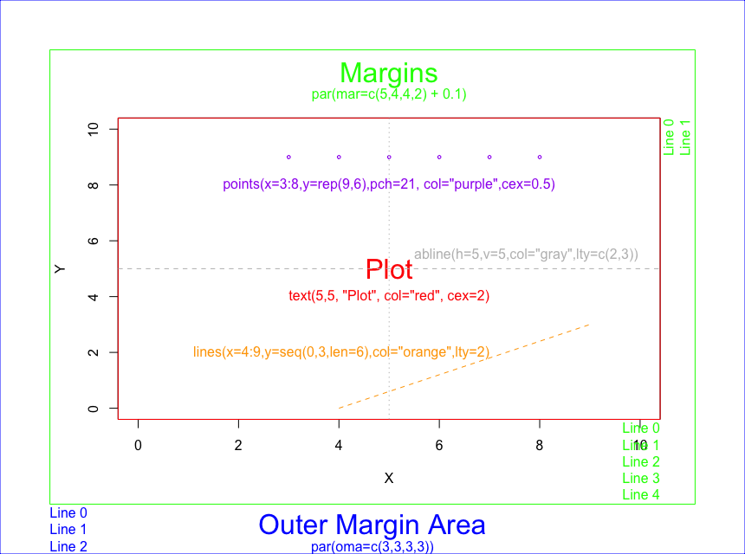
The plotting window

Slide 129
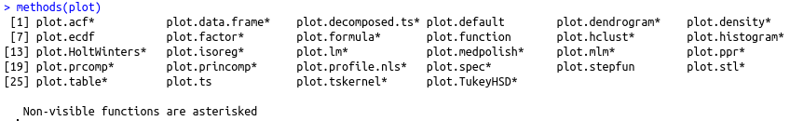
The plot function
The plot function is a generic function like summary()
i.e. results depends on the type of input
plot.default(
x # A matrix of 2 columns or a vector of numeric
y = NULL # if x is a matrix NULL otherwise a vector of numeric
type = "p", # type of plot, ‘p’ data as individual points
xlim = NULL # the x-limits of the plotting region
ylim = NULL # the y-limits of the plotting region
log = "" # should any x/y axis be in log scale
main = NULL # Main title (above plotting region)
sub = NULL # Sub title (below the xaxis)
xlab = NULL # Title of x axis,
ylab = NULL # Title of y axis,
axes = TRUE # draw the axes
panel.first = NULL # Commands to launch before things get drawn
(for example adding a grid)
... # All arguments to par function
)

Slide 130
High and Low-level plotting
High-level function
plot: make a scatterplot with x/y coordinates
(by default if type=‘p’)
hist: make a histogram representing the distribution of one vector
boxplot: distribution of different vectors with a box representation
barplot: make a bar chart
Low-level function
lines: add lines to a plot, given same numbee of x and y values (or a 2-column matrix)
abline: add line to a plot by defining a single value (h or v) or a slope (b) AND an origin (a)
points: add points to a plot using x,y coordinates
text: add text labels to a plot using specified x, y coordinates
title: add annotations to x, y axis labels, title, subtitle, outer margin
mtext: add arbitrary text to the margins (inner or outer) of the plot
axis: adding axis ticks/labels
legend: add a legend to a plot at the specified position
(x,y OR x=keyword for location i.e. x=“topleft”)

Slide 131
Parameters
Most high level functions contain arguments to modify the axis labels (xlab, ylab), plot title (main, sub), and scale of the axis, e.g. xlim, ylim.
It is possible to specify some general parameters (i.e. par() params) in the high-level functions
pch: plotting symbol
lty: line type
lwd: line width
col: plotting color
bg : background color
mar: margin size
oma: outer margin size
cex: size of plotted elements
las: orientation of axis labels
new: plot on top of existing plot

Slide 132
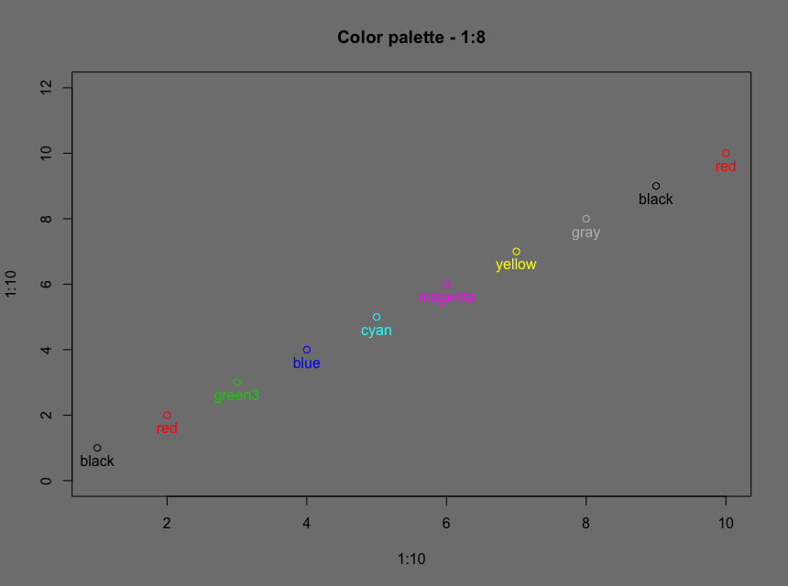
Colors in R
Vector of colors as ‘col’ argument of the plot function
Each point gets attributed a color
10 points vs 8 colors
Colors are recycled if not enough colors in the vector
par(bg='grey50')
plot(x=1:10,y=1:10,main="Color palette - 1:8",col=1:8,ylim=c(0,12))
text(x = 1:10, y = 1:10, pos = 1, labels=palette(),col=1:8)

Slide 133
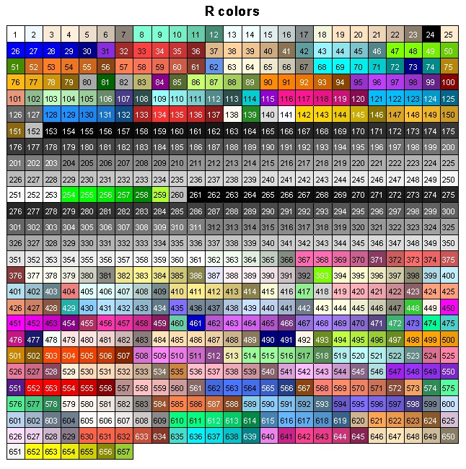
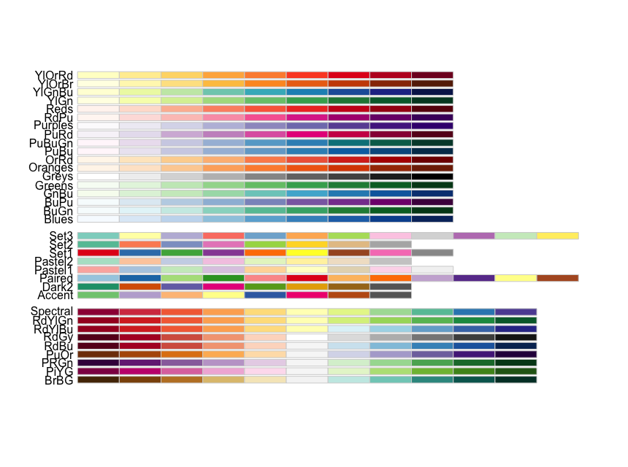
Default Color Palettes
colors() : colors by names
library(RColorBrewer) display.brewer.all()
mypal=brewer.pal(name="Set1",n=9)
grep(x=colors(),"blue", val=T)
# color names containing ‘blue’
example(colors) # defines plotCol
plotCol(“blue”) # plot a color

Slide 134
Changing colors sets
plot(ir$seplen,ir$sepwid,col=as.numeric(ir$species))
cols=brewer.pal(3,name="Set1")
Supplying different cols
plot(ir$seplen,ir$sepwid,col=cols[as.numeric(ir$species)])
Change the pallete
palette(cols)
plot(ir$seplen,ir$sepwid,col=as.numeric(ir$species))

Slide 135
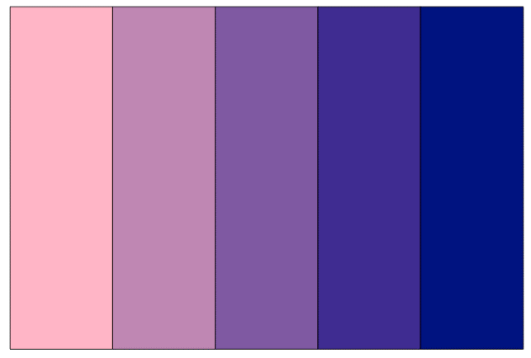
Custom Color Palettes
colorRampPalette() : creates a gradient between a vector of colors
# Define the color ramp (returns a function object)
ramp <- colorRampPalette(c("pink1", "navy"))
# Plot the color ramp
barplot(rep(1, 5), axes = FALSE, space = 0, col = ramp(5))

Slide 136
Working with Graphics Devices
Calling plot(x, y) will launch a graphics device and draw the plot on the device
Other plotting functions : hist(), barplot(), boxplot()
jpeg(), pdf(), png(): Print devices (output to a file)
dev.list(): List all devices open
quartz(): Open a new device
dev.off(): Turn off the current device
graphics.off() : Turn off all open devices
pdf(file = ’example.pdf', # Filename
title = ’tutorial plot’, # Title
pointsize = 10, # Adjust the size of everything
height = 8, width = 8 # Dimensions of the figure in inches
)
plot(…)
dev.off() # To close the pdf file

Slide 137
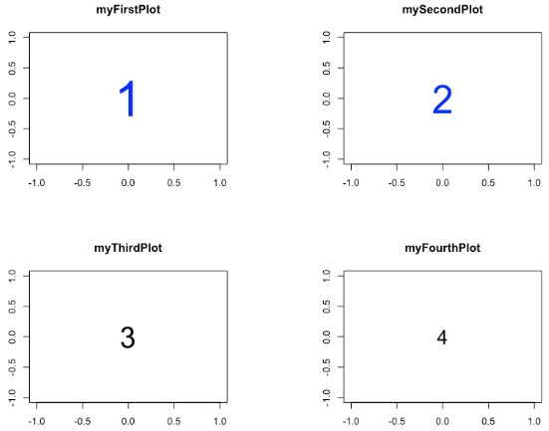
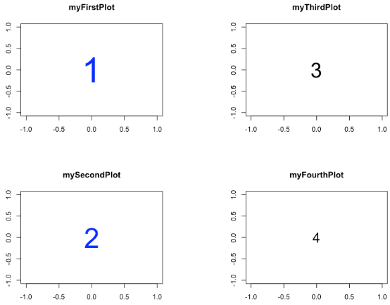
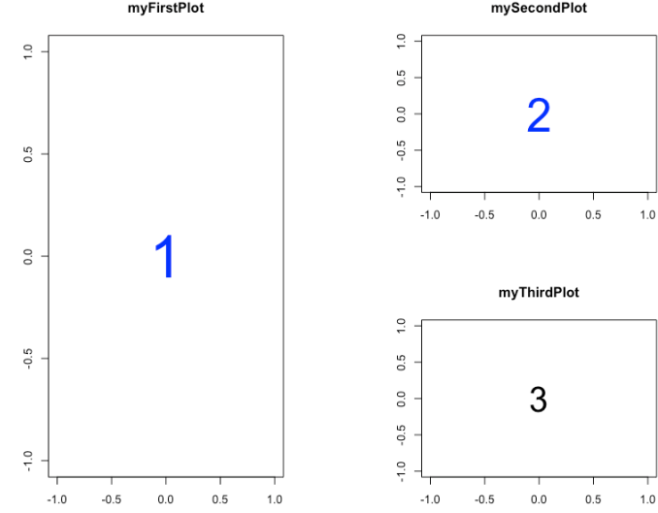
Make multiple plot figure
Symmetric layout of plots (n by n):
par(mfrow=c(2,2)) : display plot by column
par(mfcol=c(2,2)) : display plot by row
Asymmetric layout of plots:
mat=matrix(c(1,1,2,3),nrow=2,ncol=2)
[,1][,2]
[1,] 1 2
[2,] 1 3
layout(mat)

Slide 138

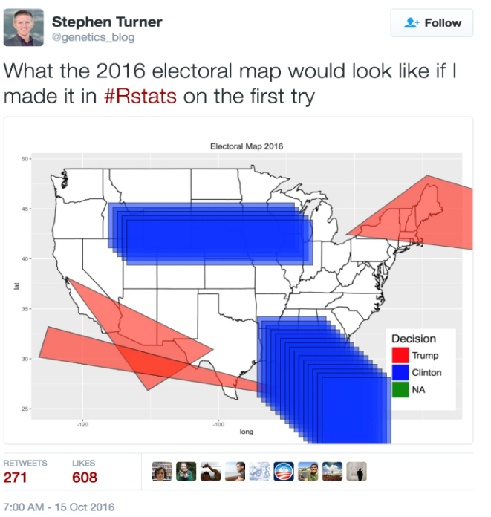
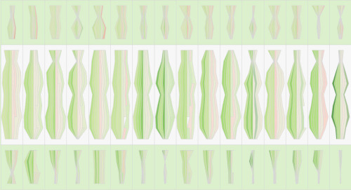
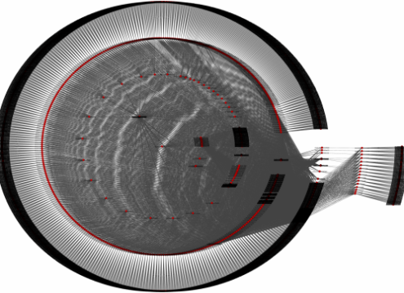
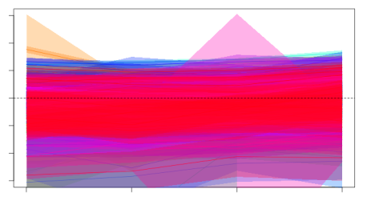
Want to get Rcoholic ?
http://blog.revolutionanalytics.com/
http://accidental-art.tumblr.com/
http://www.r-graph-gallery.com/
https://mran.microsoft.com/open/

Slide 139
Converting class of variables
as.data.frame #e.g. matrix -> data.frame
as.numeric #e.g. character to numeric
as.factor #e.g. character to factor
unlist #makes a vector from a list
nn=unlist(lapply(ll,mean))
nn=as.numeric(lapply(ll,mean))

Slide 140
Applying functions to one variable conditioned on another
What are mean/median/maximal sepal length for each iris species?
tapply(ir$seplen,ir$species,mean)
tapply receives three basic parameters: the first parameter is the one whose distribution is of interest to you (typically a continuous variable, e.g. numeric). The second is a factor variable, defining the groups into which variable 1 should be split into. The third parameters is a function which should be applied to the first parameters, as a function of the second.

Slide 141
Distribution of x conditioned on y
e.g. Life expectancy as a function of tumor stage?
e.g. chances of winning presidency as a function of vulgarity?
e.g. do iris sepal lengths depend on iris species?
boxplot(ir$seplen~ir$species)

Slide 142
The merge() function
a=
b=
merge(a,b,by="name") OR merge(a,b,by.x="name",by.y="name")

Slide 143
Merging two dataframes
ir$id=paste("id",1:nrow(ir),sep="_") #defining a unique id
moreinfo=data.frame(id=paste("id",c(10,14,22,45),sep="_"),viability=c("dead","alive","dead","dead"),state=c("horrible","disastrous","admirable","disastrous")) #generating a new data.frame with addition information
ir1=merge(ir,moreinfo)
ir2=merge(ir,moreinfo,all.x=T)

Slide 144
Cross-tabulation of data
table(ir$seplen>6,ir$petlen>3.5)
FALSE TRUE
FALSE 55 34
TRUE 0 61

Slide 145
Class 5
Schraga Schwartz & Yaron Antebi
Weizmann Institute of Science
Teaching assistants:
Hugo Schwenke, Yaara Finkel & Batsheva Frankel-Rozman

Slide 146
Saving/loading
save(vara,varb,varc,file="path.RData")
load(file="path.RData")
write.table
read.table
read.delim #useful variant of read.table

Slide 147
Working with Graphics Devices
Calling plot(x, y) will launch a graphics device and draw the plot on the device
Other plotting functions : hist(), barplot(), boxplot()
jpeg(), pdf(), png(): Print devices (output to a file)
graphics.off() : Turn off all open devices
pdf(file = ’example.pdf', # Filename
title = ’tutorial plot’, # Title
pointsize = 10, # Adjust the size of everything
height = 8, width = 8 # Dimensions of the figure in inches
)
plot(…)
graphics.off() # To close the pdf file

Slide 148
Organizing your code using Rmarkdown

Slide 149
Debugging your code
Finding your bug is a process of confirming the many things that you believe are true — until you find one which is not true.
—Norm Matloff
If debugging is the process of removing software bugs, then programming must be the process of putting them in.
- Edsger Dijkstra

Slide 150
Some general thoughts
Googling cryptic error messages
Reproducing errors via minimal code
“The most effective debugging tool is still careful thought, coupled with judiciously placed print statements” (Brian Kernighan)
Identifying source of error – traceback()
Stepping into code – browser(), debug mode

Slide 151
Example
Loading a data frame of measurements: Two different conditions, four replicates each
m=read.delim("Measurements_for_debugging.txt")

Slide 152
Calculating a P value
GetPVal=function(x) { t.test(x[1:4],x[5:8])$p.value } vals=apply(m,1,function(x) { GetPVal(x) })

Slide 153
Where did things go wrong?
traceback()

Slide 154
How to debug?
Option 1: Something is off about the function.
How does one step into a function?
browser()
debugonce(GetPVal)
Adding breakpoints

Slide 155
The bug is not in the function. But somewhere in the data. How to find it?
Judicious “print” messages
Debug->On Error->Break In Code

Slide 156
tryCatch() – a wrapper of a function
GetPValV2=function(x) { tryCatch(t.test(x[1:4],x[5:8])$p.value,
error=function(e) {
warning(e);
print(paste(x,collapse=","));
return(NA) }) }

Slide 157
Reload the iris dataset
#set work directory to the directory in which you stored the dataset
setwd("C:/Local/Labstuff/R course/2018Course")
#read-in the dataset
ir=read.table(file="iris_dataset.txt",sep="\t",header=T) #loads iris_dataset.txt into variable "ir". Assumes that the file is tab delimited, and that the first line is a header.

Slide 158
What is ggplot2?
ggplot2 is a data visualization package for R.
ggplot2 is an implementation of Leland Wilkinson's Grammar of Graphics —a general scheme for data visualization which breaks up graphs into semantic components such as scales and layers.

Slide 159
Advantages of ggplot2
Generates beautiful, annotated plots
Supports visualization of complex plots
Single ‘philosophy’ capturing all types of plots

Slide 160
Disadvantages of ggplot2
Initially less intuitive
Generating simple plots can require slightly more complex code
Figuring out how to tweak defaults is not trivial

Slide 161
Grammar of graphics
The basic idea: independently specify plot building blocks:
data
aesthetic mapping
geometric object
statistical transformations
scales
coordinate system
position adjustments
faceting

Slide 162
To use ggplot2
install.packages("ggplot2")
library("ggplot2")

Slide 163
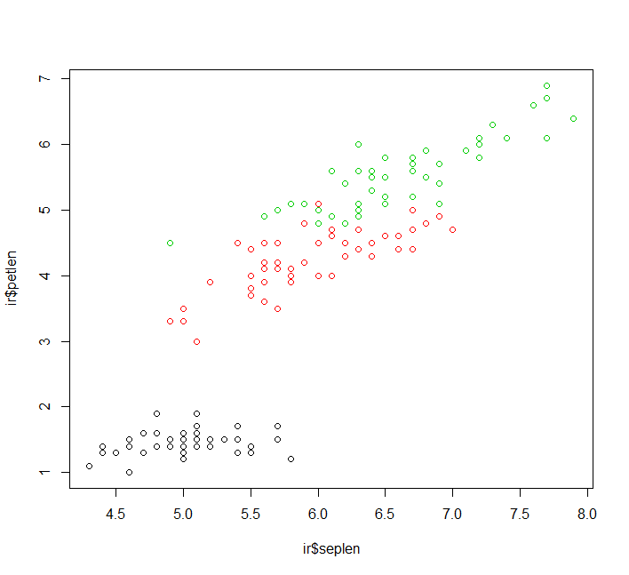
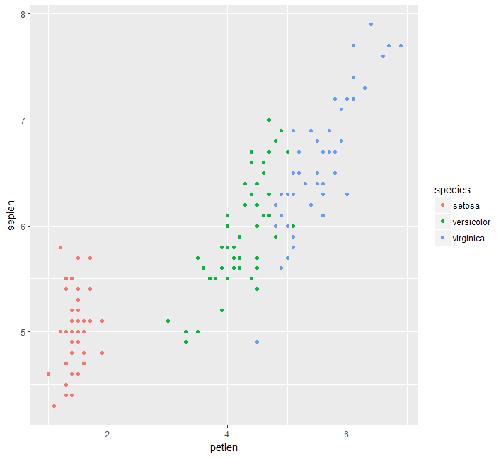
Some examples
plot(ir$seplen,ir$petlen,col=ir$species)
ggplot(data=ir,aes(x=petlen,y=seplen,col=species))+geom_point()

Slide 164
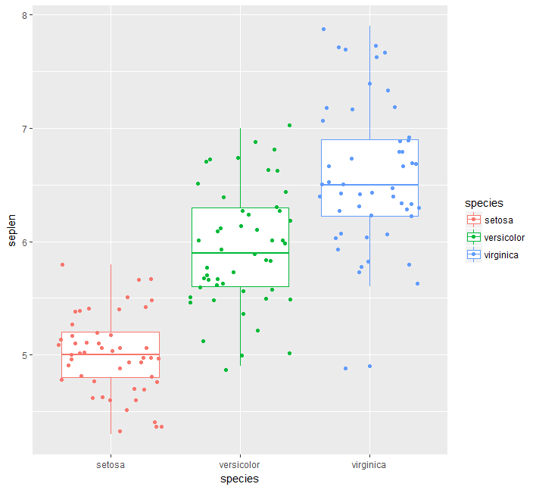
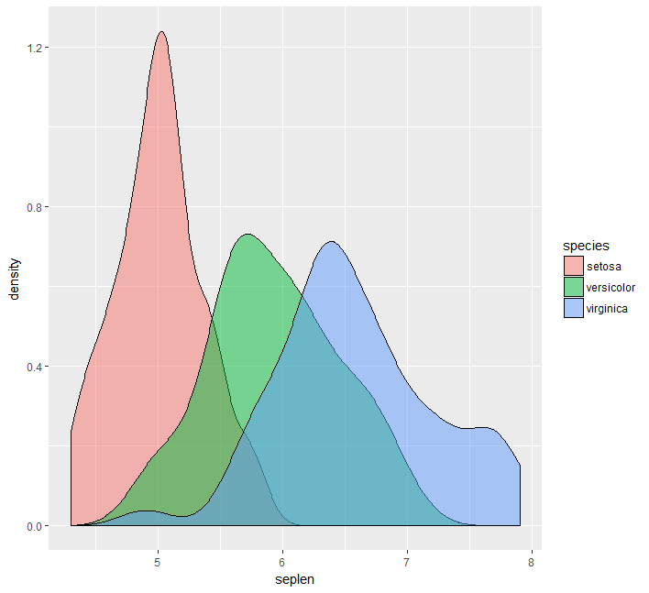
Identical data – but a different representation

Slide 165
Building blocks of a ggplot?
1. Aesthetics (aes)
2. Geometric Objects (geom)
3. Statistical Transformations (stat)
4. Scales
5. Faceting
6. Themes

Slide 166
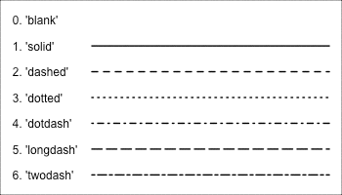
Aesthetics and geometric Objects: Mapping aesthetics
Aesthetic mappings are set with the aes( ) function
Position (x and y)
Color (outline color)
Fill
Shape (point shapes )
Line type
Size
Each geom accepts only a subset of all aesthetics

Slide 167
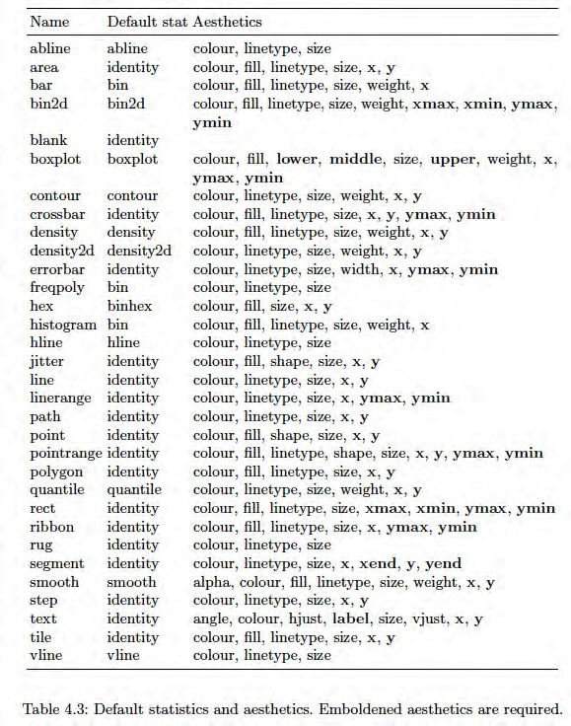
*From Hadley Wickham’s excellent book Elegant Graphics for Data Analysis

Slide 168
Aesthetics and geometric Objects: Geometric objects
Geoms are the ways of representing marks on a plot
Points (geom_point: dot plots, scatter plots)
Lines (geom_line: trend lines, timeseries)
Boxplot (geom_boxplot)
At least one geom is required (no upper limit)
Geoms are added to the plot using the + operator

Slide 169
Some examples
ggplot(data=ir,aes(x=petlen,y=seplen,col=species))+geom_point()

Slide 170
Some examples
ggplot(data=ir,aes(x=species,y=seplen,col=species))+geom_boxplot()+geom_jitter()

Slide 171
Some more examples
ggplot(data=ir,aes(x=seplen,col=species))+geom_density()
ggplot(data=ir,aes(x=seplen,col=species))+geom_density()+geom_jitter(aes(y=0.2))
ggplot(data=ir,aes(x=seplen,fill=species))+geom_density(alpha=0.5)

Slide 172
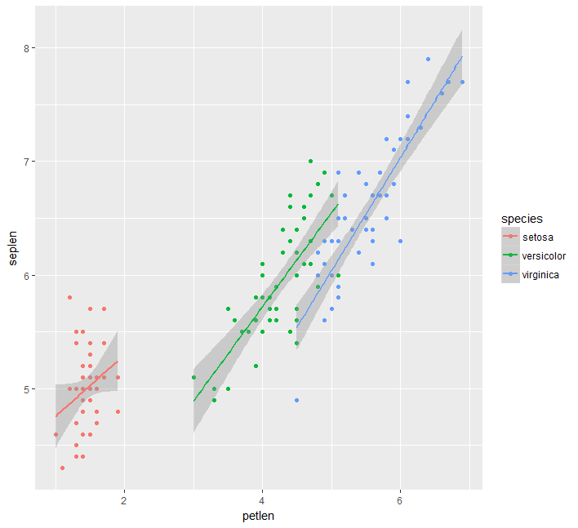
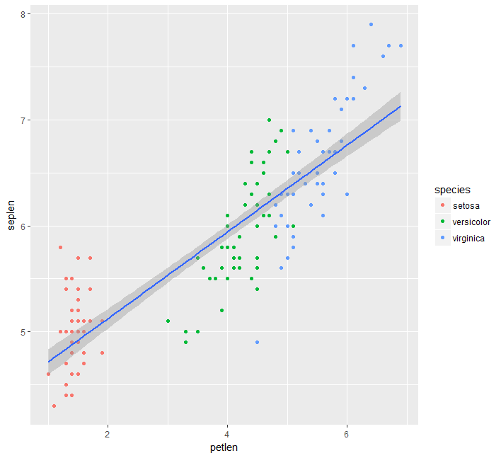
Some examples
ggplot(data=ir,aes(x=petlen,y=seplen,col=species))+geom_point()+geom_smooth(method="lm") #linear model performed for each group separately
ggplot(data=ir,aes(x=petlen,y=seplen))+geom_point(aes(col=species))+geom_smooth(method="lm") #lm for entire dataset

Slide 173
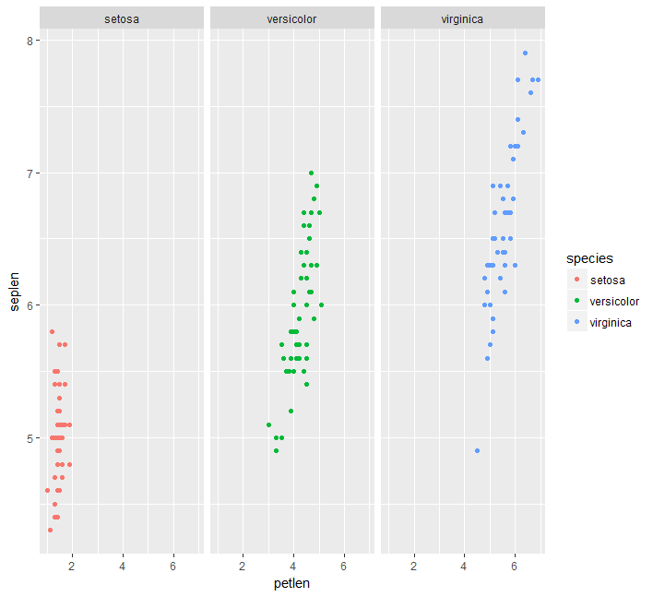
Some examples
ggplot(data=ir,aes(x=petlen,y=seplen,col=species))+geom_point()+facet_wrap(~species)

Slide 174
Themes: rapid adjustment of visualization style
p=ggplot(data=ir,aes(x=petlen,y=seplen,col=species))+geom_point()+facet_wrap(~species)
p+theme_bw()
p+theme_classic()
p+theme_minimal()

Slide 175
Saving a ggplot
ggsave("plotname.pdf",plot=p) #if plot parameter is not defined, the last generated plot will be saved

Slide 176
While we are waiting
Download YeastAnnotation.txt (in the datasets subdirectory) to your favorite work directory.
a=read.delim("YeastAnnotation.txt")

Slide 177
Our goals
Performing efficient textual searches
E.g. find all of the genes annotated with a role in meiosis
Find all genes with a role in DNA repair

Slide 178
grep/grepl
grep(pattern, x) : matches "pattern" in vector x and returns the indices that match
grepl(pattern, x) : matches "pattern" in vector x and returns a logical vector where TRUE = match
grep(pattern, x, ignore.case = FALSE, invert = FALSE, value = FALSE)
value=TRUE 🡪 will return the actual matching substrings and not the indices
invert=TRUE 🡪 returns places where there is no match
fixed=TRUE 🡪 Treats the pattern as a fixed string rather than a regular expression pattern

Slide 179
Examples
grep("meiosis",a$desc)
grep("meiosis",a$desc,value=T)
grep("meiosis",a$desc,value=T,ignore.case=T)
grepl("meiosis",a$desc,value=T,ignore.case=T)
b=a[grep("meiosis",a$desc,ignore.case=T),]

Slide 180
strsplit
Splits a vector of strings into a list, where each entry is a vector of substrings generated by the split
strsplit(x, split)
Returns a list

Slide 181
Examples
strsplit(as.character(a$id),"_")
tRNA=grep("tRNA",a$desc,value=T)
strsplit(tRNA,"-")
How can you extract only the second element?

Slide 182
gsub/sub
Substitute places in a string matching a pattern
gsub(pattern, replacement,x)
sub() – same, but only first instance is replaced

Slide 183
Examples
gsub("id_","",a$id)
gsub("id_", "Gene id: ",a$id)
tRNA=grep("tRNA",a$desc,value=T)
gsub("tRNA-","",tRNA)

Slide 184
Regular expression
The use of “wildcards” to match multiple expression
More complex syntax – Perl or ”extended” (default) expressions in R
An expression is a compound rule that can match 0 or more characters
Can match multiple times in a string
Combination of letters/digits and metacharacters: . \ | ( ) [ { ^ $ * + ?
That means that using these chars regularly requires \\ before the character

Slide 185
Matching metacharacters
. – matches any character
\\d – any digit
\\s – any whitespace – tab/space
\\w – any digit/character/_
\\D, \\S, \\W – the inverse of those (anything but digit etc.)
[..] – character class – any of the characters in the brackets will match
[^..] – anything except those characters
There are some pre-set character collections, like [:lower:]
| - separates various possibilities

Slide 186
Example
grep("RE\\D\\d",a$name2,value=T) #captures all names beginning with RE, followed by anything other than a digit, followed by a digit
grep("meio[st]i[sc]",a$desc,value=T) #will capture both meiosis and meiotic
grep("RP[LS]",a$name2,value=T) #will identify all large and smal ribosomal proteins

Slide 187
Quantifying metacharacters
“Quantifiers”
? – the preceding item will be matched 0 or 1 time
* - the preceding item will be matched 0 times or more
+ - the preceding item will be matched 1 times or more
{n} - The preceding item is matched exactly n times.
{n,} - The preceding item is matched n or more times.
{n,m} The preceding item is matched at least n times, but not more than m times.
Repetitive is greedy – will match the largest number possible. Adding a ? averts that behavior to find the shortest match

Slide 188
Example
grep("YDL\\d+W",a$id,value=T)
grep("YDL[012]{3}[CW]",a$id,value=T)

Slide 189
Neutralizing symbols forming part of regular expressions
Because various characters are considered “special”, if you actually want to search for them you need to neutralize them using two backslashes:
grep("tW\\(CCA\\)",a$name2,value=T)

Slide 190
Binding metacharacters
^ in the beginning – forces the match to start in the beginng of the string
$ in the end – forces the match to end at the end of the string
Both – requires the entire string to match the pattern

Slide 191
Example
grep("^RP[LS]",a$name2,value=T) #will identify all large and smal ribosomal proteins

Slide 192
Capturing
library(stringr)
tRNA=grep("^tRNA",a$desc,value=T)
str_match(tRNA,"^tRNA-(\\w+)")

Slide 193
Other string functions
paste (..., sep = " ", collapse = NULL)
paste0(..., collapse = NULL)
toupper(x)
tolower(x)

Slide 194
Feedback on part 1 of R course?
Pace
Content
Delivery
...

