Slide 1

Class 1
Schraga Schwartz, Igor Ulitsky & Yaron Antebi
Weizmann Institute of Science
Teaching assistants:
Einav Somech, Edo Kiper & Rotem Tal

Slide 2
To do:
Download & Install R:
https://cran.r-project.org/bin/windows/base/
Download & Install Rstudio:
https://www.rstudio.com/products/rstudio/download/#download
Download this presentation:
https://tinyurl.com/WeizmannRcourse2023/

Slide 3
Why ?

Slide 4


Slide 5

R’s strengths
Data management & manipulation
Interactive
Statistics
Graphics
Programming language
Active user community
Free!

Slide 6
R’s weakness
Not so user friendly
Minimal GUI.
No commercial support
Substantially slower than programming languages (e.g. perl, java, C++).

Slide 7
(Usually crappier) alternatives to R
Excel
Matlab

Slide 8
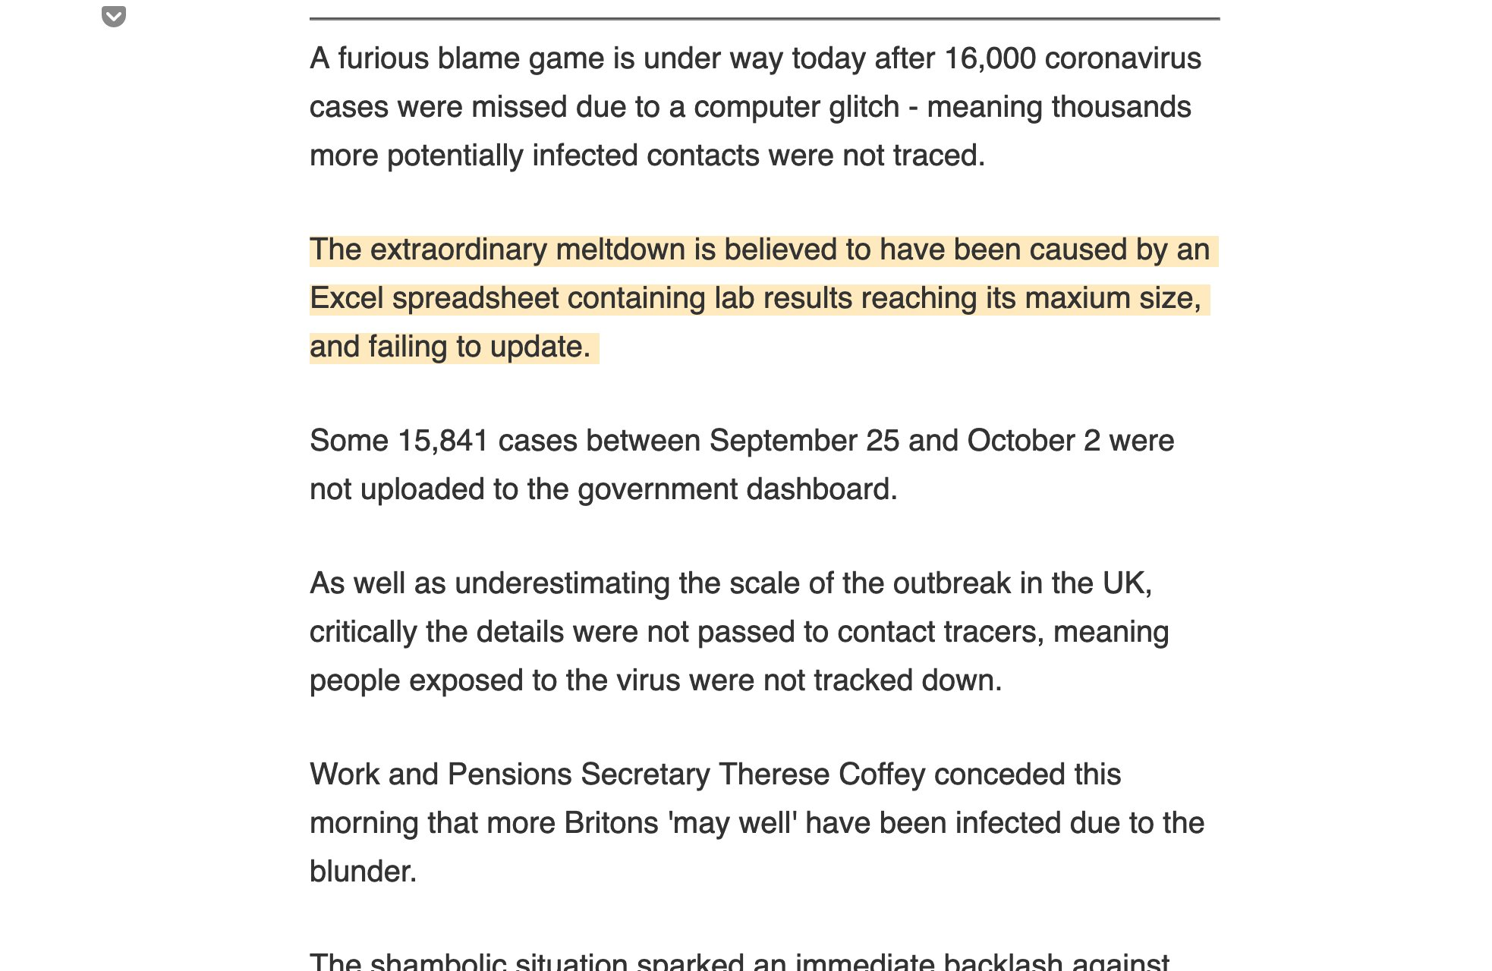
Microsoft Excel is a Sin Against Science

Slide 9
Alternatives that can have advantages with respect to R:
C++/Java
Python

Slide 10

Things that you should learn yourself (at some point)
Basic UNIX commands
Pipelines and automation
Basic scientific art
Basic software installation etc.

Slide 11
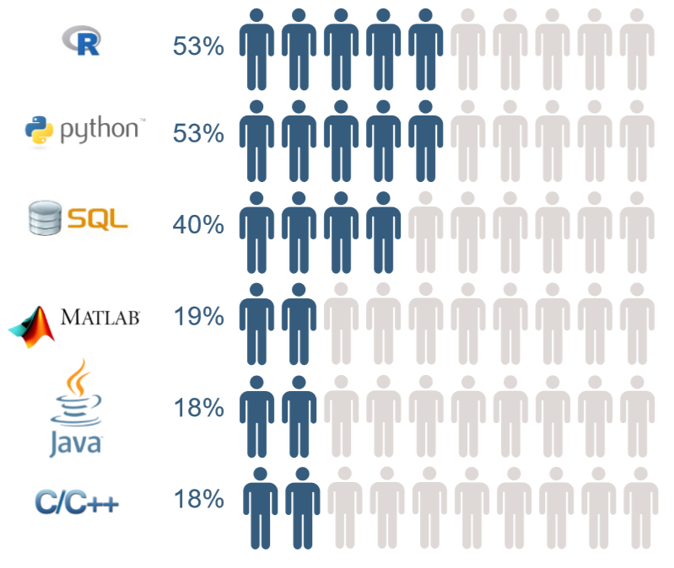
How to get data science & machine learning/AI jobs

Slide 12
When does R (typically) come into the picture?
Data in a table format

Slide 13
Goals in this course
Programing in R (Schragi)
Genomic and multidimensional data analysis (Schragi)
Data modelling and statistical analysis (Yaron)

Slide 14
The course will be of little use if you:
Don’t make it to classes
Don’t carry out the assignments
Don’t plan to do some analysis of data over the next year

Slide 15
Course Requirements
Small weekly exercise. Qualitative grading scheme. No individual feedback. Submission mandatory.
Two larger exercises (mid & end of semester). Quantitative grading, with corrections.
Tutorials: Tuesday, 12:00 - 14:00
Attendance NOT mandatory.
Full description: here

Slide 16

chatGPT?
chatGPT use is strictly forbidden for mid and final exercises

Slide 17


InstRuctors
Einav Somech
Edo Kiper
Rotem Tal

Slide 18
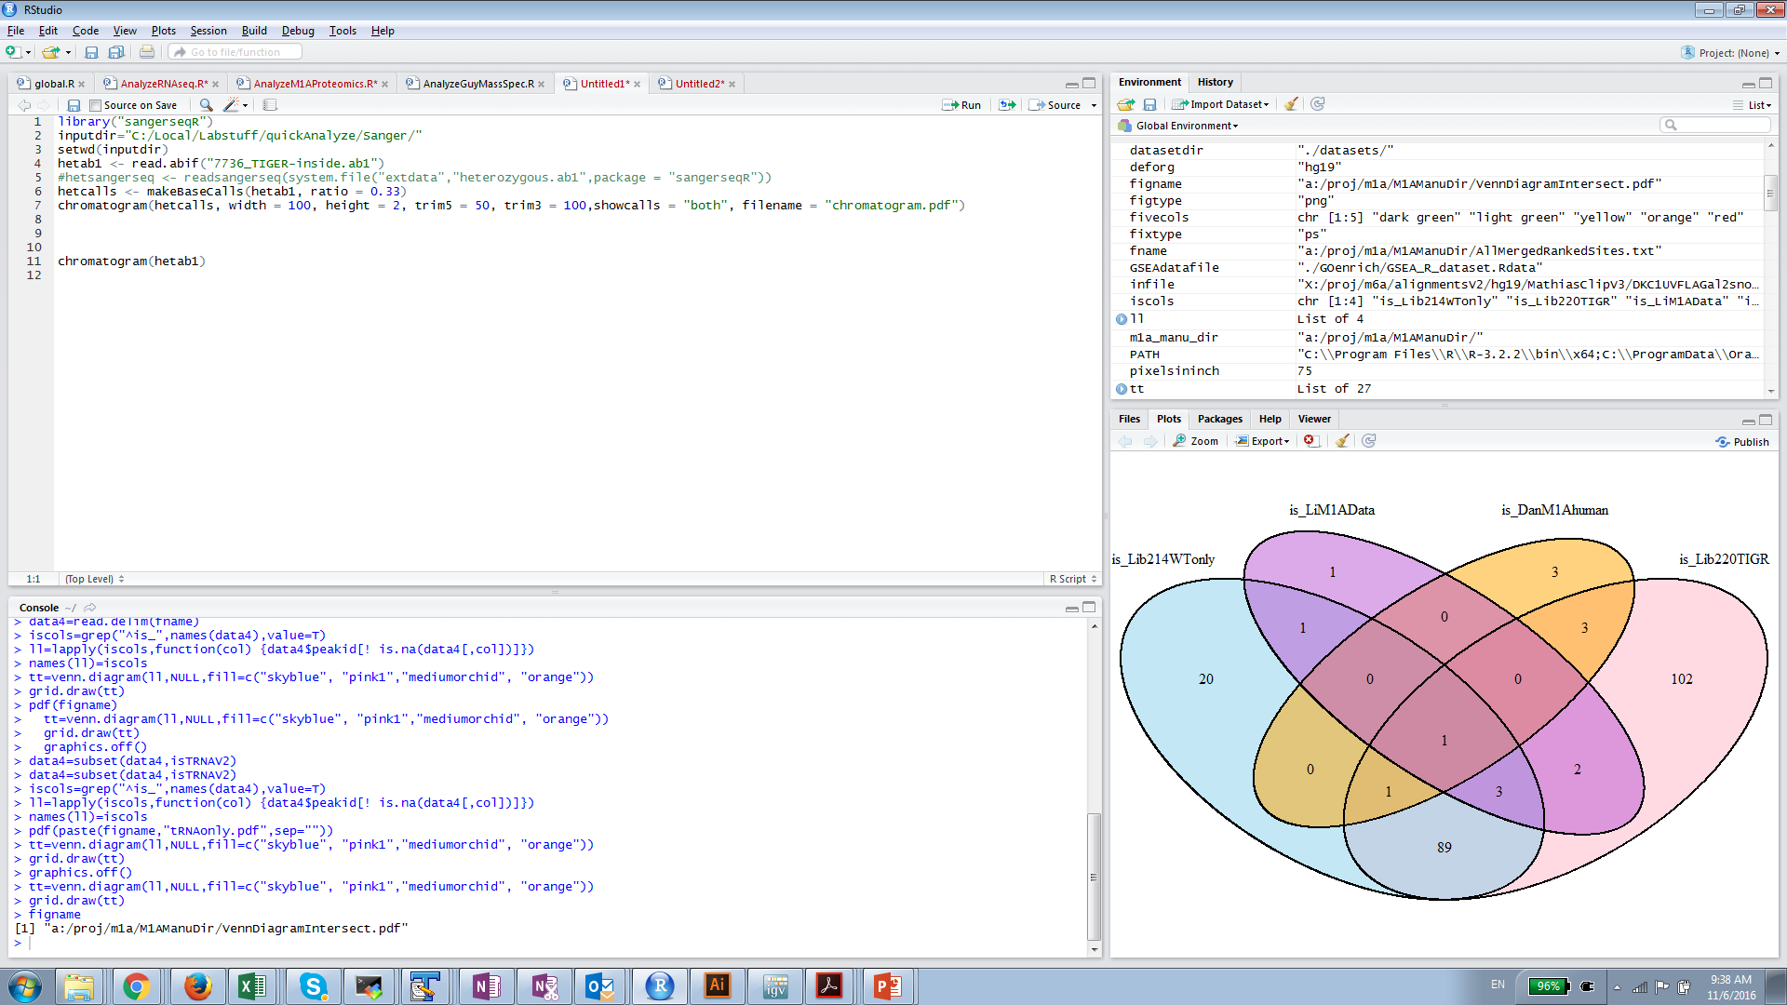
Rstudio: The working environment for R

Slide 19
How
?

Slide 20
R as a calculator
Calculator
+, -, /, *, ^, log(), exp(), sqrt(), …:
(17*0.35)^(1/3)
log(10)
exp(1)
3^-1

Slide 21
Variables in R
Variables are assigned using either “=“ or “<-”
x=12.6
x
[1] 12.6

Slide 22
Classes
Different variables can be of different classes (e.g. numeric, character, logical)

Slide 23
Vector
A vector is a sequence of data elements of the same type (e.g. a sequence of numbers, or a sequence of characters).

Slide 24
Creating a numeric vector
Such a vector may be created:
1. Using the c() (short for concatenate) function:
y=c(3,7,9,11)
> y
[1] 3 7 9 11
2. Using the rep(what,how_many_times) function:
y=rep(3,30)
3. Using the “:” operator, signifiying “a series of integers between”
y=1:30

Slide 25
Logical (Boolean) vectors
A boolean variable can be either TRUE or FALSE.
b=c(TRUE,FALSE,TRUE,FALSE,TRUE,TRUE)
Notes:
compare output of summary for numerics vs. factors

Slide 26
Vector manipulation
n=c(1,4,5,6,7,2,3,4,5,6) #creates a vector with the numbers in the brackets, stores it in y
length(n) #number of elements
n[3] #extract 3rd element in y
n[-2] #extract all of y but 2nd element
n[1:3] #extract first three element of y
n[c(1,3,4)] #extract first, third, and fourth element of y

Slide 27
Vector manipulation…
n+1 #add 1 to all elements in y
n*2 #multiply by two all elements in y
sum(n)
mean(n)
median(n)
var(n)
min(n)
max(n)
log(n) #extract logs from all variables in y

Slide 28
Functions in R
- Functions are chunks of code which (can) receive something as input (termed: arguments), and (can) produce something as output (termed: return value).
A function can be recognized by the round brackets "()" following the function name.
The arguments of the "mean" function is a vector of numbers; the return value is their average.

Slide 29
Basic visualization of numbers
barplot(n)
plot(n)
hist(n)
boxplot(n)
pie(n)

Slide 30
barplot(n,col="red")

Slide 31
plot(n,col="red")

Slide 32
hist(n,col="red")

Slide 33
boxplot(n,col="red")

Slide 34
pie(n[1:3])

Slide 35

Help in R
Click ? + function_name.
? barplot
Help pages contain the following components:
function_name(package) – if the package is not installed, this is the time to install it and call it (using "library")
Description: brief overview
Usage
Description of arguments (input)
Details: more information
Value: value returned by the function (output)
See also: great way to learn new stuff you didn't even know you wanted to do!
Examples: Can be copy-pasted as is! Highly informative!

Slide 36
Other vectors
Character vectors:
n=1:7
nms=c("miriam","schragi","chaim","jochanan","ephraim","avraham","yemima")
names(n)=nms #giving names to each value in numeric vector y
n["schragi"]
Class Exercise: Redraw some of the previous plots with modified n!

Slide 37
The paste() function
Concatenates different characters into a single character, separated by the variable defined by sep argument (default: sep=" ")
paste("To","err","is human.","To R is","divine!",sep="_")

Slide 38
Factor vectors (We love factors!)
f=as.factor(c("stupid","stupid","smart","stupid","imbecile","smart","smart","imbecile"))
levels(f) #possible values a variable in y can have
summary(f) #provides the number of time each factor occurs
Class Exercise: Compare summary(n), summary(b), and summary(f) – note difference in output!

