Slide 1

Assessed values for individual residential properties sold in Ames, Iowa from 2006 to 2010
Babu Dawadi
Feb 20, 2022

Slide 2

Agenda
Background of dataset and purpose of the presentation
Analyze the dataset data contains information from the Ames Assessor’s Office used in computing assessed values for individual residential properties sold in Ames, IA from 2006 to 2010
Identify the main factors which affect the property values
Visualize the relationships of Above median (Yes/No) with different variables considered on the assessment process.
Recommend which factors to check when purchasing residential property in city of Ames.

Slide 3
Most Important Variables that affect house prices Above Median
Original construction year
Remodeling or additions year
Total square feet of basement area
First Floor square feet
Above grade (ground) living area square feet
Size of garage in square feet
Zoning classification
Type of dwelling involved
Neighborhood
Overall material and finish of the house
Exterior covering on house
External Quality of the house
Basement Quality
Heating Quality
Number of full bathrooms
Kitchen Quality
Total room above ground
Number of fireplaces
Garage type (location)
Size of garage in car capacity
Note: We will visually check the affect of some of the above listed variables with housing price Above median (Yes/No).

Slide 4
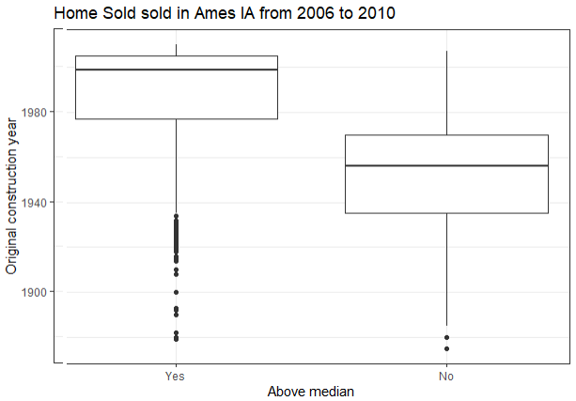
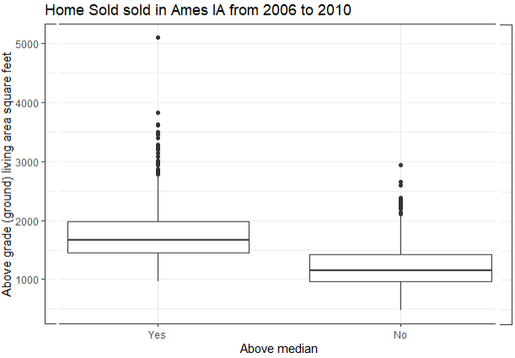
Comparison of Above medium Home price with some of the important variables
As seen in first box plot, Newer homes have above median prices.
As seen in second box plot, greater square footage houses have above median prices.

Slide 5
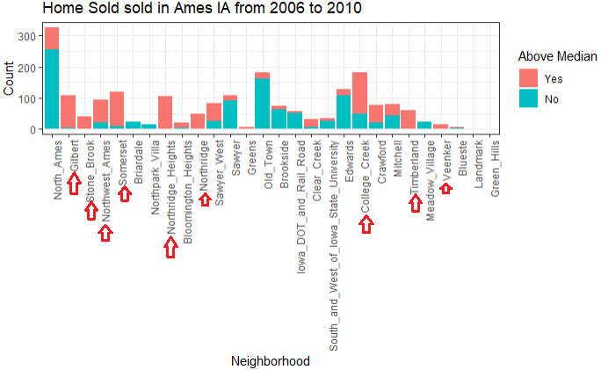
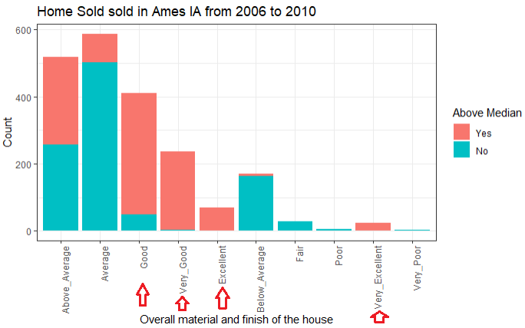
Compare additional variables
As seen in the Bar diagram (Above), certain neighborhoods have housing prices above median, Example: Northridge Heights, Gilbert, Summerset, Timberland etc.
Overall quality of the house (Left) is very important. Good, very good, excellent and very excellent condition houses tend to have above median prices.

Slide 6
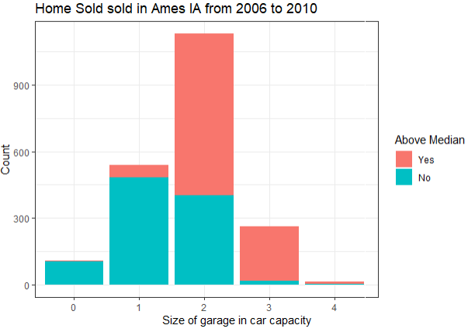
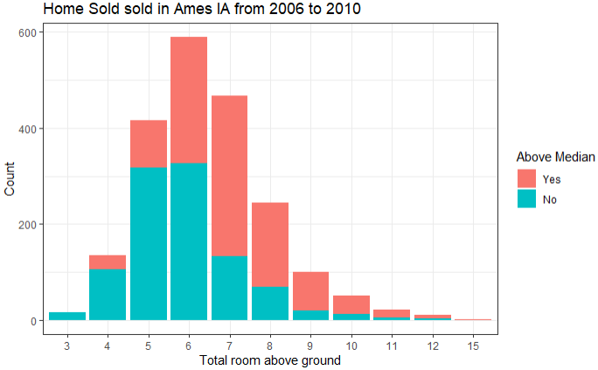
Comparison Continues
As seen in the Bar diagram (Above), size of car garage matters. The bigger garage (more car capacity), the greater chance of housing prices to be above median.
Number of rooms which reflects size of the house. As the number of total rooms above ground increases there is higher chances of housing prices to be above median (left).

Slide 7

Conclusion
There are 2930 observations and 82 variables in Ames dataset and almost every variable assessed have contributed certain role in the housing prices. In some cases, the buyers may have their preference what type of home they are willing to purchase. Some variables have more impact on housing prices than the others.
Home buying process is stressful specially for first time home buyers. So, they have to make sure they are paying reasonable amount compared to others. For example, you probably do not want to pay above median home value in old town neighborhood. So, this dataset Ames is very useful for Ames, Iowa home buyers.
When analyzing thoroughly variables like original construction year, remodeling year, size of the house, condition of the house, the neighborhood, quality of the material/appliances used, zoning, HVAC quality, Exterior covering and its material quality, number of bathrooms, Garage capacity and type, fireplaces, kitchen quality seem to make more influence on the housing prices.
It is recommended to look into all the variables that influence more in the housing prices. In addition to mentioned variables, one should check crime rate, school ratings, traffic, amenities etc.
Thank you !!

