Slide 1

KIBO
希望

Slide 2
Workshop Real Life Statistic
Despite intensive market challenges, Mitsubishi Motors successfully increased its commercial footprint. This high-volume acquisition means that the cumulative pool of vehicles requiring downstream service compounding grows exponentially year-over-year.
8.5%
National Market Share achieved in Indonesia (2025)
70,000+
Retail Sales Units recorded within a single calendar year
297
Total Authorized Dealers & Service Centers nationwide
Mitsubishi relies on a network of just 297 authorized centers to service the entire national fleet; Out of these 297 locations, not all facilities are equipped to handle complex mechanical services, paint, or advanced component repairs.
High Ratio Imbalance
The massive volume mismatch creates an intense administrative burden directly on field mechanics. Technicians spend significant fractions of their billable hours searching and procuring components rather than fixing vehicles.
This has not factor in that workflow bottleneck intensifies drastically prior to major national festive events, such as Mudik / Lebaran and Christmas holidays.
https://www.gaikindo.or.id/indonesias-vehicle-retail-sales-january-december-2025/

Slide 3
A Bottleneck
Time is Money
Mechanics have to traverse a complex system, navigate complex catalogs, decoding manuals, then checking stock.
This causes slower processes in maintenance, delayed repairs, frustrated customers.

Slide 4

Real Life Example
Bob is a mechanic in Mitsubishi Service Center in Sunter, it is a Saturday, it is a busy floor today, a lot of customers enter at the start of the day requiring daily maintenance.
He has to match parts of Each car that enters while working on it, while the clock ticks away.

Slide 5
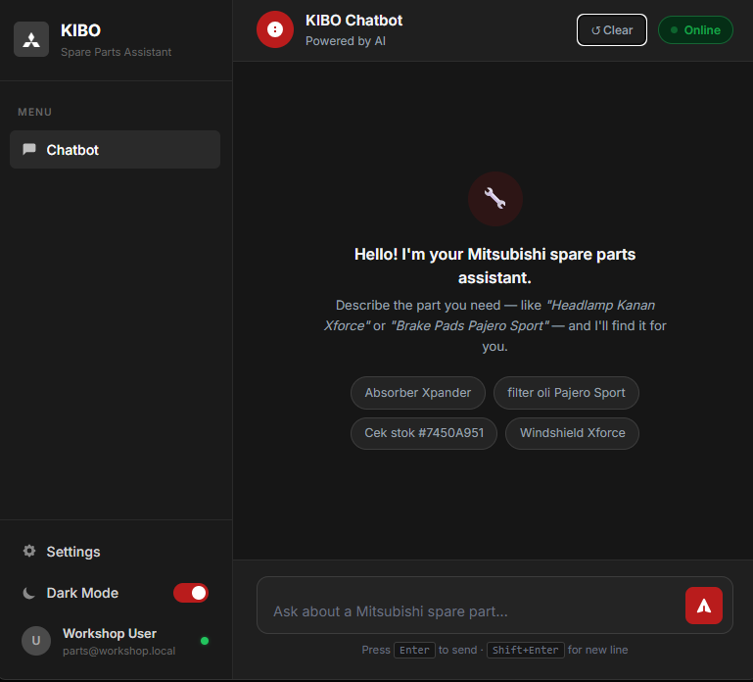
Solution : KIBO
Agentic AI-Driven
• Natural Language Processing : Users simply write or voice what component is wanted from the vehicle in text. • Automated Execution : KIBO parses the intent, queries semantic asset documentation, automatically locates the specific part ID, and validates live warehouse stock inventory. • Faster Allocation : Mechanized stock allocation takes seconds instead of manual hours
Aim is to ease the burden and increase efficiency in the workshop

Slide 6
How KIBO Works?
User simply write what is wanted from the car, KIBO will find and request what is needed
User Type
“Windshield Xforce”
KIBO Finds Part Number and Stock Availability
KIBO ask User if they want to order

Slide 7
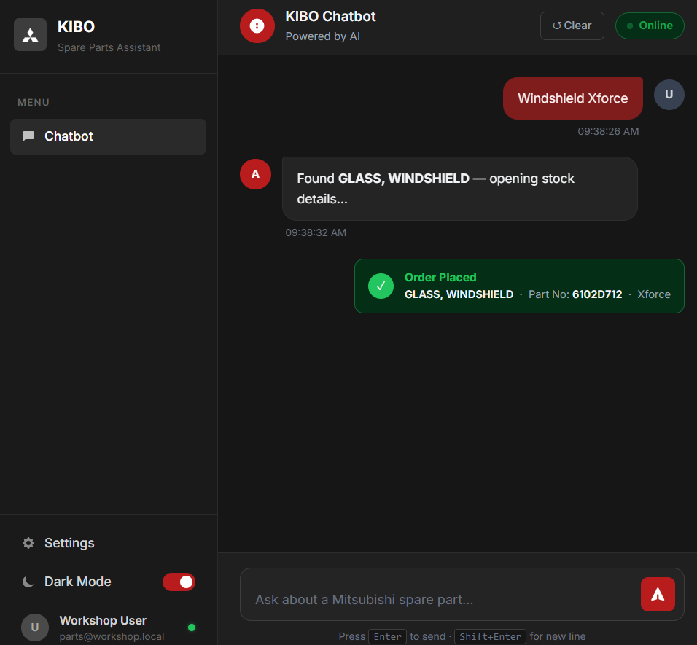
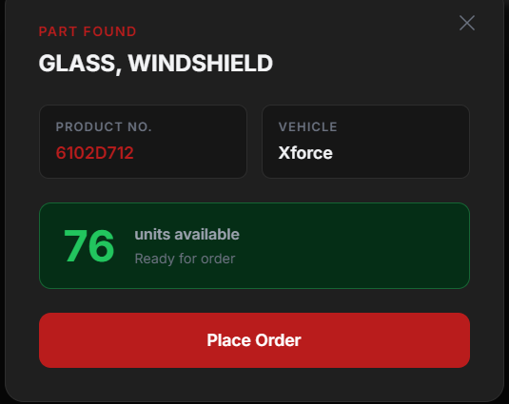
User request
KIBO Search and Query Result
Information;
- Name
- Car Type
Part ID
Unit Available
Confirmation
User can Place Order

Slide 8
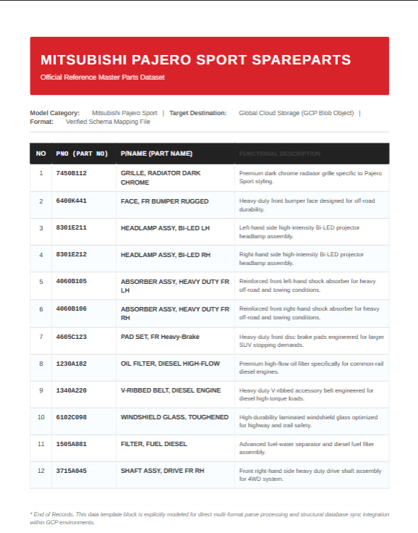
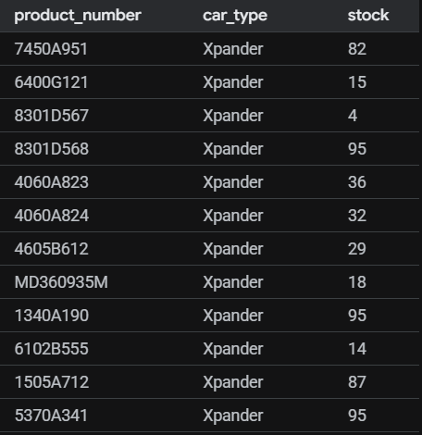

Scope of Project
https://kibo-325337932608.asia-southeast1.run.app/
Parts Number (Special ID for each Part) are still stored inside Documents (PDF/Unstructured Data) for each car type.
Stock Availability/amount is stored inside an SQL Database/Structured Format.
Each Part has unique ID
Each part currently is generated, not all parts are available in this test, only cars “Pajero sport,Xforce, Xpander” are available
PDF Data
Stock Master
Application

Slide 9
Improvement Plan
01
Database Expansion
Increase more parts and car models in the database to expand vehicle line compatibility.
02
Order Monitoring Logs
Addition of request order logs and centralized monitoring of parts ordered across bays.
04
Authentication & Roles
Enforce secure user login states and strict access control configurations per workshop role.
03
Session Persistence
Implement multi-device support to ensure continuous technician workflows on field tablets.

Slide 10
ありがとう
Thank you

Slide 11

KIBO Business Plan and Implementation

Slide 12
GCP Cost (Current Project)
Service | Component Name | Quantity | Region | Service ID | SKU | Total Price (USD)
Search (Agent Platform Agents) | Vertex AI Search: Search API Request Count - Standard | 99,998 | global | 74B1-77CF-C302 | BADA-EE26-7BDA | $134.997
Search (Agent Platform Agents) | Vertex AI Search: Search API Request Count - Enterprise | 0 | global | 74B1-77CF-C302 | 93D6-7280-CF05 | $0.000
Search (Agent Platform Agents) | Vertex AI Search: Search API Request Count - LLM Add-on | 0 | global | 74B1-77CF-C302 | 151B-D7A2-B5B5 | $0.000
Search (Agent Platform Agents) | Vertex AI Search and Conversation: Data Index | 1 | global | 74B1-77CF-C302 | BC7D-6A97-90F8 | $0.000
PostgreSQL (Cloud SQL) | Cloud SQL for PostgreSQL: Zonal - vCPU in Jakarta | 1,460 | asia-southeast2 | 9662-B51E-5089 | 283B-F56E-6593 | $78.402
PostgreSQL (Cloud SQL) | Cloud SQL for PostgreSQL: Zonal - RAM in Jakarta | 5,475 | asia-southeast2 | 9662-B51E-5089 | 6C90-4678-F5DD | $49.823
PostgreSQL (Cloud SQL) | Cloud SQL for PostgreSQL: Zonal - Standard storage in Jakarta | 7,300 | asia-southeast2 | 9662-B51E-5089 | 261C-8069-2AD8 | $2.210
Cloud Storage | Standard Storage Jakarta | 5 | asia-southeast2 | 95FF-2EF5-5EA1 | DB0A-37C5-4E19 | $0.115
TOTAL |  |  |  |  |  | $265.546

Slide 13
Scalibility and Rollout Strategy
Admin
Central API (Gemini + Agent Search)
Branch A
Branch B
Branch C
Pilot (3 Branch)
Evaluate Performance
Fix Issues on Catalogs/application
Expand to 10 Branches
Full Rollout

Slide 14
Implementation Required
Database
Branch specific stock (each branch has its own ID)
Connecting to existing ERP
Authentication
Auth middleware (roles : admin, staff)
Infrastructure
Cloud run > 0 to eliminate cold start
Cost limiter, cost alert
Incorporate caching (redis) for often used requests
Features
Creating a function to handle the request of spare part item
Model needs to know which branch to query

Slide 15

KIBO’s Architecture

Slide 16
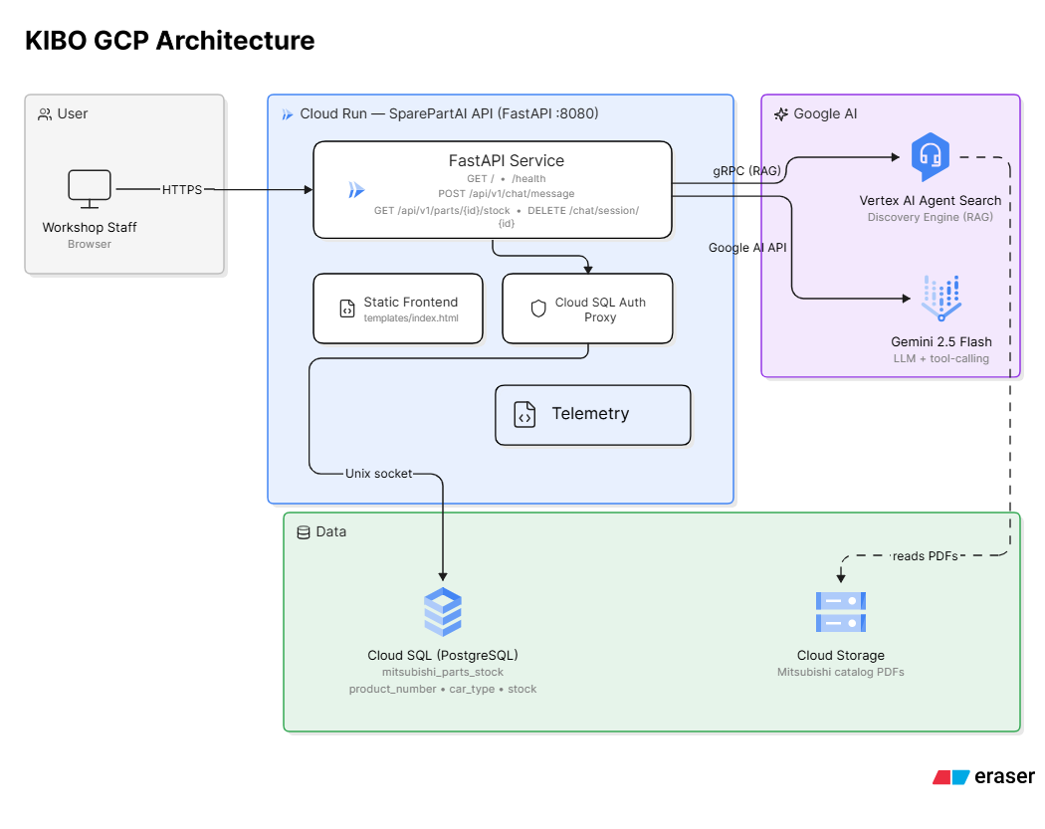
Application Architecture
Model Orchestrator : Gemini-2.5-flash
Cloud PostgreSQL (Master Stock)
Cloud Storage Bucket (SparePart PDF)
RAG (Agent Search)
Cloud Run (Autoscale ; max 5 instance)
Region:
Deployment (southeast-1)
SQL (southeast-2)
Agent Search (Global)
Storage (southeast-2)

Slide 17
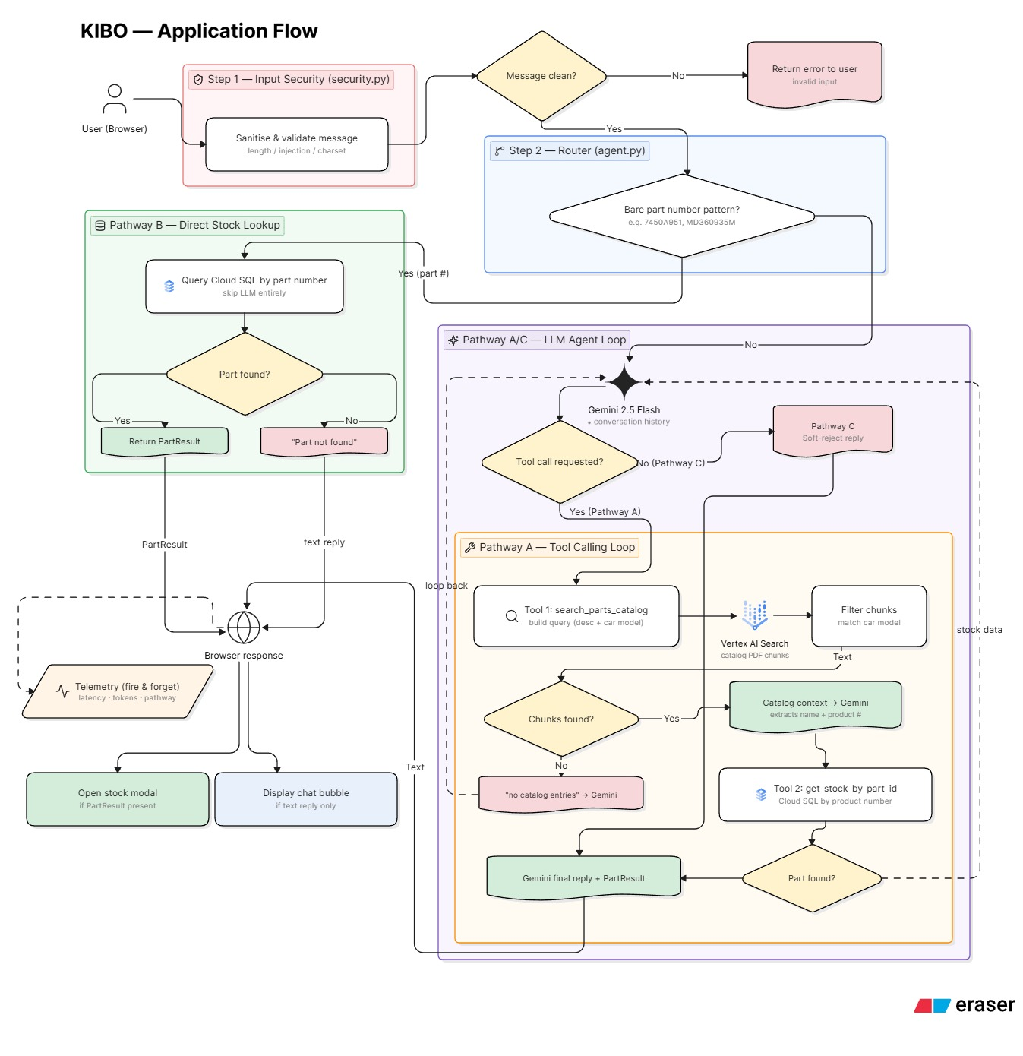
Application Flow
Tool call :
RAG Search : Utilize agent search
Query SQL : SQL Alchemy query
Orchestrator : Gemini-2.5-flash
Pathway A : RAG Docs + Query SQL
Pathway B : Query SQL
Pathway C : Run without Tool call

Slide 18
Tech Stack On this Project
UI/UX → Tailwind CSS + JavaScript
Backend → FastAPI
Monitoring → GCP MOnitoring

Slide 19
GCP Services
Cloud Run : Scalable serverless compute capped at 5 instances to guarantee zero-idle costs and budget protection.
Cloud SQL (Postgres): Fully managed relational database in Cloud
Agent Search : AI-native semantic search engine delivering real-time external intelligence to LLM workflows.

Slide 20

GCP Monitoring
Zero Infrastructure Overhead: As a fully managed Google service, GCP Monitoring requires no ongoing software updates, security patching, or storage scaling management.
Lower Total Cost of Ownership (TCO): Reduces fees and infrastructure costs associated with exporting continuous telemetry data out of GCP into an external Grafana setup.
Unified Security & IAM: Leverages existing Google Cloud IAM roles automatically, preventing the need to manage separate user permissions and credentials across a third-party platform.

