Slide 1
KIBO
希望

Slide 2
8.5%
National Market Share achieved in Indonesia (2025)
70,000+
Retail Sales Units recorded within a single calendar year
Despite intensive market challenges, Mitsubishi Motors successfully increased its commercial footprint. This
high-volume acquisition means that the cumulative pool of vehicles requiring downstream service compounding grows exponentially year-over-year.
Workshop Real Life Statisti c
297
Total Authorized Dealers &
Service Centers nationwide
Mitsubishi relies on a network of just 297 authorized centers to service the entire national fleet; Out of these 297 locations, not all facilities are equipped to handle complex mechanical services, paint, or advanced component repairs.
High Ratio Imbalance
The massive volume mismatch creates an intense administrative burden directly on field mechanics. Technicians spend significant fractions of their billable hours searching and procuring components rather than fixing vehicles.
This has not factor in that workflow bottleneck intensifies drastically prior to major national festive events, such as Mudik / Lebaran and Christmas holidays.
https://www.gaikindo.or.id/indonesias-vehicle-retail-sales-january-december-2025/

Slide 3
A Bottleneck
Time is Money
Mechanics have to traverse a complex system, navigate complex catalogs,
decoding manuals, then checking stock.
This causes slower processes in maintenance, delayed repairs, frustrated customers.

Slide 4
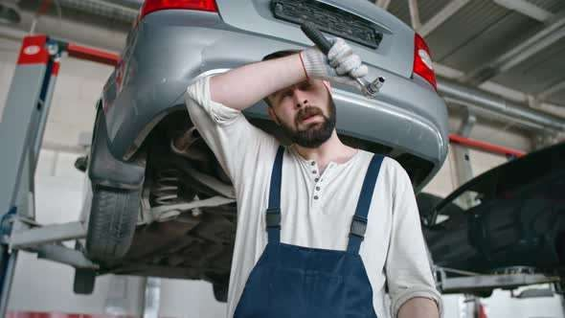
Real Life Example
Bob is a mechanic in Mitsubishi Service Center in Sunter, it is a Saturday, it is a busy floor today, a lot of customers enter at the start of the day requiring daily maintenance.
He has to match parts of Each car that enters while working on it, while the clock ticks away.

Slide 5
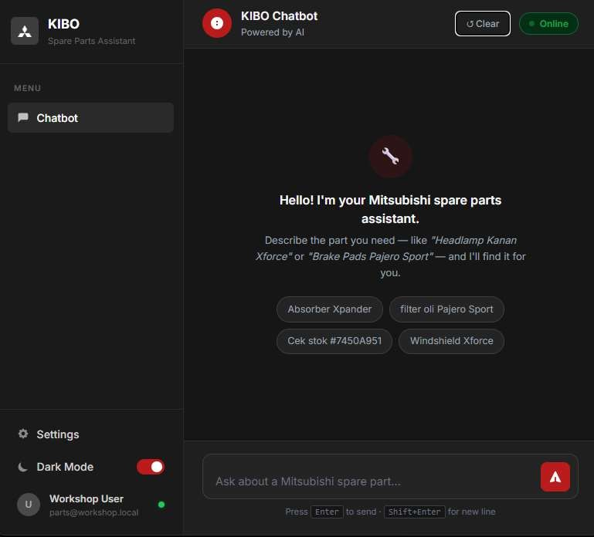
Solution : KIBO
Agentic AI-
Driven
Natural Language Processing : Users simply write or voice what
component is wanted from the vehicle in text.
Automated Execution : KIBO parses the intent, queries semantic asset documentation, automatically locates the specific part ID, and validates live warehouse stock inventory.
Faster Allocation : Mechanized stock allocation takes seconds instead of manual hours
Aim is to ease the burden and increase efficiency in the workshop

Slide 6
How KIBO Works?
User simply write what is wanted from the car, KIBO will find and request what is needed
User Type
“Windshield Xforce”
KIBO Finds Part Number and Stock Availability
KIBO ask User if they want to order

Slide 7
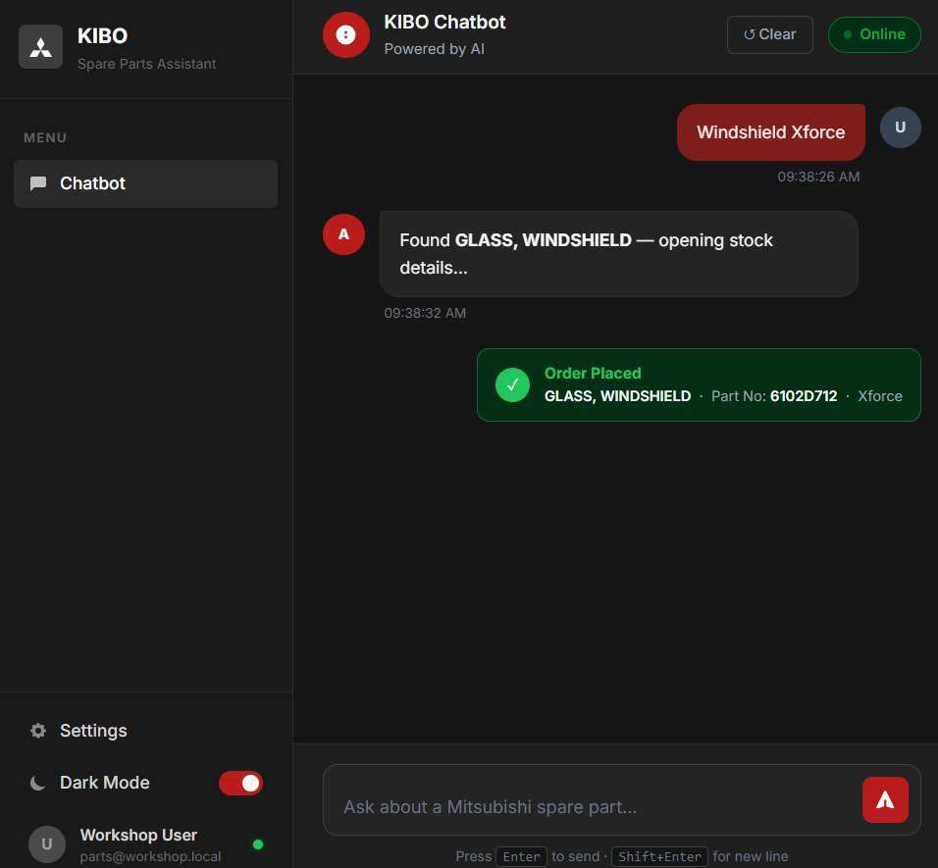
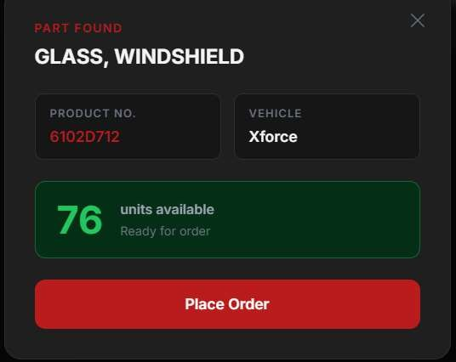
User
request
KIBO Search and Query Result
Information;
Name
Car Type
Part ID
Unit
Available
Confirmation
User can
Place Order

Slide 8
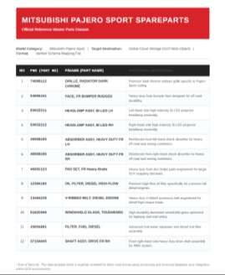
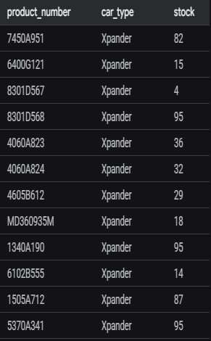
Scope of Project
1. Parts Number (Special ID for each Part) are still stored inside Documents (PDF/Unstructured Data) for
each car type.
Stock Availability/amount is stored inside an SQL Database/Structured Format.
Each Part has unique ID
Each part currently is generated, not all parts are available in this test, only cars “Pajero sport,Xforce,
Xpander” are available
PDF Data
Stock Master

Slide 9
Improvement Plan
01
Database Expansion
Increase more parts and car models in the database to expand vehicle line compatibility.
02
Order Monitoring Logs
Addition of request order logs and centralized monitoring of parts ordered across bays.
04
Authentication & Roles
Enforce secure user login states and strict access control configurations per workshop role.
03
Session Persistence
Implement multi-device support to ensure continuous technician workflows on field tablets.

Slide 10
Thank you
ありがとう

