Slide 1
playing with julia
Task Implementation Planning for Julia Research

Slide 2
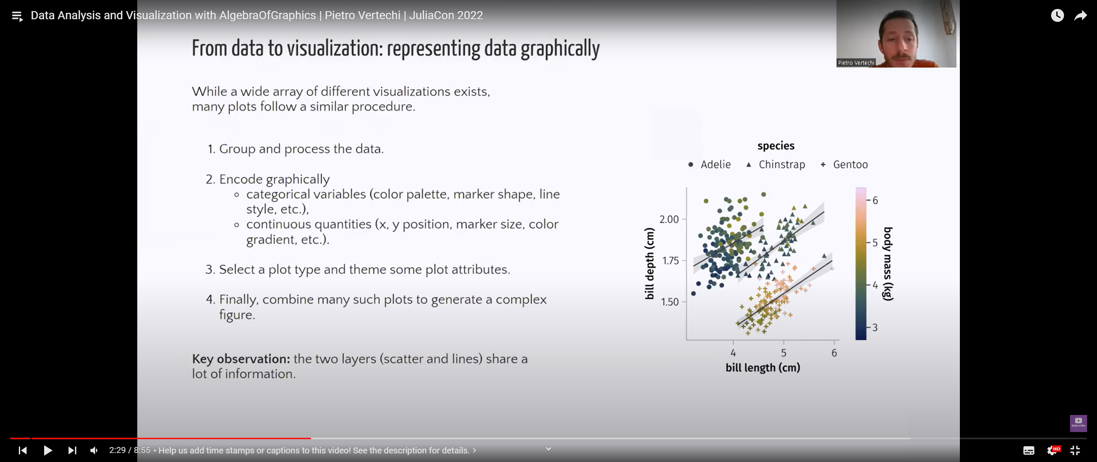
AlgebraOfGraphics

Slide 3
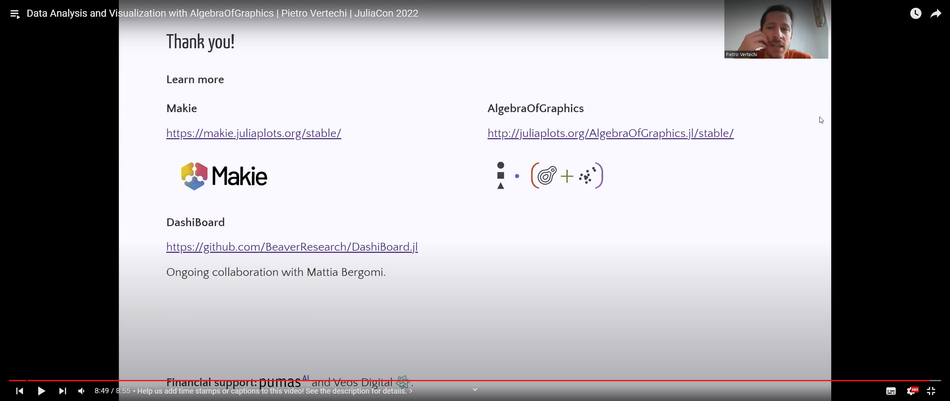
AlgebraOfGraphics

Slide 4
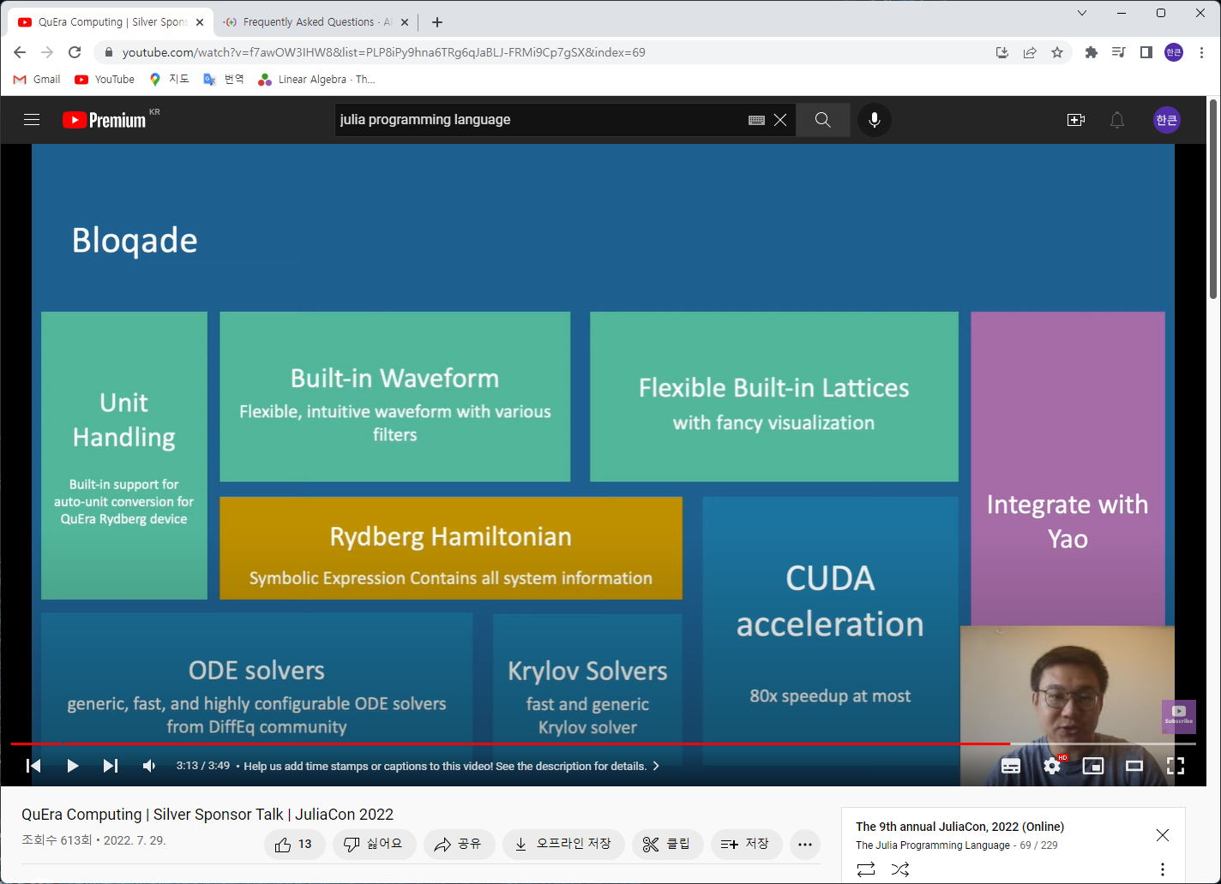
QuEra Computing

Slide 5
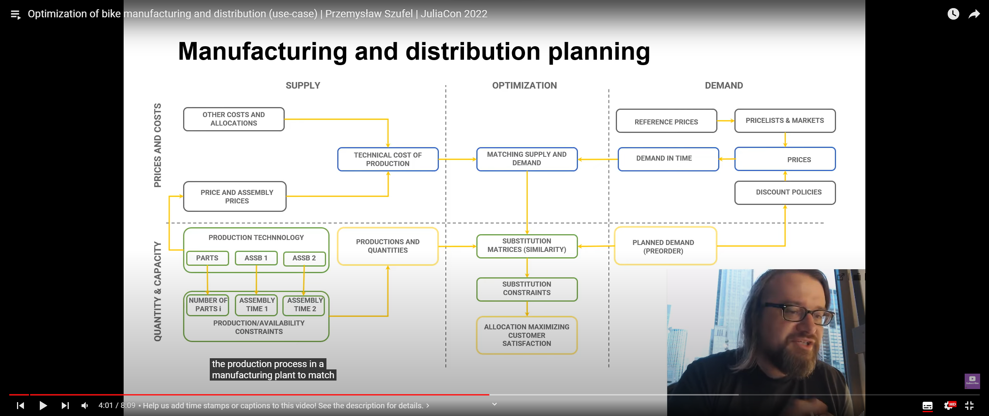
QuEra Computing

Slide 6
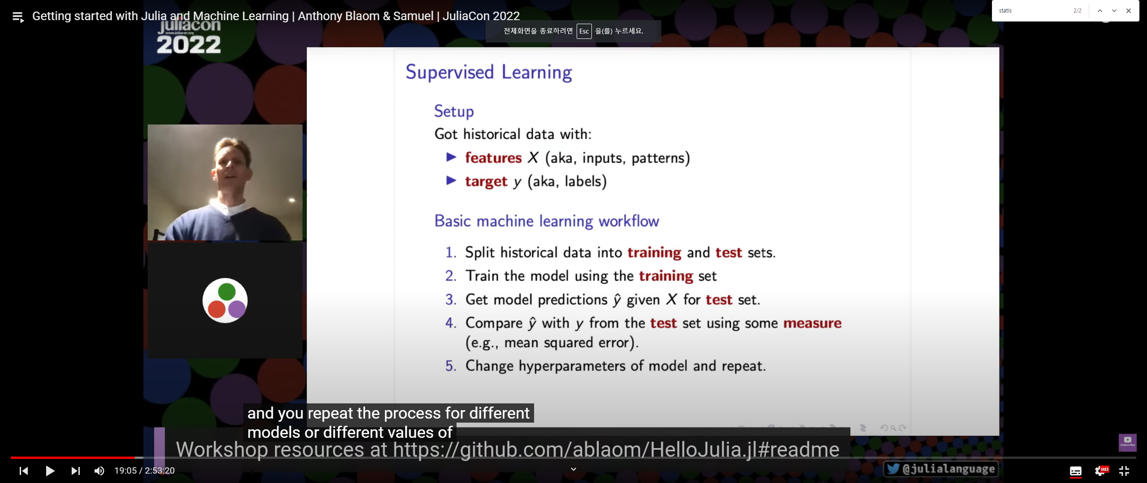
Machine learning

Slide 7
Machine Learning

Slide 8
ML

