Slide 1
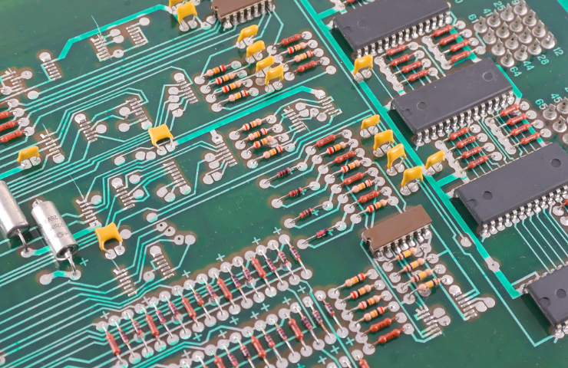
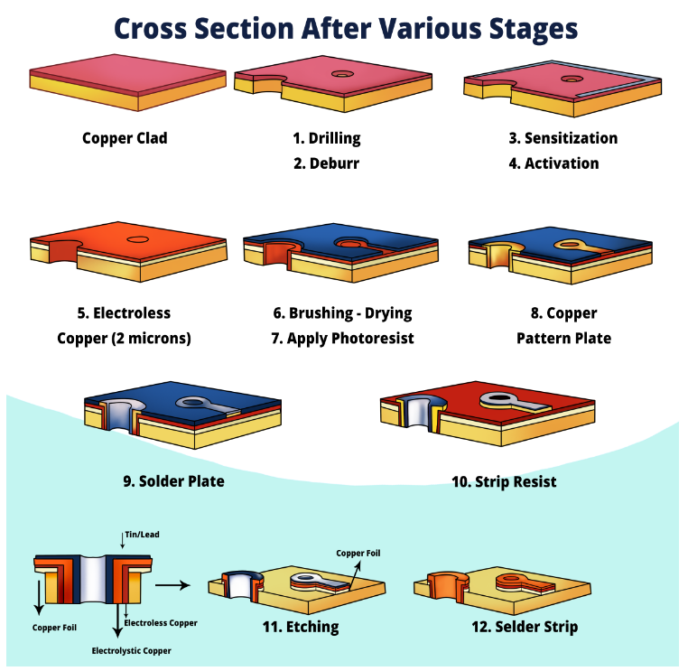
What is a Printed Circuit Board?
A printed circuit board (PCB) is an electronic assembly that uses copper conductors to create electrical connections between components.
https://resources.altium.com/p/what-is-a-pcb
PCB生产流程
Notes:
所有 PCB 都是由交替的导电铜层和电绝缘材料层构成的。印刷电路板上的导电特征包括铜迹线、焊盘和导电平面。机械结构由夹在导体层之间的绝缘材料组成。整体结构经过电镀，并覆盖有非导电阻焊层，并在阻焊层上印刷丝网，为电子元件提供图例。完成这些制造步骤后，裸板被送入印刷电路板组装，在此将组件焊接到电路板上，然后可以测试 PCBA。在制造过程中，内铜层被蚀刻，留下用于连接电路板中组件的预期铜迹线。多个蚀刻层连续层压，直到印刷电路板堆叠完成。这是 PCB 设计制造中使用的整体过程，其中裸板在经过印刷电路板的组装过程之前形成。

Slide 2
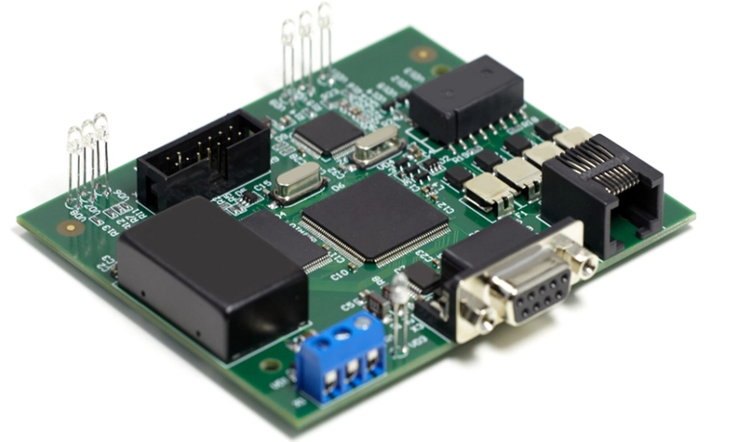
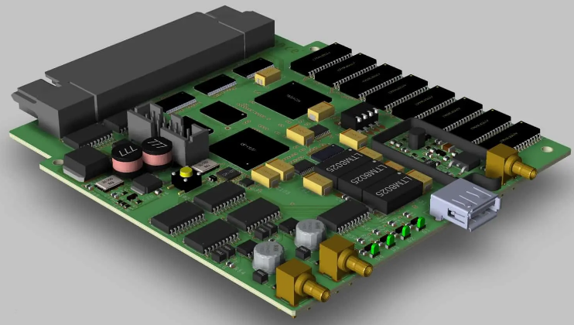
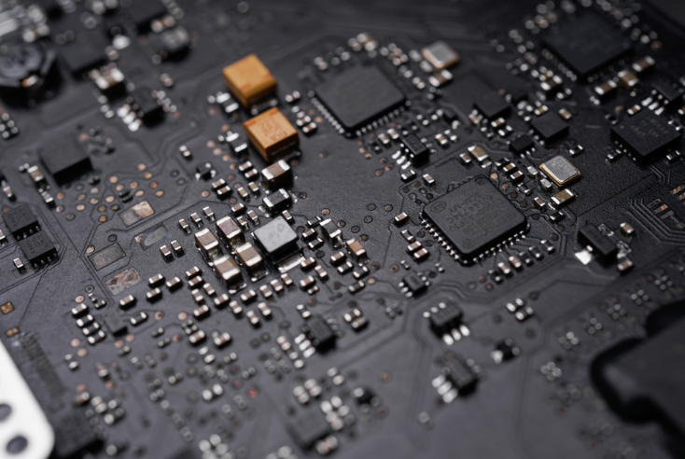
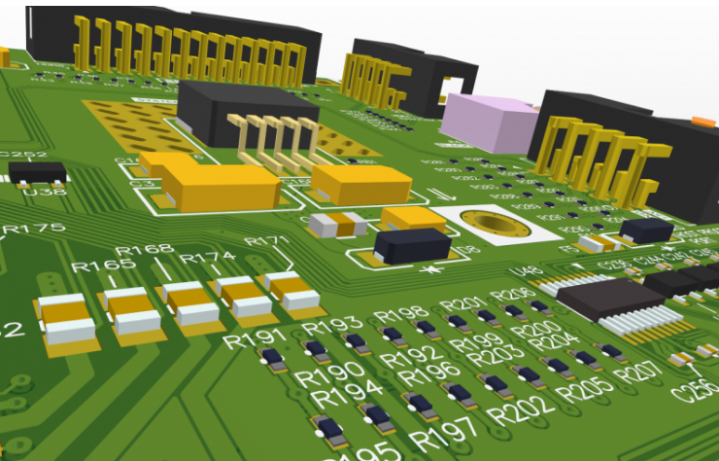
Some PCB Images
Notes:
Single-sided - This board only has components mounted on one surface. The back surface is typically fully copper (ground) and coated with a solder mask.
Double-sided - This type of circuit board has components mounted on both surfaces. Each surface is defined as a signal layer in the PCB stack-up, so the surfaces will contain traces that carry signals between components.
Multi-layer PCBs - These boards have conductors on internal layers that carry electrical signals between components, or the internal layers could be conductive plane layers. Multi-layer PCBs may be single-sided or double-sided.
Rigid-flex PCBs - Rigid-flex PCBs use a flexible polyimide ribbon that connects two or more rigid sections in a printed circuit board assembly. A rigid-flex board might be used when the design must have some movable element, such as a folding or bending enclosure.
Flex PCBs - Fully flexible PCBs do not use any rigid materials and are made entirely of flexible polyimide ribbons. These boards can have components mounted and soldered on the, just like rigid and rigid-flex printed circuit boards.
Printed flex PCBs - These PCBs use a flexible material as the base, and copper conductors are printed onto the flexible material in an inkjet process or in a similar additive process. The resulting boards are very similar to flex PCBs.
Metal-core PCBs (or insulated metal substrate (IMS) PCBs) - These boards use a metal slab in the core layer (normally aluminum) in order to provide much greater rigidity and heat dissipation than in typical rigid printed circuit boards. The metal-core PCB design manufacturing process is quite different from the standard rigid PCB design manufacturing process, and there are a few design points to consider to ensure solvability. These boards are common in high-power lighting and some industrial applications.
Ceramic PCBs - These boards are less common and are used in applications that require very high thermal conductivity such that the board can dissipate large amounts of heat away from components.
HDI PCBs - These PCBs use very high pin count components that require a specialized manufacturing process and specialized materials to accommodate a very high density of copper connections.
UHDI and Substrate-like PCBs - These PCBs are so small and dense that they have bypassed capabilities of subtractive etching, and instead they require a specialized additive manufacturing process used to build IC packages.

Slide 3
Starting a New PCB Design
Front-end engineering - In this stage, the major components are selected and some basic circuit diagrams are typically created so that the functionality in the board can be designed.
Schematic capture - This is the stage where ECAD software is used to translate simple circuit diagrams into electronic drawings that define electrical connections between components. Schematic symbols are used to denote components in the design.
Material selection and PCB stack-up design - In this stage, laminate materials are selected and the stack-up is designed to accommodate the need for plane layers, signal layers, dedicated routing channels, and specific material properties.
Component placement - After the board shape is set and components are imported into a new PCB layout, components are arranged in the layout to comply with the design's mechanical requirements.
Routing - Once the component placement is approved, it's time to route traces between components. Routing tools in ECAD software are used to set Trace geometry may be determined in this stage with the goal of ensuring impedance control (for high-speed signals).
Design review and verification - Once routing is completed, it's always a good idea to inspect and evaluate the design to ensure there are no mistakes or unresolved problems. This can be done with manual inspection or using post-layout simulation tools.
Preparing for Manufacturing - Once the design is completed, it's time to prepare for production by generating standard manufacturing files. These files are used in automated fabrication and assembly equipment.

Slide 4
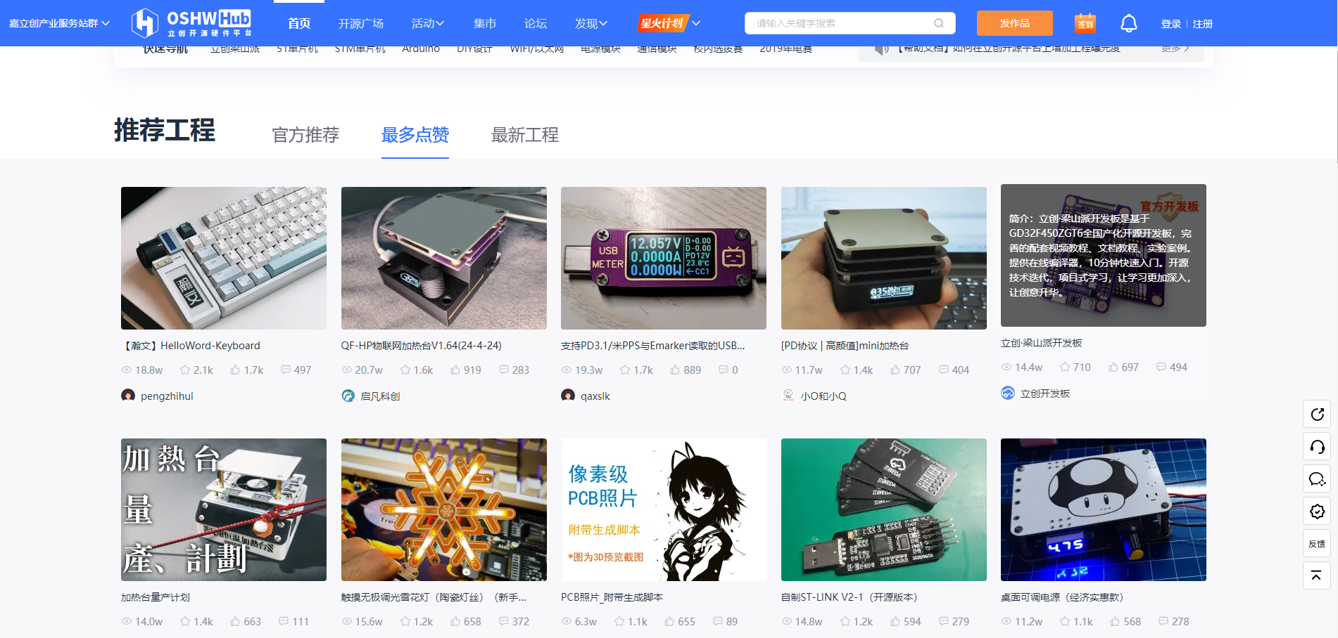
Choose a Project
https://oshwhub.com/

Slide 5
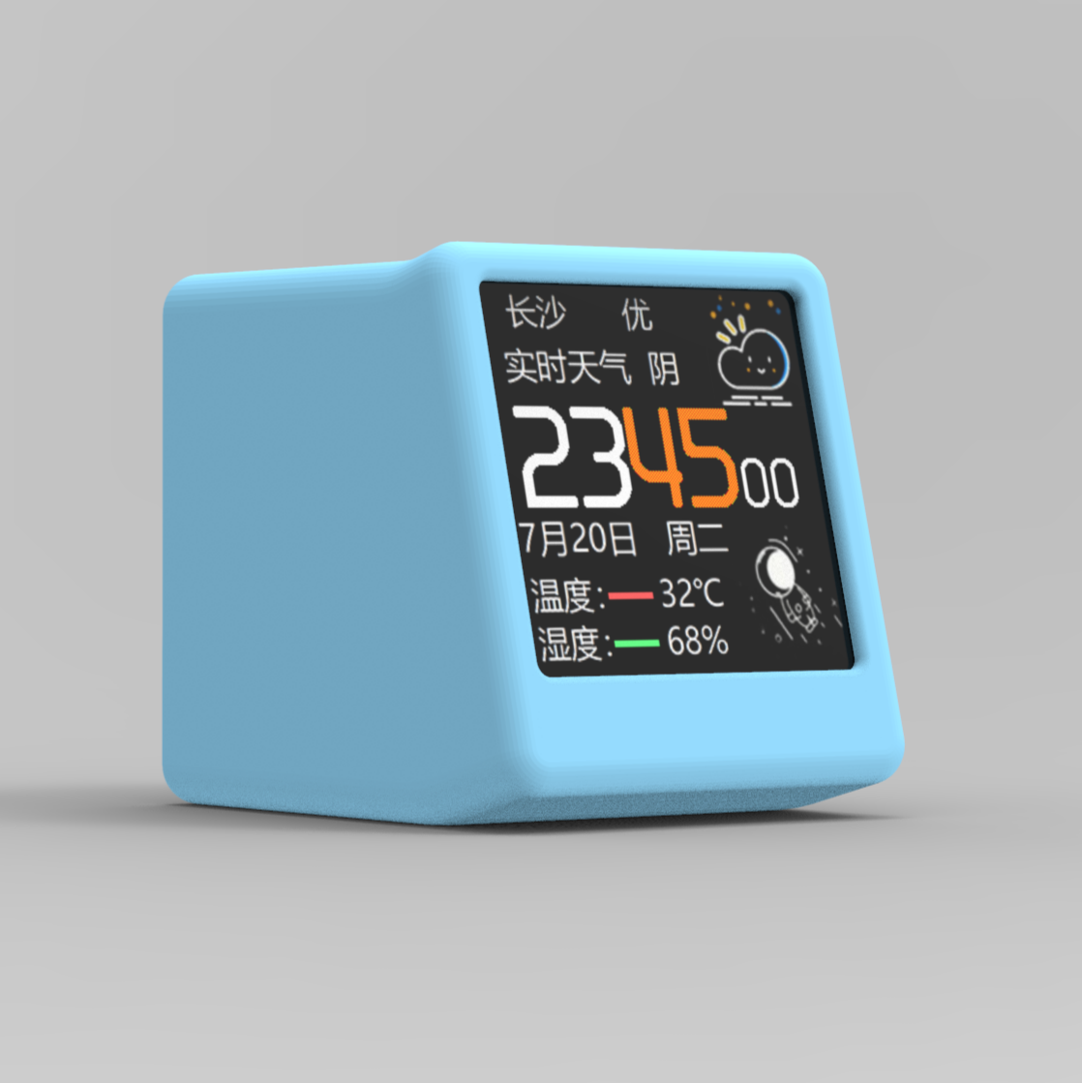
Choose a Project
个人时钟天气站https://oshwhub.com/MisakaBanBan/small_desktop_display

Slide 6
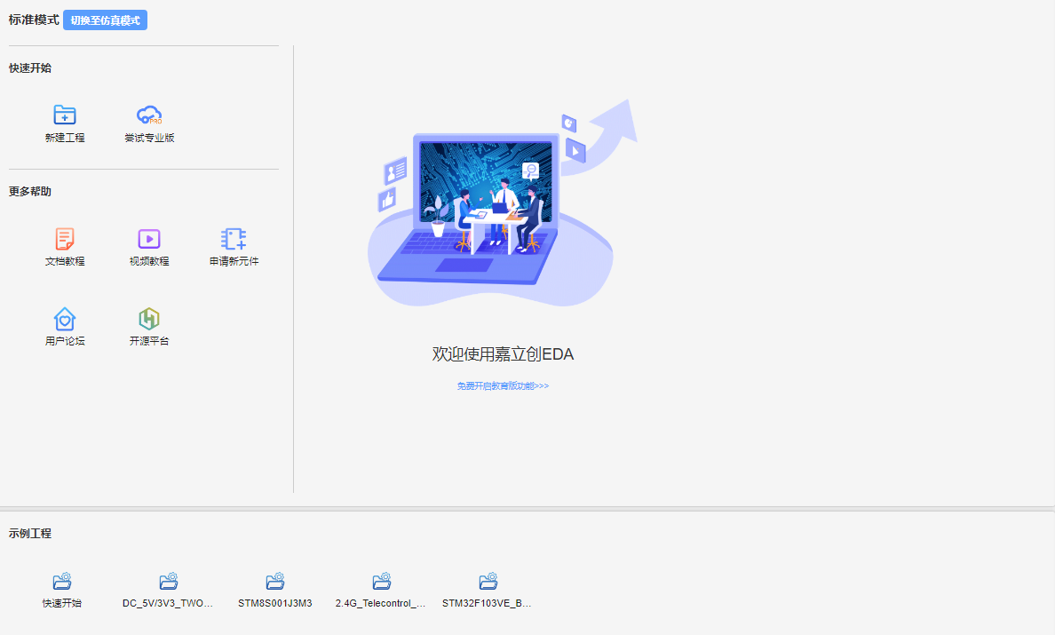
Use LCEDA
Learning Resources:
嘉立创EDA
文档教程
视频教程
Online: https://pro.lceda.cn/editor
Desktop Install: https://lceda.cn/page/download?src=index

Slide 7
Schematic capture

Slide 8
PCB design

