Slide 1
The RAG system now runs in a browser, and the pipeline did not change to make that happen
A Streamlit front-end for the Multi-Document RAG project
Talha Hafeez
September 2026
Notes:
Last time I showed the command-line version of the RAG system. This homework adds a web front-end. The headline is the whole talk: the app is a second window onto the same pipeline, and nothing inside the pipeline or the evaluation code changed to get there. The next twelve minutes are about why that was possible and what it actually took.

Slide 2
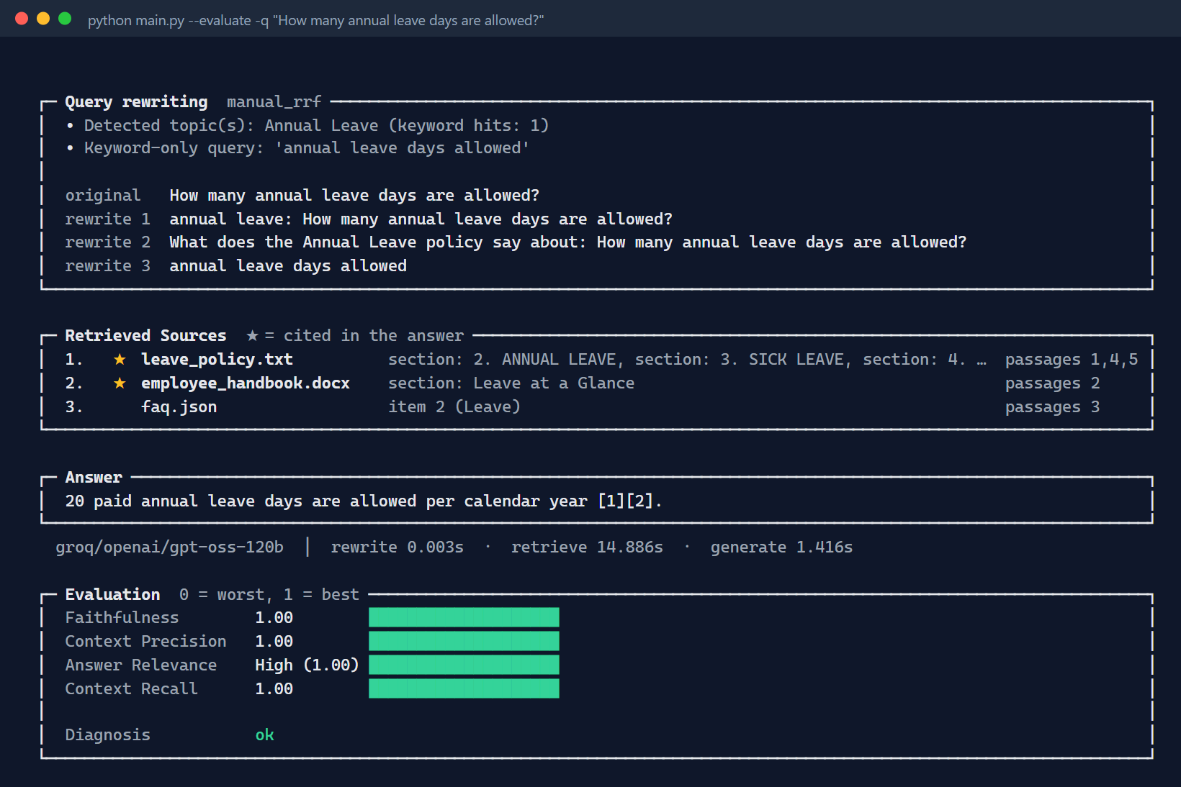
Last time the system had one front-end, the terminal
Seven document formats into ChromaDB, seven rewriting strategies fused with RRF, cited answers, and manual plus RAGAS scores.
All of it behind python main.py.
Streamlit front-end · 1
Notes:
A one-slide recap, on purpose. The previous presentation covered the loaders, the retriever, the rewriting strategies and both evaluations in depth, so I will not repeat them. What matters today is only the box on the left: a terminal was the one way in. The task was to add a browser way in and keep this one working for anyone who prefers it.

Slide 3
The CLI computes nothing; it draws one object the pipeline returns
RAGPipeline.ask() → RAGResponse
rewrite · chunks · sources · answer · timings · provider · model
Everything main.py prints comes out of that one object. So a second front-end is a second renderer, not a second pipeline.
Streamlit front-end · 2
Notes:
This is the design fact the whole homework rests on, and it was decided months ago for a different reason: the evaluation scripts needed the rewrites, the chunks and the answer as data, not as printed text. Because ask() returns a dataclass with all of it, the terminal front-end is only a printer. If the printer is replaceable, a web page is just another printer.

Slide 4
Four rules were fixed before the first line of Streamlit
1
The CLI stays the reference and keeps every feature.
2
Nothing inside src/ or evaluation/ changes.
3
Same settings and the same numbers in both front-ends.
4
Heavy objects load once per server and are shared.
Streamlit front-end · 3
Notes:
I wrote these down before opening the Streamlit docs, because the temptation with a UI is to re-implement little bits of logic in the page, and that is how two front-ends drift apart. Rule two is the strict one: if the page needed something the pipeline did not expose, that was a pipeline gap to fix in the pipeline, never a copy in the UI. Rule four is about the 90 MB embedding model: a second browser tab must not load it again.

Slide 5
Three files are new; pipeline, ingest and evaluation are imported unchanged
FRONT-ENDS (neither imports the other)
main.py
renders with src/console.py
app.py (new)
renders with ui/components.py
src/frontend.py (new)
helpers both need
ingest()
unchanged
RAGPipeline.ask()
unchanged
evaluation/
unchanged
data/ · chroma_db/ · results/ (shared by both front-ends)
Streamlit front-end · 4
Notes:
The structural picture. Three things are new: app.py, its renderer ui/components.py, and src/frontend.py, which holds what the two front-ends share. The arrows are the web app; the CLI reaches the same three entry points, it just does so as separate commands. And the files at the bottom are shared, so an index built from the browser is the index the terminal searches, and the CSVs the evaluation tab writes are the ones the scripts write.

Slide 6
Before any Streamlit, 118 lines left main.py for a shared module
118
src/frontend.py
The live evaluator, the ground-truth lookup, the manifest checks and the provider aliases. No printing, no widgets. Both front-ends import it.
lines moved out of main.py
The CLI's --evaluate output was re-run afterwards and did not change.
Streamlit front-end · 5
Notes:
The first real work was not Streamlit at all. The CLI had grown helpers the web page also needs: the AnswerEvaluator behind the live scores, find_ground_truth, the manifest checks that print the two start-up warnings, and the provider name aliases. app.py cannot import main.py, because importing main.py reconfigures stdout and pulls in argparse. So they moved to src/frontend.py, 156 lines, and main.py imports the names it used to define. 118 lines out, 10 import lines in. The check that it was done right: the --evaluate run printed the identical block afterwards.

Slide 7
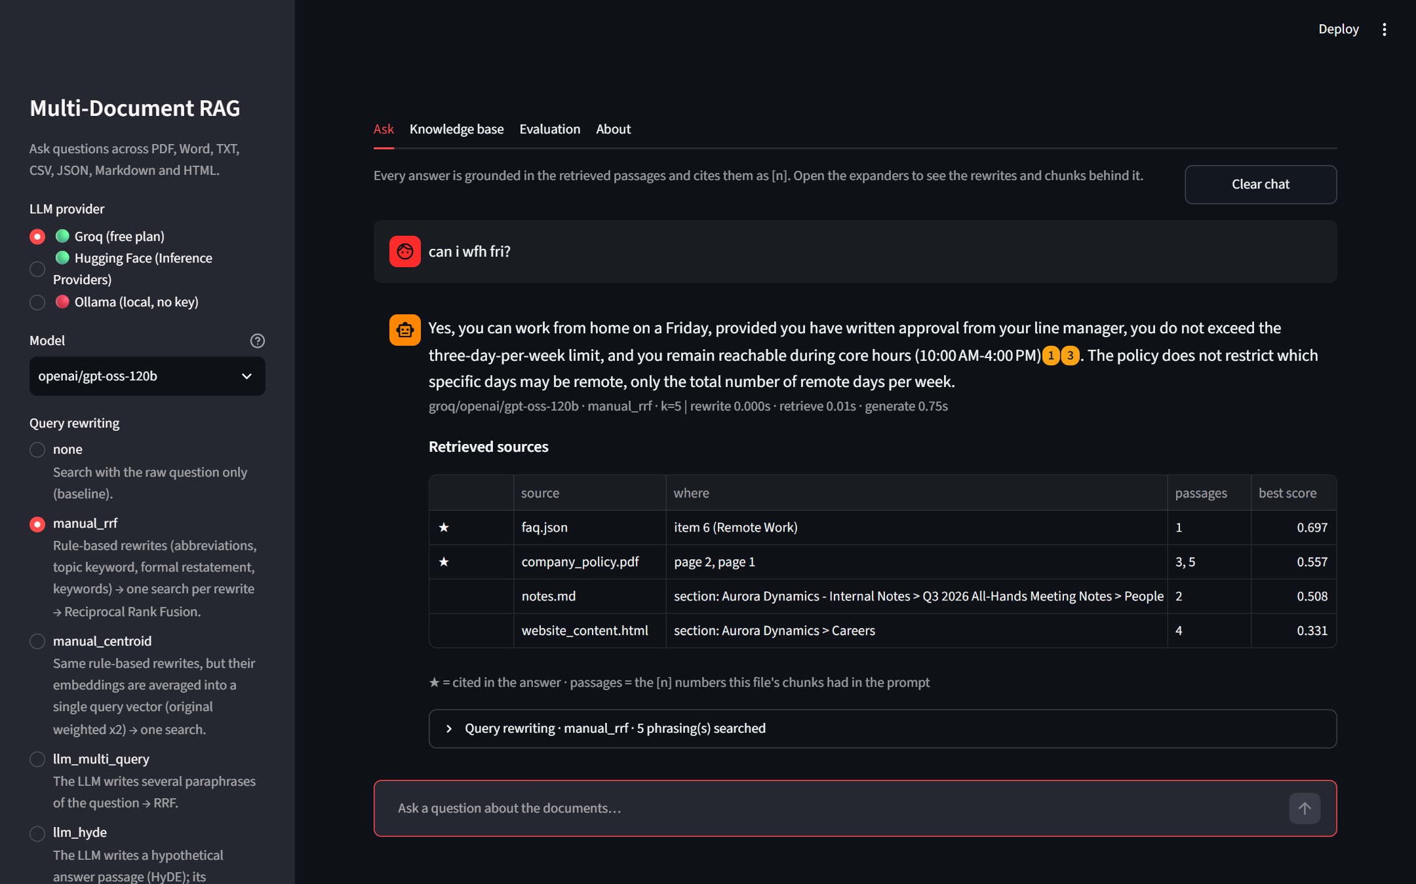
The sidebar is the CLI's flag list, read from the same registries
Provider, model, strategy, k and the three toggles. Add a provider or a strategy in src/ and both front-ends show it.
Streamlit front-end · 6
Notes:
The page itself. Nothing in the sidebar is new information: every widget is a CLI flag or slash command. The provider radio reads provider_status(), so Ollama gets a red light until its server answers; the model list is the same curated-then-live list the CLI prints; the strategy captions are the same descriptions. That is rule three in practice: one place to add a setting, two places it appears.

Slide 8
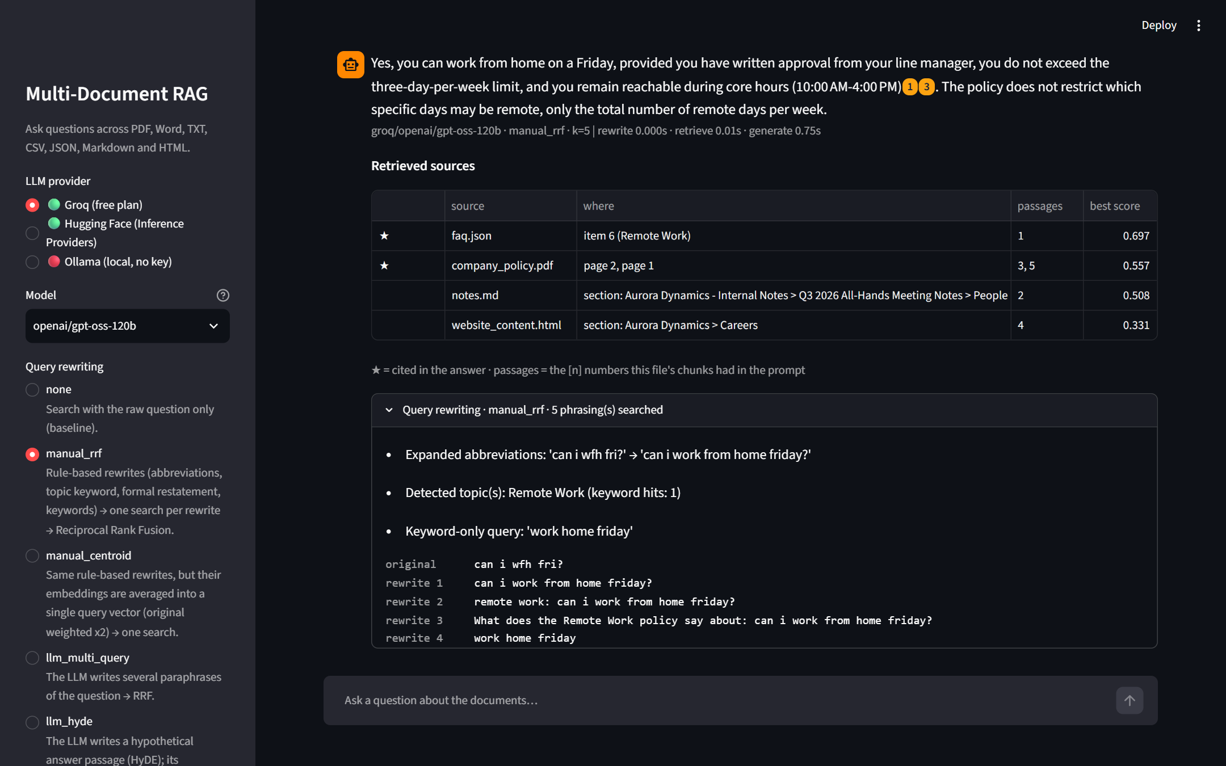
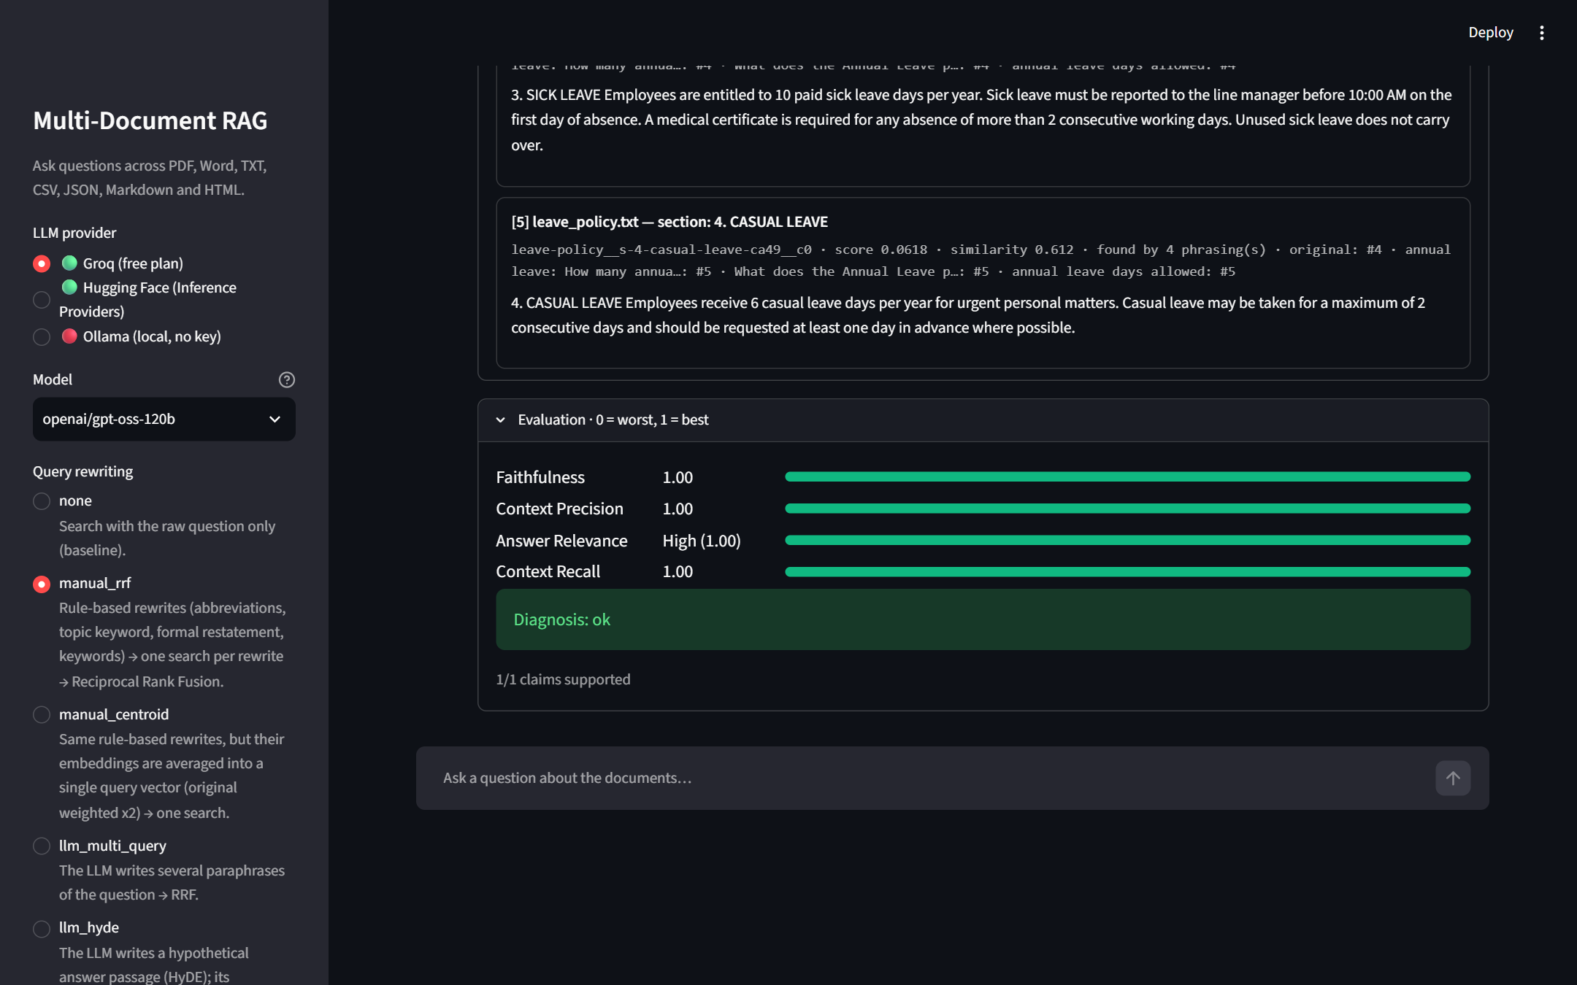
One answer opens into its phrasings, its chunks and four live scores
The phrasings that were actually searched.
Four scores from the same functions as the batch report.
Streamlit front-end · 7
Notes:
This is the demo slide. Ask something informal like "can i wfh fri?", get a cited answer, then open the rewriting expander to show the five phrasings and why the abbreviations did not matter. Open the chunks to show what the model actually read. Switch on the evaluate toggle and ask a question from the evaluation set: four scores appear, computed by the same AnswerEvaluator the batch report uses. Precision and recall show n/a with the reason when the question has no ground truth. All three panels are opt-in, so a demo can start clean and open the machinery when someone asks why.

Slide 9
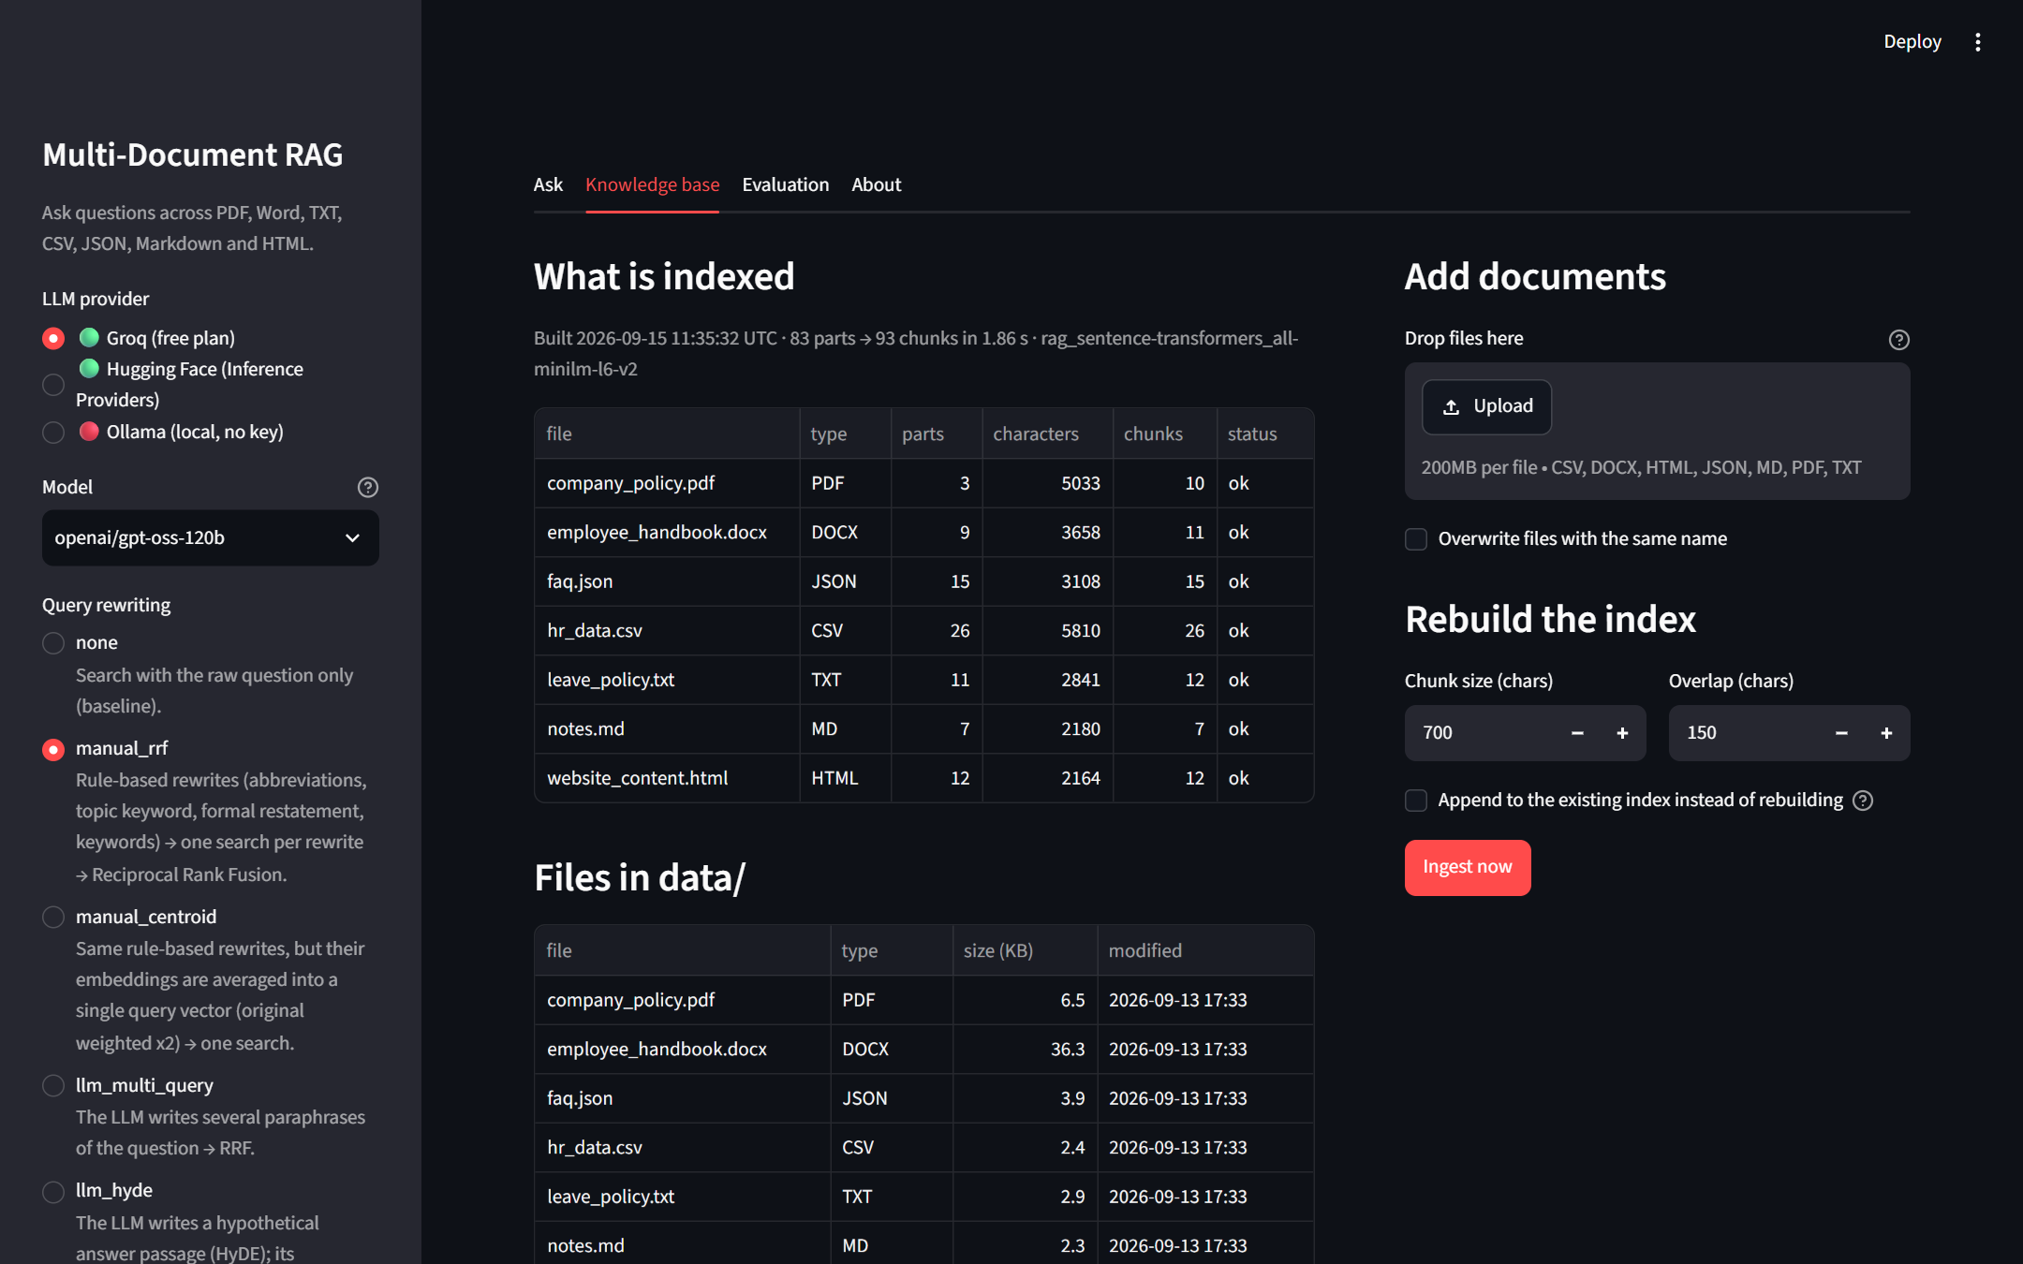
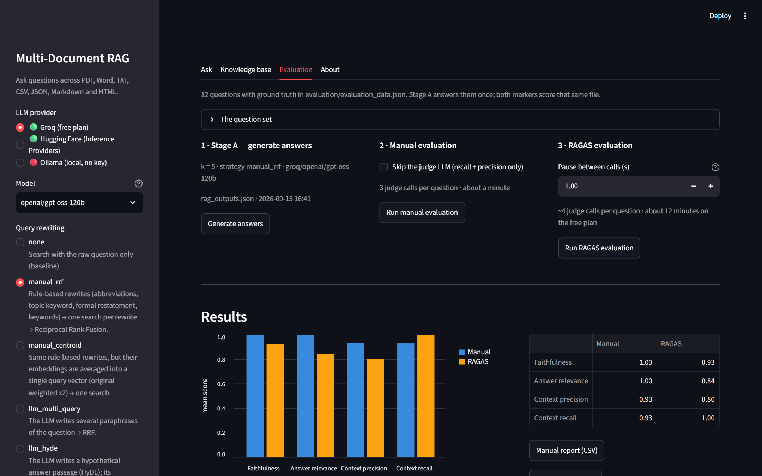
The other two tabs wrap ingest() and the evaluation scripts, nothing more
Upload, then Ingest now calls ingest() with the progress callback it already had.
Three buttons call the three script functions and write the same files.
Streamlit front-end · 8
Notes:
Knowledge base on the left: the manifest, the files in data/, drag-and-drop upload, rebuild or append with chunk size and overlap, and a search box over chunks.json. The interesting part is how little it needed. ingest() already took a progress callback because the terminal wanted percentages, so the page passes a callback that moves a progress bar. Evaluation on the right: Stage A, manual and RAGAS are three buttons calling run_pipeline_on_dataset, manual evaluate_rows and RAGAS evaluate_rows, writing rag_outputs.json and the two CSVs, then reading the CSVs back into the chart. The tab implements no metric. I ran Stage A and the manual evaluation from the browser and got 1.00, 1.00, 0.91, 0.94 against the report's 1.00, 1.00, 0.93, 0.93, which is within the judge's normal noise.

Slide 10
With caching the first question costs 15 s and every later one 0.75 s
15 s
0.75 s
the first question: model load and index open
every question after: the same timings as the CLI
The pipeline is one st.cache_resource keyed on the embedding model; a provider switch only rebuilds the LLM client.
Streamlit front-end · 9
Notes:
Streamlit's execution model is the thing to understand before writing any of it: the whole script runs top to bottom on every click. Without caching, every widget change would reload the 90 MB embedding model and reopen ChromaDB. So the pipeline, embedder plus vector store, is a cached resource keyed on the only thing that would need a different one, the embedding model. Switching provider or model goes through pipeline.set_llm(), which rebuilds only the small client. The evaluator is a second cached resource. provider_status(), which probes the Ollama port, is cached for a minute; the model lists for five. After an ingest from the browser both resource caches are cleared so the counts refresh. Measured: first question about 15 seconds, then rewrite 0.002 s, retrieve 0.01 s, generate 0.75 s on Groq, identical to the terminal.

Slide 11
Four things broke the first time, and none of them was in the pipeline
1
Edits to ui/ did not show up. Streamlit reloads app.py, not the modules it imports.
2
The results chart stacked Manual on top of RAGAS and summed to 2.0.
3
The brand navy vanished on the dark theme.
4
The uploader accepted nothing: config says ".pdf", the widget wants "pdf".
Streamlit front-end · 10
Notes:
These are the honest answer to "what did you learn". None is a pipeline problem; all four are about how Streamlit runs code and draws things. One: hot reload only re-runs app.py, so an AttributeError pointed at a function that plainly existed in ui/components.py. Restarting the server fixes it, and it is in the README so nobody loses an hour to it. Two: st.bar_chart stacks series and sorts categories alphabetically, so I replaced it with an Altair grouped bar chart in the brief's metric order with a 0 to 1 axis. Three: the deck's navy bars were invisible on Streamlit's dark theme, so the chart colours are now theme-neutral and the CSS uses semi-transparent borders. Four: a one-line lstrip on the extension list, the kind of thing only a real click finds.

Slide 12
Both front-ends give the same answer and the same four scores
python main.py --evaluate -q "…"
Ask tab, evaluate toggle on
Same RAGResponse, same AnswerEvaluator, two renderers.
Streamlit front-end · 11
Notes:
The slide that proves the rules held. Same question, "How many annual leave days are allowed?", same answer, same passage numbers, same four scores, because both sides print the same RAGResponse and call the same AnswerEvaluator. If someone asks which one is the real system, the answer is neither. The pipeline is. These are two windows onto it.

Slide 13
902 lines were added and none changed inside src/ or evaluation/
902
0
lines added
lines changed in the pipeline
app.py 502 · ui/ 244 · frontend.py 156
one new module, one optional dependency
Streamlit front-end · 12
Notes:
The numbers back the claim on the cover. 902 lines added: app.py 502, the two ui files 244, and the shared module 156. Zero lines changed in src/ or evaluation/ apart from that new module, and one optional dependency, streamlit, which the CLI does not need. The zero is the one to point at. It is only possible because the pipeline returns data instead of printing it.

Slide 14
Two commands and a three-minute demo
streamlit run app.py
python main.py
1
Ask "can i wfh fri?", open the rewrites, open the chunks.
2
Turn on evaluation, ask a dataset question, four scores.
3
Drop a file in Knowledge base, Ingest now, ask about it.
4
Evaluation tab: the chart, then the CLI printing the same block.
github.com/breakingbuilds/multi-document-rag
Notes:
Close with the two commands and offer the live demo in this order. It takes about three minutes and touches every tab. The repository link is on the slide for anyone who wants to run it afterwards.

