Slide 1
What Should We Pay
Our Data Scientist?
$147K
$88K
~2.1×
U.S. Senior DS
Median Salary
Offshore Senior DS
Median Salary
U.S. Salary
Premium
Full-time, 2020–2022 (n=216)
Full-time, 2020–2022 (n=62)
vs. offshore equivalent

Slide 2
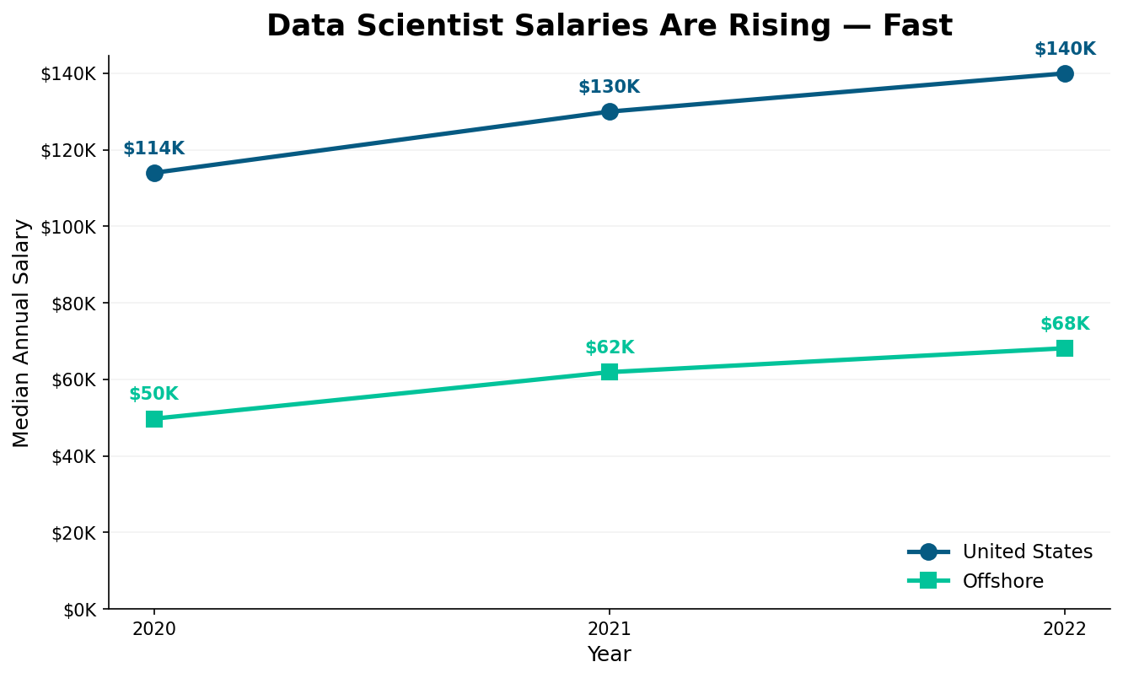
MARKET CONTEXT
A Hot Market Getting Hotter
Data science talent is scarce, demand is high, and the data prove it. U.S.-based senior data scientists now command more than 2× the salary of comparable offshore talent; a gap that has been widening every year. Waiting to hire means paying more later.
Key Insight
U.S. median salary grew from $114K in 2020 to $140K in 2022; a 23% jump in just two years. Offshore remained flat at ~$56K–$66K. The gap is real and widening.

Slide 3
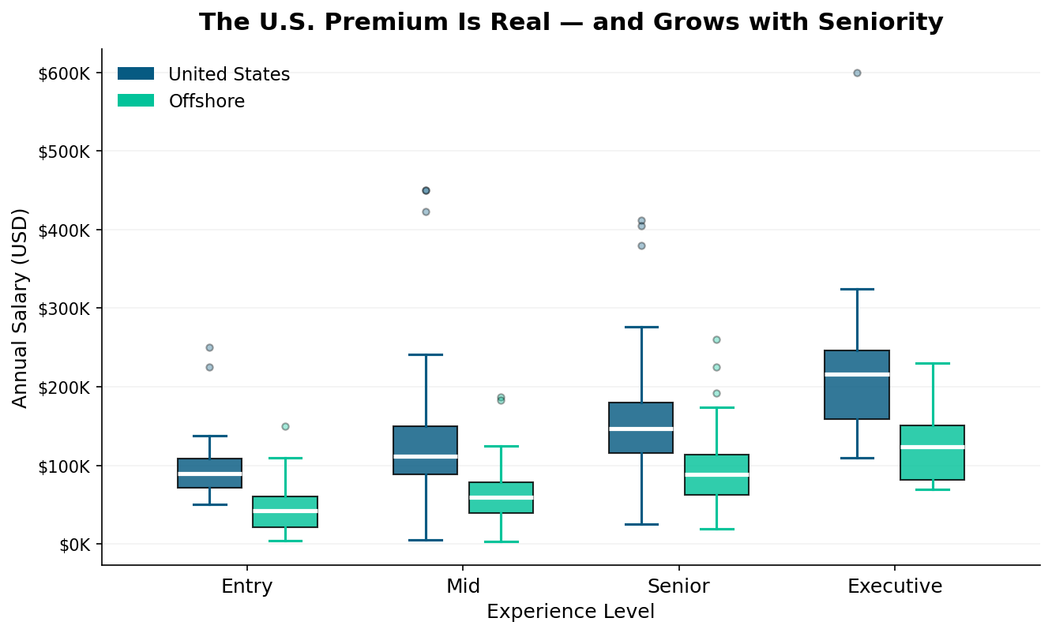
SALARY COMPARISON
The U.S. Premium Grows with Experience
⭐ U.S. Senior DS
$116K – $180K
(25th–75th percentile)
🌍 Offshore Senior DS
$62K – $114K
(25th–75th percentile)
📈 Executive Track
US median: $216K
Offshore median: $124K

Slide 4
Our Recommendation
To attract a senior data scientist with team-lead potential, we recommend the following salary ranges:
⭐ U.S.-Based Hire
🌍 Offshore Hire
$140,000 – $180,000
$75,000 – $100,000
Lands squarely at the 50th–75th percentile for a U.S. senior data scientist — competitive enough to attract top talent. For a Principal or Manager-track hire, budget up to $215K.
Covers senior-level talent in the UK, Canada, Germany, and Australia. ~40% cost savings vs. U.S., with access to comparable technical depth and growing leadership pools.
Act Now: U.S. median DS salaries rose 23% in just two years. Every quarter of delay means a higher cost-of-hire.
Plan Ahead: Set the range at $140–180K for U.S. to retain the hire as they grow into a team lead role.

