Slide 1
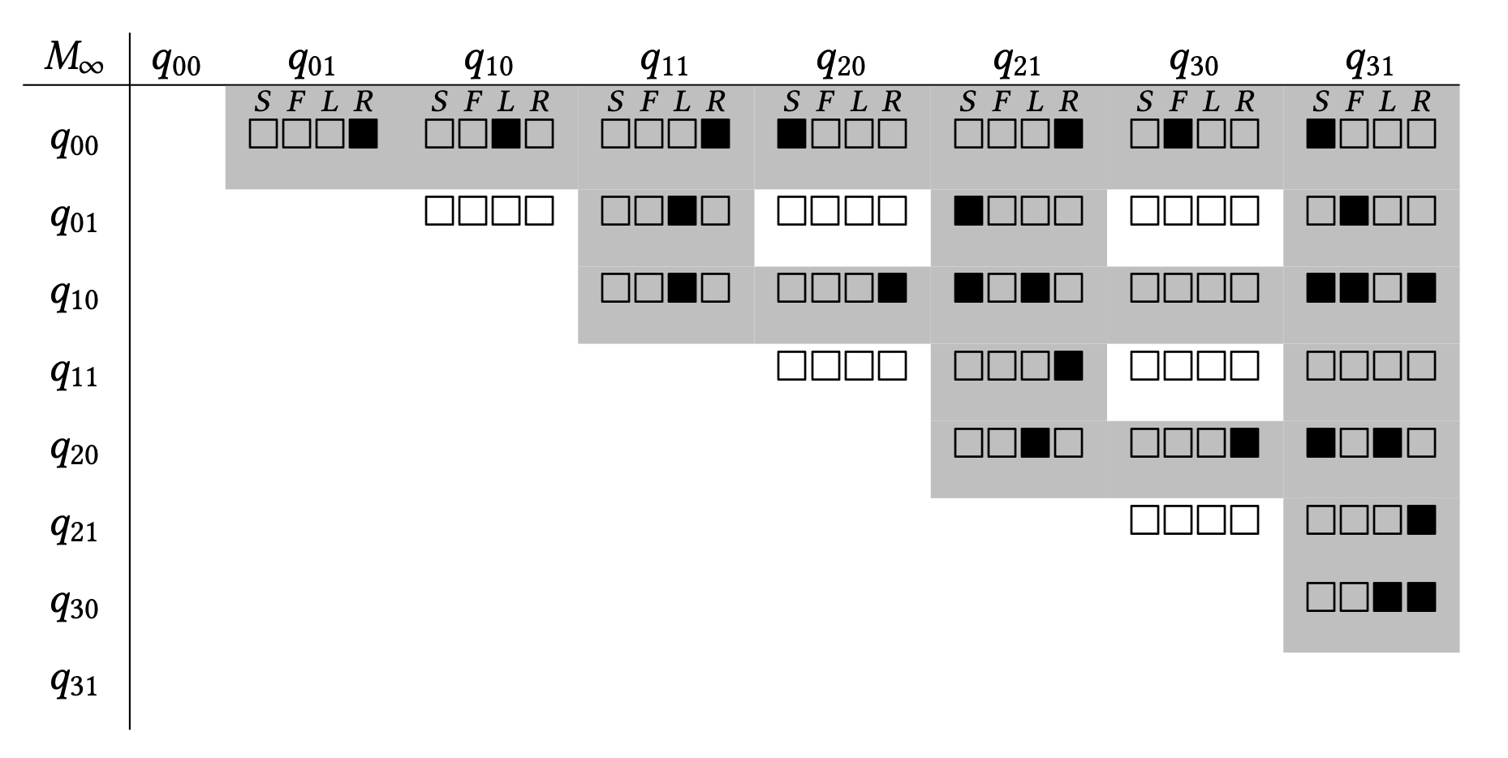
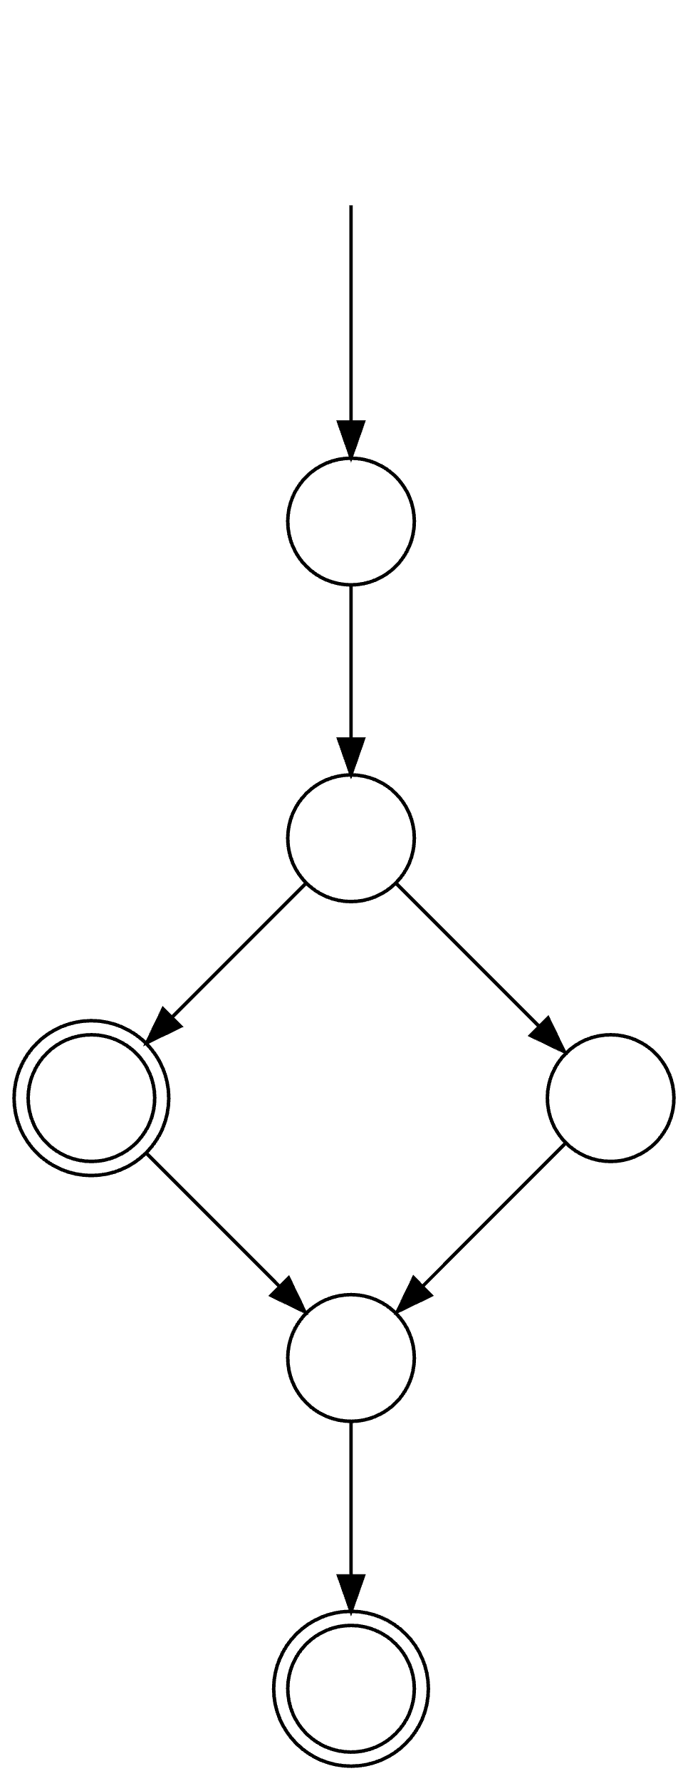
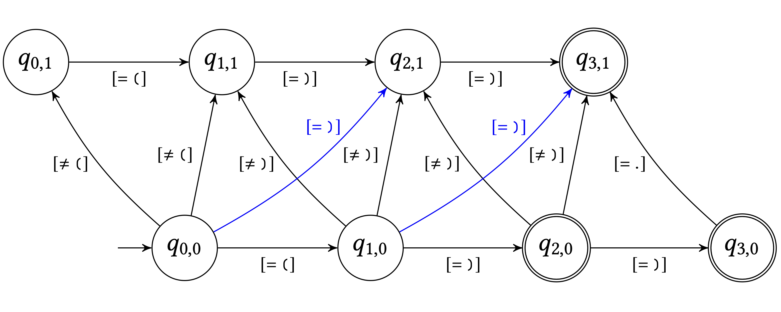
Syntax CNF grammar
Decoder
S → ( ) | ( S ) | S S
S → L R
S → L F
L → (
F → S R
S → S S
R → )
Completed Parse Matrix
Regular expression
Ranked repairs
⟶
⟶
( )
( ) ( )
( ( ) )
(
⟶
⟶
⟶
⟶
)
(
Code edits Edit automaton
⟶
(
)
)
( ) ( )
) ) )
( ) )
...
( ( )
( ( ) )
( ) )
⟶
)
)

