Slide 1
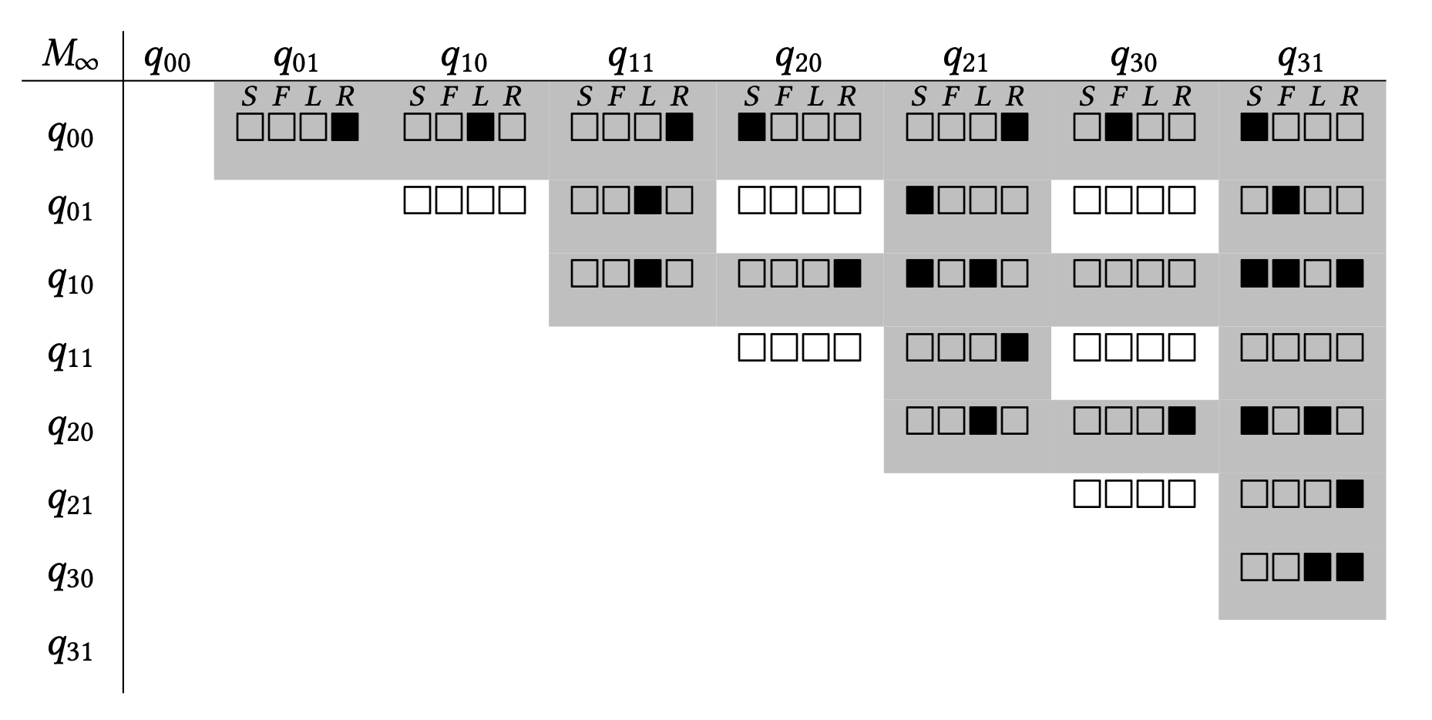
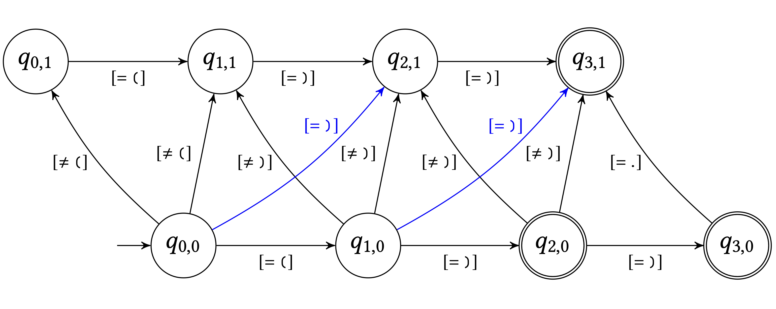
Syntax CNF grammar
Decoder
∂□E
₊
P(x_{t} | x_{t-1}, … , x_{t-c})
S → ( ) | ( S ) | S S
S → L R
S → L F
L → (
F → S R
S → S S
R → )
Completed Parse Matrix
Regular expression
Sampled repairs
Reranked repairs
⟶
⟶
( ( ) )
( ) ( )
( )
…
( )
( ) ( )
----------
(truncated @ k=2)
⟶
⟶
⟶
⟶
⟶
Source Edit automaton
)
( ) ( )
) ) )
( ) )
...
( ( )
( ( ) )
⟶
⟶
⬄
( ) )
)

