Slide 1
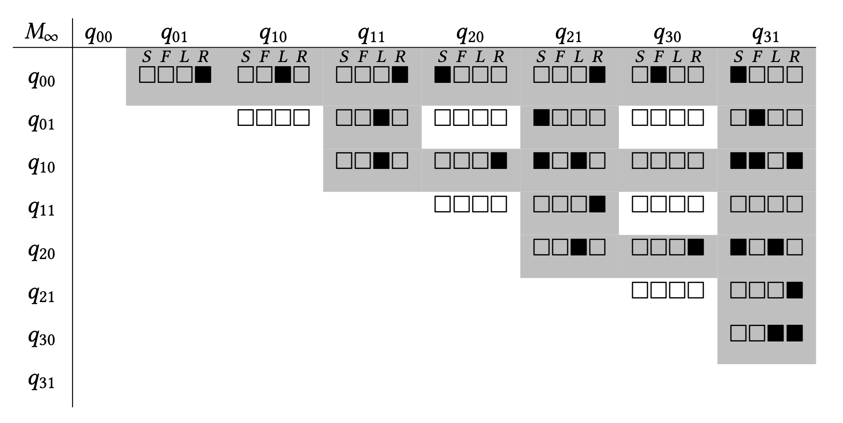
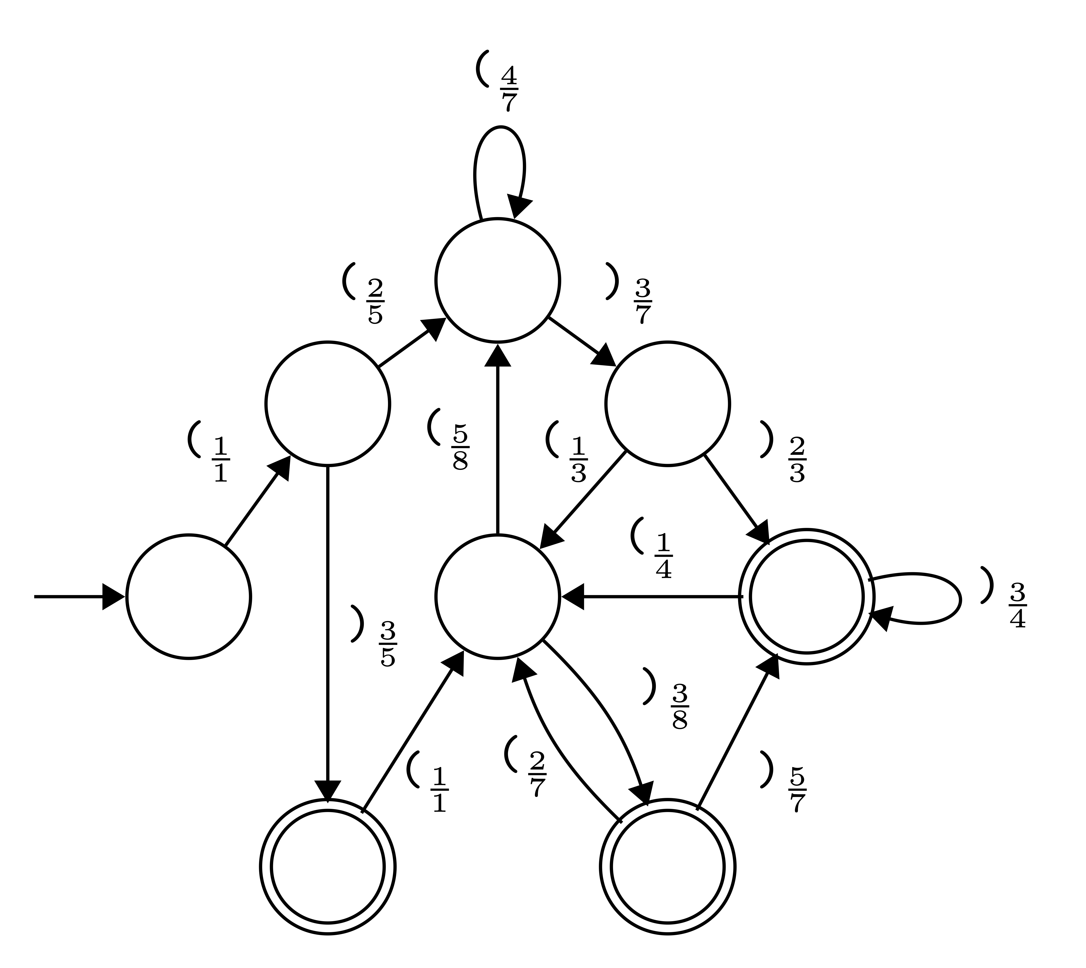
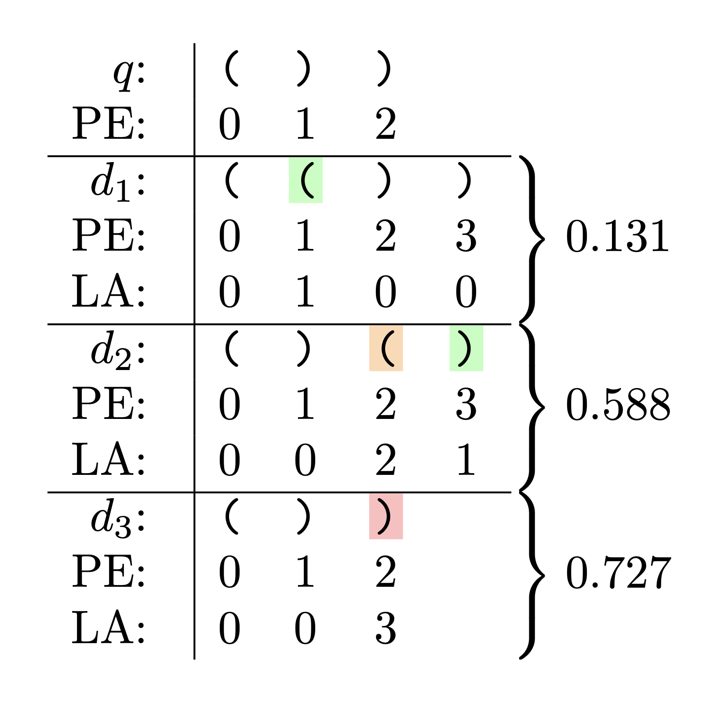
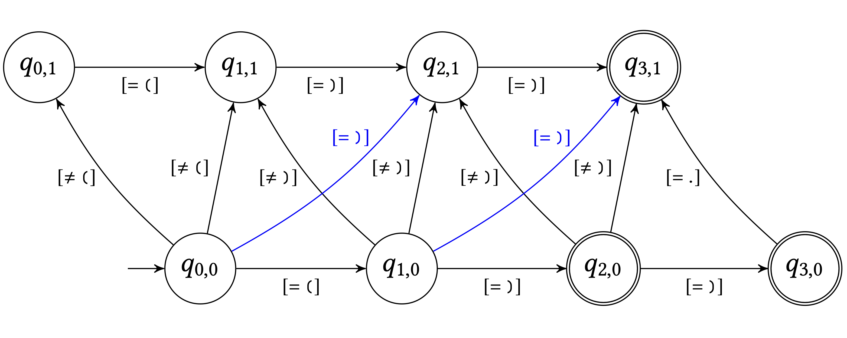
Syntax CNF grammar
S → ( ) | ( S ) | S S
LaTeR Reranking
S → L R F → S R
S → L F S → S S
L → ( R → )
WDFA Decoding
Completed Parse Matrix
Regular expression
Reranked repairs
⟶
⟶
( )
( ) ( )
----------
(truncated @ k=2)
⟶
⟶
⟶
⟶
⟶
Source Edit automaton
⟶
( ) )
⟶

