Slide 1
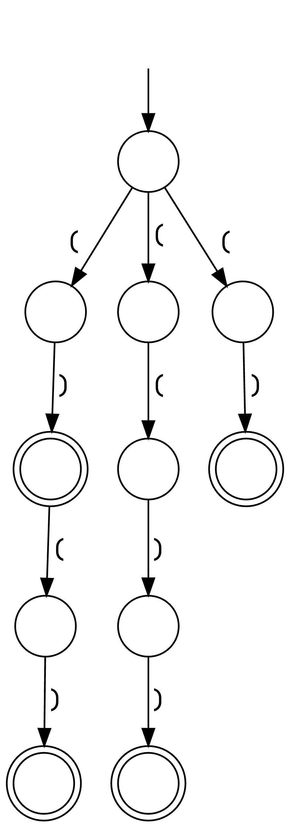
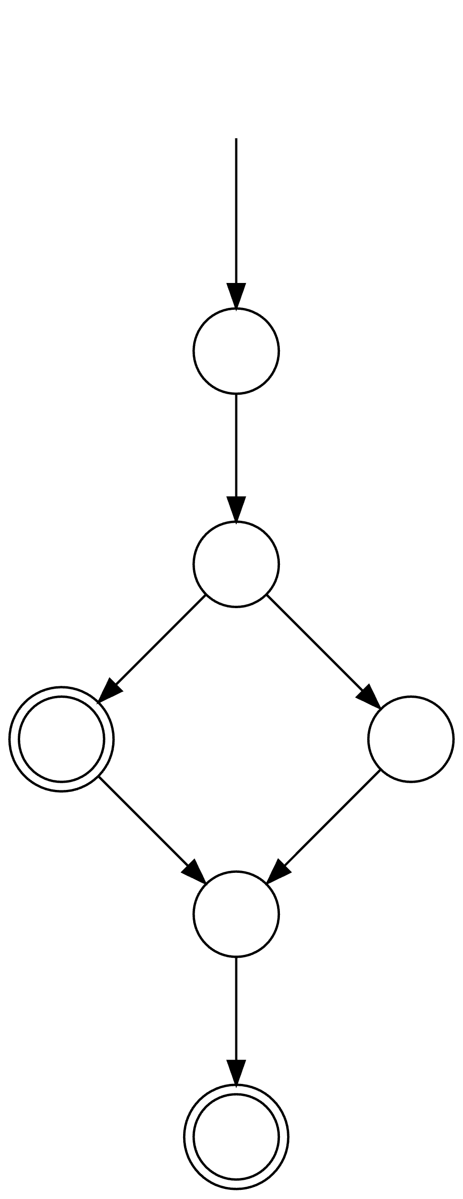
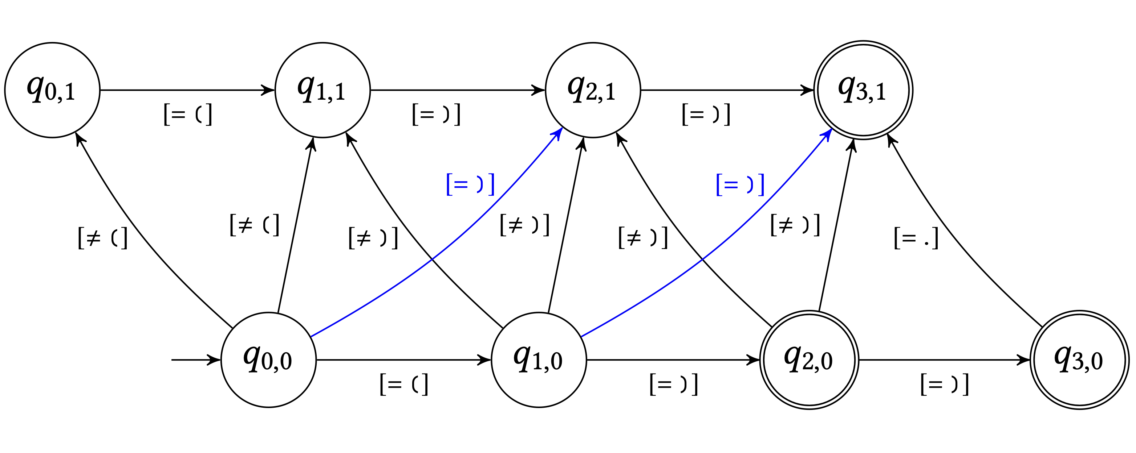
Syntax CNF grammar
CNF ∩-grammar
NFA
DFA*
Decoder
S → ( ) | ( S ) | S S
S → L R
S → L F
L → (
F → S R
S → S S
R → )
⟶
Ranked repairs
⟶
S → q₀₀Lq₁₀ q₁₀Rq₃₁ S → q₀₀Lq₂₁ q₂₁Rq₃₁ S → q₀₀Lq₀₁ q₀₁Fq₃₁ S → q₀₀Lq₁₀ q₁₀Fq₃₁ S → q₀₀Lq₁₀ q₁₀Rq₂₀ S → q₀₀Sq₂₀ q₂₀Sq₃₁
( )
( ) ( )
( ( ) )
(
(
⟶
⟶
⟶
⟶
)
(
)
(
Code edits Edit automaton
q₁₀Rq₃₁ → ) q₁₁Rq₂₁ → ) q₂₀Lq₂₁ → ( q₂₀Lq₃₀ → ( q₂₁Rq₃₁ → ) q₃₀Rq₃₁ → ) q₁₀Rq₃₁ → ) q₁₁Rq₂₁ → ) q₂₀Lq₂₁ → ( q₂₀Lq₃₀ → ( q₂₁Rq₃₁ → ) q₃₀Rq₃₁ → )
⟶
q₂₀Sq₃₁ → q₂₀Lq₂₁ q₂₁Rq₃₁ q₂₀Sq₃₁ → q₂₀Lq₃₀ q₃₀Rq₃₁ q₀₀Sq₂₀ → q₀₀Lq₁₀ q₁₀Rq₂₀ q₀₁Fq₃₁ → q₀₁Sq₂₁ q₂₁Rq₃₁ q₀₁Sq₂₁ → q₀₁Lq₁₁ q₁₁Rq₂₁ q₁₀Fq₃₁ → q₁₀Sq₂₁ q₂₁Rq₃₁ q₁₀Sq₂₁ → q₁₀Lq₁₁ q₁₁Rq₂₁ q₀₀Sq₃₁ → q₀₀Lq₁₀ q₁₀Rq₃₁ q₀₀Sq₃₁ → q₀₀Lq₂₁ q₂₁Rq₃₁
(
)
(
)
)
( ) ( )
) ) )
( ) )
...
( ( )
( ( ) )
( ) )
⟹
)
)
)

