Slide 1
Heart Disease:Predictors
Breanna Parker • 1-17-2023

Slide 2
Hypothesis
Looking at certain medical issues that could be predictors of heart disease. These can be used to help someone who’s at risk make changes to their life to lower their risk. I think age, blood pressure, cholesterol, and fasting blood sugar are all predictors
Variables:
Age: seeing if men or women are more at risk
cholesterol
Blood pressure
Fasting blood sugar
sex
Maximum heart rate

Slide 3
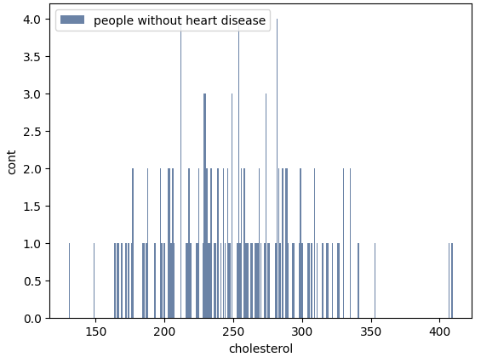
Cholesterol levels of people without heart disease
For people without heart disease we can see that their range of cholesterol is typically between 150 and 350.

Slide 4
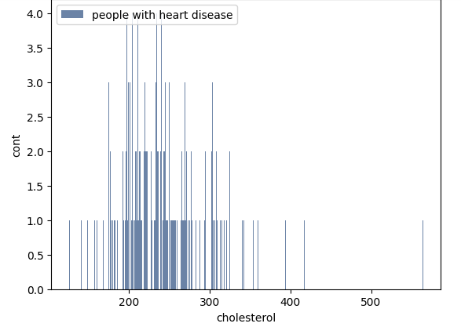
Cholesterol for people with heart disease
If you look at the graph to the left, we can see that people with heart disease have a similar range of cholesterol levels from about 150 to 350, but there appear to be more in the higher ranges, meaning cholesterol may have be a predictive factor for heart disease for this dataset.

Slide 5
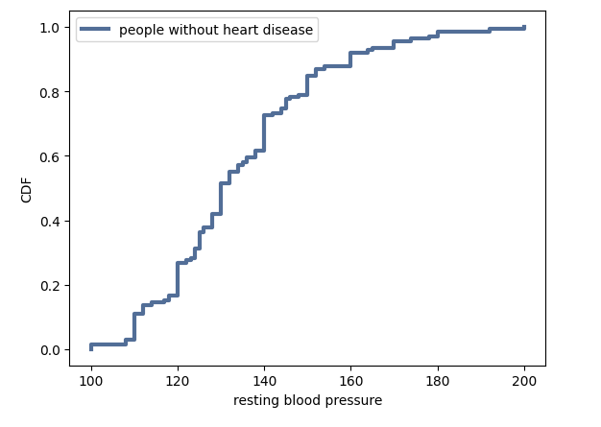
Next we’ll look at resting blood pressure
Here we have a graph of the resting blood pressure for those without heart disease

Slide 6
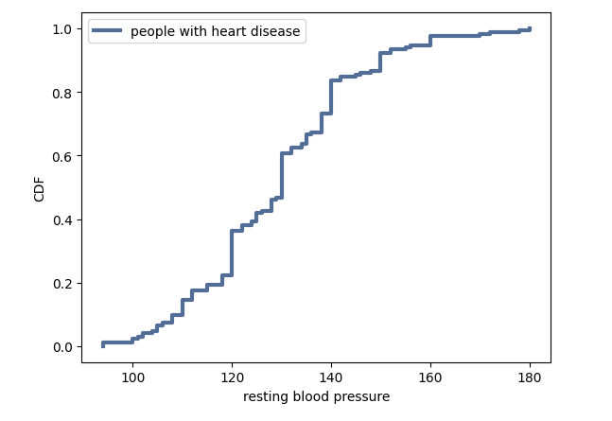
Resting blood pressure with heart disease
Here we have a graph of the blood pressure of those with heart disease. In this dataset it appears that, overall, those with heart disease tend to have lower blood pressure when first admitted to the hospital.

Slide 7
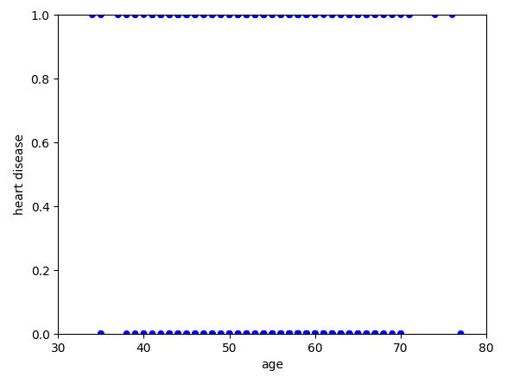
Next we’ll look at age and heart disease
Heart disease indicator of 1 means that the person has heart disease, while 0 means that they do not. If you look at the ages, they are pretty similar between the two groups.

Slide 8
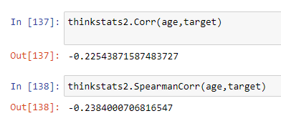
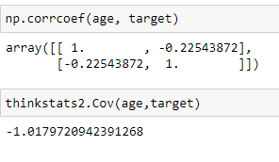
Correlation of age and Heart disease
Next I ran some correlation studies to see if age is a predictive factor of heart disease. Because the outcome is closer to 0 than it is to 1, we can assume that there isn’t a correlation. There are several studies that say there is a correlation between age and heart disease so this is just true of this dataset.

Slide 9
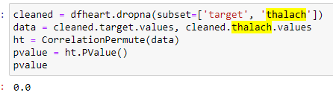
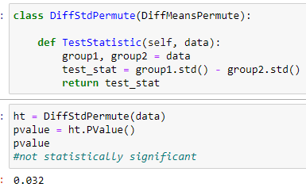
Max Heart Rate achieved
The reported p-value is o, which means that we didn’t see a correlation, under the null hypothesis, that exceeded the observed correlation.
After running the DiffStdPermute, the p-value is not statistically significant either.

Slide 10
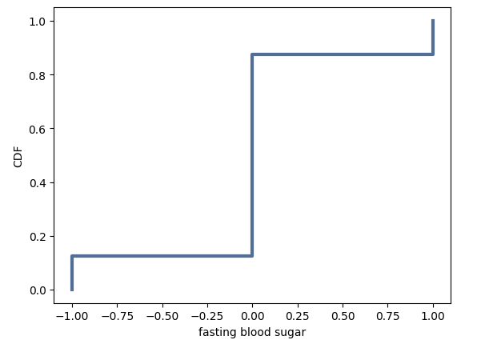
Fasting blood sugar and heart disease
Fasting blood sugar is either >120 or lower, shown as a 1 or 0.
Here we have a cdf graph of fasting blood sugar

Slide 11
Conclusion
Much more tests would need to be run on this dataset to see which variables are predictive of heart disease and which aren’t. Also, a larger dataset might be needed to get a better conclusion since only 300 people participated in this study. From the tests that I’ve run, the only variable that I’ve seen that is a predictor, possibly, is cholesterol.

