Slide 1
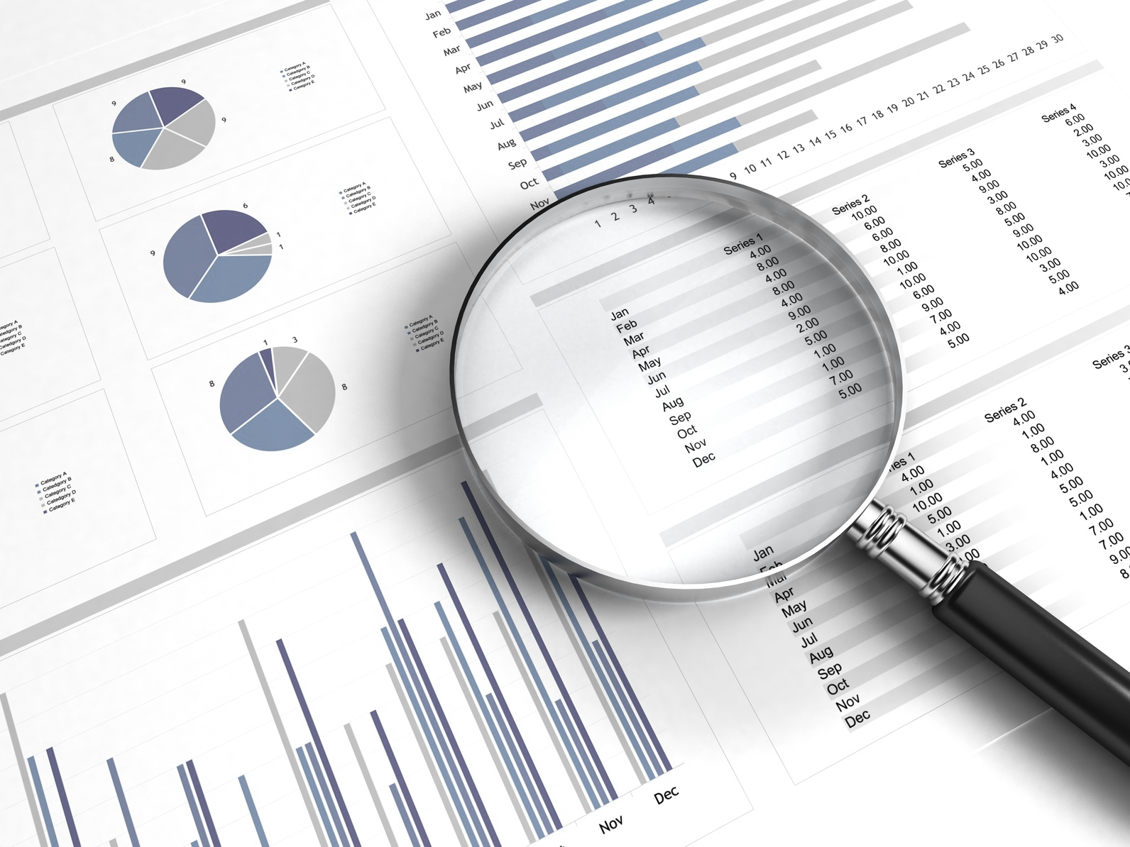
DATA CLEANING
Introduction to Machine Learning
Strictly private and confidential

Slide 2

Agenda
I
The Data Science Process
II
Pandas
III
The Data Science Process
V
Project
<number>

Slide 3
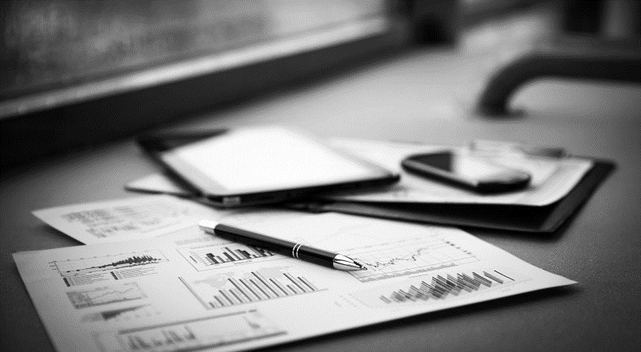
The Data Science Process
Section I

Slide 4
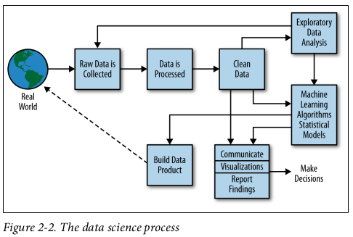
The Data Science Process
First Stage of the Whole Process

Slide 5
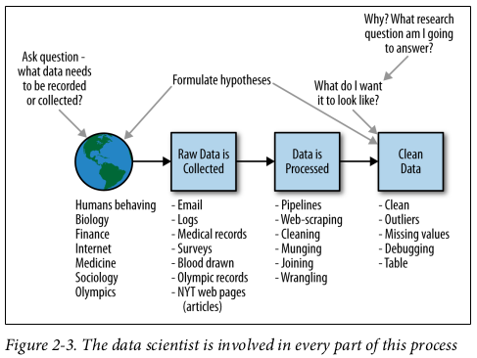
The Data Science Process
The MOST IMPORTANT STAGE of the Process

Slide 6
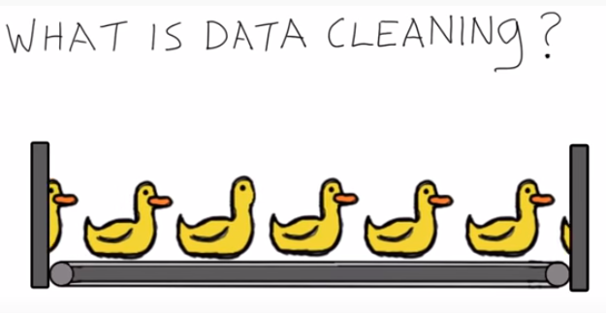
Workshop Overview
Data Cleaning
https://www.youtube.com/watch?v=dzqOwmxK3j4

Slide 7
Pandas
Section II

Slide 8
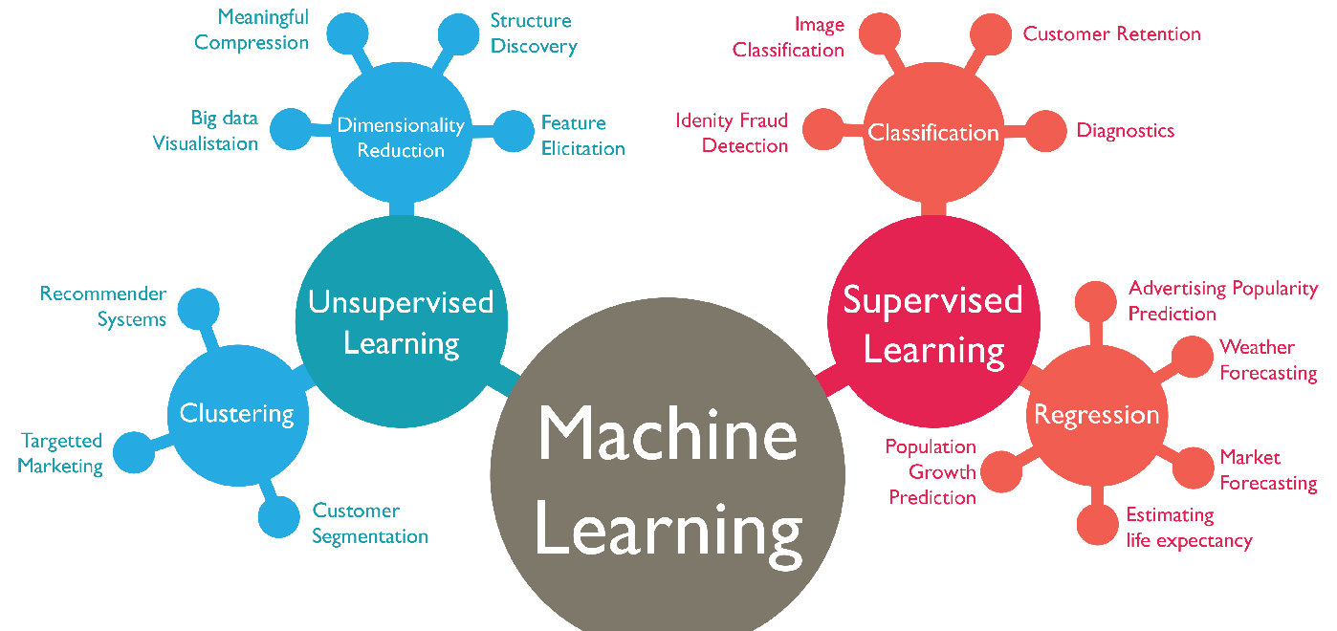
What is Machine Learning?
Machine Learning
Computational methods to learn from data with the ultimate purpose of producing rules that improve the performance of a specific task or decision making process. (Felipe González)

Slide 9
The Data Science Process
Section III

Slide 10
The Data Science Process
80% of the work

Slide 11
The Data Science Process
20% of the work

Slide 12
Project
Section IV

Slide 13
Project
The Problem
I tried to find a data set with the following characteristics:
Useful to apply all the concepts covered in the workshop
Interesting to the majority of you
Highly informative even if you don't care about the topic
Helped me to keep you awake and coming
App Development
We will understand the App development market, predict some trends and see how our “new App” would develop in the market

Slide 14
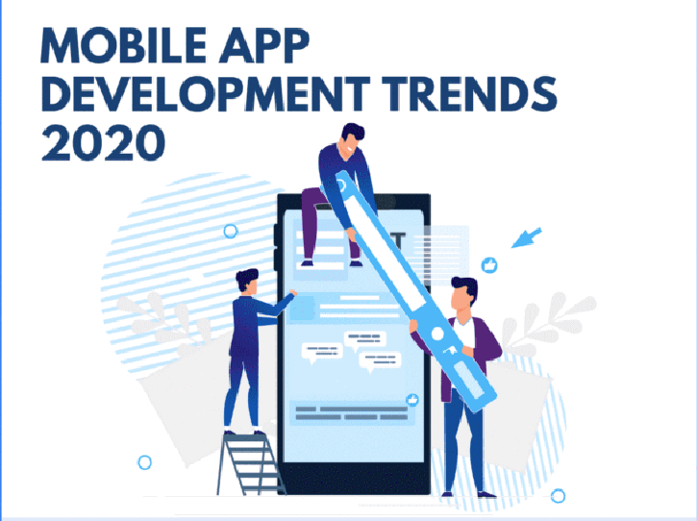
Project
The Problem

Slide 15
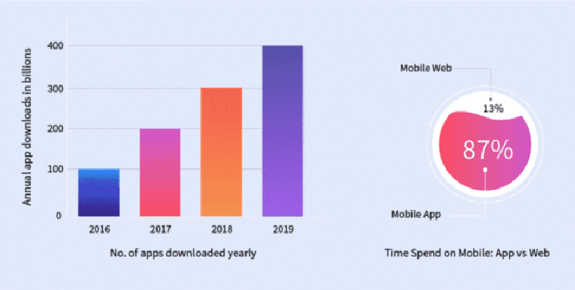
Project
The Problem

Slide 16
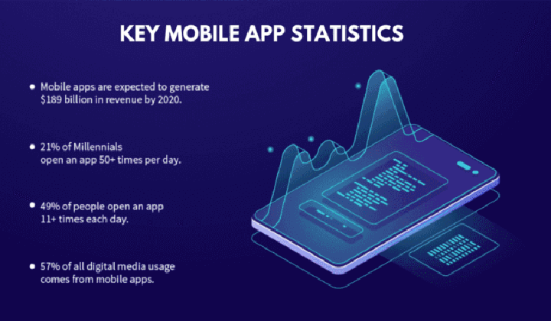
Project
The Problem

Slide 17
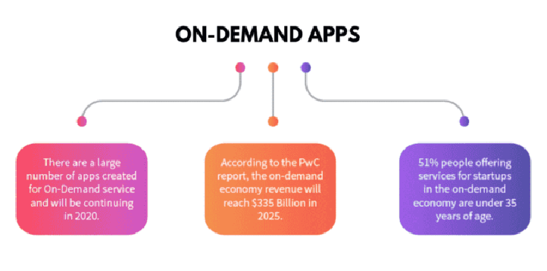
Project
The Problem

Slide 18
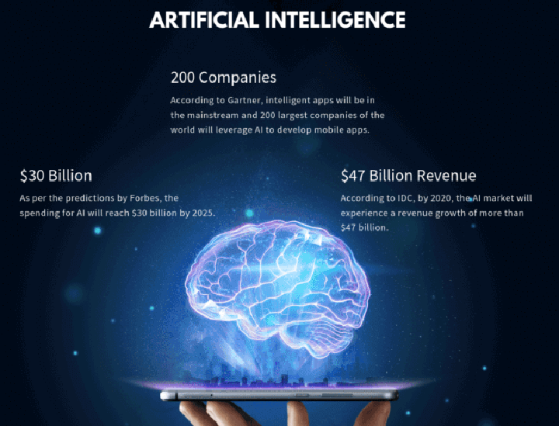
Project
The Problem

Slide 19
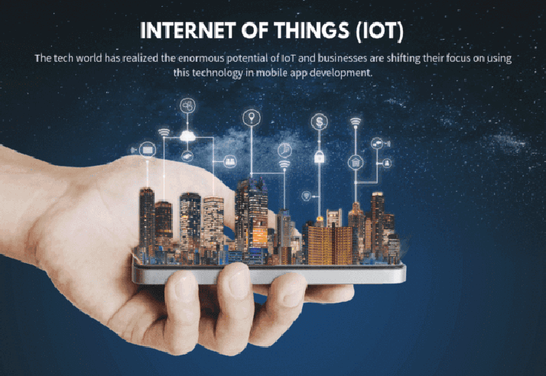
Project
The Problem

