Slide 1
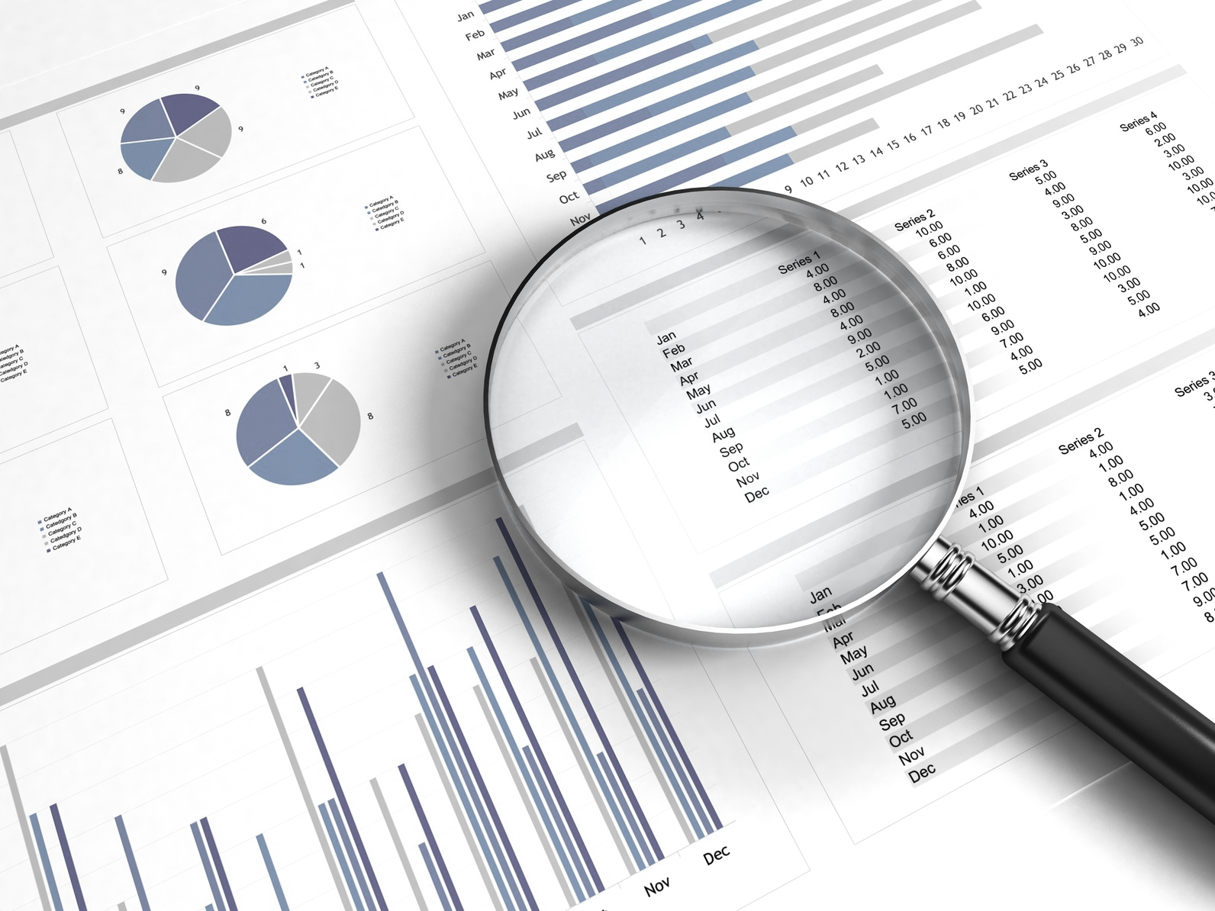
WORKSHOP OVERVIEW
Introduction to Machine Learning
Strictly private and confidential

Slide 2

Agenda
I
Workshop Overview
II
What Is Machine Learning
III
The Data Science Process
V
Project
<number>

Slide 3

Workshop Overview
Section I

Slide 4
Workshop Overview
Approach
Know what Machine Learning is to generate an analytical perspective of everyday phenomena, being able to detect possible technology applications to develop solutions to common problems.
Order of the sections
The workshop is designed in a way that you can apply the topics covered at the beginning of the session to a concrete problem
45 minutes of theory and examples
45 minutes solving a problem

Slide 5
What is Machine Learning
Section II

Slide 6
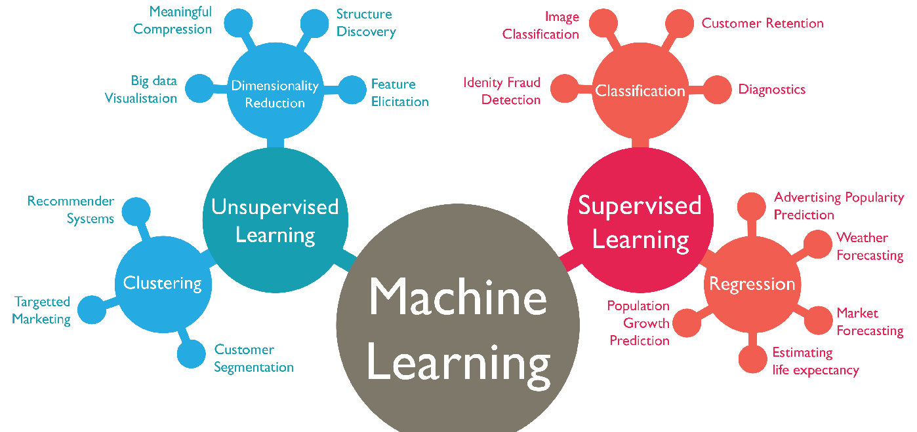
What is Machine Learning?
Machine Learning
Computational methods to learn from data with the ultimate purpose of producing rules that improve the performance of a specific task or decision making process. (Felipe González)

Slide 7
The Data Science Process
Section III

Slide 8
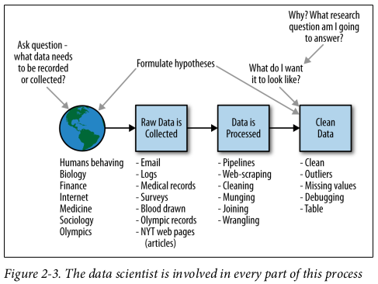
The Data Science Process
80% of the work

Slide 9
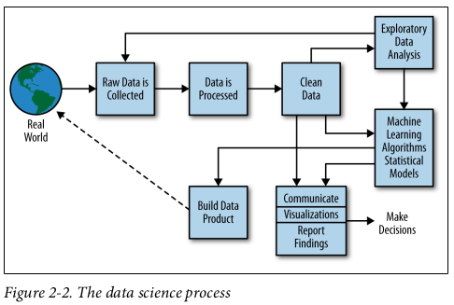
The Data Science Process
20% of the work

Slide 10
Project
Section IV

Slide 11
Project
The Problem
I tried to find a data set with the following characteristics:
Useful to apply all the concepts covered in the workshop
Interesting to the majority of you
Highly informative even if you don't care about the topic
Helped me to keep you awake and coming
App Development
We will understand the App development market, predict some trends and see how our “new App” would develop in the market

Slide 12
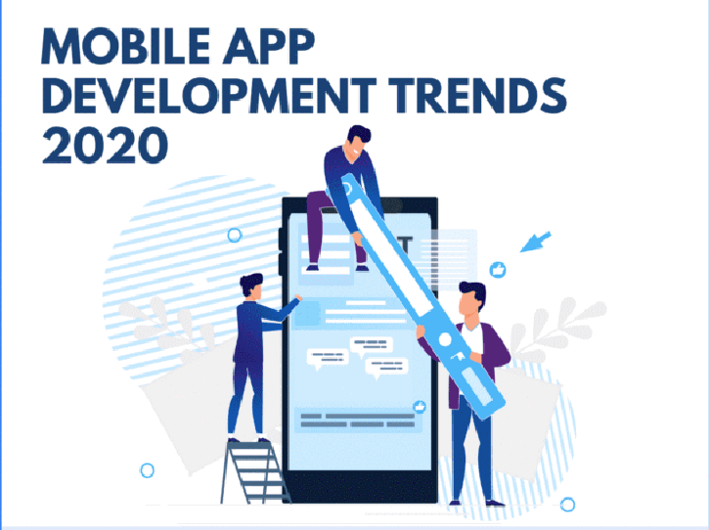
Project
The Problem

Slide 13
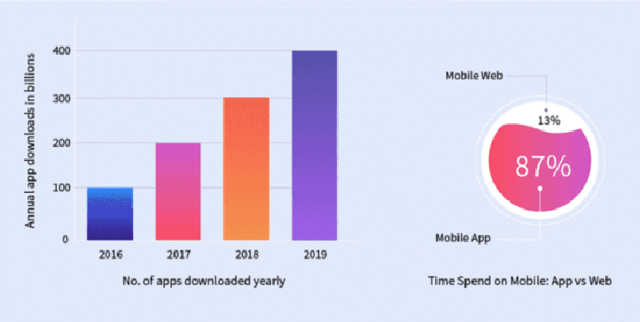
Project
The Problem

Slide 14
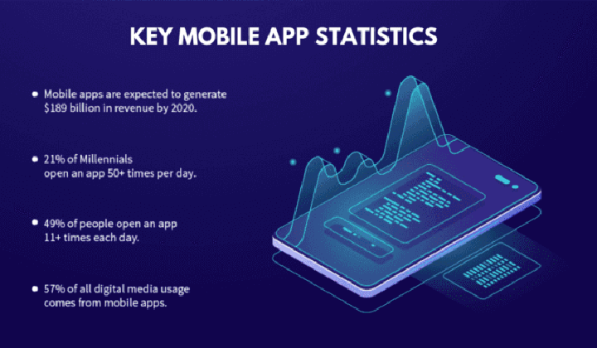
Project
The Problem

Slide 15
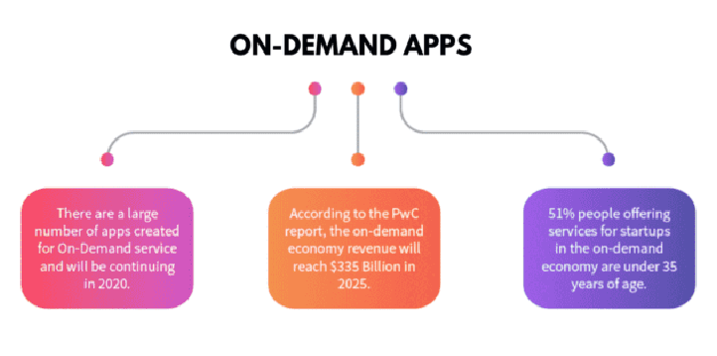
Project
The Problem

Slide 16
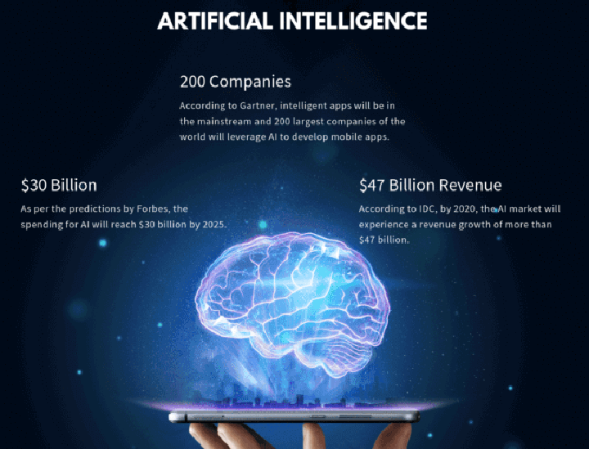
Project
The Problem

Slide 17

Project
The Problem

Slide 18
Let’s Begin
https://notebooks.azure.com/fralvro/projects/python-4-fin/tree/machine_learning_intro/pandas
Sorry For the long Link
If you want just go to https://notebooks.azure.com/fralvro/projects

