Slide 1
MessageOps Monitor
Crowd Powered Monitoring for
Enterprise SaaS Applications

Slide 2

Communication apps are mission critical
But how do you ensure high service levels when they run in the cloud?
Detect
Alert
Isolate
Fix

Slide 3


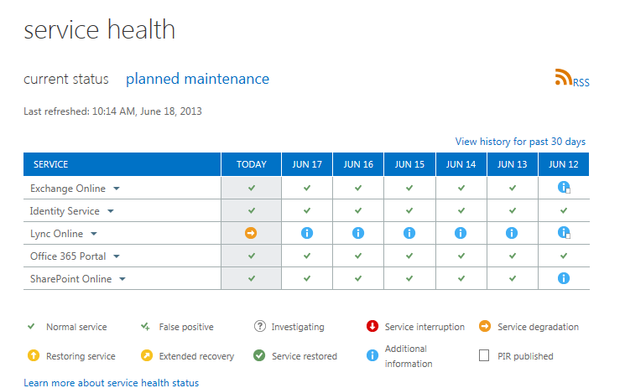
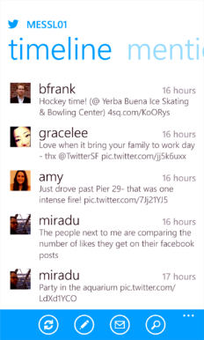
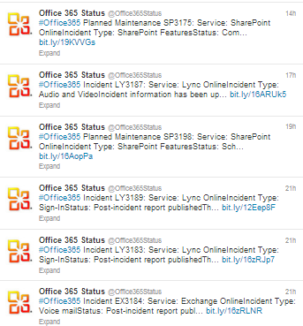
Is this how you monitor Office 365?
You need a better answer than the 365 Health Dashboard or Twitter

Slide 4





Why the 365 Dashboard isn’t enough
Your 365 service depends on multiple infrastructure providers
Your Local
Infrastructure
ISP & Internet Backbone
Infrastructure
Office 365
Infrastructure

Slide 5
Why the 365 Dashboard isn’t enough
Problems can occur in areas where the Dashboard can’t see
Will impact the
user here
A problem here
But won’t show up on the Office 365 Dashboard

Slide 6

MessageOps Monitor gives you end-to-end visibility
Active point of access monitoring detects problems in real time
Champion Cloud Monitoring synthetically monitors Office 365
from behind your firewall, to the cloud and back
detecting problems before users do

Slide 7
But that’s just one location

Slide 8

You need a bigger picture
MessageOps Monitor gives you access to a global network of sensor data

Slide 9

Your sensors provide real time performance information for your specific locations

Slide 10
Data from the MessageOps Monitor
global customer
network gives
you insight
into issues
outside
of your
network

Slide 11
So you can quickly
determine if a
problem is local…

Slide 12
In the service
delivery
networks…

Slide 13

Or at Microsoft…
You avoid wasted
calls to Microsoft
support
and
minimize the
time
to resolve
service
problems

Slide 14

Now, instead of this…

Slide 15
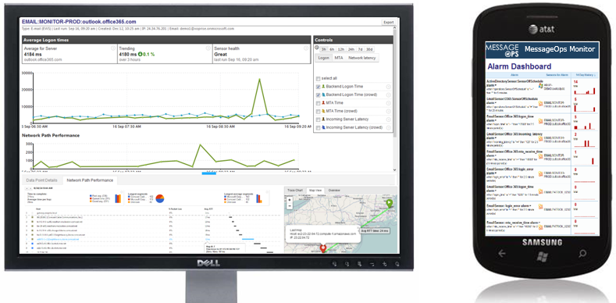
You get this…

Slide 16
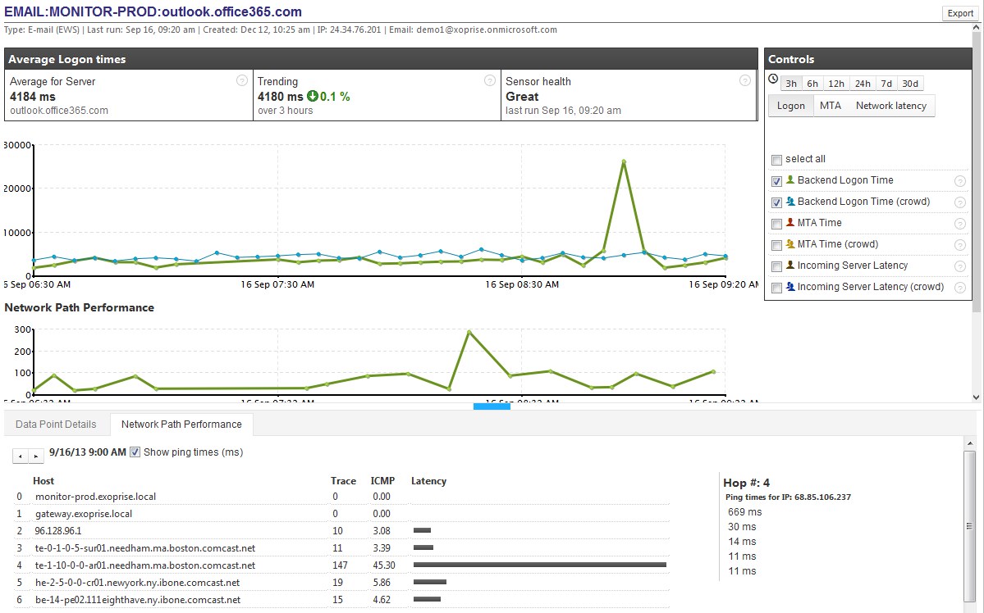

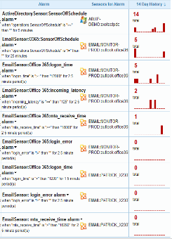
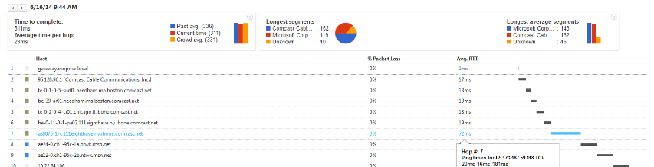
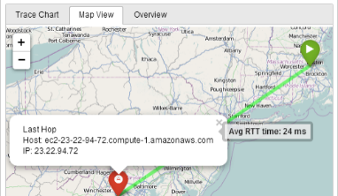
You get this…
MessageOps Monitor
Real time alerts for Office 365 service disruptions and performance problems

Slide 17
You get this…
MessageOps Monitor
Office 365 performance data continuously measured from your access locations

Slide 18
You get this…
MessageOps Monitor
Ability to pinpoint local, regional, or global service problems with CloudReady’s crowd data analytics

Slide 19
You get this…
View & download up to 30 days Office 365 Performance and Service Level Attainment data
MessageOps Monitor

Slide 20
You get this…
Detect and diagnose network problems end-to-end from your locations, through your ISPs, to Microsoft’s datacenters
MessageOps Monitor

Slide 21
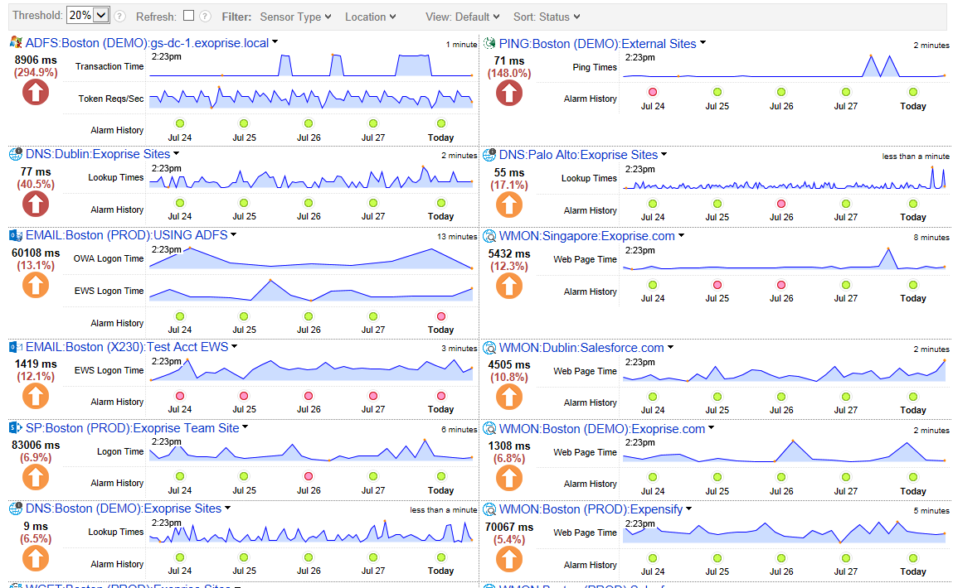
You get this…
MessageOps Monitor
And a single pane of glass view of performance and availability health for all of their cloud & hybrid services

Slide 22
MessageOps Monitor
Active Point of Access Monitoring
Real Time Alerts
Crowd Powered Data Analytics
Detailed Network Path Performance
Detect, Isolate, and Fix SaaS Issues Before they Impact Users

Slide 23
Next Steps
For more information or to place an order contact MessageOps at:
877-788-1617
http://www.messageops.com/contact

