Slide 1
Basic Programming
Hy-Tech Club: Python 201

Slide 2

Variables
What is the purpose of variables in a program?
Variables in Python
num1 = 10
num2 = 5
num2 = num1
x = num1 + num2
Declaration is just like setting
Notes:
Call on a student and ask what the purpose of variables is in a program. They store information about the program.
Variables are kind of like files – and a computer’s memory is like a file cabinet. Everything has a name, and the information in a given folder can be accessed and changed.
Show the students the syntax. Call on different students to ask what the value of the num1, num2, and x variables would be after execution.

Slide 3

Data Types
What are some examples of data types?
Integer
Float
String
Boolean
List
Dictionary
Type Conversion Example
yearStr = input("What year were you born?")
year = int(yearStr)
Notes:
Ask the students to call out different data types. While these data types may have some slight differences, they are largely the same across programming languages.
In Python, these data types are largely hidden from the programmer. They are still important to keep in mind though!
One specific case where it is necessary to work with data types is type conversions. If a program needs numeric information from the user, it will usually come in the form of text. This string text must be converted to numeric data. This is possible using int.

Slide 4
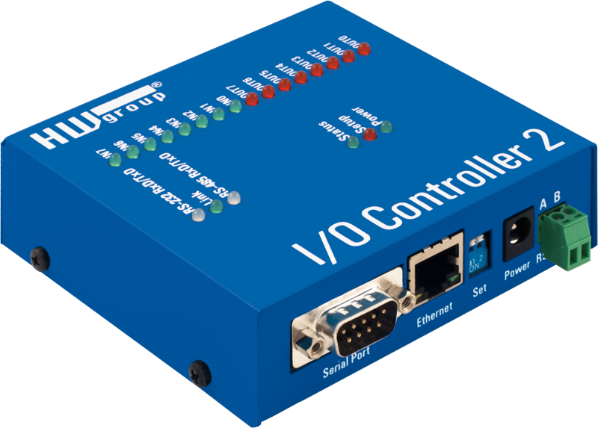
Input & Output
What is the purpose of input & output in a program?
Input in Python
name = input("What is your name?")
print("Hello, " + name)
Output in Python
print(":) :) :)")
print(6 + 4)
print(":( :( :(")
Displays: ?
:) :) :)
10
:( :( :(
Notes:
Ask a student what the purpose of input and output are: it’s the way the user of the program can communicate with the program.
Show the Output example and ask a student what will be displayed.
Show the Input example and ask a student what will be displayed.

Slide 5
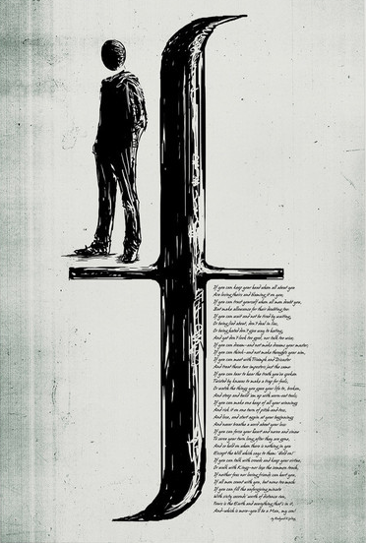
IF statements (Conditionals)
What is the purpose of if statements in a program?
Conditional Statements in Python
year = 1993
if year > 1996:
print("Gen Z")
else:
print("Millennial")
No Parentheses
Colons
Indentation
Notes:
Ask a student what the purpose of an if statement is in a program. If statements (along with else clauses) handle control flow in a program.
If statements, or conditionals, can make different things happen depending on conditions.
Show the example of an if/else in Python. Ask a student which message will appear.
Ask the students if they see anything different: there are no parentheses, and there are colons. There is also indentation (but that’s normal).

Slide 6
Syntax note: Colons and indentation
Python uses colons and indentation to create new code blocks.
They are used in if statements, for loops, functions, and more
They are a lot like curly brackets in JavaScript or C#
Python
if friend == "Mark":
print("oh hi mark")
JavaScript
if (friend == "Mark") {
alert("oh hi mark");
}
if friend == "Mark":
print("oh hi mark")
Notes:
Ask the students if they can explain what a code block is. It’s basically a new section of code with a different scope: it has different variables and things it can access.
Show the example of JavaScript.
Ask a student to translate the JS code into Python code. Type what the student suggests into the interactive text box – use Ctrl+Enter to make a new line.
Reveal the Python proper Python code.
Note that in JavaScript, the code would still work if there was no indentation; whitespace does not matter. In Python, however, the code would NOT work without indentation.

Slide 7
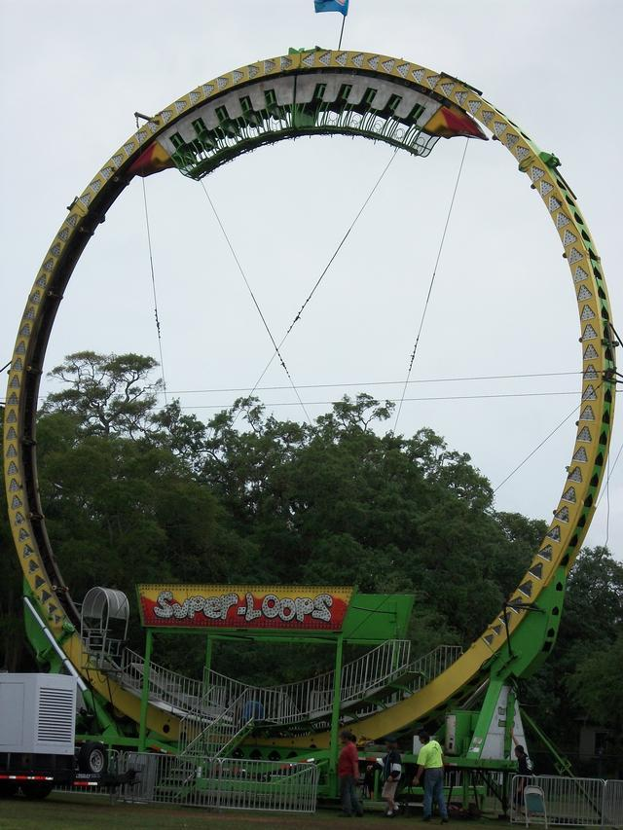
WHILE loops
What is the purpose of loops in a program?
While Loop in Python
going = True
while going:
more = input("Continue (y/n)?")
going = more == "y"
print("Done")
Very similar to if
Repeats until the condition is false
Uses colon/indentation
Notes:
Ask a student what loops do in a program. They allow developers to repeat code dynamically.
Show the example of a while loop. The syntax is very similar to the if statement syntax: it uses colon/indentation to create a new code block. The only difference is that the while loop will continue to repeat until the condition is false.
Note that boolean values in Python begin with capital letters: True and False.

Slide 8

functions
What is the purpose of a function/method in a program?
def keyword
Name
Parentheses
Parameter(s)
Colon / Indent
return keyword
Defining a Function
def add1(num):
return num + 1
Calling a Function
new_num = add1(4)
Name
Parentheses
Arguments
Setting Variable
Notes:
Ask the students what purpose functions (or methods, as they might know them) serve. They are designed to group re-usable blocks of code functionality.
Go over the syntax for defining a function. Make sure to mention each part of the function. Ask the students questions like “what is the name of the function” and “what is the parameter name.” Note that, again, this is similar to the syntax of other things: colon, new line, indentation.
Go over the syntax for calling a function. This is actually identical to the syntax in other languages. Ask the students questions like “what is the name of the function” and “what is the argument being passed into the function.” Make sure to note that the value returned is being set to the new variable value.

Slide 9
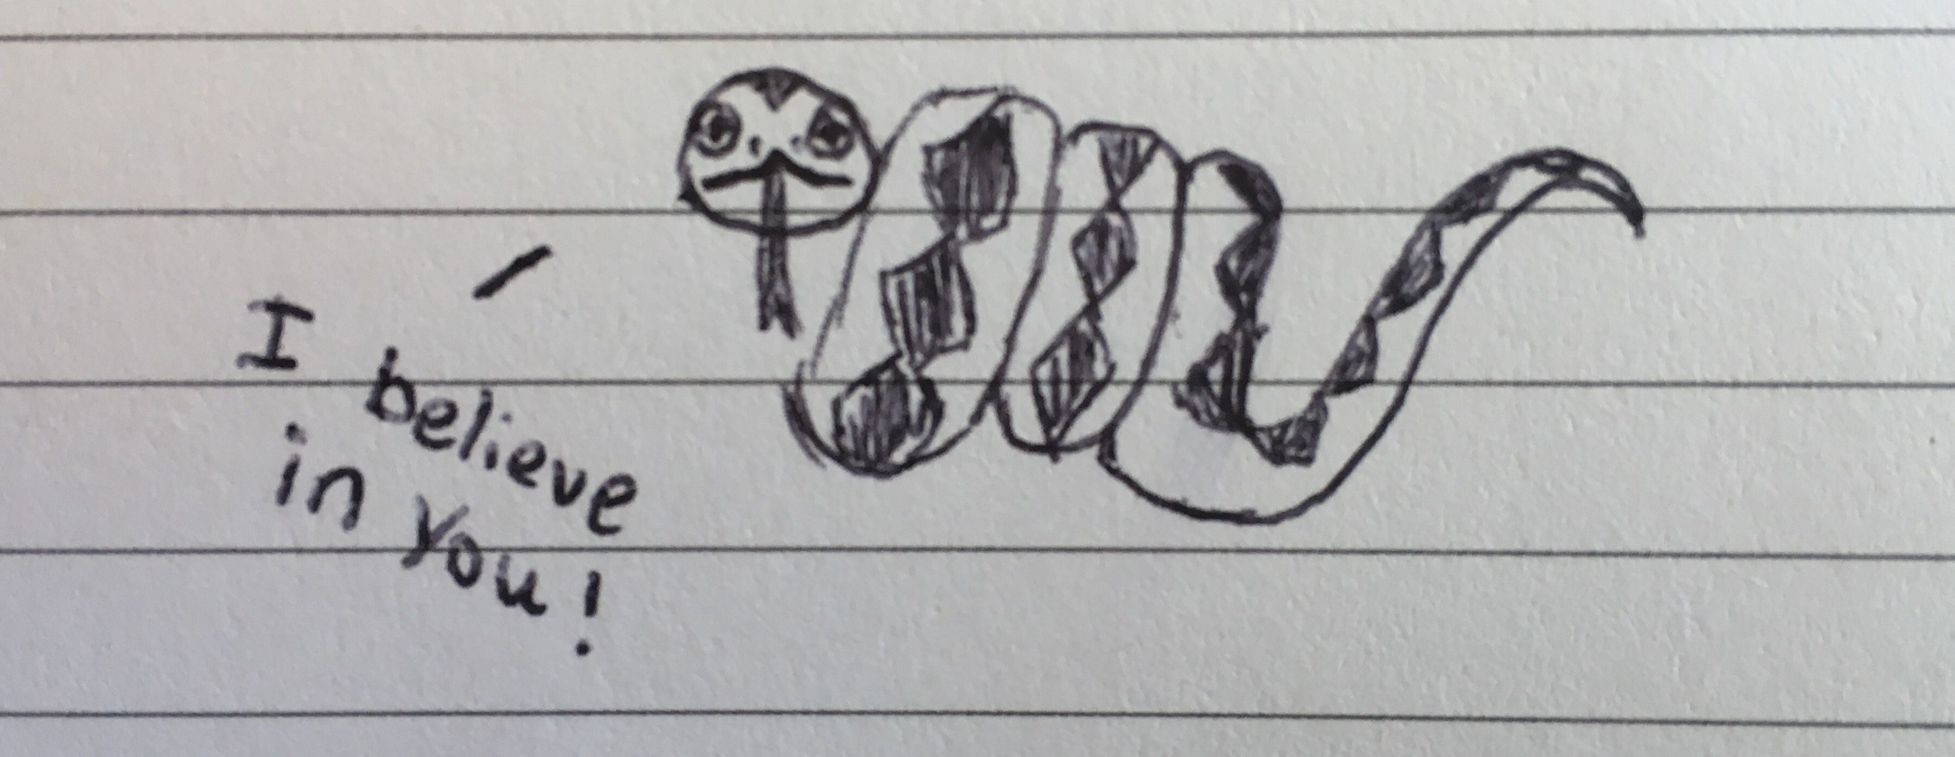
Summary and Closing Remarks
It is normal to feel overwhelmed by new syntax
Python is different, but ultimately simpler
Programming concepts transcend language
It takes time to get used to, but it’s very valuable to learn
You can do it!
Notes:
This may seem like a lot, but if you can write in any language, you can write in Python! It’s different, and may feel weird, but once you get into it, it is much shorter and simpler.
The programming concepts and structures used in Python are very similar to concepts from other languages (like C# and JavaScript).
Learning a new language can be tough, but it’s really worth it. It helps reinforce the mastery of the concepts and makes you a much better and more versatile programmer.
It might be challenging but you can do it!

Slide 10
Questions?

