Slide 1
Hello Python
Hy-Tech Club: Python 201

Slide 2
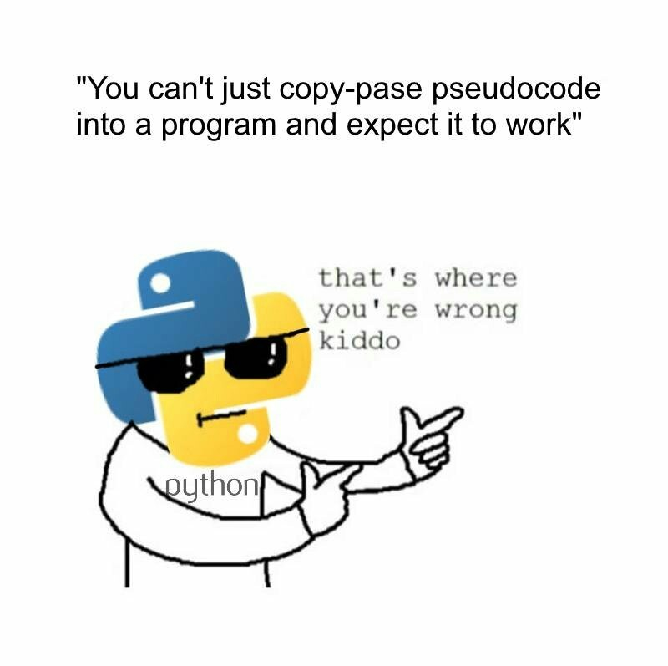
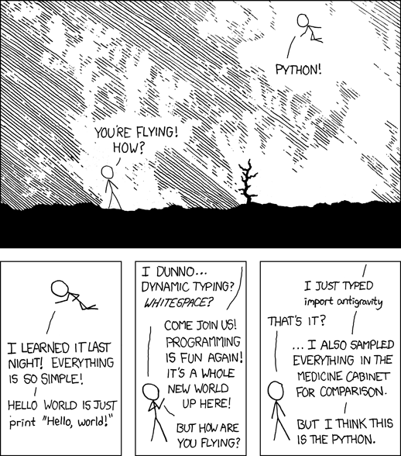
Notes:
There are a lot of pre-conceived notions you might have about python. The general perception is that Python is simpler – and it generally is. It tends to be much less verbose than a language like C# or JavaScript. However, there are some key differences that can become potential gotchas.

Slide 3
What makes Python different?
Conceptual
Dynamically typed (not static)
Interpreted (not compiled)
Syntactical
No curly brackets / semi-colons
Indentation matters!
C#
public static void Main()
{
string hello = "Hello World";
Console.WriteLine(hello);
}
Python
hello = "Hello World"
print(hello)
Notes:
From a conceptual perspective, Python is dynamically typed. This does not refer to typing on a keyboard – this is referring to the types of the variables. This is similar to JavaScript – it is not necessary to explicitly label types for variables. In a statically typed language like C#, it is necessary to give a type to every variable.
Python is also interpreted as opposed to compiled. This won’t matter too much, but this means that the interpreter runs the program directly instead of compiling it into a separate program file (e.g. main.exe in C#). This does make Python a little bit slower, but it can also make it a little easier to work with.
In terms of the syntax, curly brackets and semi-colons are not necessary for basic scripts. They are certainly less present. The one big gotcha is that indentation matters! This is how Python creates blocks of code: instead of placing statements within curly brackets (like in the body of an if statement in C#), those lines of code are indented. This can be weird to get used to, but it helps code stay nicely formatted!
Let’s take a look at a comparison. If you wanted to create a program that said “Hello World” it would look very different in C# and Python. Python programs are generally a little shorter and less verbose, but they can express the same thing!

Slide 4
What makes Python The same?
variables
while loops
input and output
data types
objects
lists
if statements
functions
for loops
Notes:
Although there are some key differences, all of the same programming concepts generally apply in any language. All of these words should hopefully be familiar!

Slide 5


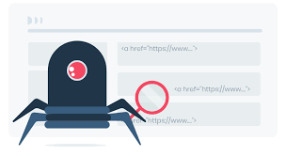
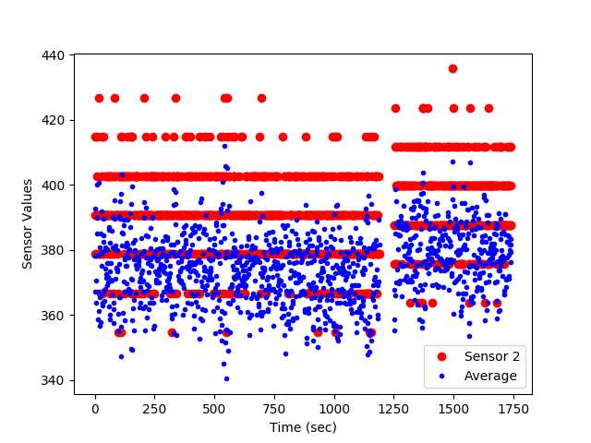


How can a developer use python?
Web Development
Automation
Web Scraping
Data Analysis
Game Development
Machine Learning
Notes:
Python has a ton of uses. A few of them:
Game Development
Automation
Web Development
Data Analysis
Web Scraping
Machine Learning

Slide 6

BONUS: Python Trivia
Released in 1991 by Dutch programmer Guido van Rossum
Some guiding principles include:
Beautiful is better than ugly.
Explicit is better than implicit.
Simple is better than complex.
Complex is better than complicated.
Readability counts.
Named after
Monty Python's Flying Circus
Notes:
None of this information is strictly necessary, but it’s fun to know.
Look at Guido van Rossum’s glasses
Read some of the guiding principles
Look at the cat

Slide 7
Questions?

