Slide 1
NY Math Score Predictor
Brecht Lauwers 3AI

Slide 2
What to predict?
Mean Scale Score (MSC):
Rating that shows performance level of a student
Divided into 4 levels or quartiles
In this case → math scores

Slide 3
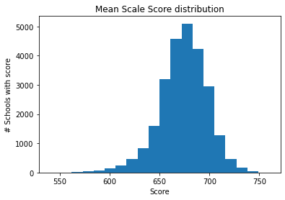
Regression

