Slide 1
Stan Is The Plan: Coding
Breck Baldwin

Slide 2
Resources
Tutorial repository—please download
https://github.com/breckbaldwin/StanIsThePlanDist
Install CmdStanPy—also install CmdStan
https://cmdstanpy.readthedocs.io/en/latest/index.html

Slide 3
Goals
Learn to code Stan models
Focus on prediction—A.I. and machine learning
Not statistics focused
Learn the pitfalls and common mistakes of Stan

Slide 4
Flow
Python reads from the command line
  Stan file to run
  Data to send, putt distance
Runs Stan model
  Compile if necessary
  Fit data (not part of compile)
  Predicts performance for stated putt distance
Summarizes results
Plots 'chance_in_5'

Slide 5
Run the goal program
> cd <path>/StanIsThePlanDist
> python puttBet.py stan/mechanistic_golf.stan 2

Slide 6
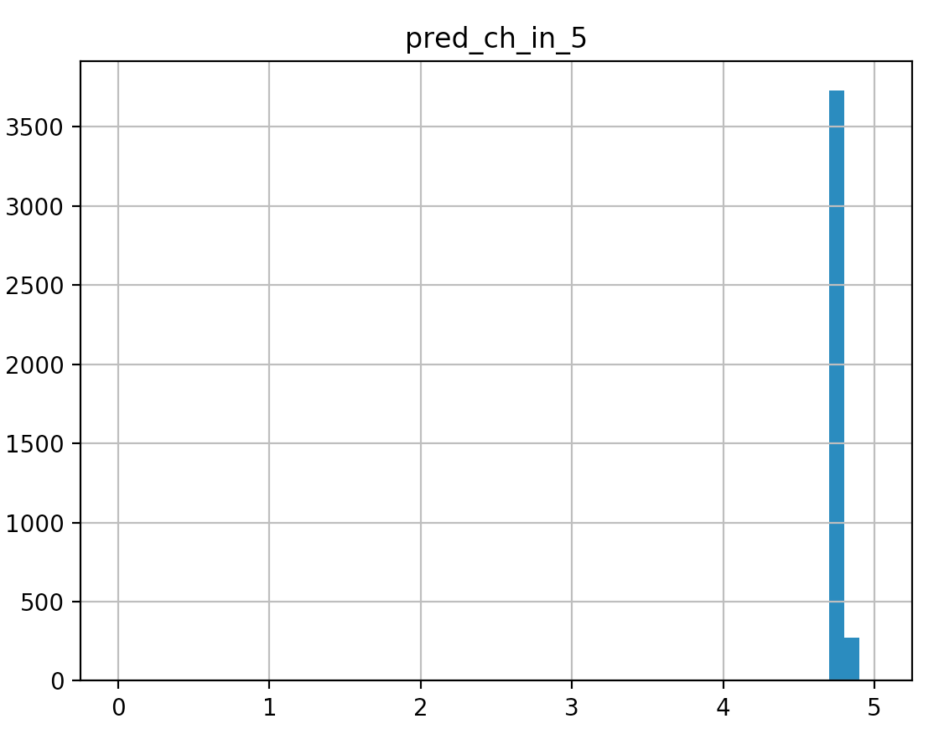
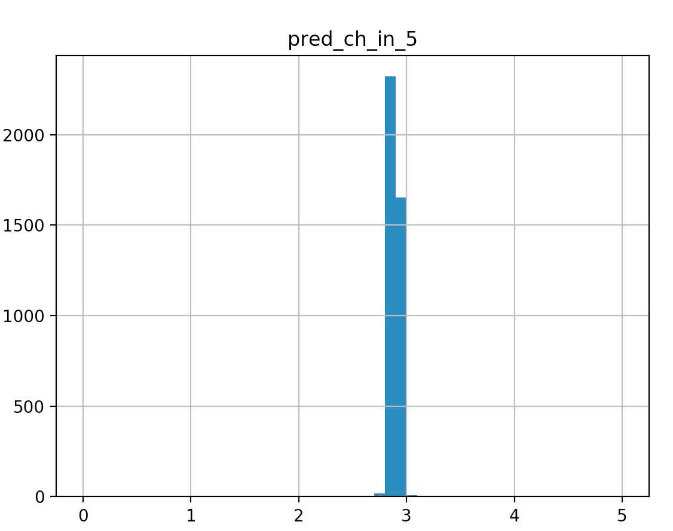
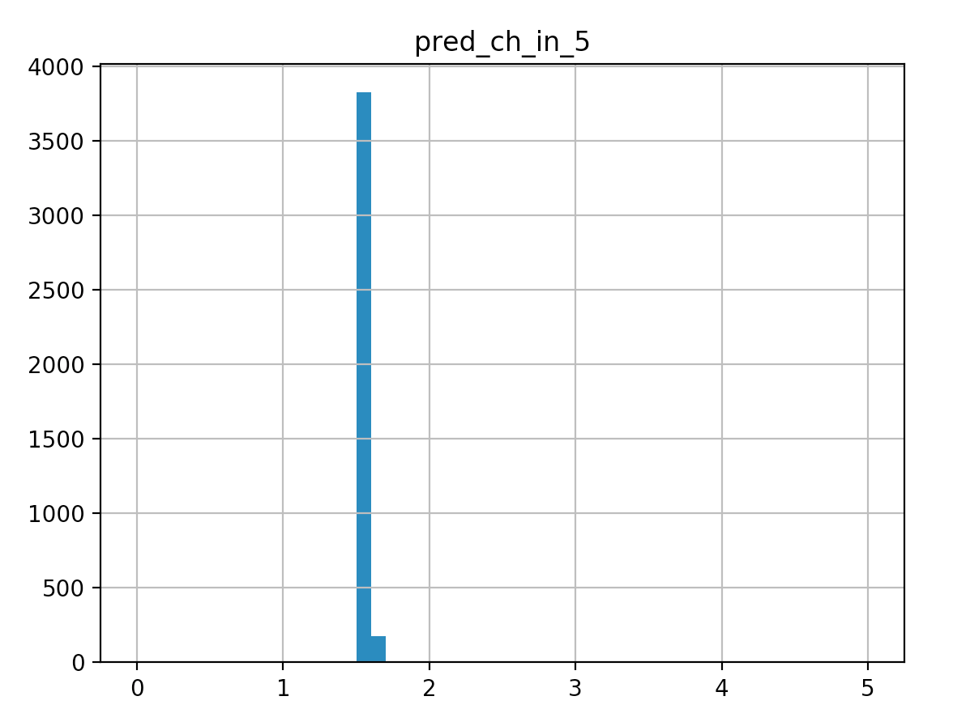
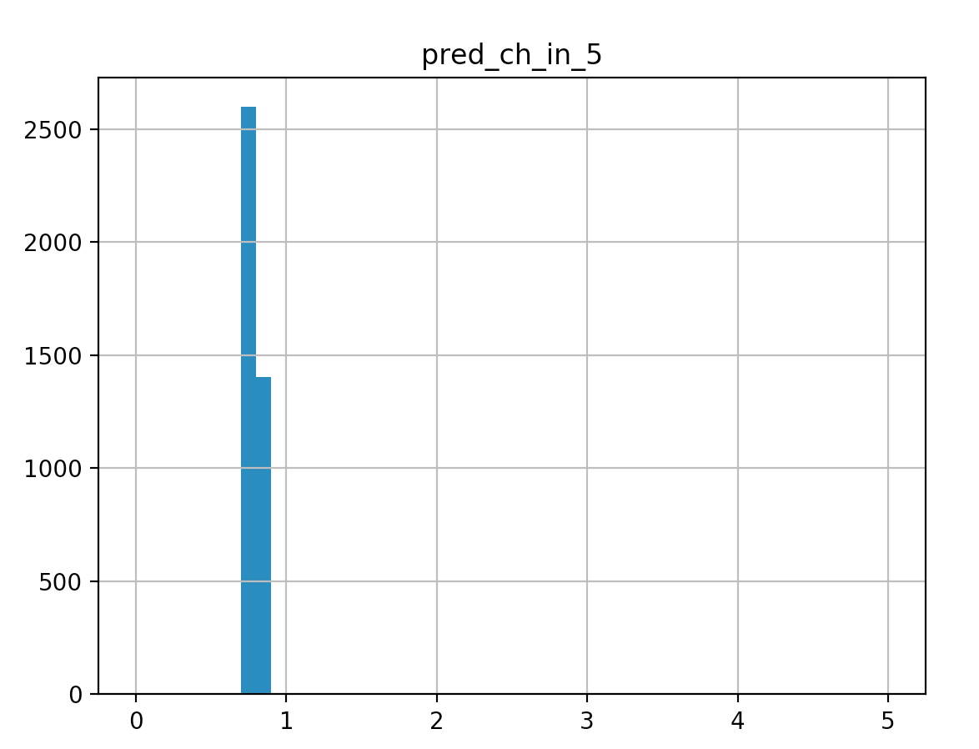
Some Predictions
2 ft
5 ft
10 ft
20 ft

Slide 7
The Basic Idea
Get a bunch of training data
Build a program generalizes that training data so it will work with novel data
Evaluate progress and refine
But we are doing it in a Bayesian way

Slide 8
Working with the posterior
The posterior is the combination of prior information with data via a likelihood.
Stan programs do not produce posteriors
Stan programs draw samples from posteriors.
chance_in_5 will have around 4,000 samples
  Each one a draw from the posterior
  No probabilities yet

Slide 9
Values for chance_in_5
[1] 4.983672319 0.504675345 0.956908493 2.875748848 0.997364239 0.417071450 4.501827071 0.936049387 0.863498351
[10] 4.153279253 2.060605266 1.139810114 3.779605672 1.658594148 1.067616110 4.116676326 2.330651455 3.967579063
[19] 1.842490519 0.455000172 1.157479467 2.752047595 0.915102101 4.982286286 4.391265367 4.992451716 2.447138984
[28] 2.205051616 4.231899958 0.812689175 3.989032044 0.796250061 0.859436737 1.028724611 1.924055572 3.208221532
[37] 2.210415693 2.136084733 1.248423340 3.315607704 2.254323347 4.784930724 4.885145022 1.982817767 4.984226181
[46] 0.048460657 0.282379449 3.722942450 0.999613762 2.502718692 3.243868759 0.822543222 0.211249991 1.147694845
[55] 4.896531799 4.199396308 0.665606386 3.141129394 2.607873759 4.690558455 4.696524164 4.031962569 2.755539678
[64] 1.283222482 2.248947510 0.319166050 0.636175197 1.570415334 2.837057149 2.539923313 3.181580786 1.233043905
[73] 3.061787637 4.764964321 0.918676119 0.480524564 1.491754639 3.321344687 0.492543512 2.089836199 4.983904438
[82] 1.547706472 2.414447829 0.282179524 1.666381844 0.367431461 4.361380324 3.373313419 4.397065423 1.689771086
[91] 1.141912694 2.459350776 4.159030935 3.116608167 3.076992472 0.823561946 2.969654653 1.165449756 1.658783029
[100] 0.351305357 1.694081739 1.259235890 1.387418442 2.528962612 4.852489185 1.374381734 2.941864848 1.157997846
[109] 0.168440287 4.373520019 3.886488608 1.093028201 4.987565650 4.812540735 4.595358682 0.655243261 2.834453881
[118] 2.728336762 1.977742924 2.179817460 0.320485894 3.711874986 0.189774115 2.125163616 2.366089869 2.752047595
[127] 2.270779435 2.060605266 0.497764905 1.841243712 0.039907438 3.040357791 2.607759999 1.721114910 2.466011311
...

Slide 10
Histograms
End goal is to figure out probability for values of 'chance_in_5'.
We bin 10 ways, 0-0.499, .5-.999, ...4.5-5
  Any exact value is unlikely to be found in samples
  Bins are human interpretable
P(chance_in_5 < 2.8) = 50%
  count(values < 2.8) / count(all values)
  Look at values
    $ less puttbet-1.csv

Slide 11
Histograms
End goal is to figure out probability for values of 'chance_in_5'.
We bin 10 ways, 0-0.499, .5-.999, ...4.5-5
  Any exact value is unlikely to be found in samples
  Bins are human interpretable
P(chance_in_5 < 2.8) = 50%
  count(values < 2.8) / count(all values)
  Look at values
    $ less puttbet-1.csv

Slide 12
A tour of puttBet.py
import os
from cmdstanpy import cmdstan_path, CmdStanModel
import pandas as pd
import numpy as np
import matplotlib.pyplot as plt
import seaborn as sns
import fileinput
import sys
stan_program_path = sys.argv[1]
distance_of_putt = float(sys.argv[2])
stan_program = CmdStanModel(stan_file=stan_program_path)
stan_program.compile()
json_data = data= {"distance_of_putt":distance_of_putt}
fit = stan_program.sample(data=json_data,
csv_basename='./puttbet')
print(fit.summary())
fit.get_drawset(params=['pred_ch_in_5']).hist(bins=50,range=(0,5))
plt.show()

Slide 13
Summarizing
We know Stan inputs
  Data
  Model
We know Stan outputs
  Posterior draws
We see roughly how they connect
  puttBet.py
  mechanistic_golf.stan

Slide 14
Next
Cover detailed mechanics of compiling/running Stan programs
Start building PuttBet app from zero

Slide 15
Compiling with CmdStan
cd <path>/cmdstan-2.21.0
mkdir tmp
edit/save tmp/test.stan
parameters {
real <lower=0, upper = 5> chance_in_5;
}
model {}
make tmp/test
ls tmp
test test.hpp test.o test.stan

Slide 16
Running a stan program
$ tmp/test sample
method = sample (Default)
sample
num_samples = 1000 (Default)
num_warmup = 1000 (Default)
…
Iteration: 1900 / 2000 [ 95%] (Sampling)
Iteration: 2000 / 2000 [100%] (Sampling)
Elapsed Time: 0.010488 seconds (Warm-up)
0.035355 seconds (Sampling)
0.045843 seconds (Total)

Slide 17
Running a Stan program
$ less output.csv
….
lp__,accept_stat__,stepsize__,treedepth__,n_leapfrog__,divergent__,energy__,chance_in_5
# Adaptation terminated
# Step size = 0.947331
# Diagonal elements of inverse mass matrix:
# 2.56888
0.195175,0.999576,0.947331,1,3,0,0.0821981,2.91519
0.125106,0.980979,0.947331,1,1,0,-0.124422,3.26398
-0.367036,1,0.947331,1,1,0,0.803274,4.16915
0.153601,0.993894,0.947331,1,3,0,0.584455,1.85203
0.216061,1,0.947331,2,3,0,-0.163841,2.71003
0.220674,0.999161,0.947331,1,3,0,-0.211056,2.37584
0.0979697,0.964437,0.947331,1,3,0,-0.0598895,3.35753
0.0966662,0.999669,0.947331,1,1,0,-0.0630794,3.36171
0.0966662,0.624582,0.947331,1,3,0,1.44813,3.36171
-1.16498,0.724709,0.947331,1,3,0,1.34801,4.66572
-0.429226,1,0.947331,2,3,0,1.07796,4.23059
-0.942596,0.937841,0.947331,1,1,0,0.960438,4.57411
-0.703981,1,0.947331,1,1,0,1.01248,4.44343
-1.55183,0.92825,0.947331,1,1,0,1.55254,4.77831
...

Slide 18
Summarizing Output
$ bin/stansummary output.csv
Inference for Stan model: test_model
1 chains: each with iter=(1000); warmup=(0); thin=(1); 1000 iterations saved.
Warmup took (0.010) seconds, 0.010 seconds total
Sampling took (0.035) seconds, 0.035 seconds total
Mean MCSE StdDev 5% 50% 95% N_Eff N_Eff/s R_hat
lp__ -0.30 3.6e-02 6.8e-01 -1.7 -7.5e-02 0.22 3.6e+02 1.0e+04 1.0e+00
accept_stat__ 0.93 3.2e-03 1.1e-01 0.68 9.8e-01 1.0 1.2e+03 3.4e+04 1.0e+00
stepsize__ 0.95 nan 2.9e-15 0.95 9.5e-01 0.95 nan nan nan
treedepth__ 1.4 2.1e-02 5.6e-01 1.0 1.0e+00 2.0 6.7e+02 1.9e+04 1.0e+00
n_leapfrog__ 2.7 5.4e-02 1.4e+00 1.0 3.0e+00 7.0 7.0e+02 2.0e+04 1.0e+00
divergent__ 0.00 nan 0.0e+00 0.00 0.0e+00 0.00 nan nan nan
energy__ 0.79 4.9e-02 9.5e-01 -0.16 5.3e-01 2.7 3.7e+02 1.1e+04 1.0e+00
chance_in_5 2.5 7.7e-02 1.4e+00 0.34 2.5e+00 4.7 3.3e+02 9.4e+03 1.0e+00
Samples were drawn using hmc with nuts.
For each parameter, N_Eff is a crude measure of effective sample size,
and R_hat is the potential scale reduction factor on split chains (at
convergence, R_hat=1).

Slide 19
Summarizing Output
$ bin/stansummary output.csv
Inference for Stan model: test_model
1 chains: each with iter=(1000); warmup=(0); thin=(1); 1000 iterations saved.
Warmup took (0.010) seconds, 0.010 seconds total
Sampling took (0.035) seconds, 0.035 seconds total
Mean MCSE StdDev 5% 50% 95% N_Eff N_Eff/s R_hat
lp__ -0.30 3.6e-02 6.8e-01 -1.7 -7.5e-02 0.22 3.6e+02 1.0e+04 1.0e+00
accept_stat__ 0.93 3.2e-03 1.1e-01 0.68 9.8e-01 1.0 1.2e+03 3.4e+04 1.0e+00
stepsize__ 0.95 nan 2.9e-15 0.95 9.5e-01 0.95 nan nan nan
treedepth__ 1.4 2.1e-02 5.6e-01 1.0 1.0e+00 2.0 6.7e+02 1.9e+04 1.0e+00
n_leapfrog__ 2.7 5.4e-02 1.4e+00 1.0 3.0e+00 7.0 7.0e+02 2.0e+04 1.0e+00
divergent__ 0.00 nan 0.0e+00 0.00 0.0e+00 0.00 nan nan nan
energy__ 0.79 4.9e-02 9.5e-01 -0.16 5.3e-01 2.7 3.7e+02 1.1e+04 1.0e+00
chance_in_5 2.5 7.7e-02 1.4e+00 0.34 2.5e+00 4.7 3.3e+02 9.4e+03 1.0e+00
Samples were drawn using hmc with nuts.
For each parameter, N_Eff is a crude measure of effective sample size,
and R_hat is the potential scale reduction factor on split chains (at
convergence, R_hat=1).

Slide 20
Compile/Run from Python
$ cd <path>/StanIsThePlanDist
$ python rv.py stan/test.stan
$ python rv.py stan/test.stan chance_in_5
$ python rv.py stan/test.stan chance_in_5 cat

Slide 21
Outline: Model Authoring for Beginners
Pick the simplest parameters that make sense
  Betting/Putting app: Sink or miss.
Eliminate the impossible (prior knowledge)
  A persons height can't be negative or > 10 ft
Find a way to incorporate data into priors (likelihood) that turns into a posterior
Have a way to decide if the posterior is useful

Slide 22
Code model up in Stan
Look at stan/no_putt.stan or just type into an editor
parameters {
real <lower=0, upper=5> chance_in_5;
}
model {
}
Save as 'stan/no_putt.stan'
$ cd <path>/StanIsThePlanDist
$ python rv.py stan/no_putt.stan chance_in_5

Slide 23
Inspect output-1.csv
>less output-1.csv
lp__,accept_stat__,...,divergent__,energy__, chance_in_5
-0.788662,0.834613,1.12129,1,1,0,0.799103, 4.49443
-0.34793,0.967041,1.12129,2,3,0,1.39449, 0.850982
-1.74739,0.802025,1.12129,2,3,0,1.78157, 4.81924
-1.74739,0.963619,1.12129,1,1,0,2.66079, 4.81924
…
0.171325,1,1.12129,1,1,0,-0.14552, 3.0618
0.0610676,0.958562,1.12129,1,1,0,-0.048304, 3.46703
-0.56155,0.829213,1.12129,1,3,0,0.878503, 0.656531

Slide 24
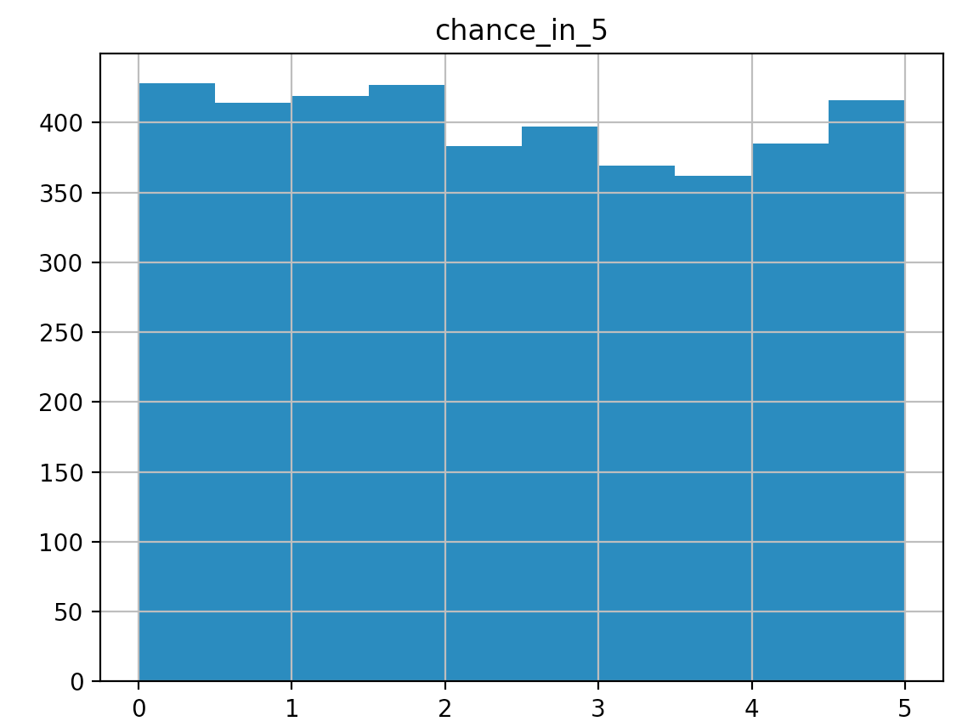
Histogram of 'chance_in_5'
$ python rv.py stan/no_putt.stan chance_in_5

Slide 25
Messing with Distributions
$ python rv.py stan/uniform_uniform.stan chance_in_5
parameters {
real <lower=0, upper = 5> chance_in_5;
}
model {
chance_in_5 ~ uniform(0,5);
}
Mean MCSE StdDev 5% 50% 95% N_Eff N_Eff/s R_hat
name
lp__ -0.379682 0.022752 0.840617 -2.094090 -0.043359 0.221461 1365.13 5689.78 0.999403
chance_in_5 2.513630 0.036922 1.427840 0.227396 2.461970 4.743070 1495.51 6233.22 1.002910

Slide 26
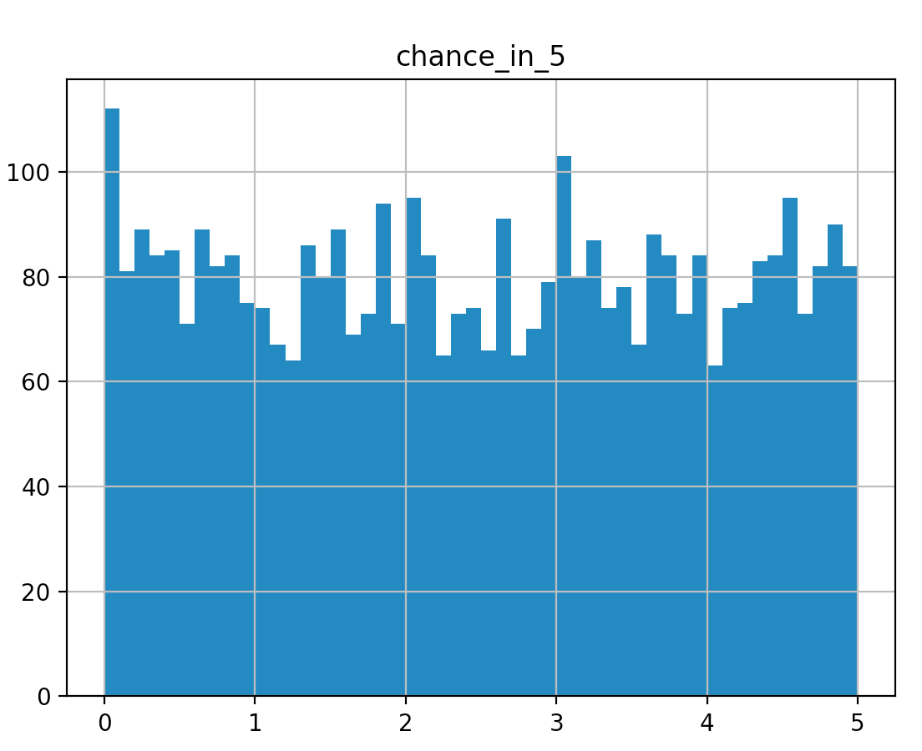
Uniform x Uniform

Slide 27
Uniform Haircut
parameters {
real <lower=0, upper = 5> chance_in_5;
}
model {
chance_in_5 ~ uniform(0,1);
}
> python rv.py stan/targ_unif_unif.stan chance_in_5

Slide 28
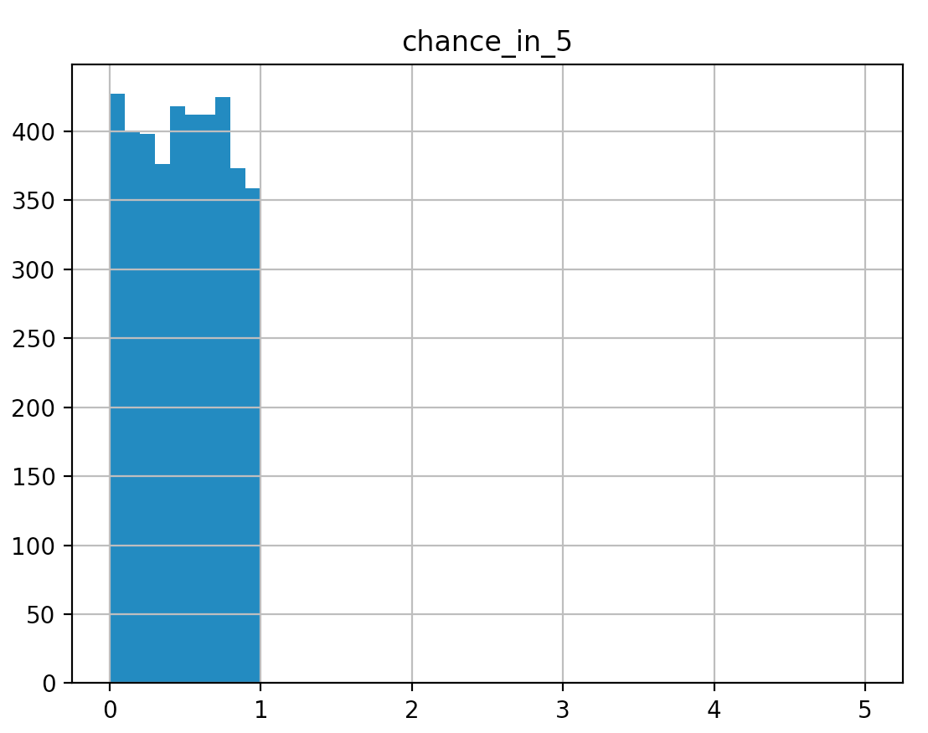
uniform(0,5) x uniform(0,1)

Slide 29
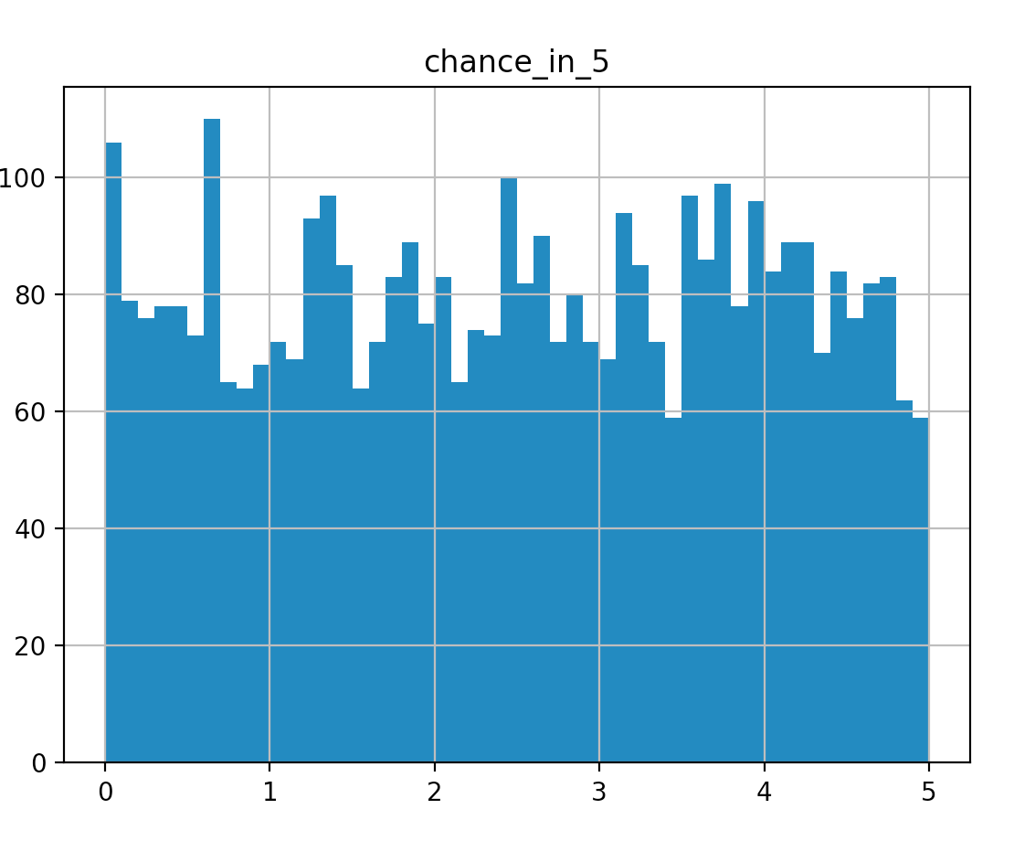
Fix by scaling
parameters {
real <lower=0, upper = 5> chance_in_5;
}
transformed parameters {
real chance_in_1 = chance_in_5/5;
}
model {
chance_in_1 ~ uniform(0,1);
}
$ python rv.py stan/scaled_uniform_uniform.stan chance_in_5

Slide 30
Adding some data to our model
Putt went in = 1, putt did not = 0
$ python rv.py stan/one_putt.stan chance_in_5
parameters {
real<lower=0, upper=5> chance_in_5;
}
transformed parameters {
real chance_in_1 = chance_in_5/5;
}
model {
chance_in_1 ~ uniform(0,1);
1 ~ bernoulli(chance_in_1);
}

Slide 31
Running the model
> python rv.py stan/one_putt.stan chance_in_5
Mean MCSE StdDev 5% 50% 95% N_Eff N_Eff/s R_hat
name
lp__ -0.890663 0.023695 0.784950 -2.54812 -0.592286 -0.303383 1097.41 6401.1 1.00204
chance_in_5 3.339720 0.031065 1.184030 1.13355 3.560120 4.876400 1452.69 8473.4 1.00132
chance_in_1 0.667945 0.006213 0.236806 0.22671 0.712025 0.975280 1452.69 8473.4 1.00132

Slide 32
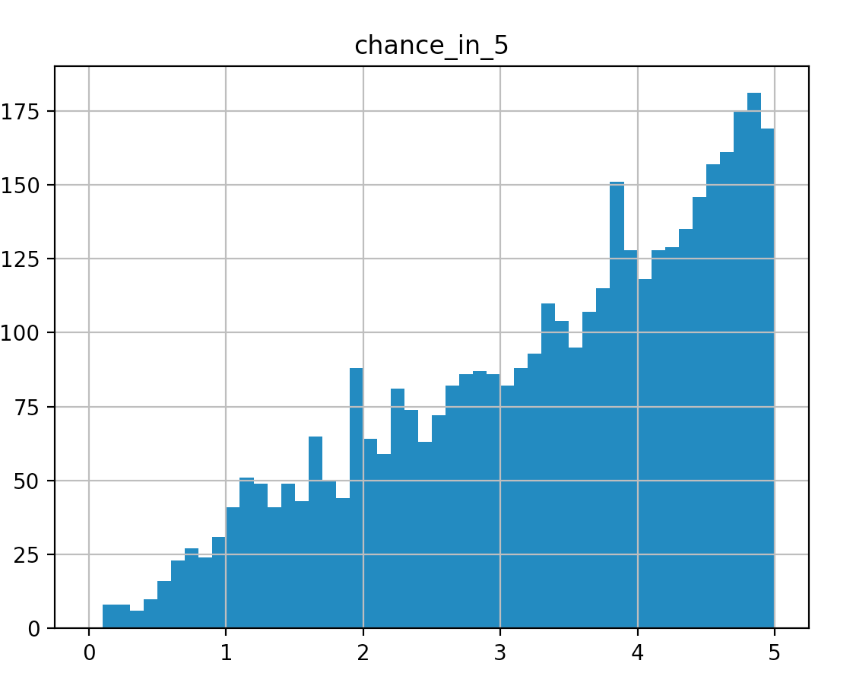
Running the model
> python rv.py stan/one_putt.stan chance_in_5

Slide 33
What happened?
Understand the Bernoulli distribution
Expose the implicit loop around blocks
Give the intuition around what the target() does

Slide 34
What is this Bernoulli thing?
Putt goes in: 1
  1 ~ bernoulli(.99) = .99
  1 ~ bernoulli(.1) = .1
  1 ~ bernoulli(.5) = .5
Putt does not go in: 0
  0 ~ bernoulli(.99) = .1
  0 ~ bernoulli(.1) = .99
  0 ~ bernoulli(.5) = .5

Slide 35
breck_noulli function
> python rv.py stan/breck_noulli.stan theta
functions {
real breck_noulli_lpmf(int zero_or_one,
real param_to_return_prob_of) {
if (zero_or_one == 1) {
return log(param_to_return_prob_of);
}
return log(1.0-param_to_return_prob_of);
}
}
parameters {
real<lower=0,upper=1> theta;
}
model {
1 ~ breck_noulli(theta);
}

Slide 36
Simplified (Wrong) Evaluation
From last iteration prev_target = .3
Propose a random value for chance_in_5 = 2:
Rescale to chance_in_1 = .4
Set target to 1
target = target*(1 ~ breck_noiulli(chance_in_1))
target = 1*(.4) = .4
If target > prev_target, accept proposal.
If target < prev_target
  accept proposal at 1/target rate, else keep last target().

Slide 37
How did Bernoulli change the posterior?
exp(prev_target)= .5, values of params recorded.
exp(target()) = 1
chance_in_1 = .4
exp(target()) * exp(uniform_lpdf(.4,1,0)) = 1
exp(target()) * exp(bernoulli_lpmf(1|.4)) = .4
.4/.5 < 1 so we accept 40% of the time
40% of .4 param survive, they reduce in histogram count.

Slide 38
generated quantities {
real chance_in_5[250];
real sigma_step_size = .5;
real my_target[250];
chance_in_5[1] = 2.5;
my_target[1] = log(chance_in_5[1]);
for (i in 2:250) {
real proposal = chance_in_5[i-1] + normal_rng(0,sigma_step_size);
real chance_in_1;
real random_value = uniform_rng(0,1);
my_target[i] = 0;
proposal = fmax(0.0,proposal);
proposal = fmin(5.0,proposal);
chance_in_1 = proposal/5;
my_target[i] += bernoulli_lpmf(1|chance_in_1);
if (exp(my_target[i])/
exp(my_target[i-1]) > random_value) {
chance_in_5[i] = proposal;
}
else {
chance_in_5[i] = chance_in_5[i-1];
}
}
print("Chance_In_5: ",chance_in_5);
print("Mean: ", mean(chance_in_5));
}
$ python run_met_hastings.py

Slide 39
Summary Section 1
We know the basics of how to run a Stan program with CmdStanPy.
Setup basic app, PuttData
Have very simple program with one data point
Next we will improve our model by
  Adding data
  Modifying the model

