Slide 1
Stan Is The Plan
Breck Baldwin
NYC PyData 2019

Slide 2
Goals
Programmer focused on mechanics, not statistical theory
Enough statistics to get you started understanding what is going on overall
Get past high probability failure points

Slide 3
What do statistics/AI care about?
Understand how/why golf putts happen?
  Sociology of golf, Economics of golf, Physics of golf
  Bayesians build a model to describe the data
PuttBet--Predict future golf putts:
  Deep Learning
    Use fixed model + data to predict
  Bayesian Inference
    Write own model + data to predict

Slide 4
PuttBet: Ideal Golf Betting App
Will a putt go in?
  Masters, Tiger Woods, Nov 6 2019, first putt?
Best possible answer?
  Return 0, putt will miss
  Return 1, putt will go in
What is the best possible backend?
  Golf Data Weekly from the future
  Simulation of parallel universe

Slide 5
Model Authoring for Beginners
Pick the simplest parameters that make sense
  Betting/Putting app: sink_or_miss(putt info) => [0,1]
  0 means miss, 1 means the put goes in (sink)
Eliminate the impossible (prior knowledge)
  One putt cannot miss twice or sink twice
  A persons height can't be negative or > 10 ft
Find a way to incorporate data into priors (likelihood) that turns into a posterior
Have a way to decide if the posterior is useful

Slide 6
An Important Philosophical Point
Can't model world for detail and scope reasons
  Detail: Computationally too big, don't have theory
  Scope: Computationally too big, don't have data
We can approximate however by averaging things out
  We limit how much we look at
  We ignore interactions hoping it won't matter
This gets us uncertainty
  Instead of 0 or 1, we say 0.01 or .5 or .99

Slide 7
Uncertainty
Calibration: .99 means that 99 times out of 100 we get X, 1 time we don't....over time....
Often abused, a system will claim .99 but it is not.
Difficult to separate poor calibration from uncertainty.
  We don't get HTHT on coin flips all the time
  Over large amounts of data we should get .5 H
  We should also get HHHHH with enough data

Slide 8
1st Revision to our model
Is PuttBet modeling the entire universe?
  No
Does PuttBet have access to the future?
  No
The PuttBet app will now return chance in 5 to reflect our uncertainty.
  0 chance in 5 is 0% probability
  5 chance in 5 if 100%
  2.5 chance in 5 is 50%

Slide 9
Code model up in Stan
Go to:
https://github.com/breckbaldwin/StanIsThePlanDist/
Copy and paste or just type into an editor
parameters {
real <lower=0, upper = 5> chance_in_5;
}
model {
}
Save as 'no_putt.stan'
>cd <path to cmdstan>
>make <path to no_putt.stan>
><path to no_putt.stan> sample

Slide 10
Running Stan Program
>./no_putt sample
method = sample (Default)
sample
num_samples = 1000 (Default)
num_warmup = 1000 (Default)
…
Iteration: 2000 / 2000 [100%] (Sampling)
Elapsed Time: 0.013104 seconds (Warm-up)
0.035397 seconds (Sampling)
0.048501 seconds (Total)

Slide 11
Inspect output.csv
>less output.csv
lp__,accept_stat__,...,divergent__,energy__, chance_in_5
-0.788662,0.834613,1.12129,1,1,0,0.799103, 4.49443
-0.34793,0.967041,1.12129,2,3,0,1.39449, 0.850982
-1.74739,0.802025,1.12129,2,3,0,1.78157, 4.81924
-1.74739,0.963619,1.12129,1,1,0,2.66079, 4.81924
…
0.171325,1,1.12129,1,1,0,-0.14552, 3.0618
0.0610676,0.958562,1.12129,1,1,0,-0.048304, 3.46703
-0.56155,0.829213,1.12129,1,3,0,0.878503, 0.656531

Slide 12
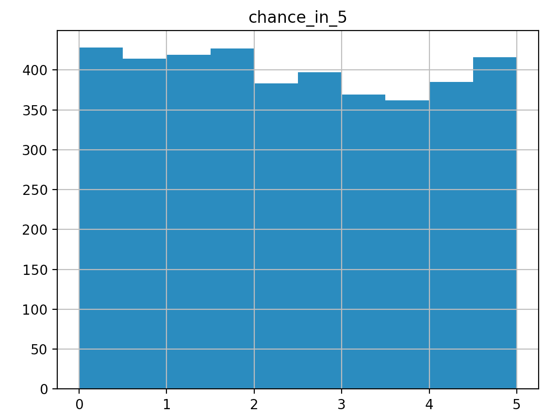
Histogram of 'chance_in_5'
>python run_visualize.py stan/no_putt.stan chance_in_5

Slide 13
Resources
https://github.com/stan-dev/cmdstan/releases
  >make
https://github.com/breckbaldwin/StanIsThePlanDist
  Clone or download button
  Use web interface
https://cmdstanpy.readthedocs.io/en/latest/index.html
  >pip install --upgrade cmdstanpy
  >export CMDSTAN='/path/to/cmdstan-2.21.0'
  >cd StanIsThePlanDist/python
  >python run_external_data_n_putt.py

Slide 14
Compile and Run It
cmdstan-2.20.0$ make tmp/zebra.stan
make: Nothing to be done for `tmp/zebra.stan'.
The compiler expects the file name without a .stan suffix

Slide 15
Successfully Compile
cmdstan-2.20.0$ make tmp/zebra
--- Translating Stan model to C++ code ---
bin/stanc --o=tmp/zebra.hpp tmp/zebra.stan
Model name=zebra_model
Input file=tmp/zebra.stan
Output file=tmp/zebra.hpp
--- Compiling, linking C++ code ---
clang++ -std=c++1y -Wno-unknown-warning-option -Wno-tautological-compare -Wno-sign-compare -O3 -I src -I stan/src -I stan/lib/stan_math/ -I stan/lib/stan_math/lib/eigen_3.3.3 -I stan/lib/stan_math/lib/boost_1.69.0 -I stan/lib/stan_math/lib/sundials_4.1.0/include -DBOOST_RESULT_OF_USE_TR1 -DBOOST_NO_DECLTYPE -DBOOST_DISABLE_ASSERTS -DBOOST_PHOENIX_NO_VARIADIC_EXPRESSION -c -include-pch stan/src/stan/model/model_header.hpp.gch -x c++ -o tmp/zebra.o tmp/zebra.hpp
clang++ -std=c++1y -Wno-unknown-warning-option -Wno-tautological-compare -Wno-sign-compare -O3 -I src -I stan/src -I stan/lib/stan_math/ -I stan/lib/stan_math/lib/eigen_3.3.3 -I stan/lib/stan_math/lib/boost_1.69.0 -I stan/lib/stan_math/lib/sundials_4.1.0/include -DBOOST_RESULT_OF_USE_TR1 -DBOOST_NO_DECLTYPE -DBOOST_DISABLE_ASSERTS -DBOOST_PHOENIX_NO_VARIADIC_EXPRESSION src/cmdstan/main.o stan/lib/stan_math/lib/sundials_4.1.0/lib/libsundials_nvecserial.a stan/lib/stan_math/lib/sundials_4.1.0/lib/libsundials_cvodes.a stan/lib/stan_math/lib/sundials_4.1.0/lib/libsundials_idas.a tmp/zebra.o -o tmp/zebra
cmdstan-2.20.0$

Slide 16
A Compilation Trick
Often there are errors, you need to clean out
tmp/<program>.o and tmp/<program>.hpp
Want to leave
tmp/<program>.stan
$ rm tmp/<program>.[^stan]; make tmp/<program>

Slide 17
Run
cmdstan-2.20.0$ ./tmp/zebra optimize
method = optimize
optimize
algorithm = lbfgs (Default)
lbfgs
init_alpha = 0.001 (Default)
tol_obj = 9.9999999999999998e-13 (Default)
tol_rel_obj = 10000 (Default)
tol_grad = 1e-08 (Default)
<SNIP>
output
file = output.csv (Default)

Slide 18
Examine Output
# stan_version_major = 2
# stan_version_minor = 20
# stan_version_patch = 0
# model = zebra_model
# method = optimize
# optimize
# algorithm = lbfgs (Default)
# lbfgs
<SNIP>
lp__,safe_to_pass
-6929.47,0.51

Slide 19
Lets Get a Posterior
cmdstan-2.20.0$ ./tmp/zebra sample
method = sample (Default)
sample
num_samples = 1000 (Default)
<SNIP>
Iteration: 1 / 2000 [ 0%] (Warmup)
Iteration: 100 / 2000 [ 5%] (Warmup)
<SNIP>
Iteration: 1001 / 2000 [ 50%] (Sampling)
Iteration: 1100 / 2000 [ 55%] (Sampling)
<SNIP>
Elapsed Time: 0.01954 seconds (Warm-up)
0.038559 seconds (Sampling)
0.058099 seconds (Total)

Slide 20
Examine Posterior
cmdstan-2.20.0$ less output.csv
<SNIP>
lp__,accept_stat__,stepsize__,treedepth__,n_leapfrog__,divergent__,energy__,safe_to_pass
# Adaptation terminated
# Step size = 0.867836
# Diagonal elements of inverse mass matrix:
# 0.000382415
-6931.04,0.984271,0.867836,2,3,0,6931.27, 0.50696
-6930.86,1,0.867836,2,3,0,6931.02, 0.509773
-6931.25,0.923685,0.867836,1,3,0,6931.43, 0.505596
-6931.32,0.996916,0.867836,2,7,0,6931.32, 0.51481
<SNIP>
-6931.15,0.90582,0.867836,1,3,0,6931.75 0.50619
-6931.12,0.897298,0.867836,1,3,0,6932.16, 0.513595
#
# Elapsed Time: 0.01954 seconds (Warm-up)
# 0.038559 seconds (Sampling)
# 0.058099 seconds (Total)

Slide 21
More Useful Output
cmdstan-2.20.0$ bin/stansummary output.csv
Inference for Stan model: zebra_model
1 chains: each with iter=(1000); warmup=(0); thin=(1); 1000 iterations saved.
Warmup took (0.020) seconds, 0.020 seconds total
Sampling took (0.039) seconds, 0.039 seconds total
Mean MCSE StdDev 5% 50% 95% N_Eff N_Eff/s R_hat
lp__ -6931 4.3e-02 7.6e-01 -6933 -6931 -6931 311 8066 1.0e+00
accept_stat__ 0.95 2.2e-03 7.4e-02 0.79 0.98 1.0 1093 28352 1.0e+00
stepsize__ 0.87 3.1e-15 3.1e-15 0.87 0.87 0.87 1.0 26 1.0e+00
treedepth__ 1.5 1.9e-02 5.7e-01 1.0 1.0 2.0 932 24168 1.0e+00
n_leapfrog__ 3.1 6.5e-02 1.9e+00 1.0 3.0 7.0 806 20904 1.0e+00
divergent__ 0.00 0.0e+00 0.0e+00 0.00 0.00 0.00 500 12967 nan
energy__ 6932 5.9e-02 1.0e+00 6931 6932 6934 304 7890 1.0e+00
safe_to_pass 0.51 2.5e-04 5.0e-03 0.50 0.51 0.52 405 10511 1.0e+00
Samples were drawn using hmc with nuts.
For each parameter, N_Eff is a crude measure of effective sample size,
and R_hat is the potential scale reduction factor on split chains (at
convergence, R_hat=1).

Slide 22
Moving over to an IDE and post processing tools
Rstudio
  Superior data preprocessing
  Superior posterior processing
Running same model
ShinyStan post processor

Slide 23
What is Sampling?
Grid approximation
Metropolis Hastings
HMC with NUTS

Slide 24
Grid Sampling
transformed data {
int attempts= 10;
int successes=5;
print("attempts",attempts,"successes",successes);
}
generated quantities {
real total = 0.0;
for (value in {.1,.2,.3,.4,.5,.6,.7,.8,.9,.999}) {
real probability_at_value
= exp(binomial_lpmf(successes|attempts,value));
total += probability_at_value;
}
for (value in {.1,.2,.3,.4,.5,.6,.7,.8,.9,.999}) {
real probability_at_value = exp(binomial_lpmf(successes|attempts,value));
print("grid value: ",value,
" probability_at_value: ", probability_at_value/total);
} }

Slide 25
Running grid_zebra.stan
$ ./tmp/grid_zebra method=sample algorithm=fixed_param num_samples=1
<SNIP>
attempts10successes5
Iteration: 1 / 1 [100%] (Sampling)
grid value: 0.1 probability_at_value: 0.00163687
grid value: 0.2 probability_at_value: 0.0290671
grid value: 0.3 probability_at_value: 0.113214
grid value: 0.4 probability_at_value: 0.220728
grid value: 0.5 probability_at_value: 0.270708
grid value: 0.6 probability_at_value: 0.220728
grid value: 0.7 probability_at_value: 0.113214
grid value: 0.8 probability_at_value: 0.0290671
grid value: 0.9 probability_at_value: 0.00163687
grid value: 0.999 probability_at_value: 2.75822e-13

Slide 26
Running Metropolis-Hastings

