Slide 1
Stan is the Plan:
Human interpretable, knowledge heavy and uncertainty preserving AI
Understandable AI that draws from what we know which remains humble in the face of uncertainty
Transparent, knowledgeable and Goldilocks balanced inference
Breck Baldwin
Columbia University

Slide 2
Outline
Introduction to Stan
Focus on inference/prediction
Discuss in context of common AI practices
Sling some Stan code
Slides/code at:

Slide 3
What is Stan?
Modeling Language
  Parameters
  Prior
  Likelihood
  Posterior
Inference
Math
Sanity checks

Slide 4
Major Points
Point estimates vs posteriors
  Role of data size in concentration
  What is knowing concentration good for in AI?
  AI data structure opportunity
Mechanistic models vs black box models
  Model validation outside of prediction
  Extrapolation
  Small/Medium data

Slide 5
Major Points
Point estimates vs posteriors
  Role of data size in concentration
  What is knowing concentration good for in AI?
Mechanistic models vs black box models
  Model validation outside of prediction
  Extrapolation
  Small/Medium data

Slide 6
Our First Application
PuttBet--Predict future golf putts for $
Derived from:
https://mc-stan.org/users/documentation/case-studies/golf.html
Historical putting data
  2 feet, sink 1346 out of 1443 attempts
  ...
  20 feet, sink 24 of 152 attempts
Various distances of putt we want to bet on:
  2...30 feet
Return 'chance_in_1' value

Slide 7
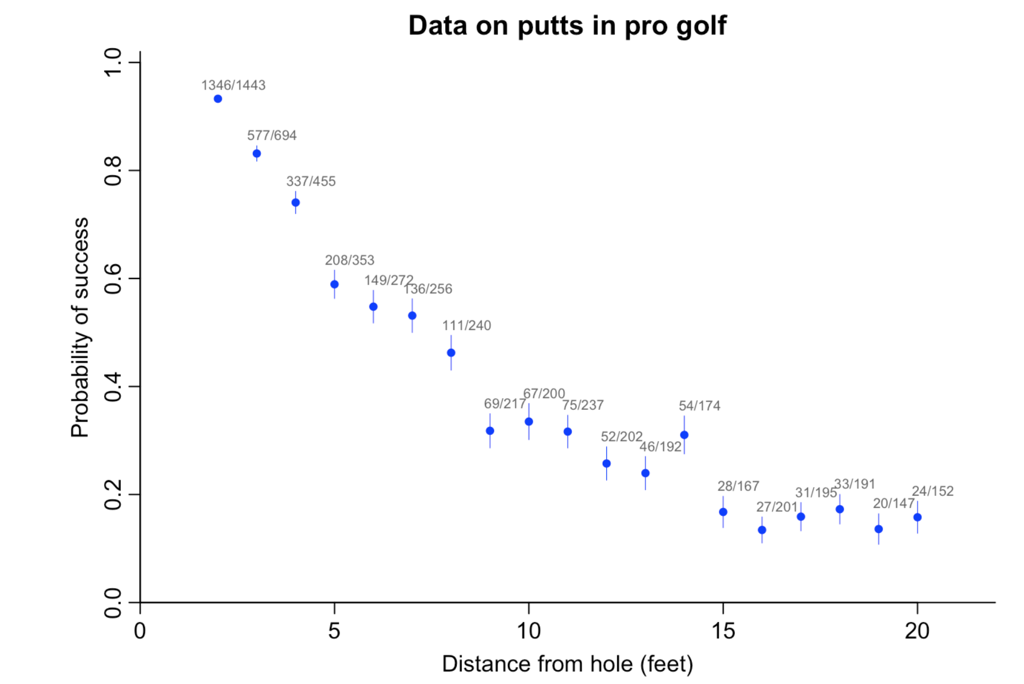

Slide 8
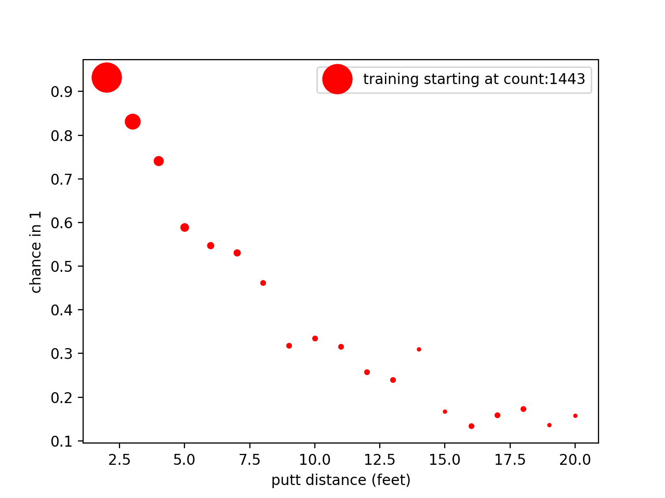

Slide 9
Straw Person Arg: One Hidden Node Neural Net
sgd = optimizers.SGD(lr=0.15)
model = Sequential()
model.add(Dense(1, batch_input_shape=(None, 1), activation='sigmoid'))
model.compile(loss='binary_crossentropy',
optimizer=sgd,
metrics=['accuracy'])
model2 = Sequential()
model2.add(Dense(1, batch_input_shape=(None,1), activation='sigmoid'))
model2.add(Dense(1,activation='sigmoid'))
model2.compile(loss='binary_crossentropy',
optimizer=sgd,
metrics=['accuracy'])

Slide 10
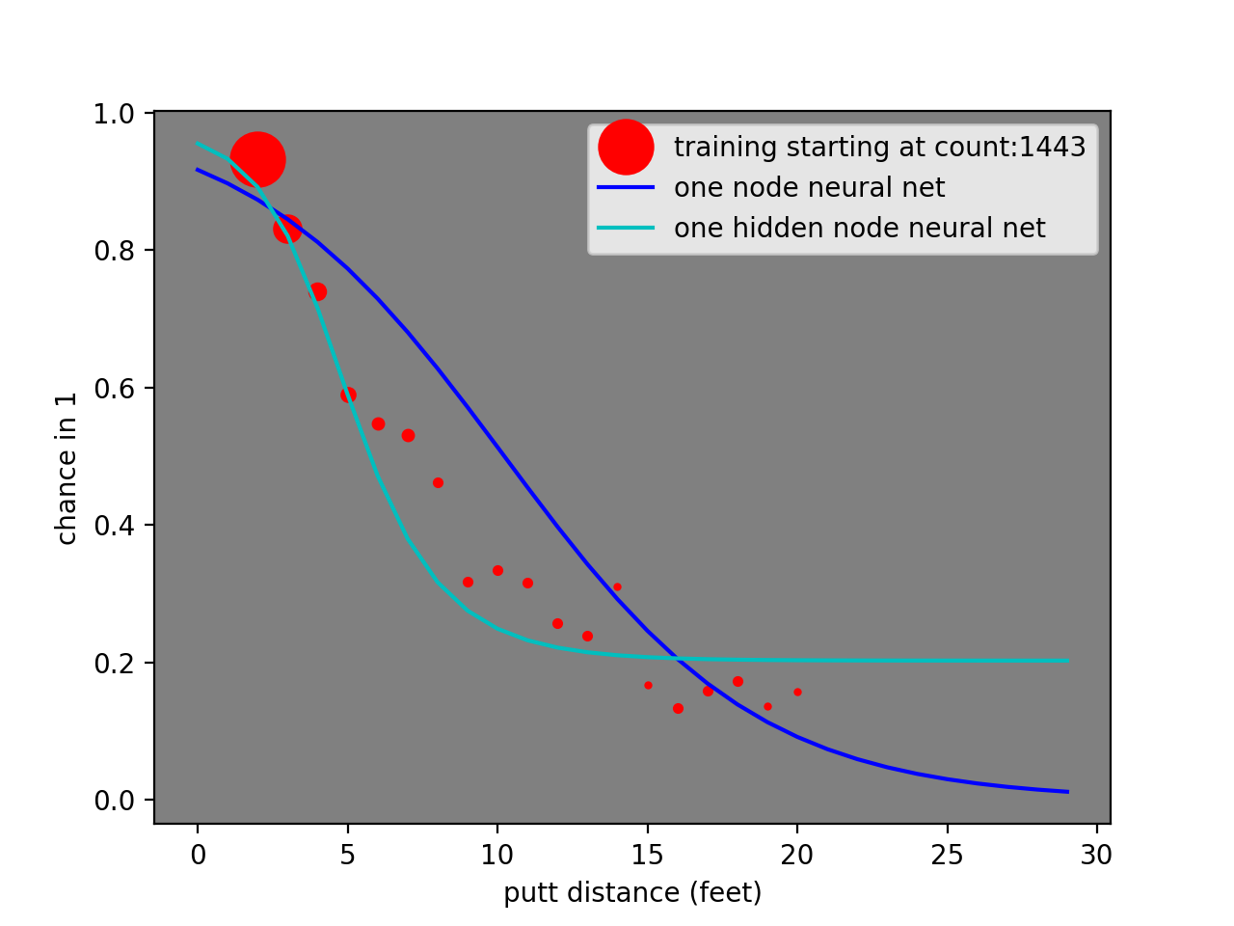
1 Node Neural Net

Slide 11
Stan Version Logistic Regression

Slide 12
What is in an AI decision?
Best category of many given data D
Ranked categories | D
Scored categories | D
Scores of categories sum to 1 | D: Probability
  Dangerous
Joint Probability (Cat,D): sums to 1 over all Ds

Slide 13
Posteriors
Best Category
  Count hits

Slide 14
Run the goal program
> cd <path>/StanIsThePlanDist
> python puttBet.py stan/mechanistic_golf.stan 2

Slide 15
Goal: when you think of AI consider
Mechanistic models appropriate for domain
  Priors
  Likelihood
Attention to calibration
  51% chance of winning means 49% loss over time
Attention to uncertainty: mean is 51%
  95% of draws are within 50.9%-51.1%
  95% of draws are within 45%-55%

Slide 16
Stan vs Deep Learning
Advantage Stan: Mechanistic model based on golf
Advantage Deep Learning: Image recognition
Hybrid Models
  Space

Slide 17
What does Bayesian Mean?
Controversial:
  Formalize all you prior hunches, bad ideas, conjectures into math, update with data via a likelihood and we get a bunch of ass aka a posterior.
  Garbage in/garbage out
Not controversial:
  Prior is previous posterior, e.g., has seen some data, update with data and the angels sing the posterior hymn.
Controversial is how humans roll.

Slide 18
What is this Bayesian AI Mean?
???No Idea???
  Not going to talk about Bayes rule
Focus on differences
  Stan vs Deep Learning
Focus on prediction from data, not description
  Not the current focus of Stan research
  This talk a personal excuse to delve deeper
This will be an introduction to creating Stan models.

Slide 19
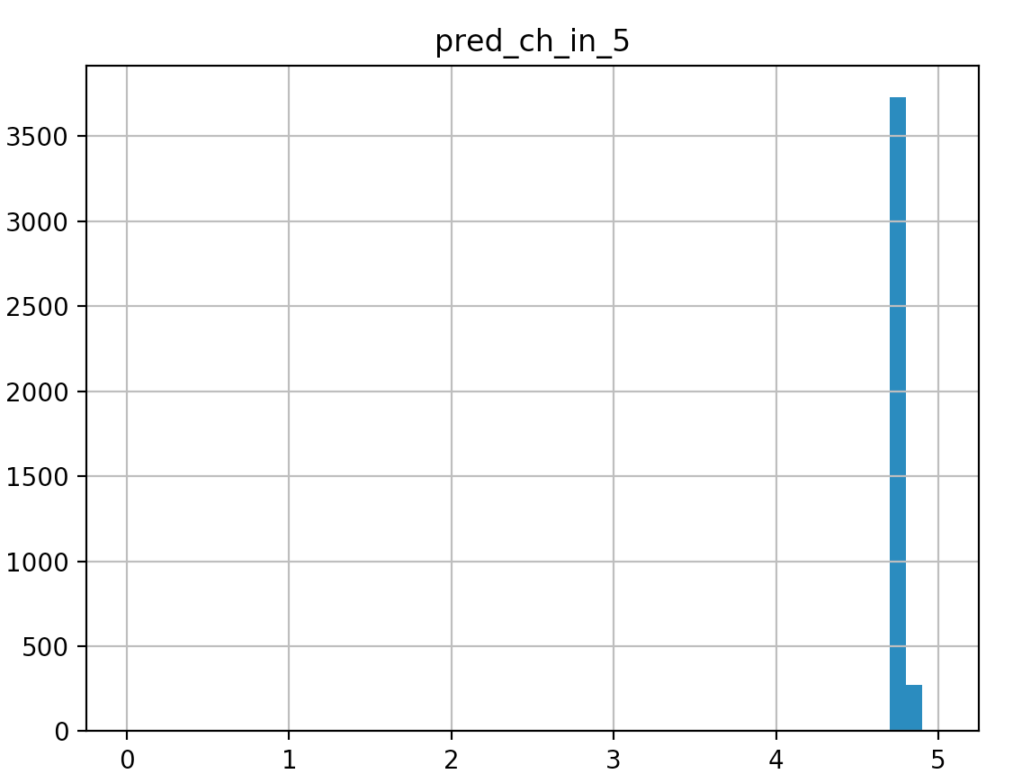
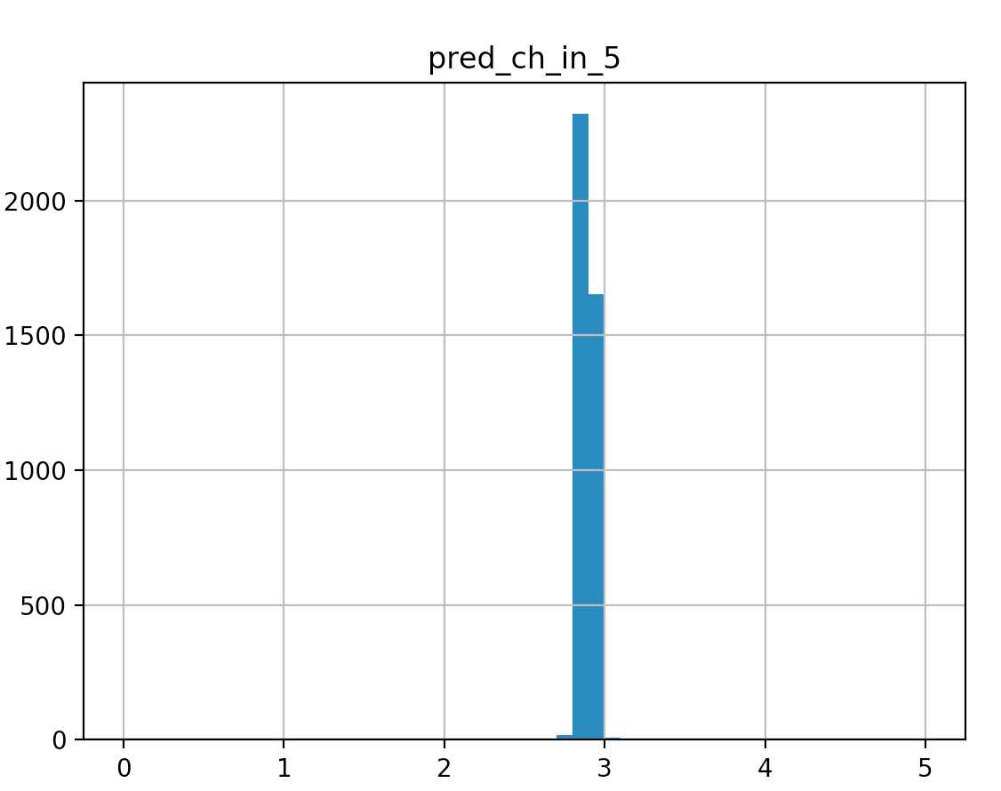
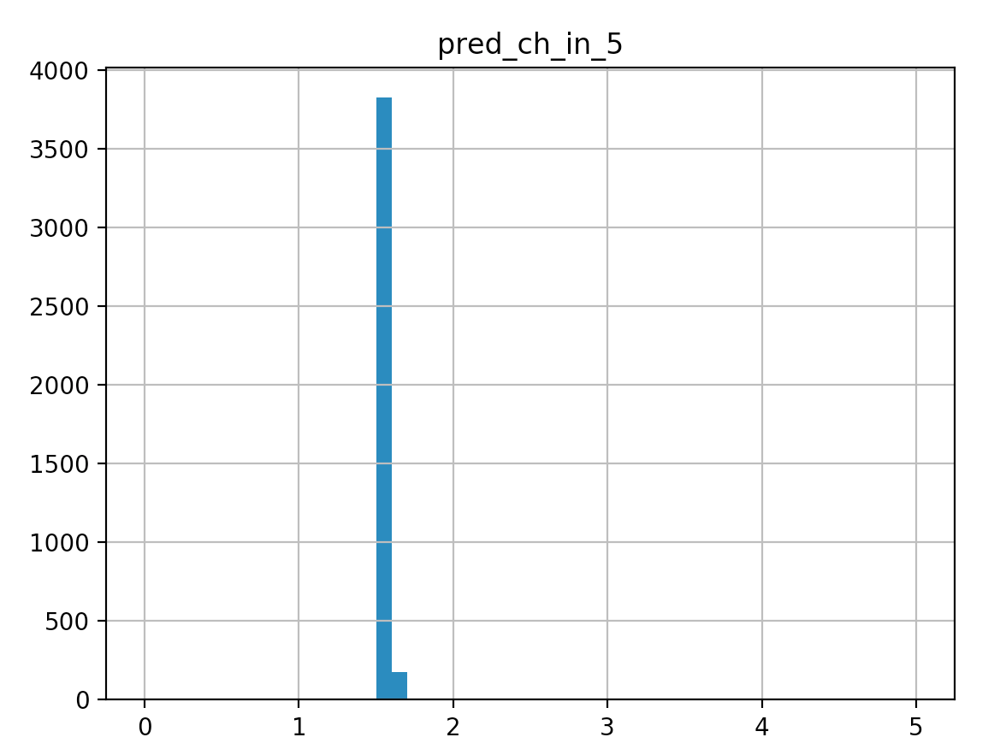
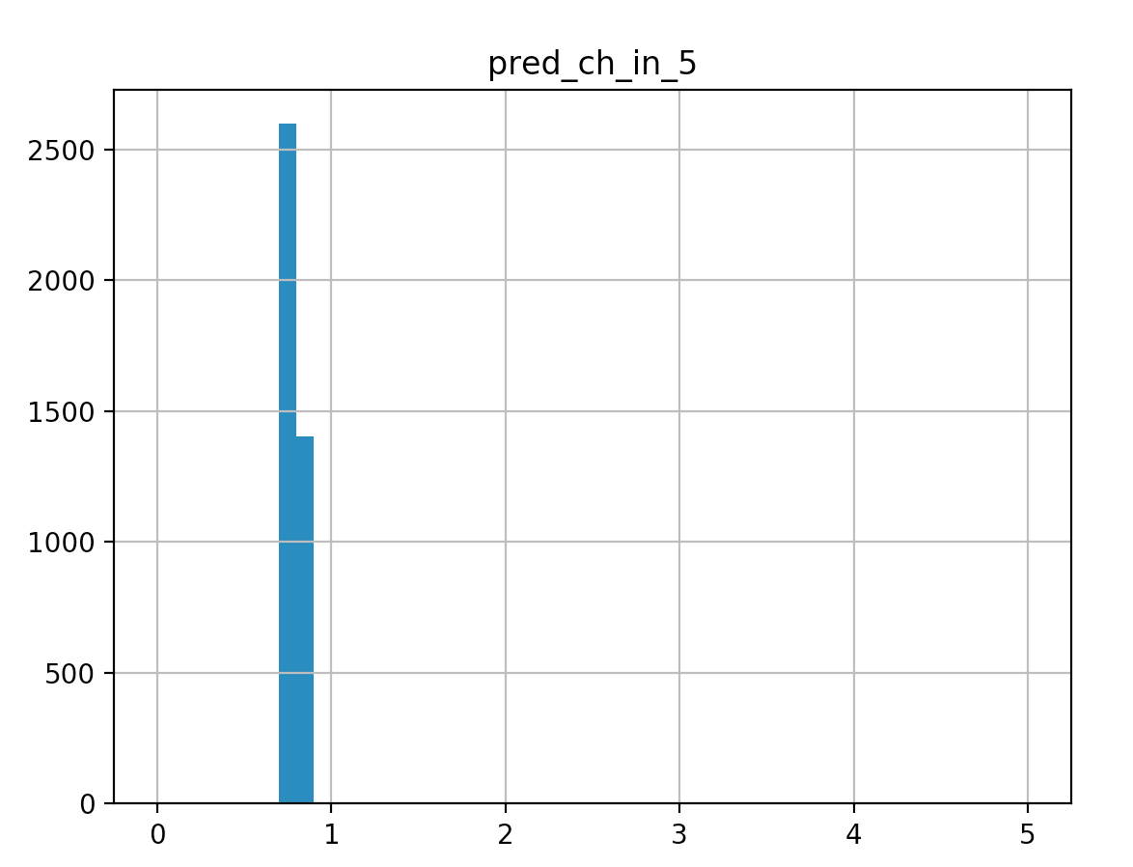
Some Predictions
2 ft
5 ft
10 ft
20 ft

Slide 20
The Basic Idea
Get a bunch of training data
Build a program generalizes that training data so it will work with novel data
Evaluate progress and refine
But we are doing it in a Bayesian way

Slide 21
Why Baysian: Its the Posterior
Alternative is point estimates, but no matter how good....
Deep learning will find a solution
Betting where concentration matters
Calibration
Multi-modal, good to know—I can spend less $ for same result

Slide 22
Bayesian Point 1
Some AI systems will give you a probability for a prediction.
  Our program reports a median value as the most likely value
How sure is the system of that value?
Watch what happens as we increase data
  Median values remain roughly the same

Slide 23
Bayesian Point 1
Some AI systems will give you a probability for a prediction.
  Our program reports a median value as the most likely value
How sure is the system of that value?
Watch what happens as we increase data
  Median values remain roughly the same

Slide 24
A tour of puttBet.py
import os
from cmdstanpy import cmdstan_path, CmdStanModel
import pandas as pd
import numpy as np
import matplotlib.pyplot as plt
import seaborn as sns
import fileinput
import sys
stan_program_path = sys.argv[1]
distance_of_putt = float(sys.argv[2])
stan_program = CmdStanModel(stan_file=stan_program_path)
stan_program.compile()
json_data = data= {"distance_of_putt":distance_of_putt}
fit = stan_program.sample(data=json_data,
csv_basename='./puttbet')
print(fit.summary())
fit.get_drawset(params=['pred_ch_in_5']).hist(bins=50,range=(0,5))
plt.show()

Slide 25
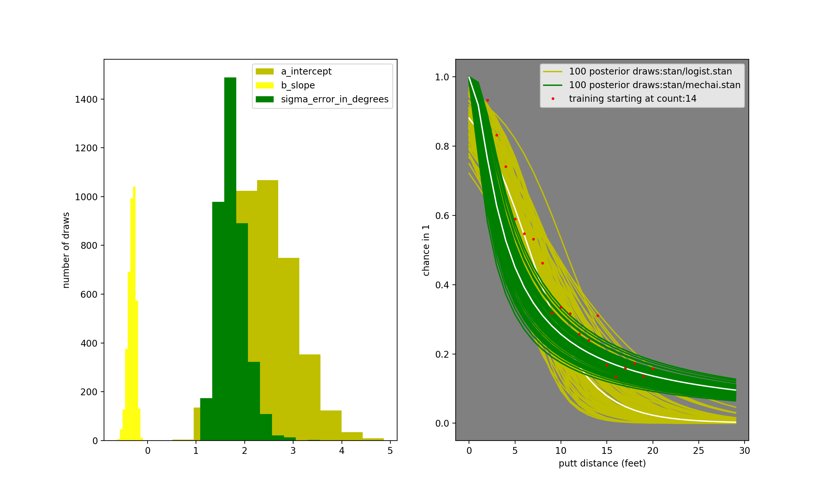
1% of Data

Slide 26
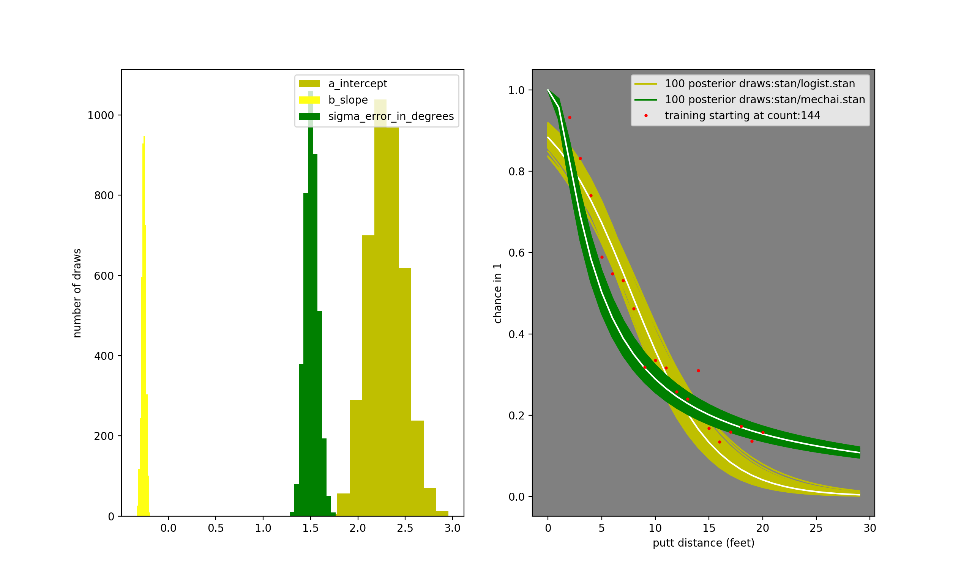
10% of Data

Slide 27
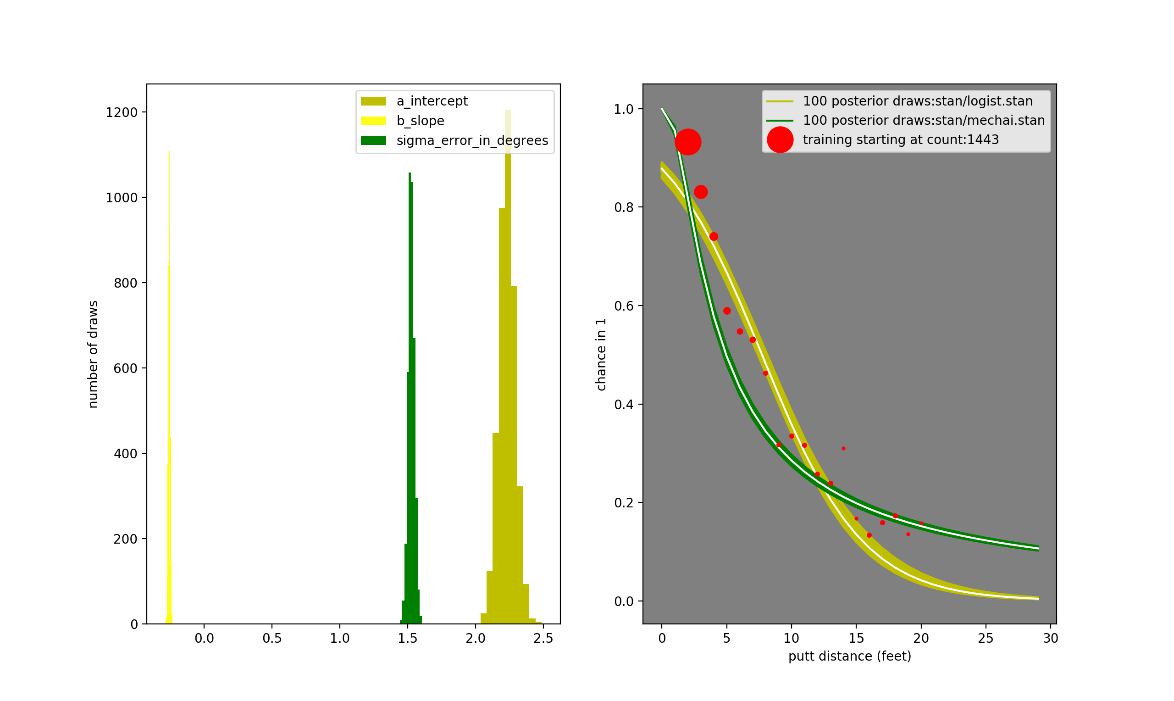
100% of Data

Slide 28
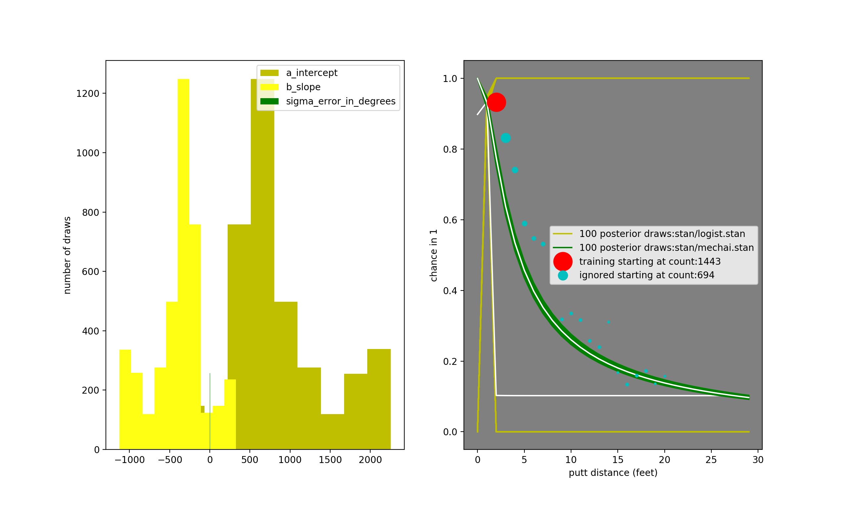
1 of 19 of Data Points

Slide 29
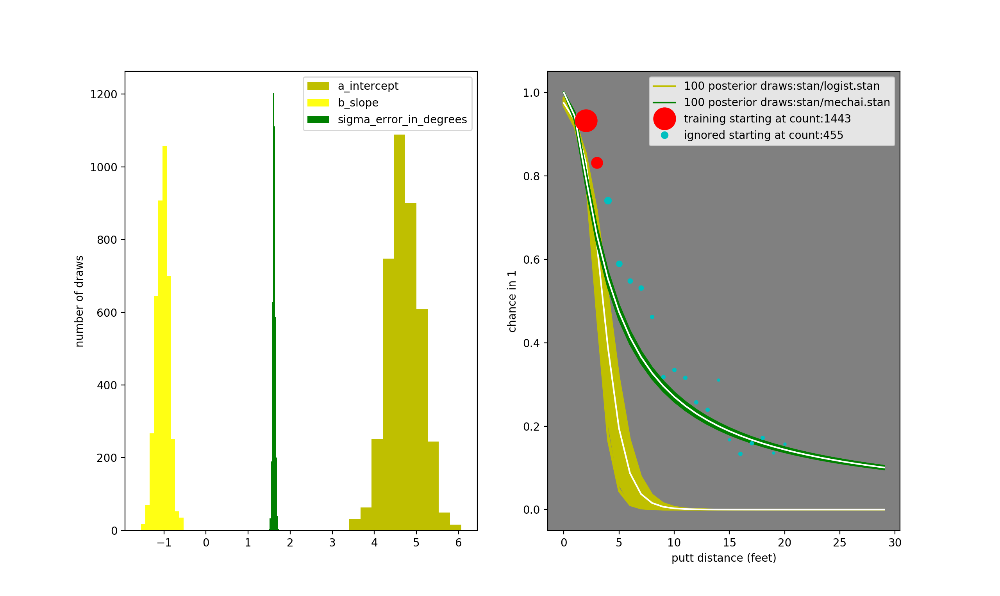
2 of 19 of Data Points

Slide 30
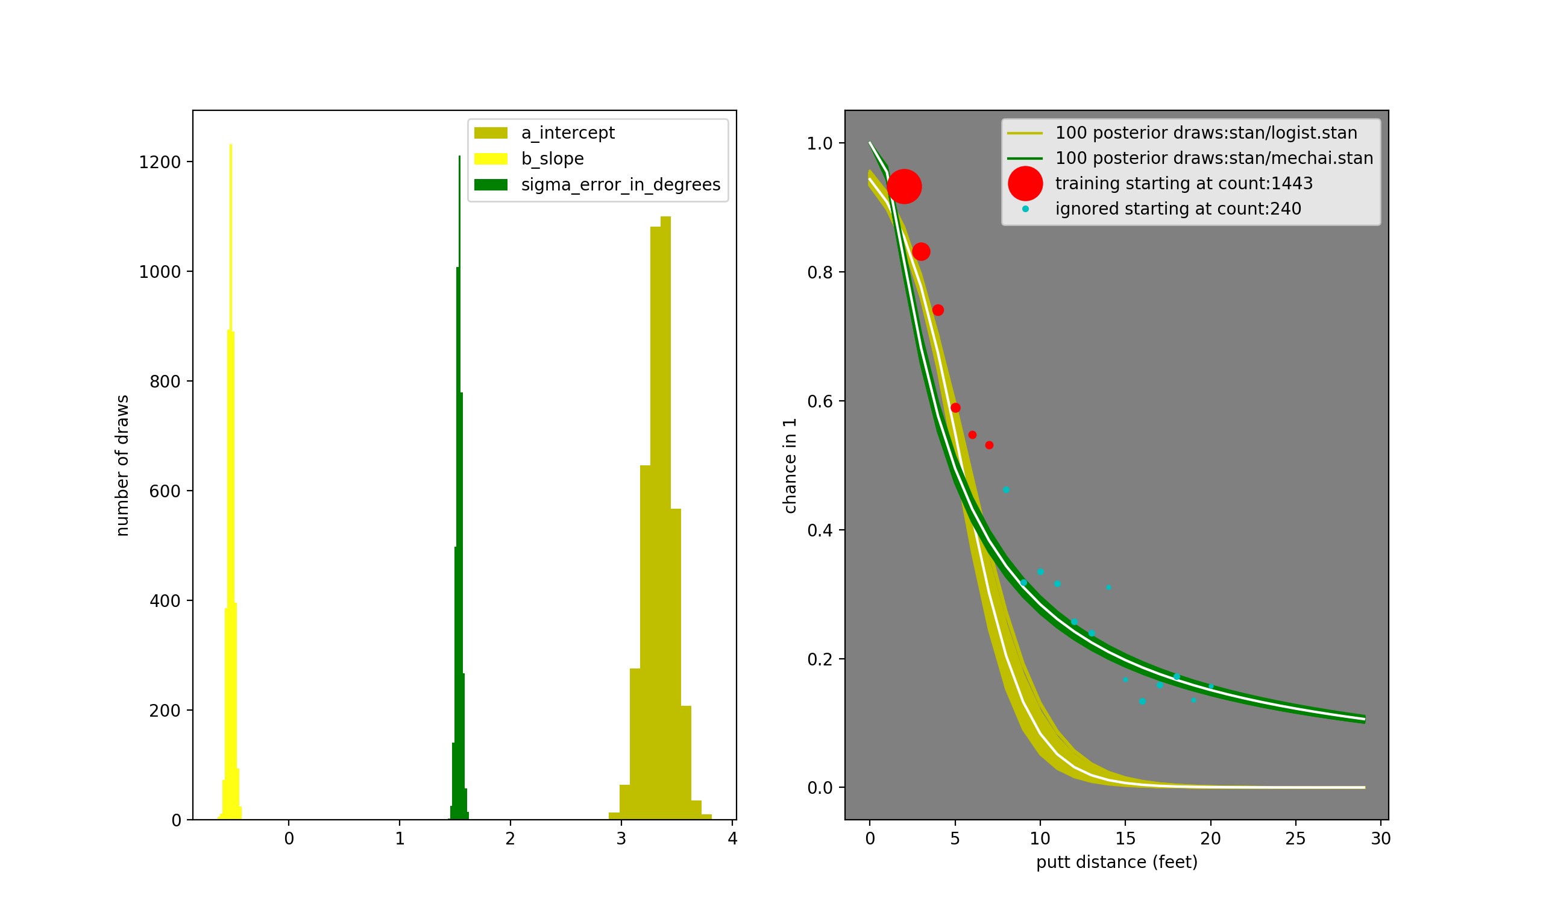
6 of 19 of Data Points

Slide 31
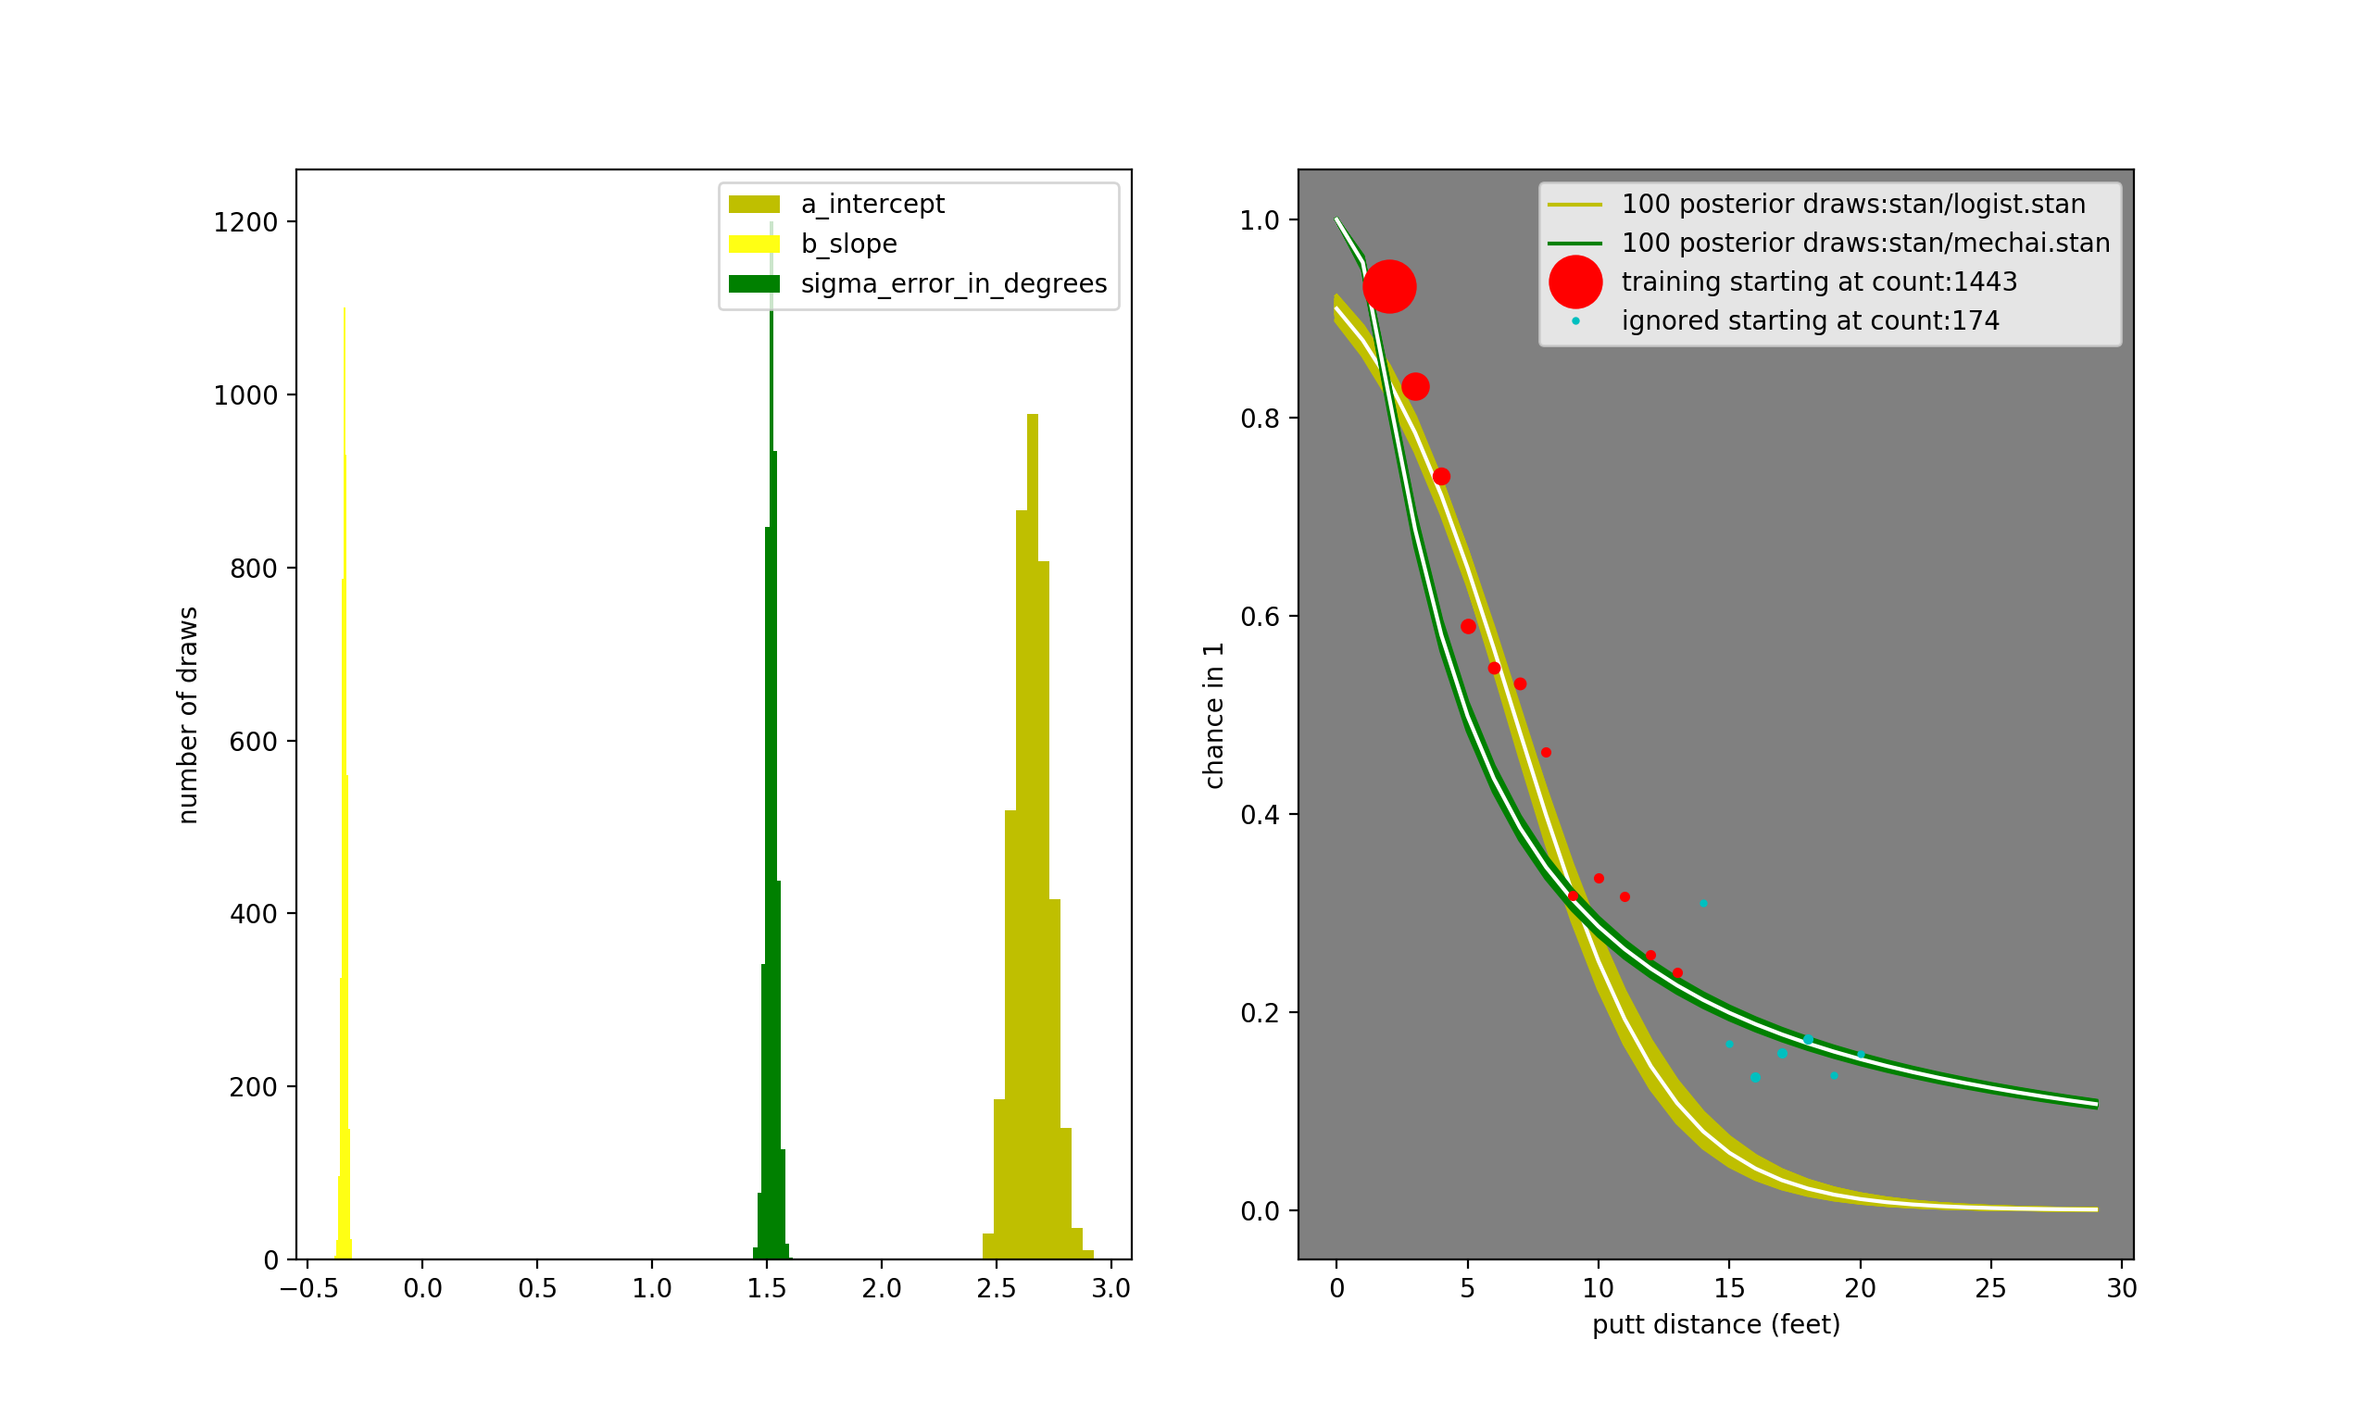
12 of 19 of Data Points

Slide 32
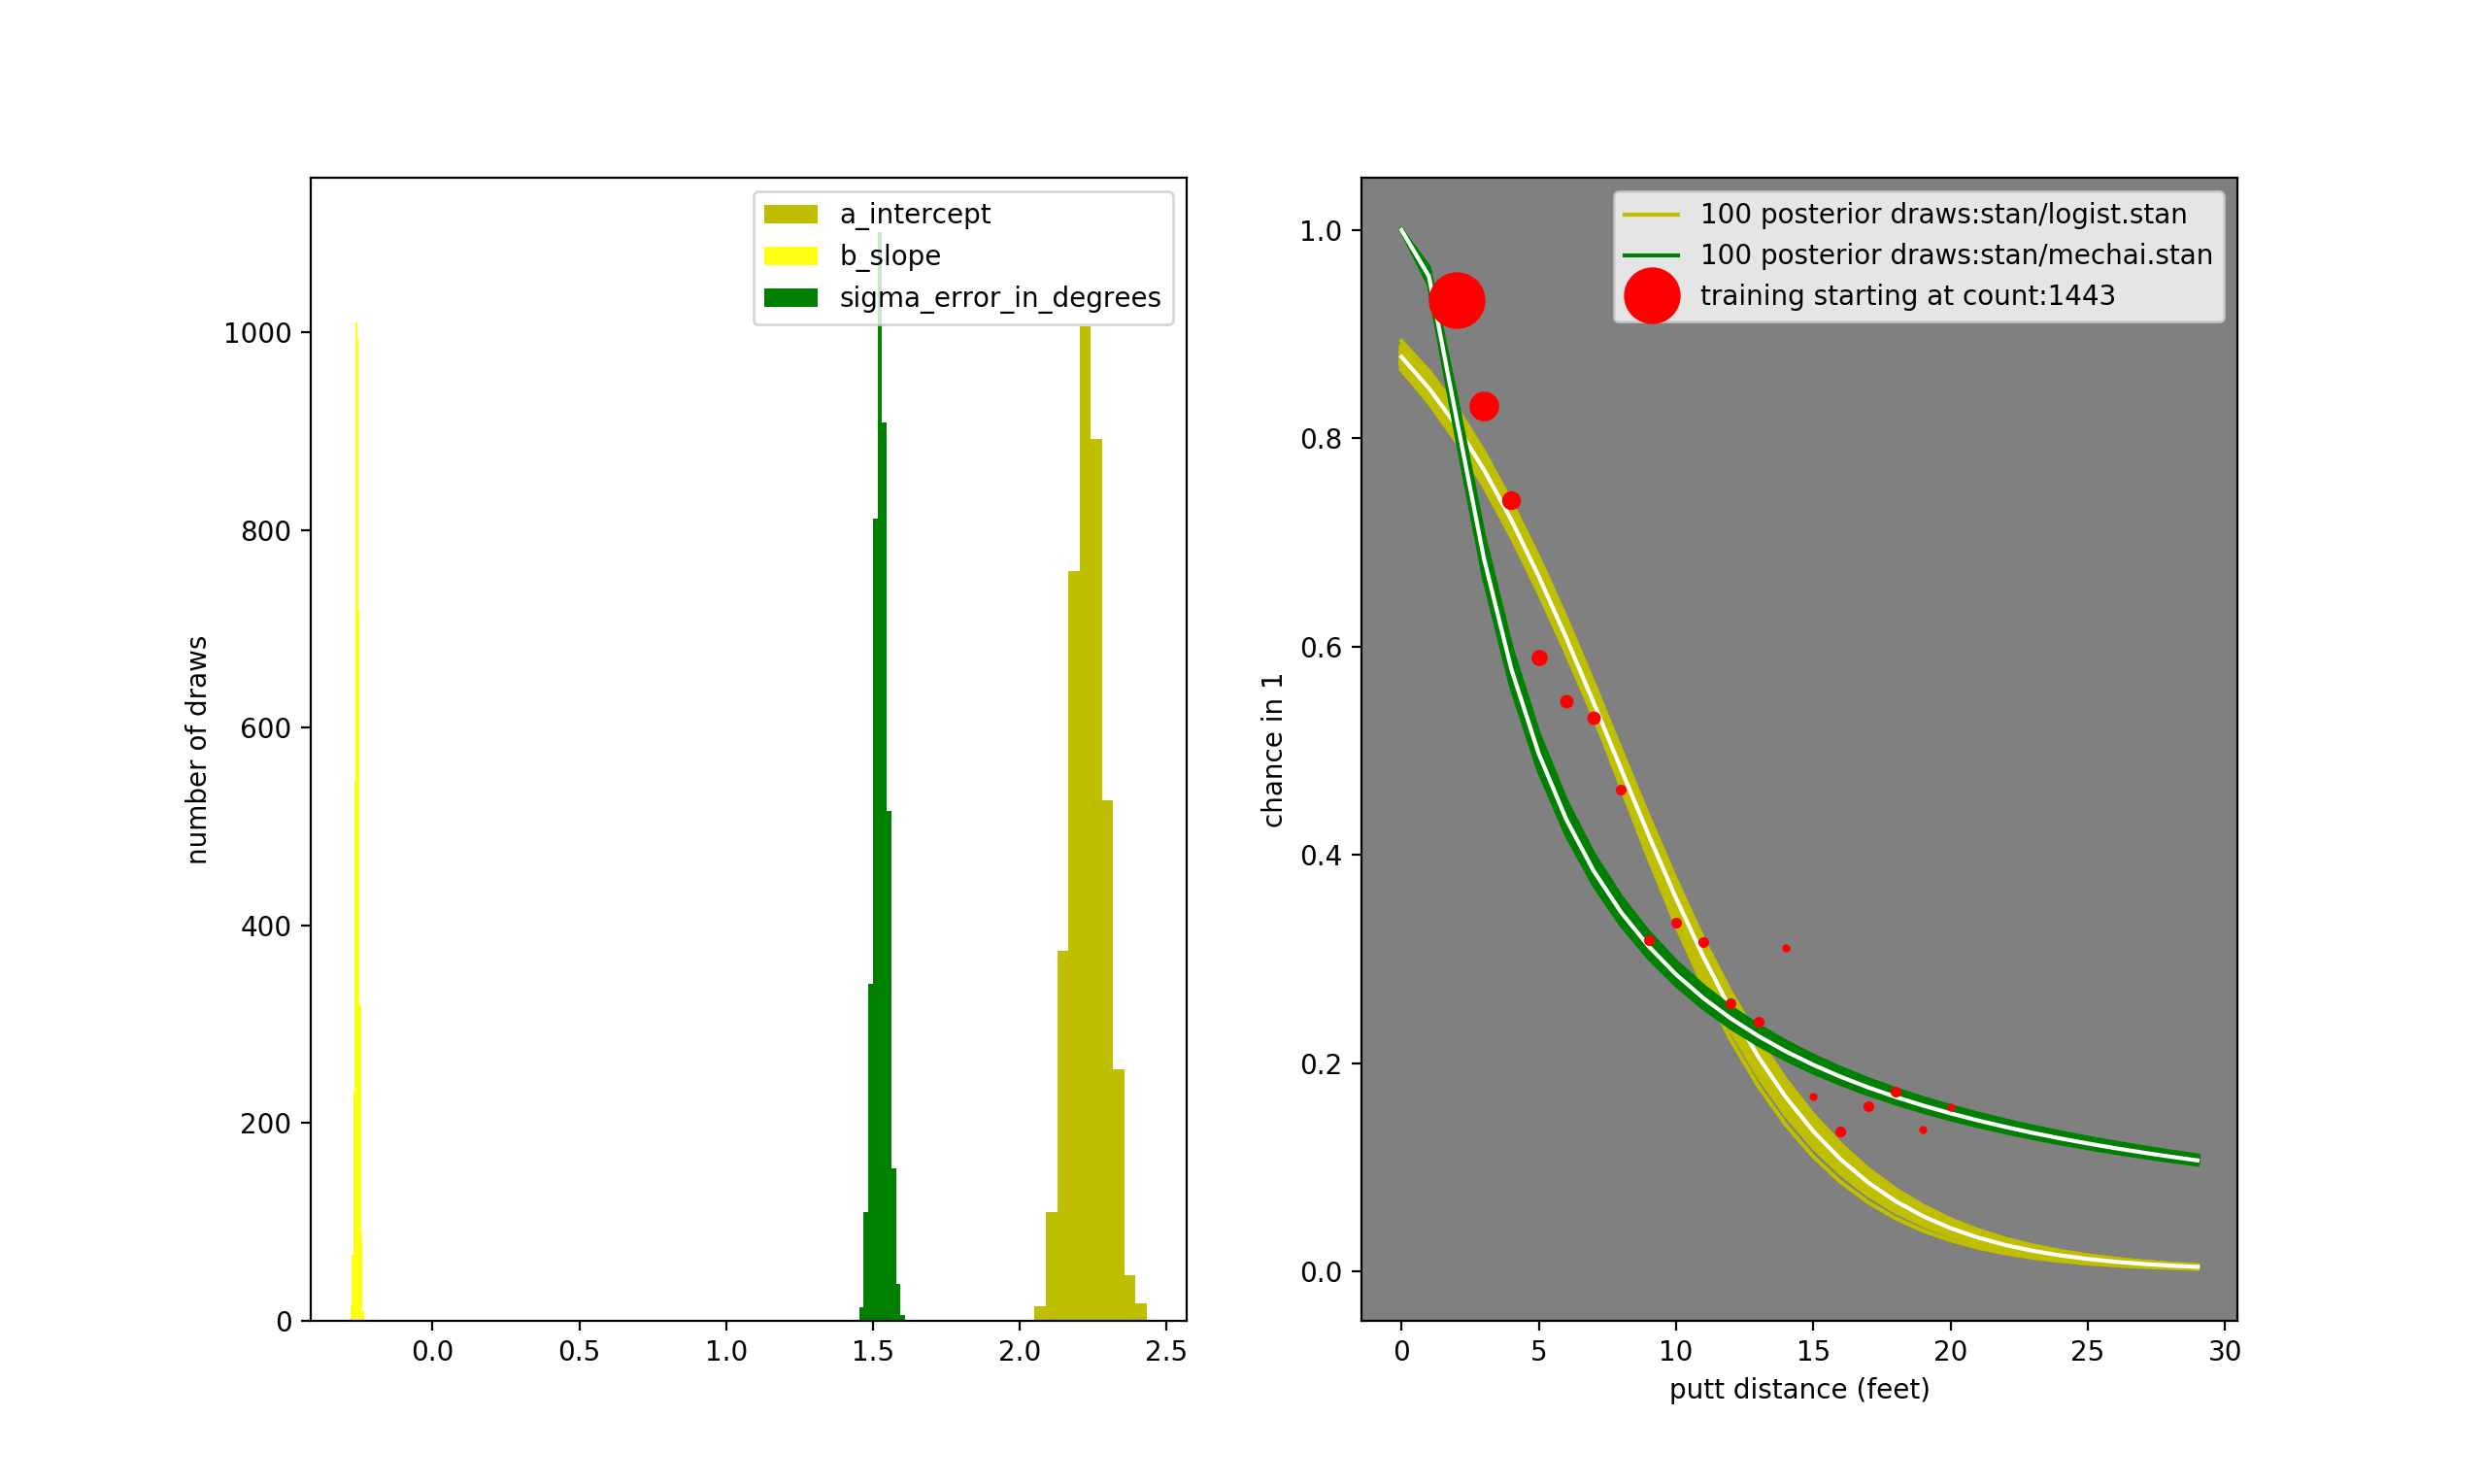
19 of 19 of Data Points

Slide 33
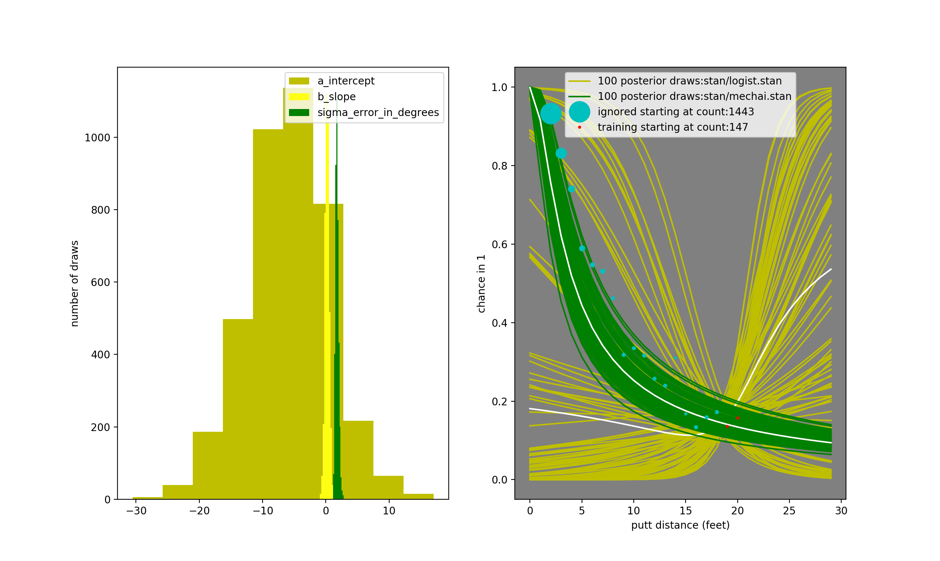
19 & 20ft Data Points Only

Slide 35
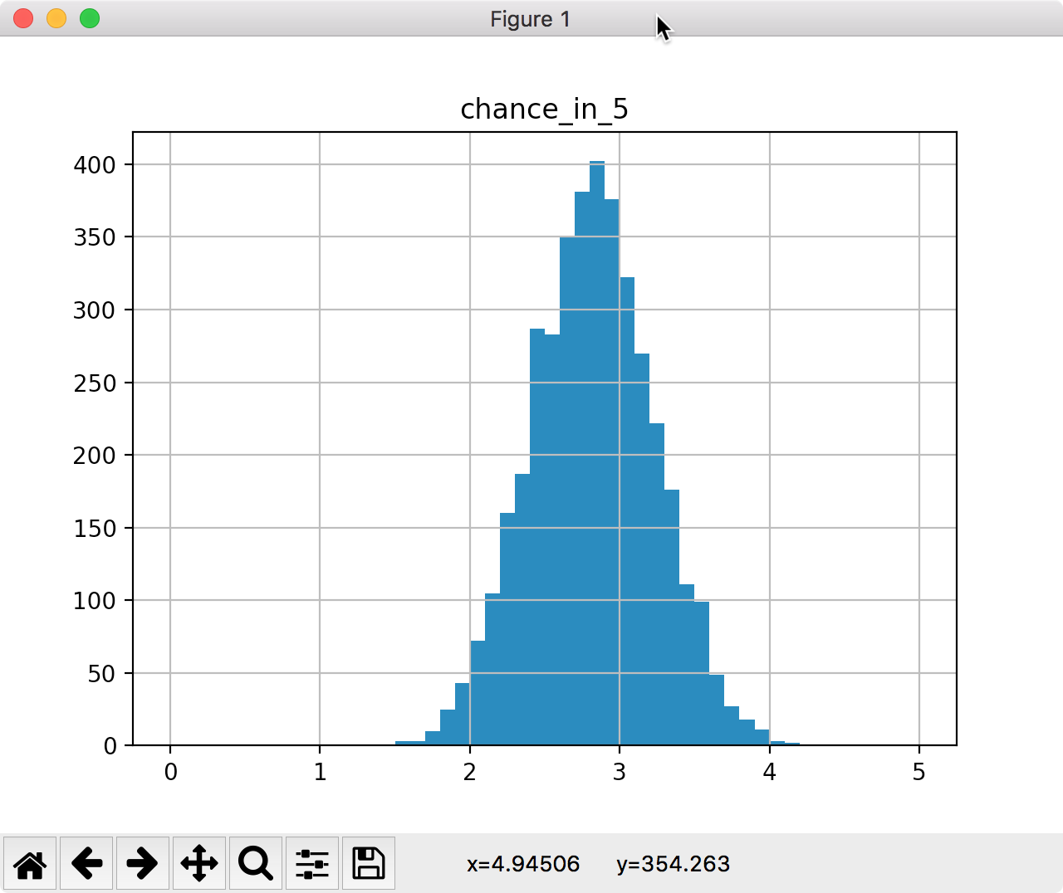
Posterior Draws
$ python puttBetScale.py stan/mechanistic_golf_shrinkage.stan 5 .01 3

Slide 36
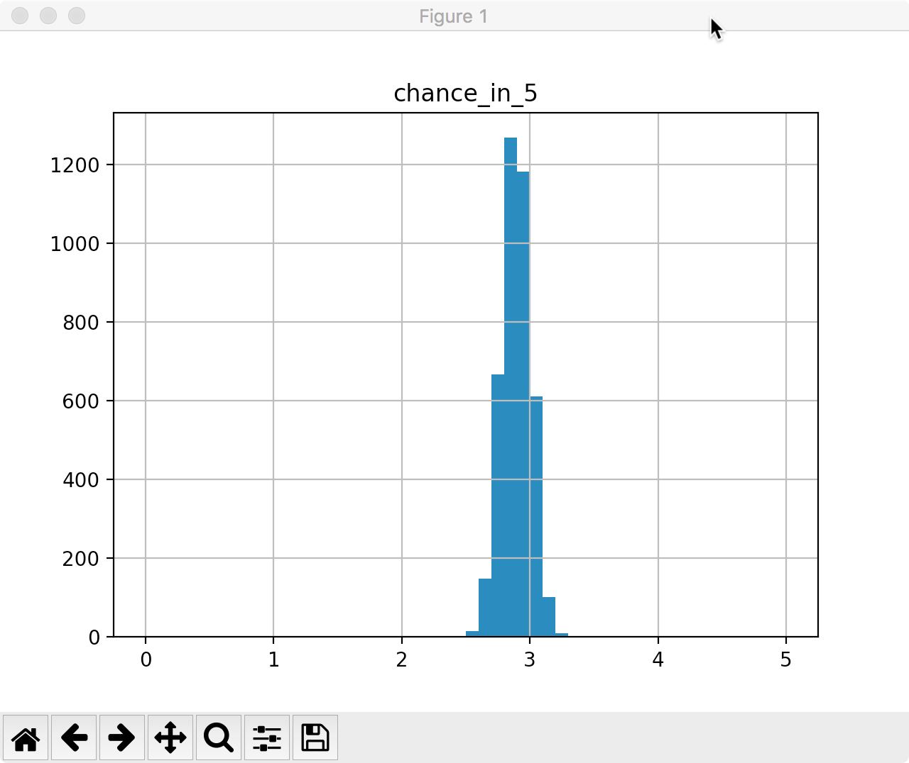
$ python puttBetScale.py stan/mechanistic_golf_shrinkage.stan 5 .1 10

Slide 37
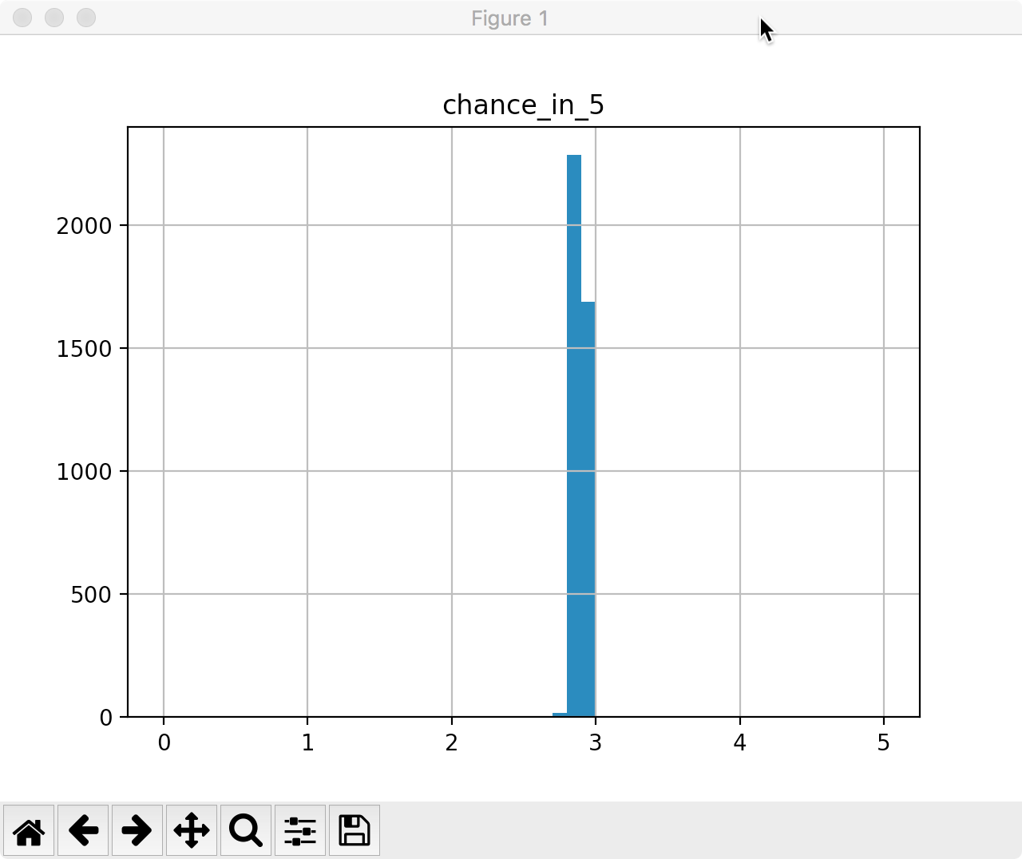
$ python puttBetScale.py stan/mechanistic_golf_shrinkage.stan 5 1 19

Slide 38
Compare 5%-95% intervals
Mean 5% 50% 95%
name
chance_in_5 .01 3 2.823270 2.151960 2.824790 3.454040
chance_in_5 .1 10 2.895170 2.711690 2.894230 3.075980
chance_in_5 1 19 2.890480 2.833360 2.890500 2.948710

Slide 39
Less Data Means Less Certainty
Is there a difference between 95% of posterior samples that range from:
  2.1 and 3.4?
  2.8 and 2.9?
The house insists on even bets and $1 max
10,000 $1 bets
  makes $ if the true chance_in_5 is 2.8
  looses $ if the true chance_in_5 is 2.3

Slide 40
Working with the posterior
The posterior is the combination of prior information with data via a likelihood.
Stan programs do not produce posteriors
Stan programs draw samples from posteriors.
chance_in_5 will have around 4,000 samples
  Each one a draw from the posterior
  No probabilities yet

Slide 41
Values for chance_in_5
[1] 4.983672319 0.504675345 0.956908493 2.875748848 0.997364239 0.417071450 4.501827071 0.936049387 0.863498351
[10] 4.153279253 2.060605266 1.139810114 3.779605672 1.658594148 1.067616110 4.116676326 2.330651455 3.967579063
[19] 1.842490519 0.455000172 1.157479467 2.752047595 0.915102101 4.982286286 4.391265367 4.992451716 2.447138984
[28] 2.205051616 4.231899958 0.812689175 3.989032044 0.796250061 0.859436737 1.028724611 1.924055572 3.208221532
[37] 2.210415693 2.136084733 1.248423340 3.315607704 2.254323347 4.784930724 4.885145022 1.982817767 4.984226181
[46] 0.048460657 0.282379449 3.722942450 0.999613762 2.502718692 3.243868759 0.822543222 0.211249991 1.147694845
[55] 4.896531799 4.199396308 0.665606386 3.141129394 2.607873759 4.690558455 4.696524164 4.031962569 2.755539678
[64] 1.283222482 2.248947510 0.319166050 0.636175197 1.570415334 2.837057149 2.539923313 3.181580786 1.233043905
[73] 3.061787637 4.764964321 0.918676119 0.480524564 1.491754639 3.321344687 0.492543512 2.089836199 4.983904438
[82] 1.547706472 2.414447829 0.282179524 1.666381844 0.367431461 4.361380324 3.373313419 4.397065423 1.689771086
[91] 1.141912694 2.459350776 4.159030935 3.116608167 3.076992472 0.823561946 2.969654653 1.165449756 1.658783029
[100] 0.351305357 1.694081739 1.259235890 1.387418442 2.528962612 4.852489185 1.374381734 2.941864848 1.157997846
[109] 0.168440287 4.373520019 3.886488608 1.093028201 4.987565650 4.812540735 4.595358682 0.655243261 2.834453881
[118] 2.728336762 1.977742924 2.179817460 0.320485894 3.711874986 0.189774115 2.125163616 2.366089869 2.752047595
[127] 2.270779435 2.060605266 0.497764905 1.841243712 0.039907438 3.040357791 2.607759999 1.721114910 2.466011311
...

Slide 42
Histograms
End goal is to figure out probability for values of 'chance_in_5'.
We bin 10 ways, 0-0.499, .5-.999, ...4.5-5
  Any exact value is unlikely to be found in samples
  Bins are human interpretable
P(chance_in_5 < 2.8) = 50%
  count(values < 2.8) / count(all values)
  Look at values
    $ less puttbet-1.csv

Slide 43
A tour of stan/mechanistic_golf.stan
data {
real distance_of_putt;
}
transformed data {
int J = 19;
int x_distance[J] = {2,3,4,5,6,7,8,9,10,11,12,13,14...};
int y_successes[J] = {1346,577,337,208,149,136,111...};
int n_attempts[J] = {1443,694,455,353,272,256,240...};
real r = (1.68/2)/12;
real R = (4.25/2)/12;
real threshold_angle[J];
for (i in 1:J) {
threshold_angle[i] = asin((R-r)/x_distance[i]);
}
}
parameters {
real<lower=0> sigma_error_in_radians;
}
model {
for (i in 1:J) {
real prob = 2*Phi(threshold_angle[i]/sigma_error_in_radians) - 1;
y_successes[i] ~ binomial(n_attempts[i], prob);
}
}
generated quantities {
real sigma_error_in_degrees = (180/pi())*sigma_error_in_radians;
real pred_ch_in_5;
real threshold_angle_for_distance = asin((R-r)/distance_of_putt);
pred_ch_in_5 =
(2*Phi(threshold_angle_for_distance/sigma_error_in_radians) - 1) * 5;
}

Slide 44
Summarizing
We know Stan inputs
  Data
  Model
We know Stan outputs
  Posterior draws
We see roughly how they connect
  puttBet.py
  mechanistic_golf.stan
Learned that size of data matters

Slide 45
 | Baysian AI | Deep Learning NN
Mechanistic Model | + encouraged | + only for vision
Model Authoring | + expected | - very limited
Multi-modal | + very difficult | + unimodal solution
Posterior | + | -
Big Data | - | + required
Medium/Small Data | + | -
Approx Inference | + | +
Baked in Calibration | + | + w/held out data
Concentration | + | -
Eval w held out data | + | +
Eval w model inspection | + | -
Prior Pred Checks | + | ? unsupervised?
Post Pred Checks | + | +
Calibration across data | + | ??

Slide 46
Comparison of Bayesian Inference to Deep Learning
BI allows for mechanistic models
BI provides posteriors, BI preserves uncertainty
BI works well with small/medium data with big model
Custom hierarchical models is a big draw

Slide 47
Mechanistic Models
Parsimony
  Mecca-golf is one parameter
  Linear/Logistic golf is two
  Partially pooled is 21
Better understood failure modes
  Mecca-golf will never give a negative prob
  Logistic can't but were getting lucky
  Linear is a mess
  Pooled is safe

Slide 48
One data point/neuron

Slide 49
More inference/less data
Consider adding just a few data points to mechanistic golf vs LR golf.

Slide 50
Deep Learning is a Mechanistic Model
Based on perceptual system

Slide 51
Hierarchical Models
A hierarchical model is one where a prior is specified on a parameter conditional on another unknown parameter

Slide 52
?s for Bayesian AI
Key is posterior
  Parameterizations
  Predictions (may be derivative)
Data structures need to advance to take advantage of posteriors
Seems like preserving parameter posteriors and models
Develop complete model, proceed with partial info, re-calculate if needed.

Slide 53
HMM for POS
Coref
What does complete model look like?
Setup as backtracking system, constrain satisfaction problem.
  Two params, coref with existing ent and new ent

Slide 54
Where is the computation?
Old School: reality does the computation
  Control vs Treatment
  Difference is not due to chance
  Counts dominate reasoning, small Ns don't work
Deep Learning
  Large param space
  Greedy gradient search
Bayesian AI

Slide 55
Classes of Bayesian Systems
Pure reallocation of information
  Can run backwards—generate data from posterior
  param ~ unif(); post = prior * data

