Slide 1
Stan Is The Plan
Breck Baldwin
NYC PyData 2019

Slide 2
Goals
Learn to code Stan models
Focus on prediction—A.I. and machine learning
Learn just enough statistics to learn more
Learn the pitfalls and common mistakes of Stan

Slide 3
Outline Section 1
Should have CmdStanPy installed by afternoon
Run Final Example: puttBet.py
Write Stan models of increasing complexity
Explore execution environment
Describe how inference is done

Slide 4
Resources
Tutorial repository—please download
https://github.com/breckbaldwin/StanIsThePlanDist
Install CmdStanPy—also install CmdStan
https://cmdstanpy.readthedocs.io/en/latest/index.html
Review if you are waiting
Pre/Post test: https://forms.gle/J5kqACo5m6cy9WKd9
Look ahead in the slides

Slide 5
Our Application
PuttBet--Predict future golf putts
Derived from:
https://mc-stan.org/users/documentation/case-studies/golf.html
Historical putting data
  2 feet, sink 1346 out of 1443 attempts
  ...
  20 feet, sink 24 of 152 attempts
Various distances of putt we want to bet on:
  2...30 feet
Return 'chance_in_5' value

Slide 6
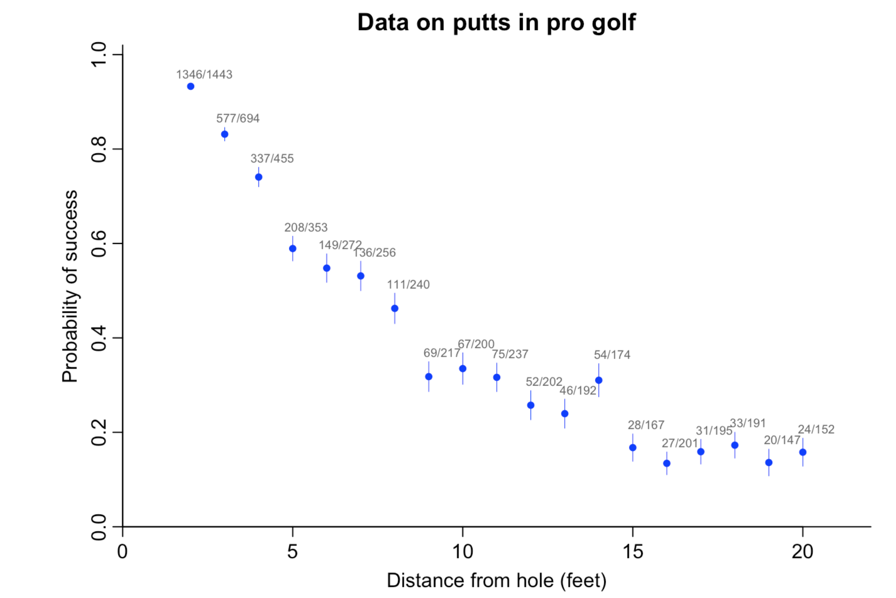

Slide 7
Flow
Python reads from the command line
  Stan file to run
  Data to send, putt distance
Runs Stan model
  Compile if necessary
  Fit data (not part of compile)
  Predicts performance for stated putt distance
Summarizes results
Plots 'chance_in_5'

Slide 8
Run the goal program
> cd <path>/StanIsThePlanDist
> python puttBet.py stan/mechanistic_golf.stan 2

Slide 9
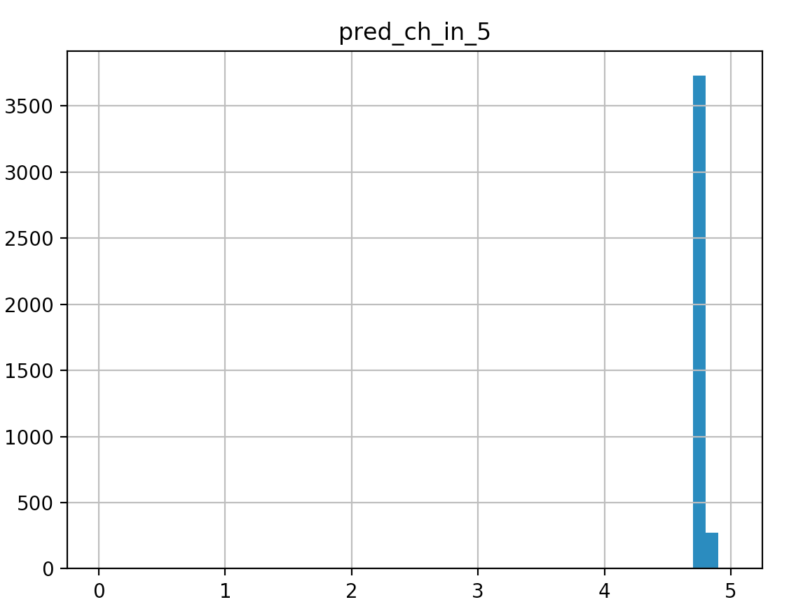
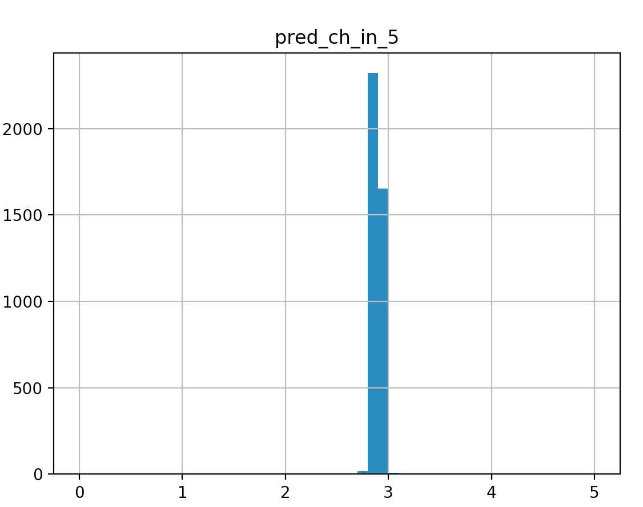
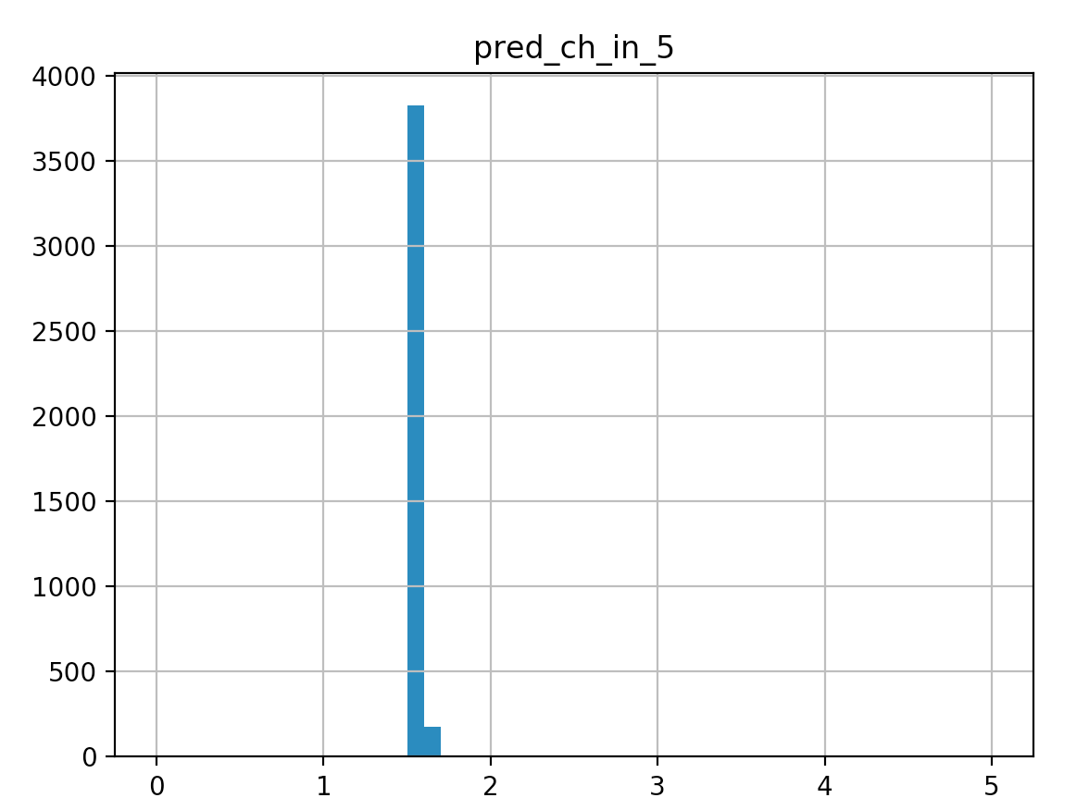
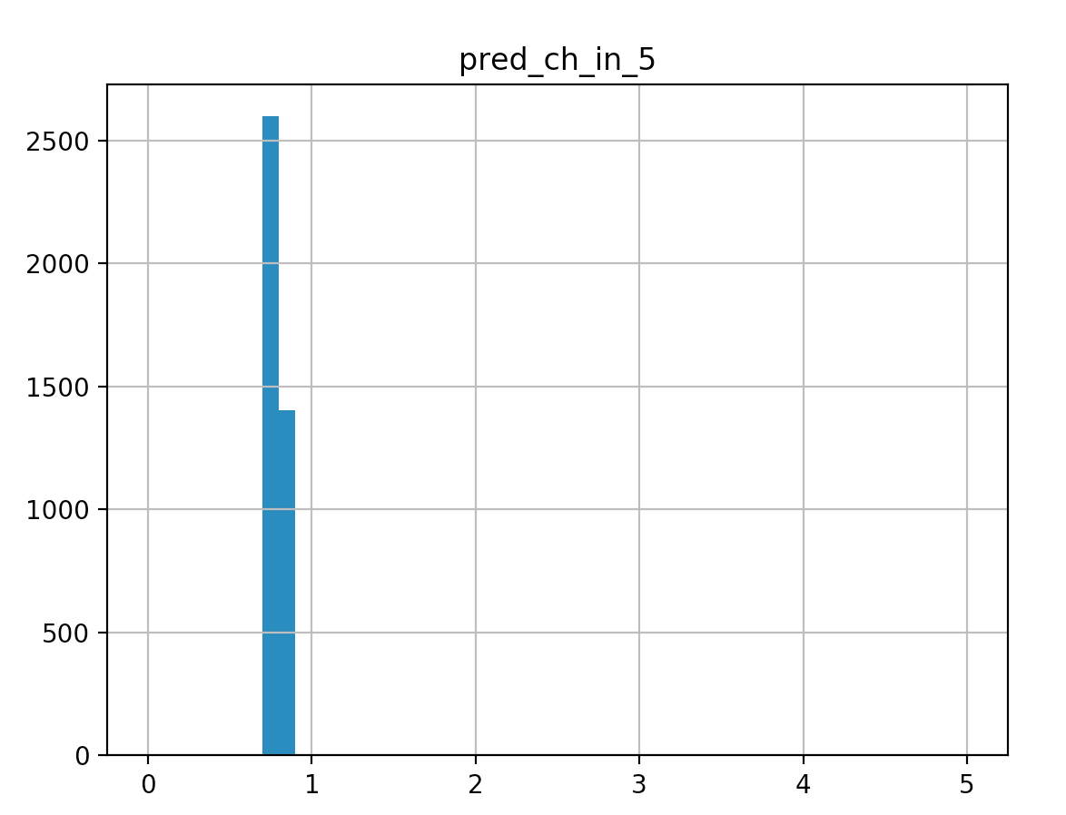
Some Predictions
2 ft
5 ft
10 ft
20 ft

Slide 10
The Basic Idea
Get a bunch of training data
Build a program generalizes that training data so it will work with novel data
Evaluate progress and refine
But we are doing it in a Bayesian way

Slide 11
Bayesian Point 1
Some AI systems will give you a probability for a prediction.
  Our program reports a median value as the most likely value
How sure is the system of that value?
Watch what happens as we increase data
  Median values remain roughly the same

Slide 12
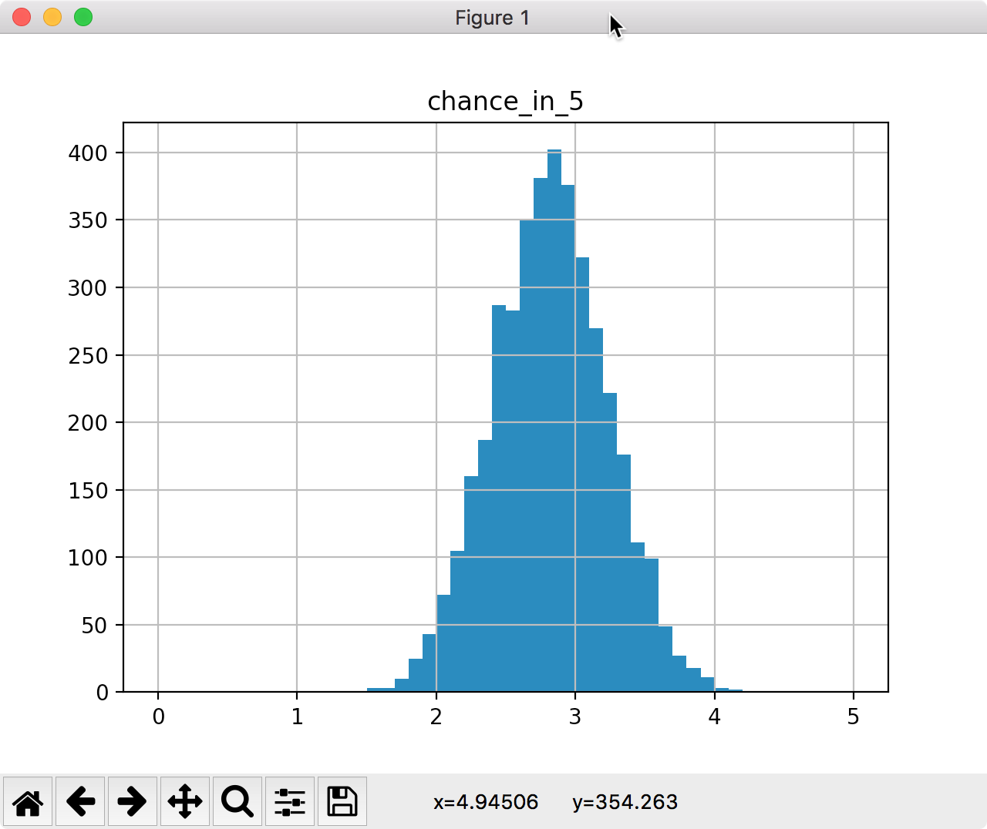
Posterior Draws
$ python puttBetScale.py stan/mechanistic_golf_shrinkage.stan 5 .01 3

Slide 13
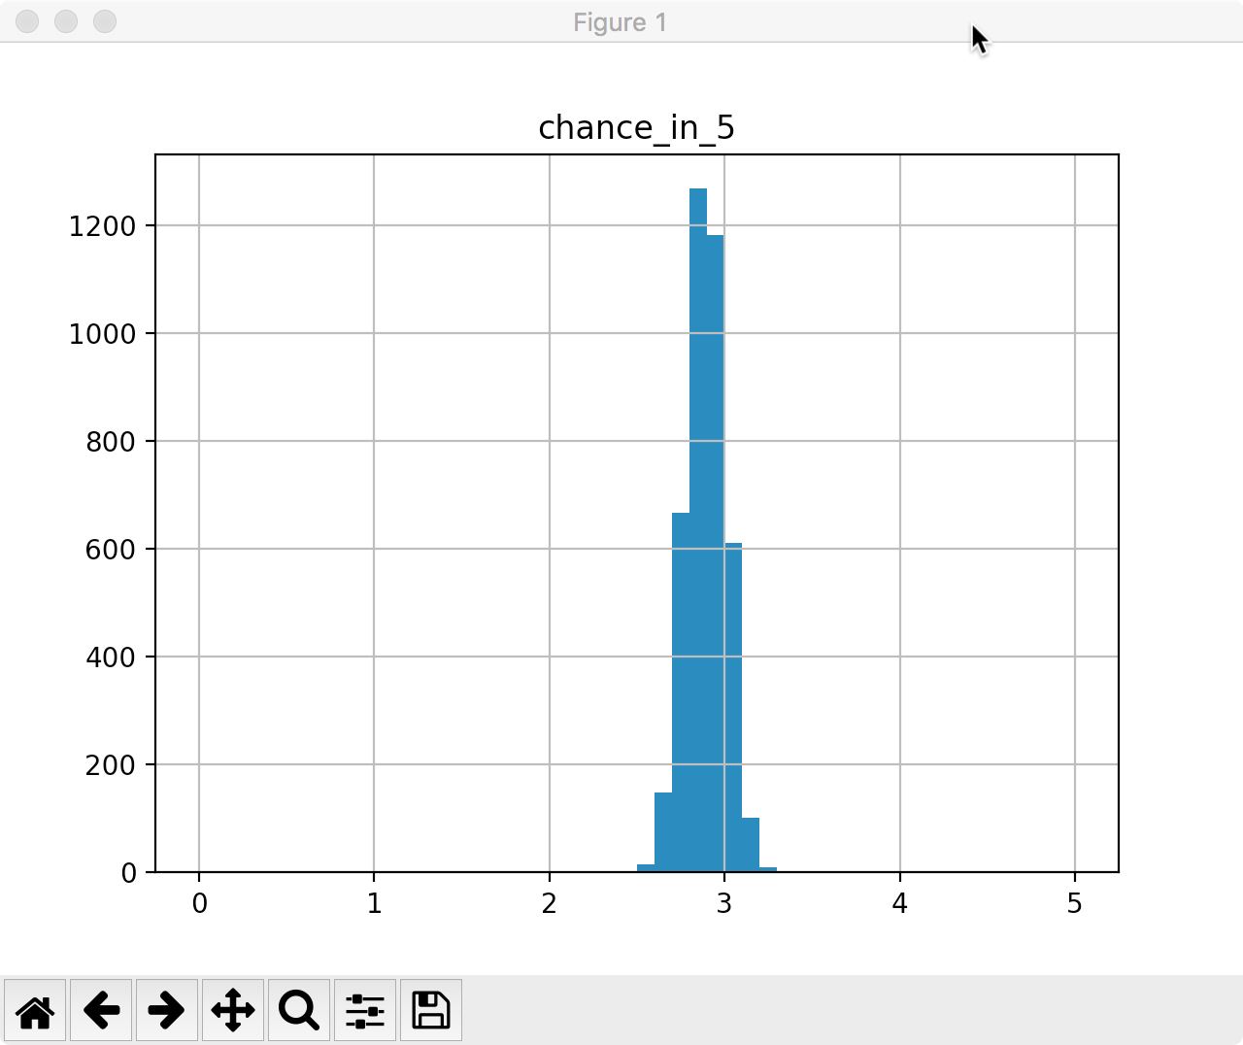
$ python puttBetScale.py stan/mechanistic_golf_shrinkage.stan 5 .1 10

Slide 14
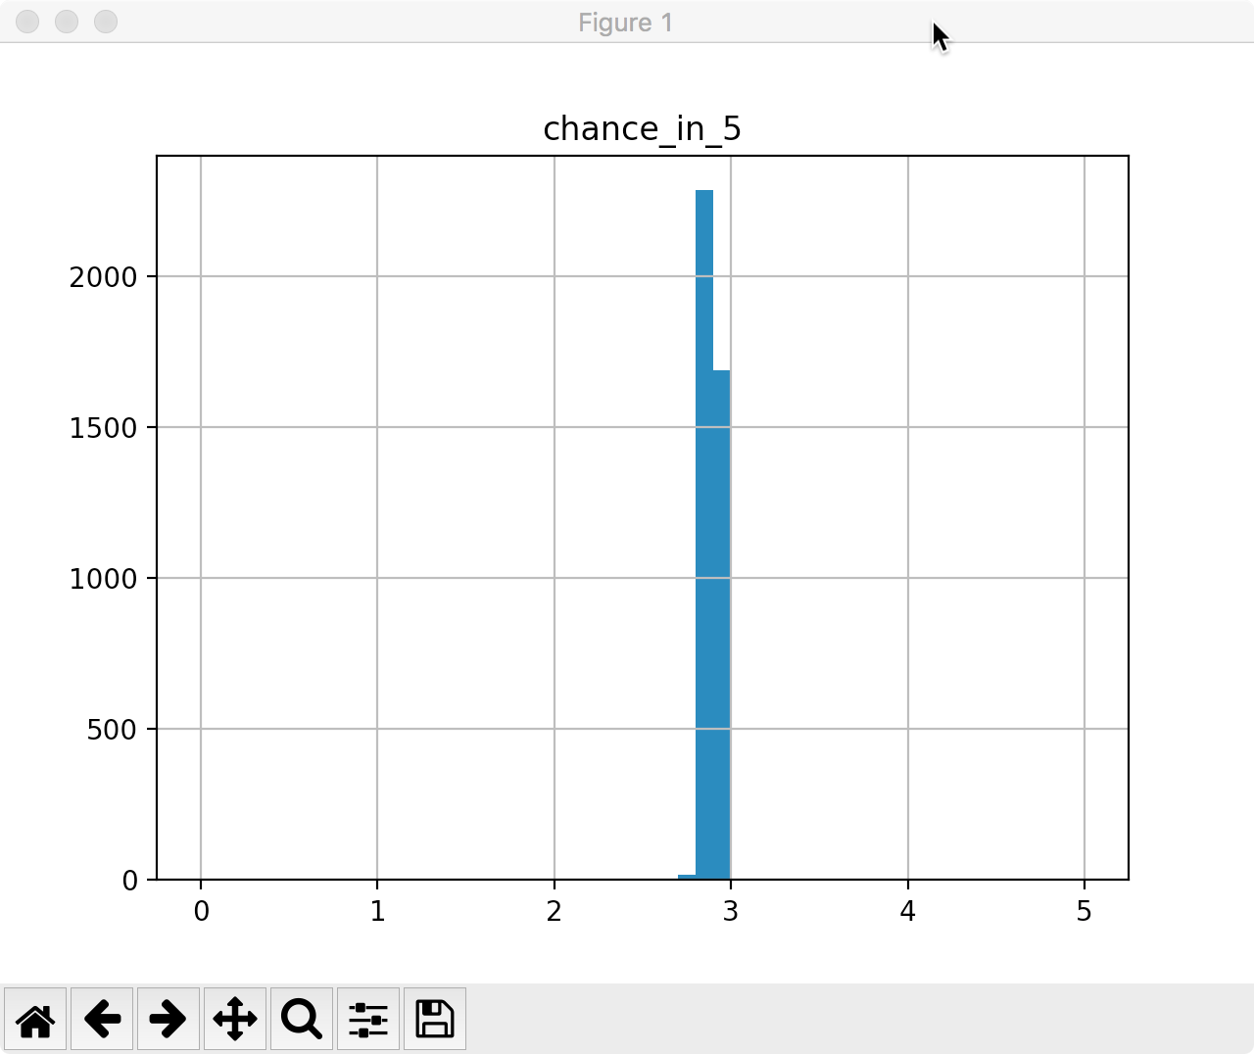
$ python puttBetScale.py stan/mechanistic_golf_shrinkage.stan 5 1 19

Slide 15
Compare 5%-95% intervals
Mean 5% 50% 95%
name
chance_in_5 .01 3 2.823270 2.151960 2.824790 3.454040
chance_in_5 .1 10 2.895170 2.711690 2.894230 3.075980
chance_in_5 1 19 2.890480 2.833360 2.890500 2.948710

Slide 16
Less Data Means Less Certainty
Is there a difference between 95% of posterior samples that range from:
  2.1 and 3.4?
  2.8 and 2.9?
The house insists on even bets and $1 max
10,000 $1 bets
  makes $ if the true chance_in_5 is 2.8
  looses $ if the true chance_in_5 is 2.3

Slide 17
Working with the posterior
The posterior is the combination of prior information with data via a likelihood.
Stan programs do not produce posteriors
Stan programs draw samples from posteriors.
chance_in_5 will have around 4,000 samples
  Each one a draw from the posterior
  No probabilities yet

Slide 18
Values for chance_in_5
[1] 4.983672319 0.504675345 0.956908493 2.875748848 0.997364239 0.417071450 4.501827071 0.936049387 0.863498351
[10] 4.153279253 2.060605266 1.139810114 3.779605672 1.658594148 1.067616110 4.116676326 2.330651455 3.967579063
[19] 1.842490519 0.455000172 1.157479467 2.752047595 0.915102101 4.982286286 4.391265367 4.992451716 2.447138984
[28] 2.205051616 4.231899958 0.812689175 3.989032044 0.796250061 0.859436737 1.028724611 1.924055572 3.208221532
[37] 2.210415693 2.136084733 1.248423340 3.315607704 2.254323347 4.784930724 4.885145022 1.982817767 4.984226181
[46] 0.048460657 0.282379449 3.722942450 0.999613762 2.502718692 3.243868759 0.822543222 0.211249991 1.147694845
[55] 4.896531799 4.199396308 0.665606386 3.141129394 2.607873759 4.690558455 4.696524164 4.031962569 2.755539678
[64] 1.283222482 2.248947510 0.319166050 0.636175197 1.570415334 2.837057149 2.539923313 3.181580786 1.233043905
[73] 3.061787637 4.764964321 0.918676119 0.480524564 1.491754639 3.321344687 0.492543512 2.089836199 4.983904438
[82] 1.547706472 2.414447829 0.282179524 1.666381844 0.367431461 4.361380324 3.373313419 4.397065423 1.689771086
[91] 1.141912694 2.459350776 4.159030935 3.116608167 3.076992472 0.823561946 2.969654653 1.165449756 1.658783029
[100] 0.351305357 1.694081739 1.259235890 1.387418442 2.528962612 4.852489185 1.374381734 2.941864848 1.157997846
[109] 0.168440287 4.373520019 3.886488608 1.093028201 4.987565650 4.812540735 4.595358682 0.655243261 2.834453881
[118] 2.728336762 1.977742924 2.179817460 0.320485894 3.711874986 0.189774115 2.125163616 2.366089869 2.752047595
[127] 2.270779435 2.060605266 0.497764905 1.841243712 0.039907438 3.040357791 2.607759999 1.721114910 2.466011311
...

Slide 19
Histograms
End goal is to figure out probability for values of 'chance_in_5'.
We bin 10 ways, 0-0.499, .5-.999, ...4.5-5
  Any exact value is unlikely to be found in samples
  Bins are human interpretable
P(chance_in_5 < 2.8) = 50%
  count(values < 2.8) / count(all values)
  Look at values
    $ less puttbet-1.csv

Slide 20
A tour of puttBet.py
import os
from cmdstanpy import cmdstan_path, CmdStanModel
import pandas as pd
import numpy as np
import matplotlib.pyplot as plt
import seaborn as sns
import fileinput
import sys
stan_program_path = sys.argv[1]
distance_of_putt = float(sys.argv[2])
stan_program = CmdStanModel(stan_file=stan_program_path)
stan_program.compile()
json_data = data= {"distance_of_putt":distance_of_putt}
fit = stan_program.sample(data=json_data,
csv_basename='./puttbet')
print(fit.summary())
fit.get_drawset(params=['pred_ch_in_5']).hist(bins=50,range=(0,5))
plt.show()

Slide 21
A tour of stan/mechanistic_golf.stan
data {
real distance_of_putt;
}
transformed data {
int J = 19;
int x_distance[J] = {2,3,4,5,6,7,8,9,10,11,12,13,14...};
int y_successes[J] = {1346,577,337,208,149,136,111...};
int n_attempts[J] = {1443,694,455,353,272,256,240...};
real r = (1.68/2)/12;
real R = (4.25/2)/12;
real threshold_angle[J];
for (i in 1:J) {
threshold_angle[i] = asin((R-r)/x_distance[i]);
}
}
parameters {
real<lower=0> sigma_error_in_radians;
}
model {
for (i in 1:J) {
real prob = 2*Phi(threshold_angle[i]/sigma_error_in_radians) - 1;
y_successes[i] ~ binomial(n_attempts[i], prob);
}
}
generated quantities {
real sigma_error_in_degrees = (180/pi())*sigma_error_in_radians;
real pred_ch_in_5;
real threshold_angle_for_distance = asin((R-r)/distance_of_putt);
pred_ch_in_5 =
(2*Phi(threshold_angle_for_distance/sigma_error_in_radians) - 1) * 5;
}

Slide 22
Summarizing
We know Stan inputs
  Data
  Model
We know Stan outputs
  Posterior draws
We see roughly how they connect
  puttBet.py
  mechanistic_golf.stan
Learned that size of data matters

Slide 23
Next
Cover detailed mechanics of compiling/running Stan programs
Start building PuttBet app from zero

Slide 24
Compiling with CmdStan
cd <path>/cmdstan-2.21.0
mkdir tmp
edit/save tmp/test.stan
parameters {
real <lower=0, upper = 5> chance_in_5;
}
model {}
make tmp/test
ls tmp
test test.hpp test.o test.stan

Slide 25
Running a stan program
$ tmp/test sample
method = sample (Default)
sample
num_samples = 1000 (Default)
num_warmup = 1000 (Default)
…
Iteration: 1900 / 2000 [ 95%] (Sampling)
Iteration: 2000 / 2000 [100%] (Sampling)
Elapsed Time: 0.010488 seconds (Warm-up)
0.035355 seconds (Sampling)
0.045843 seconds (Total)

Slide 26
Running a Stan program
$ less output.csv
….
lp__,accept_stat__,stepsize__,treedepth__,n_leapfrog__,divergent__,energy__,chance_in_5
# Adaptation terminated
# Step size = 0.947331
# Diagonal elements of inverse mass matrix:
# 2.56888
0.195175,0.999576,0.947331,1,3,0,0.0821981,2.91519
0.125106,0.980979,0.947331,1,1,0,-0.124422,3.26398
-0.367036,1,0.947331,1,1,0,0.803274,4.16915
0.153601,0.993894,0.947331,1,3,0,0.584455,1.85203
0.216061,1,0.947331,2,3,0,-0.163841,2.71003
0.220674,0.999161,0.947331,1,3,0,-0.211056,2.37584
0.0979697,0.964437,0.947331,1,3,0,-0.0598895,3.35753
0.0966662,0.999669,0.947331,1,1,0,-0.0630794,3.36171
0.0966662,0.624582,0.947331,1,3,0,1.44813,3.36171
-1.16498,0.724709,0.947331,1,3,0,1.34801,4.66572
-0.429226,1,0.947331,2,3,0,1.07796,4.23059
-0.942596,0.937841,0.947331,1,1,0,0.960438,4.57411
-0.703981,1,0.947331,1,1,0,1.01248,4.44343
-1.55183,0.92825,0.947331,1,1,0,1.55254,4.77831
...

Slide 27
Summarizing Output
$ bin/stansummary output.csv
Inference for Stan model: test_model
1 chains: each with iter=(1000); warmup=(0); thin=(1); 1000 iterations saved.
Warmup took (0.010) seconds, 0.010 seconds total
Sampling took (0.035) seconds, 0.035 seconds total
Mean MCSE StdDev 5% 50% 95% N_Eff N_Eff/s R_hat
lp__ -0.30 3.6e-02 6.8e-01 -1.7 -7.5e-02 0.22 3.6e+02 1.0e+04 1.0e+00
accept_stat__ 0.93 3.2e-03 1.1e-01 0.68 9.8e-01 1.0 1.2e+03 3.4e+04 1.0e+00
stepsize__ 0.95 nan 2.9e-15 0.95 9.5e-01 0.95 nan nan nan
treedepth__ 1.4 2.1e-02 5.6e-01 1.0 1.0e+00 2.0 6.7e+02 1.9e+04 1.0e+00
n_leapfrog__ 2.7 5.4e-02 1.4e+00 1.0 3.0e+00 7.0 7.0e+02 2.0e+04 1.0e+00
divergent__ 0.00 nan 0.0e+00 0.00 0.0e+00 0.00 nan nan nan
energy__ 0.79 4.9e-02 9.5e-01 -0.16 5.3e-01 2.7 3.7e+02 1.1e+04 1.0e+00
chance_in_5 2.5 7.7e-02 1.4e+00 0.34 2.5e+00 4.7 3.3e+02 9.4e+03 1.0e+00
Samples were drawn using hmc with nuts.
For each parameter, N_Eff is a crude measure of effective sample size,
and R_hat is the potential scale reduction factor on split chains (at
convergence, R_hat=1).

Slide 28
Compile/Run from Python
$ cd <path>/StanIsThePlanDist
$ python rv.py stan/test.stan
$ python rv.py stan/test.stan chance_in_5
$ python rv.py stan/test.stan chance_in_5 cat

Slide 29
Outline: Model Authoring for Beginners
Pick the simplest parameters that make sense
  Betting/Putting app: Sink or miss.
Eliminate the impossible (prior knowledge)
  A persons height can't be negative or > 10 ft
Find a way to incorporate data into priors (likelihood) that turns into a posterior
Have a way to decide if the posterior is useful

Slide 30
An Important Philosophical Point
Can't model world for detail and scope reasons
  Detail: Computationally too complex & don't have theory
  Scope: Computationally too big & don't have data
We can approximate however by averaging things out
  We approximate physics
  We limit how much we look at
This gets us uncertainty
  Instead of 0 or 1, we say 0.01 or .5 or .99

Slide 31
Uncertainty
.99 (99%) probability means that 99 times out of 100 we get X, 1 time we don't....over time....
Often abused, a system will claim .99 but it is not.
Difficult to separate poor calibration from uncertainty.
  We don't get HTHT on coin flips all the time
  Over large amounts of data we should get .5 H
  We should also get HHHHH with enough data

Slide 32
1st Revision to our model
Is PuttBet modeling the entire universe?
Does PuttBet have access to the future?
The PuttBet app will now return 'chance_in_5' to reflect our uncertainty.
  0 chance in 5 is 0% probability
  5 chance in 5 is 100%
  2.5 chance in 5 is 50%
chance_in_5 keeps us from discussing probabilities of probabilities
Instead, probability of a 'chance_in_5'

Slide 33
Playing with parameter scales
Instead of 0 to 5 we use A-E
  A=0-.999
  B=1-1.999
  C=2-2.999
  D=3-3.999
  E=4-5
What is probability of E?

Slide 34
Code model up in Stan
Look at stan/no_putt.stan or just type into an editor
parameters {
real <lower=0, upper=5> chance_in_5;
}
model {
}
Save as 'stan/no_putt.stan'
$ cd <path>/StanIsThePlanDist
$ python rv.py stan/no_putt.stan chance_in_5

Slide 35
Inspect output-1.csv
>less output-1.csv
lp__,accept_stat__,...,divergent__,energy__, chance_in_5
-0.788662,0.834613,1.12129,1,1,0,0.799103, 4.49443
-0.34793,0.967041,1.12129,2,3,0,1.39449, 0.850982
-1.74739,0.802025,1.12129,2,3,0,1.78157, 4.81924
-1.74739,0.963619,1.12129,1,1,0,2.66079, 4.81924
…
0.171325,1,1.12129,1,1,0,-0.14552, 3.0618
0.0610676,0.958562,1.12129,1,1,0,-0.048304, 3.46703
-0.56155,0.829213,1.12129,1,3,0,0.878503, 0.656531

Slide 36
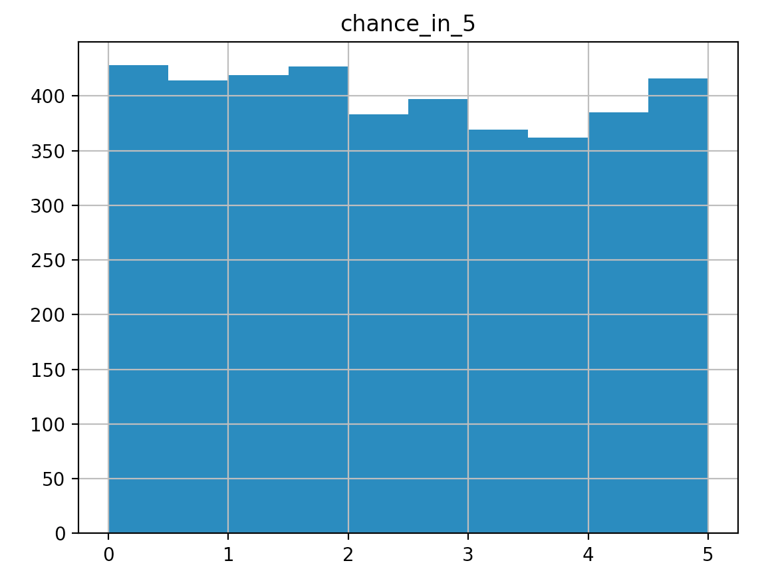
Histogram of 'chance_in_5'
$ python rv.py stan/no_putt.stan chance_in_5

Slide 37
Welcome to the Uniform Distribution
Given the uniform distribution draws above:
  What are some ranges of 'chance_in_5' that have 50% probability?
  Is any value of the distribution more likely than any other?
  Name some phenomenon and the relative parameter scale that is uniformly distributed.
  Name some phenomenon that are not uniformly distributed.
  The mean parameter value is 2.5, is that useful?

Slide 38
Messing with Distributions
$ python rv.py stan/uniform_uniform.stan chance_in_5
parameters {
real <lower=0, upper = 5> chance_in_5;
}
model {
chance_in_5 ~ uniform(0,5);
}
Mean MCSE StdDev 5% 50% 95% N_Eff N_Eff/s R_hat
name
lp__ -0.379682 0.022752 0.840617 -2.094090 -0.043359 0.221461 1365.13 5689.78 0.999403
chance_in_5 2.513630 0.036922 1.427840 0.227396 2.461970 4.743070 1495.51 6233.22 1.002910

Slide 39
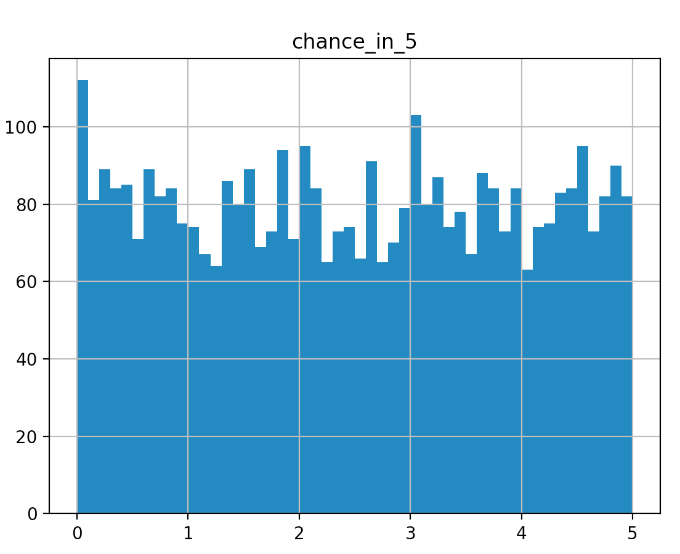
Uniform x Uniform

Slide 40
Uniform Haircut
parameters {
real <lower=0, upper = 5> chance_in_5;
}
model {
chance_in_5 ~ uniform(0,1);
}
> python rv.py stan/targ_unif_unif.stan chance_in_5

Slide 41
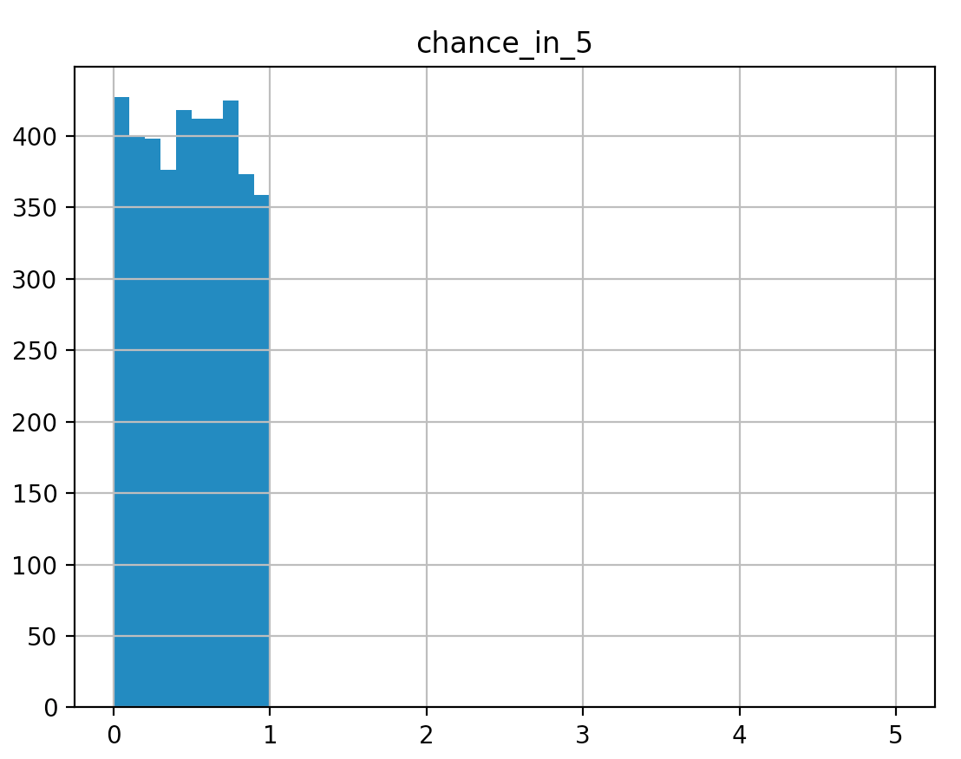
uniform(0,5) x uniform(0,1)

Slide 42
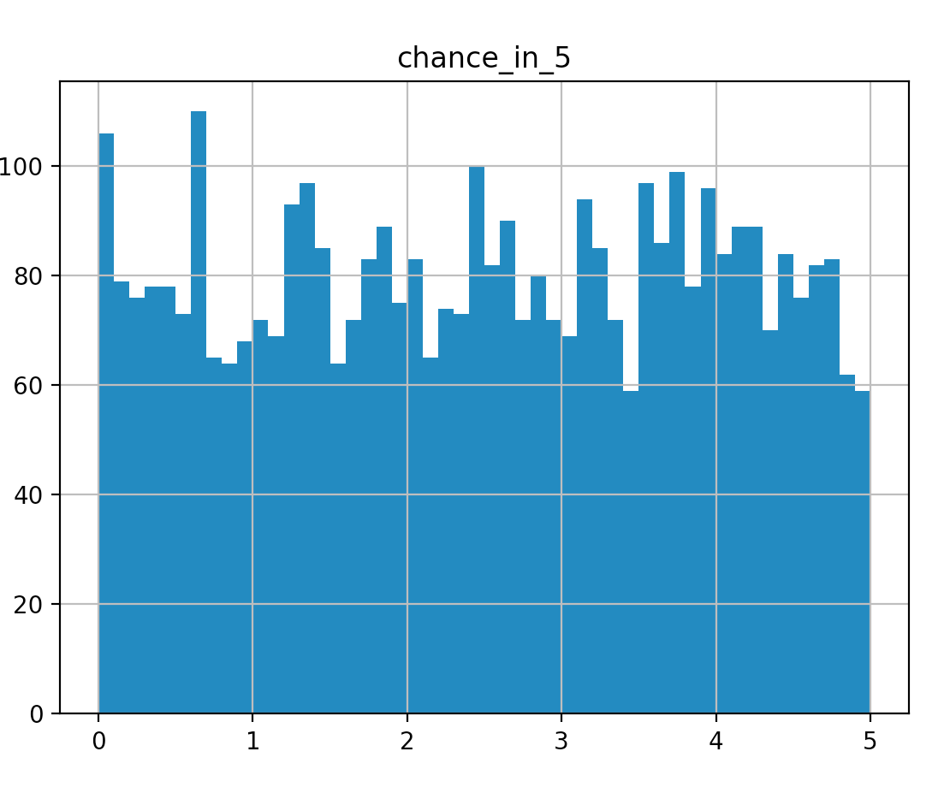
Fix by scaling
parameters {
real <lower=0, upper = 5> chance_in_5;
}
transformed parameters {
real chance_in_1 = chance_in_5/5;
}
model {
chance_in_1 ~ uniform(0,1);
}
$ python rv.py stan/scaled_uniform_uniform.stan chance_in_5

Slide 43
Adding some data to our model
Putt went in = 1, putt did not = 0
$ python rv.py stan/one_putt.stan chance_in_5
parameters {
real<lower=0, upper=5> chance_in_5;
}
transformed parameters {
real chance_in_1 = chance_in_5/5;
}
model {
chance_in_1 ~ uniform(0,1);
1 ~ bernoulli(chance_in_1);
}

Slide 44
Running the model
> python rv.py stan/one_putt.stan chance_in_5
Mean MCSE StdDev 5% 50% 95% N_Eff N_Eff/s R_hat
name
lp__ -0.890663 0.023695 0.784950 -2.54812 -0.592286 -0.303383 1097.41 6401.1 1.00204
chance_in_5 3.339720 0.031065 1.184030 1.13355 3.560120 4.876400 1452.69 8473.4 1.00132
chance_in_1 0.667945 0.006213 0.236806 0.22671 0.712025 0.975280 1452.69 8473.4 1.00132

Slide 45
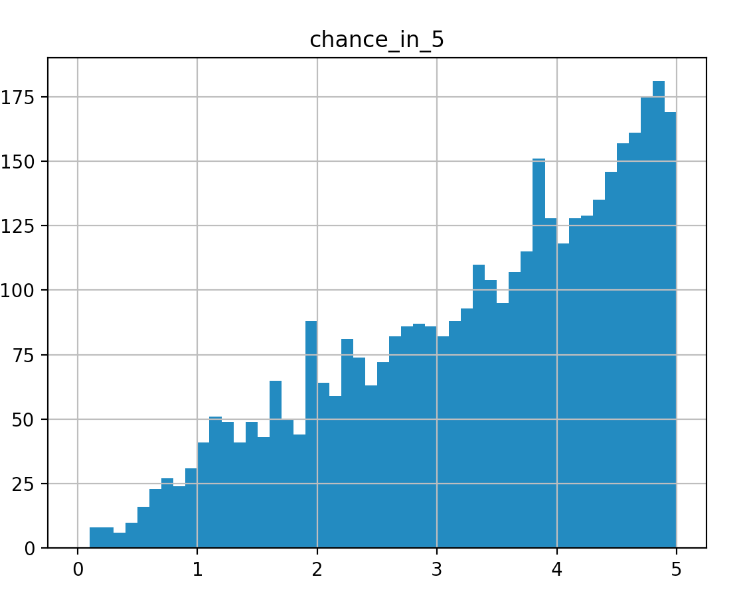
Running the model
> python rv.py stan/one_putt.stan chance_in_5

Slide 46
What happened?
Understand the Bernoulli distribution
Expose the implicit loop around blocks
Give the intuition around what the target() does

Slide 47
What is this Bernoulli thing?
Putt goes in: 1
  1 ~ bernoulli(.99) = .99
  1 ~ bernoulli(.1) = .1
  1 ~ bernoulli(.5) = .5
Putt does not go in: 0
  0 ~ bernoulli(.99) = .1
  0 ~ bernoulli(.1) = .99
  0 ~ bernoulli(.5) = .5

Slide 48
breck_noulli function
> python rv.py stan/breck_noulli.stan theta
functions {
real breck_noulli_lpmf(int zero_or_one,
real param_to_return_prob_of) {
if (zero_or_one == 1) {
return log(param_to_return_prob_of);
}
return log(1.0-param_to_return_prob_of);
}
}
parameters {
real<lower=0,upper=1> theta;
}
model {
1 ~ breck_noulli(theta);
}

Slide 49
Simplified (Wrong) Evaluation
From last iteration prev_target = .3
Propose a random value for chance_in_5 = 2:
Rescale to chance_in_1 = .2
Set target to 1
target = target*(1 ~ breck_noiulli(chance_in_1))
target = 1*(.2) = .2
If target > prev_target, accept proposal.
If target < prev_target
  accept proposal at 1/target rate, else keep last target().

Slide 50
How did Bernoulli change the posterior?
exp(prev_target)= .5, values of params recorded.
exp(target()) = 1
chance_in_1 = .4
exp(target()) * exp(uniform_lpdf(.4,1,0)) = 1
exp(target()) * exp(bernoulli_lpmf(1|.4)) = .4
.4/.5 < 1 so we accept 40% of the time
40% of .4 param survive, they reduce in histogram count.

Slide 51
Distributions in Action
Animation uniformXbernoulli

Slide 52
transformed data {
int num_samples=250;
}
generated quantities {
real chance_in_5[num_samples];
real sigma_step_size = .5;
real my_target[num_samples];
chance_in_5[1] = 2.5;
my_target[1] = log(chance_in_5[1]);
for (i in 2:num_samples) {
real proposal = chance_in_5[i-1] + normal_rng(0,sigma_step_size);
real chance_in_1;
real random_value = uniform_rng(0,1);
my_target[i] = 0;
proposal = fmax(0.0,proposal);
proposal = fmin(5.0,proposal);
chance_in_1 = proposal/5;
my_target[i] += bernoulli_lpmf(1|chance_in_1);
if (exp(my_target[i])/
exp(my_target[i-1]) > random_value) {
chance_in_5[i] = proposal;
}
else {
chance_in_5[i] = chance_in_5[i-1];
}
}
print("Chance_In_5: ",chance_in_5);
print("Mean: ", mean(chance_in_5));
}

Slide 53
Summary Section 1
We know the basics of how to run a Stan program with CmdStanPy.
Setup basic app, PuttData
Have very simple program with one data point
Next we will improve our model by
  Adding data
  Modifying the model

Slide 54
Homework
Add more data to model
Add another parameter to model
Try different distribution in place of bernoulli
  1 ~ normal(a,.5)
  1 ~ normal(3,a)
  a ~ normal(3,.5)
  1 ~ exponential(a)
Change the number of bins in the histogram

