Slide 1
Stan Is The Plan Part 2
Breck Baldwin
NYC PyData 2019

Slide 2
Outline
Turn one_putt.stan into one_putt_predict.stan
Go over major parts of a Bayesian model
Try some different likelihoods
Add some data.
Add a lot of data.

Slide 3
Stan/one_putt_predict.stan
Externally supplied data
data {
real distance_of_putt;
}
parameters {
real<lower=0, upper=1> chance_in_1;
}
model {
chance_in_1 ~ uniform(0,1);
1 ~ bernoulli(chance_in_1);
}
generated quantities {
real pred_ch_in_5 = chance_in_1 * 5;
}
$ python puttBet.py stan/one_putt_predict.stan 5
Parameter we are trying to learn
Prior
Likelihood
Prediction

Slide 4
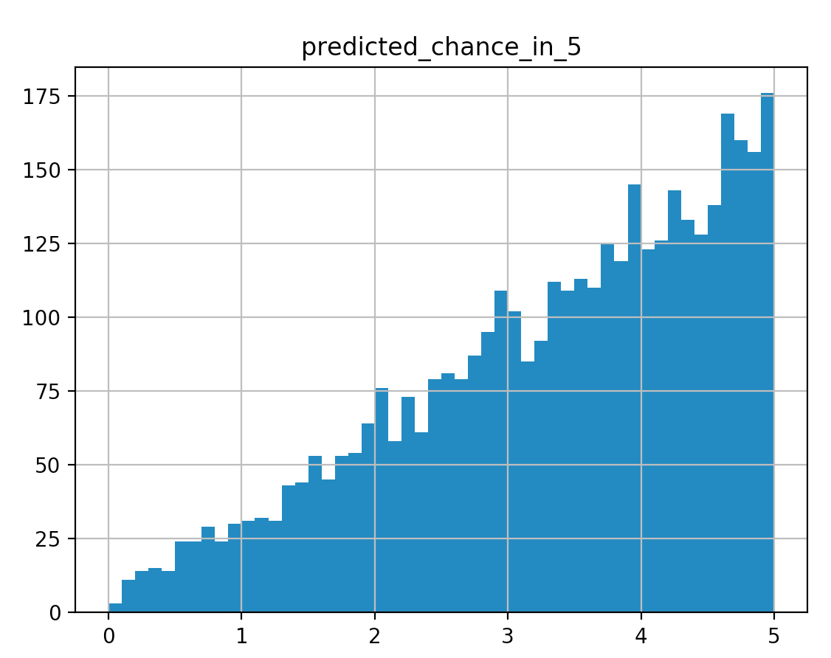
$ python puttBet.py stan/one_putt_predict.stan 5
Mean MCSE StdDev 5% ... 95% N_Eff N_Eff/s R_hat
name ...
lp__ -2.539970 0.025559 0.904508 -4.321050 ... -1.912100 1252.40 6963.88 1.00248
chance_in_1 0.668104 0.006756 0.239877 0.208745 ... 0.977099 1260.52 7009.04 1.00323
pred_ch_in_5 3.340520 0.033782 1.199390 1.043720 ... 4.885490 1260.52 7009.04 1.00323

Slide 5
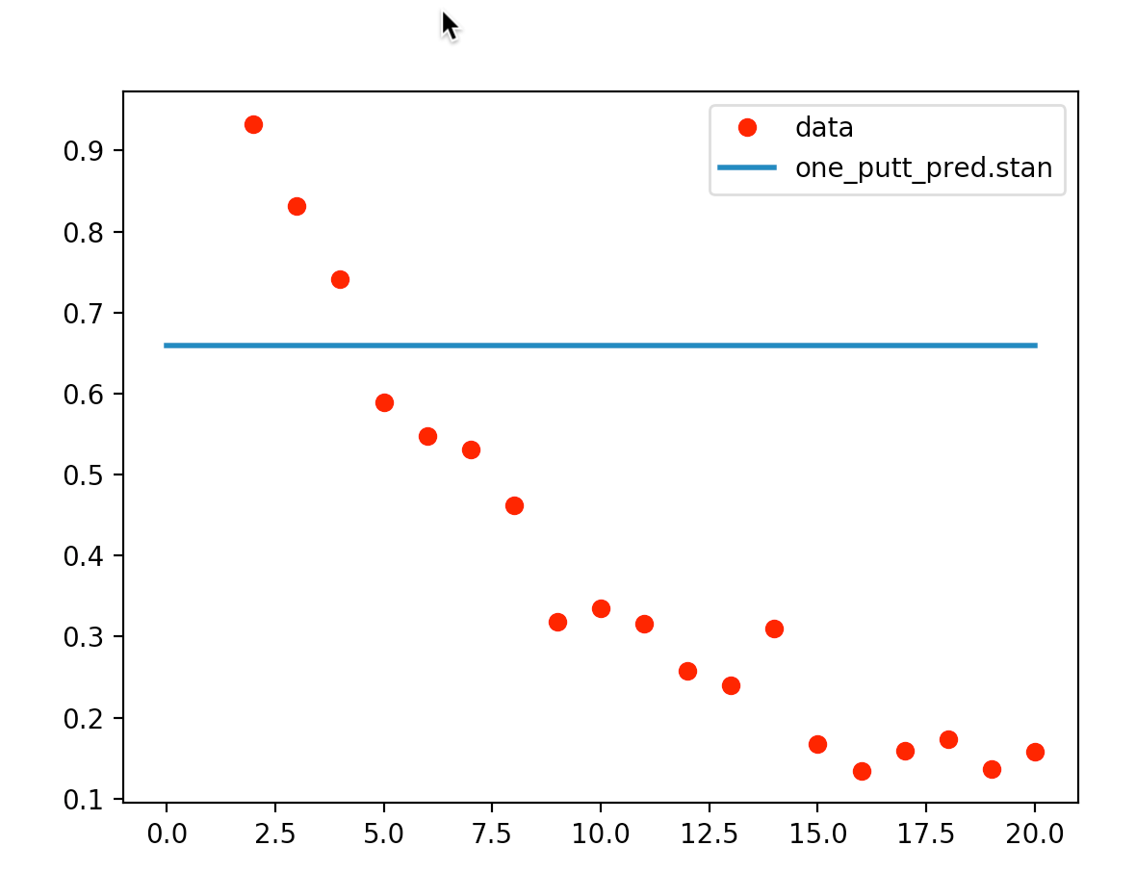

Slide 6
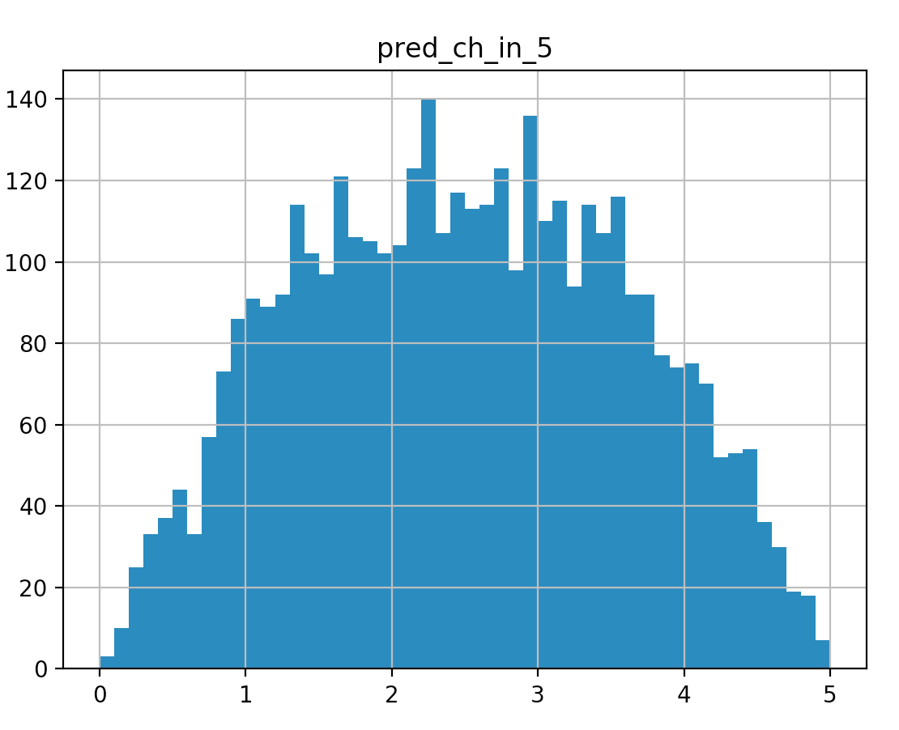
Add some more data
model {
chance_in_1 ~ uniform(0,1);
1 ~ bernoulli(chance_in_1);
0 ~ bernoulli(chance_in_1);
}
$ python puttBet.py stan/two_putt.stan 5

Slide 7
stan/pooled_golf.stan
data {
real distance_of_putt;
}
transformed data {
int J = 19;
int x[J] = {2,3,4,5,6,7,8,9,10,11,12,13,14,15...};
int n[J] = {1443,694,455,353,272,256,240,217,200...};
int y[J] = {1346,577,337,208,149,136,111,69,67,...};
}
parameters {
real<lower=0,upper=1> chance_in_1;
}
model {
for (i in 1:J) {
y[i] ~ binomial(n[i], chance_in_1);
}
}
generated quantities {
real pred_ch_in_5 = chance_in_1*5;
}

Slide 8
What is the bionomial?
functions {
real my_binomial_lpmf(int successes, int attempts,
real chance_in_1) {
real return_probability = 0;
for (i in 1:successes) {
return_probability += bernoulli_lpmf(1|chance_in_1);
}
for (i in 1:attempts-successes) {
return_probability += bernoulli_lpmf(0|chance_in_1);
}
return return_probability;
}
}
$ python puttBet.py stan/my_binomial.stan 5

Slide 9
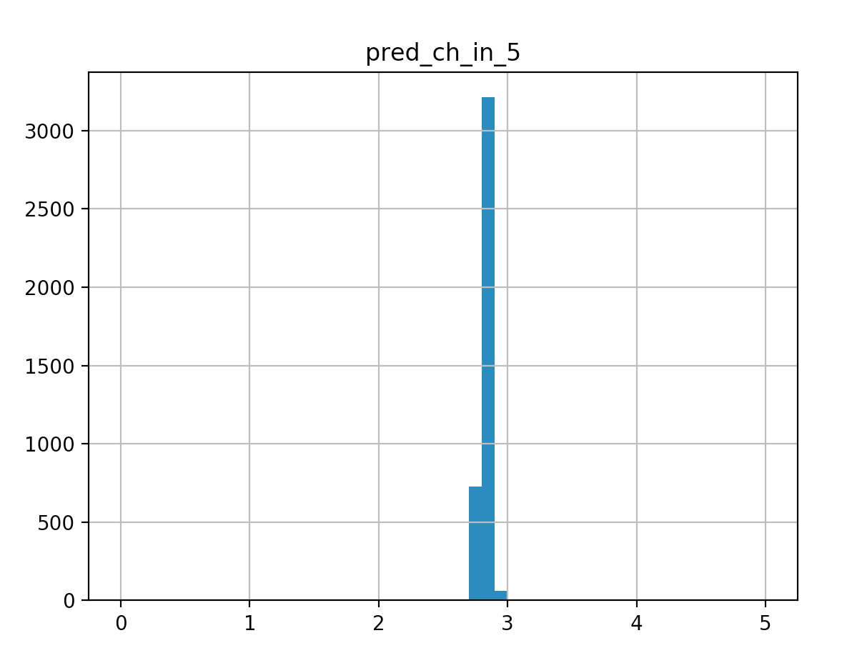
$ python puttBet.py stan/pooled_golf.stan 5

Slide 10
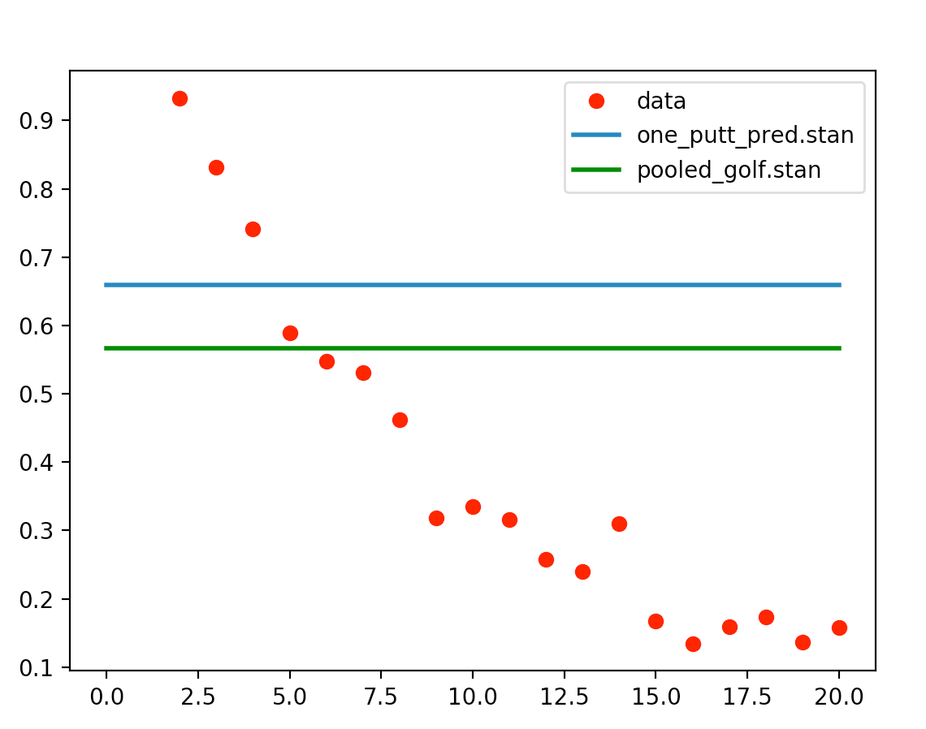

Slide 11
Changes for not pooled: not_pooled_golf.stan
parameters {
real<lower=0,upper=1> chance_in_1_for_dist[J];
}
model {
for (i in 1:J) {
y[i] ~ binomial(n[i], chance_in_1_for_dist[i]);
}
}
generated quantities {
real pred_ch_in_5 = chance_in_1_for_dist[J]*5;
for (i in 1:J) {
if (distance_of_putt < x[i]) {
pred_ch_in_5 = chance_in_1_for_dist[i]*5;
break;
}
}
}

Slide 12
$ python puttBet.py stan/not_pooled_golf.stan 5
Mean MCSE StdDev ... N_Eff N_Eff/s R_hat
name ...
lp__ -2935.680000 0.082004 3.129880 ... 1456.75 3062.43 1.000410
chance_in_1_for_dist[1] 0.932163 0.000070 0.006558 ... 8678.76 18244.70 0.999355
chance_in_1_for_dist[2] 0.830304 0.000138 0.014137 ... 10556.90 22192.90 0.999654
chance_in_1_for_dist[3] 0.739621 0.000227 0.021108 ... 8658.28 18201.70 0.999627
chance_in_1_for_dist[4] 0.588373 0.000250 0.026130 ... 10893.30 22900.20 0.999372
chance_in_1_for_dist[5] 0.547546 0.000318 0.029914 ... 8821.41 18544.60 0.999533
chance_in_1_for_dist[6] 0.531649 0.000303 0.030247 ... 9949.41 20915.90 0.999200
chance_in_1_for_dist[7] 0.462658 0.000318 0.031639 ... 9895.18 20801.90 0.999390
...
chance_in_1_for_dist[18] 0.140775 0.000272 0.028243 ... 10756.00 22611.50 0.999154
chance_in_1_for_dist[19] 0.162293 0.000334 0.030506 ... 8325.80 17502.70 0.999948
pred_ch_in_5 2.737730 0.001592 0.149570 ... 8821.38 18544.50 0.999533

Slide 13
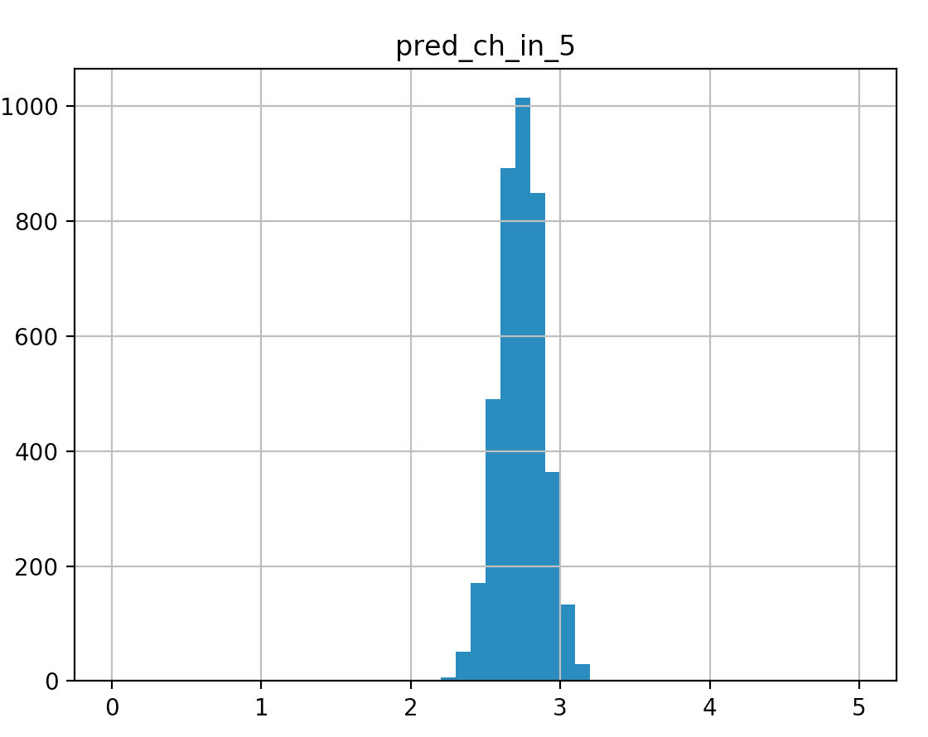
python puttBet.py stan/not_pooled_golf.stan 5

Slide 14
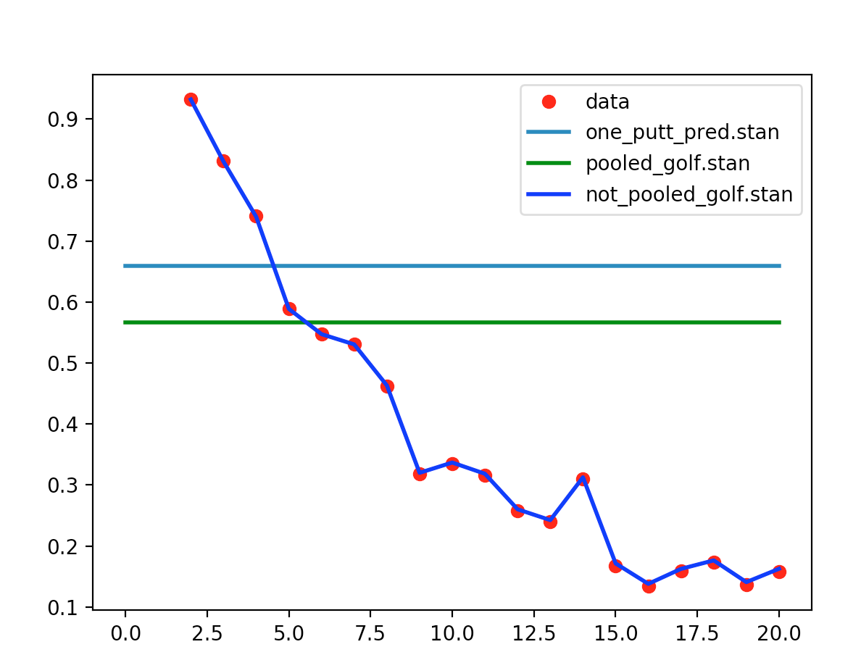

Slide 15
Changes for linear_golf.stan
parameters {
real a_intercept;
real <lower=-.1,upper=0>b_slope;
}
model {
for (i in 1:J) {
real chance_in_1 = a_intercept + b_slope*x[i];
y[i] ~ binomial(n[i], chance_in_1);
}
}
generated quantities {
real pred_ch_in_5 =
(a_intercept + b_slope*distance_of_putt)*5;
}
Mean MCSE StdDev 5% 50% 95% N_Eff N_Eff/s R_hat
name
lp__ -3061.360000 0.026869 1.005330 -3063.380000 -3061.050000 -3060.370000 1399.98 4256.86 1.00086
a_intercept 0.951225 0.000241 0.008740 0.936986 0.951358 0.965452 1316.54 4003.16 1.00136
b_slope -0.045555 0.000017 0.000610 -0.046541 -0.045580 -0.044531 1224.13 3722.17 1.00222
pred_ch_in_5 3.845020 0.000879 0.033947 3.790300 3.845330 3.900940 1490.89 4533.30 1.00095

Slide 16
Changes for linear_golf.stan
parameters {
real a_intercept;
real <lower=-.1,upper=0>b_slope;
}
model {
for (i in 1:J) {
real chance_in_1 = a_intercept + b_slope*x[i];
y[i] ~ binomial(n[i], chance_in_1);
}
}
generated quantities {
real pred_ch_in_5 =
(a_intercept + b_slope*distance_of_putt)*5;
}
Mean MCSE StdDev 5% 50% 95% N_Eff N_Eff/s R_hat
name
lp__ -3061.360000 0.026869 1.005330 -3063.380000 -3061.050000 -3060.370000 1399.98 4256.86 1.00086
a_intercept 0.951225 0.000241 0.008740 0.936986 0.951358 0.965452 1316.54 4003.16 1.00136
b_slope -0.045555 0.000017 0.000610 -0.046541 -0.045580 -0.044531 1224.13 3722.17 1.00222
pred_ch_in_5 3.845020 0.000879 0.033947 3.790300 3.845330 3.900940 1490.89 4533.30 1.00095

Slide 17
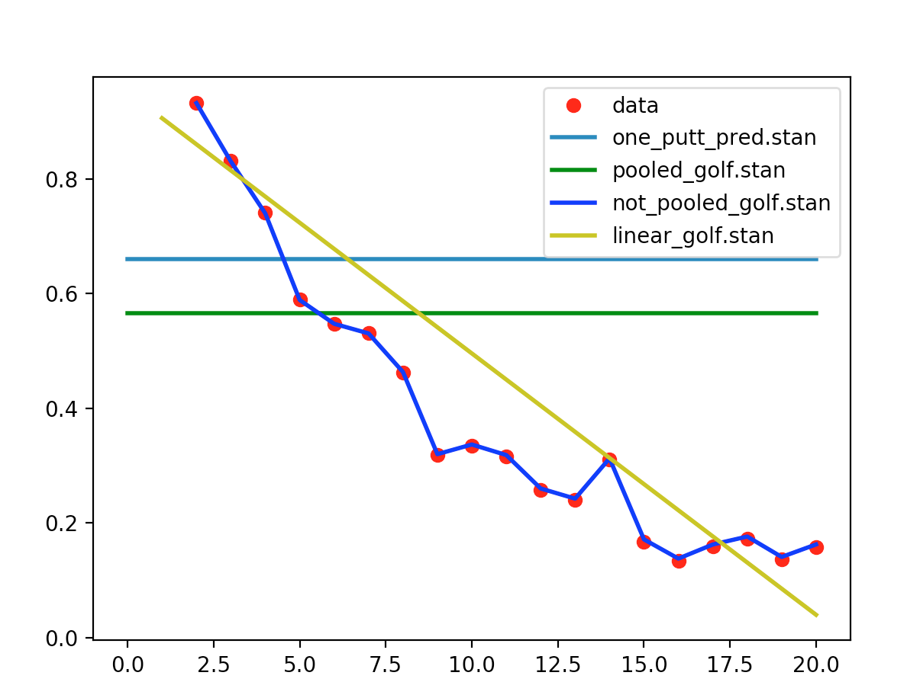

Slide 18
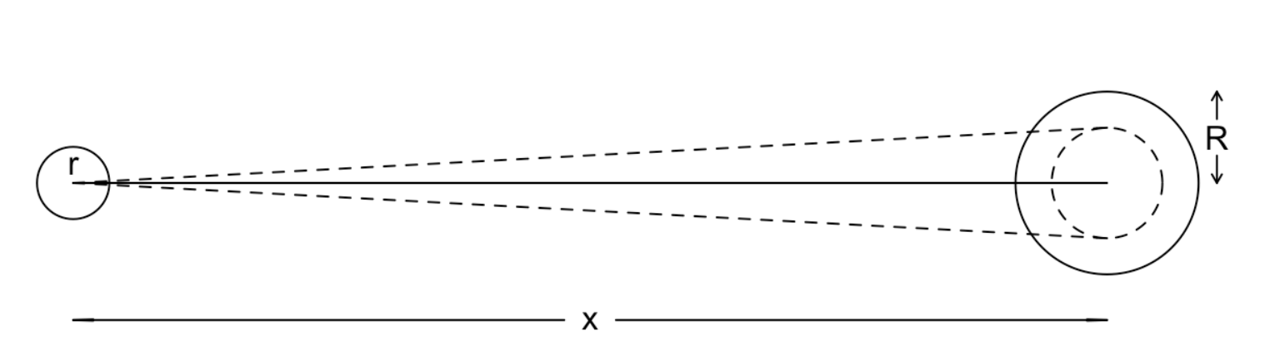
More on the Mechanistic Model
Andrew Gelman Case Study:
  https://mc-stan.org/users/documentation/case-studies/golf.html

Slide 19
Changes for mechanistic_golf.stan
transformed data {
...
real r = (1.68/2)/12;
real R = (4.25/2)/12;
real threshold_angle[J];
for (i in 1:J)
threshold_angle[i] = asin((R-r)/x[i]);
}
parameters {
real<lower=0> sigma;
}
model {
for (i in 1:J) {
real prob = 2*Phi(threshold_angle[i]/sigma) - 1;
y[i] ~ binomial(n[i], prob);
}
}
generated quantities {
real sigma_degrees = (180/pi())*sigma;
real pred_ch_in_5 =
(2*Phi(threshold_angle_for_distance/sigma) - 1) * 5;
}

Slide 20
$ python puttBet.py stan/mechanistic_golf.stan 4
Mean MCSE StdDev ... N_Eff N_Eff/s R_hat
name ...
lp__ -2926.760000 1.708170e-02 6.843830e-01 ... 1605.22000 6509.1500 1.002320
sigma 0.026662 1.016150e-05 3.926940e-04 ... 1493.47000 6056.0100 1.001460
sigma_degrees 1.527630 5.822050e-04 2.249980e-02 ... 1493.50000 6056.1300 1.001460
pred_ch_in_5 3.423840 9.231030e-04 3.563680e-02 ... 1490.38000 6043.4600 1.001490
threshold_angle_for_distance 0.026774 9.705930e-17 1.943130e-16 ... 4.00803 16.2525 0.998999

Slide 21
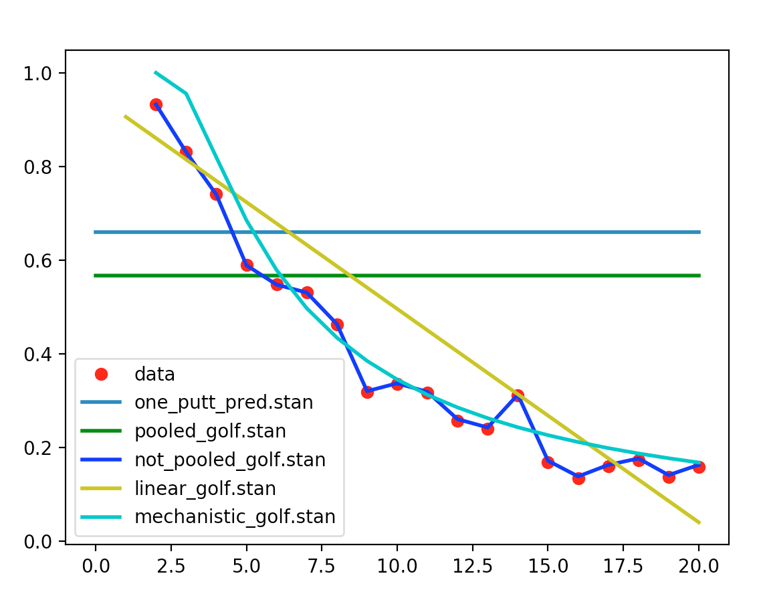

Slide 22
Second Bayesian Point
What is the most robust model?
Custom models allow mechanistic models
Mechanistic models are human interpretable
Mechanistic models more likely robust

Slide 23
General Mucking About with Stan
Execution Environment
  Hello World
Messing about with distributions
Overview of diagnostics

Slide 24
Stan's execution environment
Metropolis-Hastings
  Generate proposal values for all params
  Get max probability from likelihood across all statements accumulated in target
  Accumulate previous values or proposal values based on probabilistic accept target vs prev_target
  Start over with target = 0, exp(target)=1

Slide 25
HMC/NUTS
4x1000 warmups to scope out the posterior and step size
4x1000 draws
  Proposals are developed sensitive to combined gradients of parameters via leapfrog exploration.
  Cannot deal with discontinuity in parameters
  Discrete data is fine
  Most proposals are accepted
  Proposals end up drawing from posterior

Slide 26
HMC/NUTS
1000 warmups to scope out the posterior and step size
1000 draws
  Proposals are developed sensitive to combined gradients of parameters via leapfrog exploration
  Cannot deal with discontinuity in parameters
  Discrete data is fine
  Most proposals are accepted
  Proposals end up drawing from posterior

Slide 27
$ python hello_stan.py
import os
from cmdstanpy import cmdstan_path, CmdStanModel
import fileinput
import sys
stan_program = CmdStanModel(stan_file='stan/hello_world.stan')
stan_program.compile()
fit = stan_program.sample(csv_basename='./output',
data={'count_data':4,'continuous_data':2.1},
sampling_iters=4)
console_output = open('output-1.txt');
print(console_output.read());
print(fit.summary())

Slide 28
functions {
void helloWorld() {
print("Functions{} hello world!");
}
}
data {
int count_data;
real continuous_data;
}
transformed data {
int tran_count = 1;
print("transformed data{} hello have access to count_data=",count_data,
", continuous_data=",continuous_data);
print("transformed data{} created new variable with value,”,
“tran_count=",tran_count);
helloWorld();
}
parameters {
real estimate_me;
}
transformed parameters {
real modified_estimate_me = estimate_me/count_data;
print("transformed parameters {} Hello, modified_estimate_me=",modified_estimate_me);
print("transformed parameters {} is called once per leapfrog step, as is parameters{}");
}
model {
print("model{} Hello every leap frog step");
print("model{} initial target()=",target(),", exp(target()=",exp(target()),
", estimate_me=",estimate_me);
estimate_me ~ normal(count_data,continuous_data);
print("model{} after increment target()=",target(),", exp(target()=",exp(target()),
", estimate_me=",estimate_me);
}
generated quantities {
real prediction = estimate_me * 5; //will be accumulated in fit object
print("generated quantities {} Hello run once per sample");
}

Slide 29
Hello World CmdStan
Compile from cmdstan dir.
  cmdstan-2.21.0$ make ~/git/StanIsThePlanDist/stan/hello_world
Change directory to executable
  cmdstan-2.21.0$ cd ~/git/StanIsThePlanDist/stan/
Run with json data
  stan$ ./hello_world sample data file=hello_world.json
Run with R data
  stan$ ./hello_world sample data file=hello_world.RData

Slide 30
Stan Output-CmdStan
CmdStan is the core
Plusses
  Robust
  Best way to really get the feel of Stan execution
Minuses
  Accumulation is on output.csv
  One chain at a time

Slide 31
Interface Languages
CmdStanPy, CmdStanR, ScalaStan....
  Light weight
  Easy to keep with current Stan version
Rstan
  In memory access to Stan functions
  Lags 6 mos behind
PyStan
  Similar to RStan

Slide 32
Mucking about with Distributions

Slide 33
Best Practices
https://github.com/stan-dev/stan/wiki/Stan-Best-Practices
Think Generatively
Start Simple
Validate your fit: Necessary, not sufficient!
  Recover simulated data within 5% to 95%
  Check rhat
  N_eff / N < 0.001 (low effective sample size)
  Check Divergences
  Check for caterpillars
Folk Theorem

Slide 34
Recover parameters
transformed data {
int simulated_data[100];
for(i in 1:100) {
simulated_data[i] = bernoulli_rng(.7);
}
}
parameters {
real<lower=0,upper=1> coin_bias;
}
model {
for (i in 1:100) {
simulated_data[i] ~ bernoulli(coin_bias);
//simulated_data[i] ~ exponential(coin_bias);
}
}
$ python rv.py stan/recover_simulated_params.stan
5% 50% 95%
coin_bias 0.578442 0.658552 0.733275

Slide 35
Recover parameters
transformed data {
int simulated_data[100];
for(i in 1:100) {
simulated_data[i] = bernoulli_rng(.7);
}
}
parameters {
real<lower=0,upper=1> coin_bias;
}
model {
for (i in 1:100) {
//simulated_data[i] ~ bernoulli(coin_bias);
simulated_data[i] ~ exponential(coin_bias);
}
}
$ python rv.py stan/recover_simulated_params.stan
5% 50% 95%
coin_bias 0.922764 0.980232 0.998481

Slide 36
Check rhat and N_eff
$ python rv.py stan/recover_simulated_params.stan
Mean MCSE StdDev 5% 50% 95% N_Eff N_Eff/s R_hat
name
lp__ -73.099500 0.023835 0.742460 -74.680600 -72.807100 -72.542300 970.303 3317.81 1.00162
coin_bias 0.972771 0.000708 0.024974 0.922764 0.980232 0.998481 1245.720 4259.55 1.00201

Slide 37
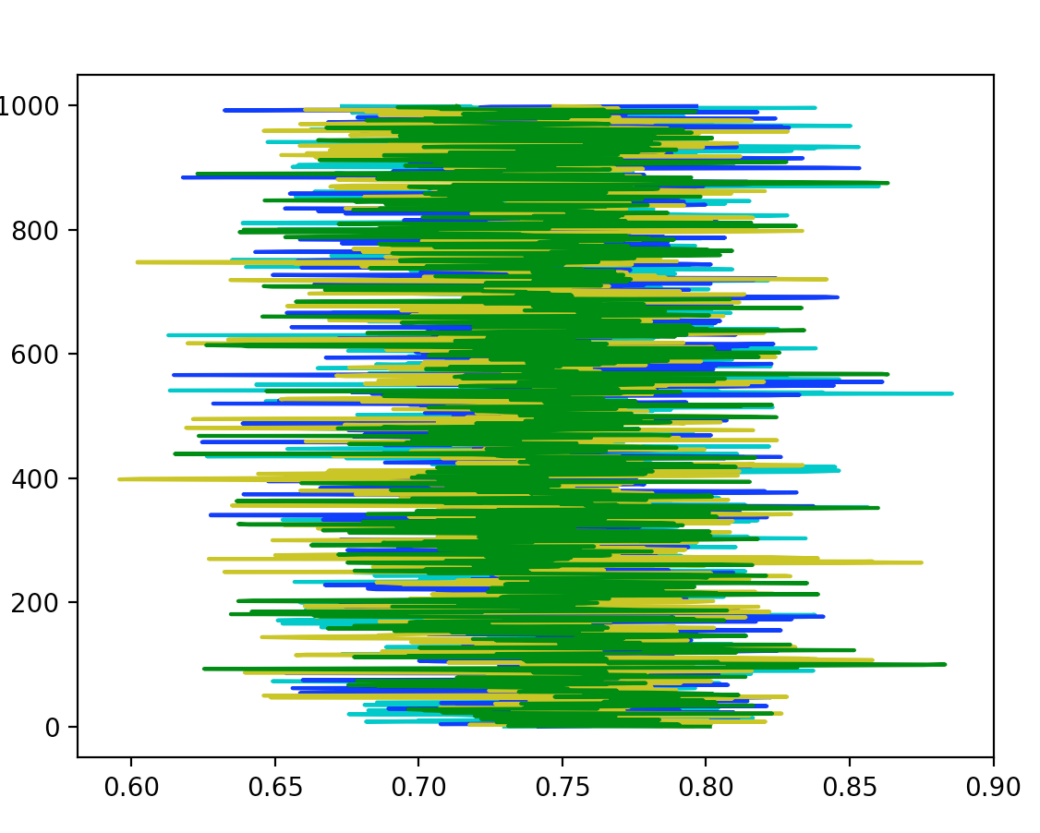
Fuzzy Catepillar
$ python rv.py stan/recover_simulated_params.stan coin_bias cat

Slide 38
Modify Prior
data {
real distance_of_putt;
}
parameters {
real<lower=0, upper=1> chance_in_1;
}
model {
chance_in_1 ~ uniform(0,.5);
1 ~ bernoulli(chance_in_1);
}
generated quantities {
real predicted_chance_in_5 = chance_in_1 * 5;
}
$ python puttBet.py stan/one_putt_haircut.stan 5
Change from 1 to .5

Slide 39
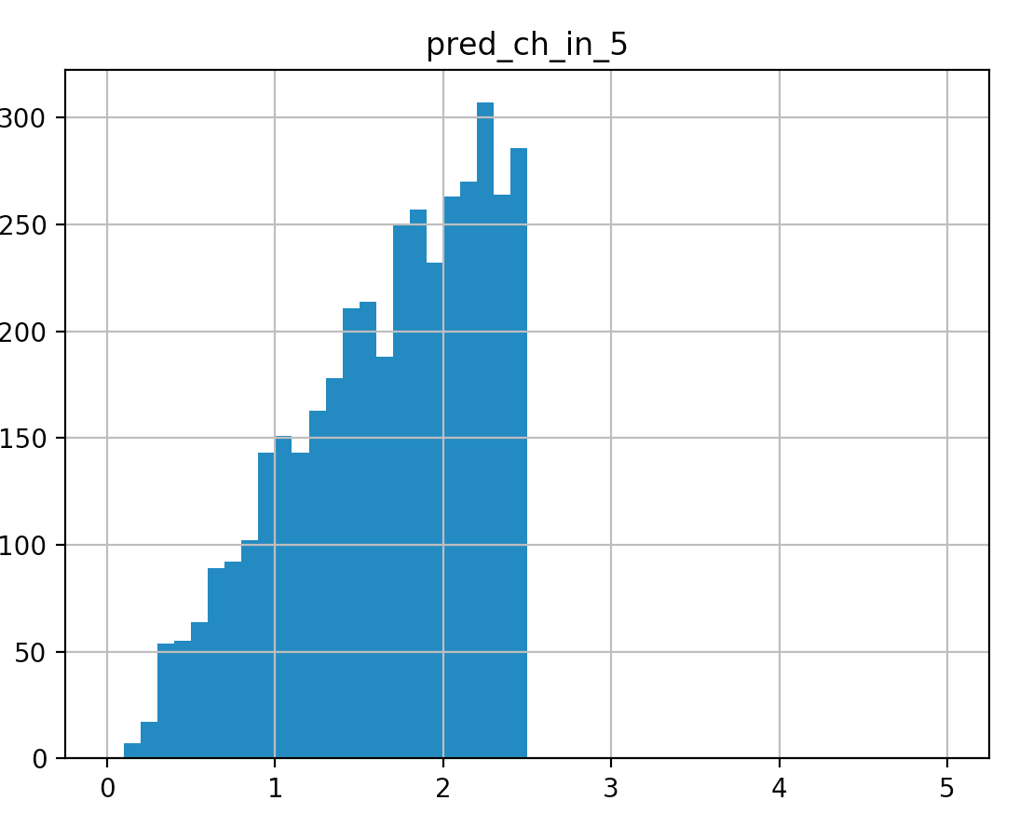
$ python puttBet.py stan/one_putt_haircut.stan 5
Mean MCSE StdDev 5% 50% 95% N_Eff N_Eff/s R_hat
name
lp__ -2.784990 0.039319 0.794131 -4.383440 -2.517000 -2.104640 407.916 1814.98 1.00732
chance_in_1 0.334846 0.005337 0.115581 0.119033 0.353239 0.487846 468.929 2086.45 1.00767
pred_ch_in_5 1.674230 0.026687 0.577904 0.595165 1.766190 2.439230 468.929 2086.45 1.00767

Slide 40
Modify Likelihood
data {
real distance_of_putt;
}
parameters {
real<lower=0, upper=1> chance_in_1;
}
model {
chance_in_1 ~ uniform(0,.5);
1 ~ exponential(chance_in_1);
}
generated quantities {
real pred_ch_in_5 = chance_in_1 * 5;
}
$ python puttBet.py stan/one_putt_exp.stan 5
Change from bernoulli to exponential

Slide 41
Prediction Centered Workflow
Related but different to Bayesian Workflow
Scope out Problem: PuttBet
  Settled on chance_in_5 posterior draws
  We have lots of training data
int J = 19;
int x_distance[J] = {2,3,4,5,6,7,8,9,10,11,...};
int y_successes[J] = {1346,577,337,208,149,136,111...};
int n_attempts[J] = {1443,694,455,353,272,256,240,217,...};
Specify priors and likelihood
  Keep it simple at first
Have feedback mechanism for improvement

Slide 42
Add data
data {
real distance_of_putt;
}
transformed data {
int J = 19;
int x_distance[J] = {2,3,4,5,6,7,8,9,10,11,...};
int y_successes[J] = {1346,577,337,208,149,136,111...};
int n_attempts[J] = {1443,694,455,353,272,256,240,217,...};
}
parameters {
real<lower=0,upper=1> chance_in_5;
}
transformed parameters {
real chance_in_1 = chance_in_5/5;
}
model {
for (i in 1:J) {
y[i] ~ binomial(n[i], chance_in_1);
}
}

