Slide 1
Behavior-Driven Development
June 07 2017
Nodejs bootcamp

Slide 2
What are Tests in general
Express the expected behaviour before writing code.
Code proven to meet requirements
Lesser debug time
Tests become Safety Net
Eliminate Bugs
Rhythm of Success

Slide 3
What is Test-Driven Development?
Test-driven development (TDD), also called test-driven design, is a method of software development in which unit testing is repeatedly done on source code. The concept is to "get something working now and perfect it later.“
TDD is testing from the business' perspective. We're not concerned with the HOW but the WHAT.
TDD uses tests as a way to design code by creating the test first, before any actually production code is written.

Slide 4
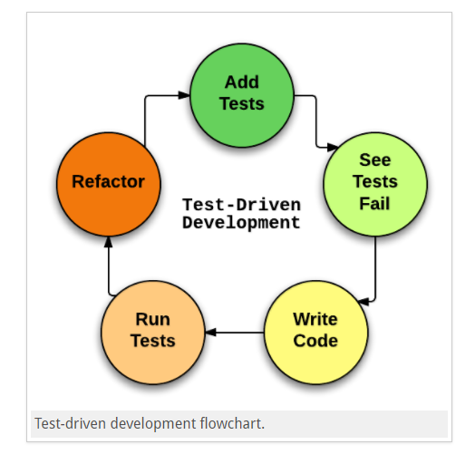
Test-Driven Development Flow
First the developer writes some tests.
The developer then runs those tests and (obviously) they fail because none of those features are actually implemented.
Next the developer actually implements those tests in code.
If the developer writes their code well, then the in next stage they will see that their tests pass.
The developer can then refactor their code, add comments and clean it up, as they wish because the developer knows that if the new code breaks something, then the tests will be an alert by failing.

Slide 5
Why Behavior-Driven Development?
Behavior-Driven Development (BDD) is a technique that operates at a slightly higher level than TDD while still following the basic principle of writing the test, then coding to pass the test.
BDD is usually the lowest level that will use the Given-When-Then pattern to describe the test (e.g. "Given that I have logged in, When I click the My Orders link Then I will be directed to the Order List page").
In contrast to TDD, BDD is when we write behavior & specification that then drives our software development.
BDD also meant to eliminate issues that TDD might cause.
(https://sqa.stackexchange.com/questions/15263/exactly-how-are-bdd-tdd-atdd-kanban-and-scrum-different-from-a-waterfall-appr)

Slide 6
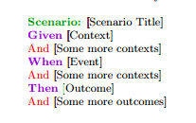
Scenarios
GIVEN, an initial context
WHEN, occurrence of an event
THEN, expected outcome
Parameters in Quotes, " "
Connectives - And and Not (only in then condition)

Slide 7
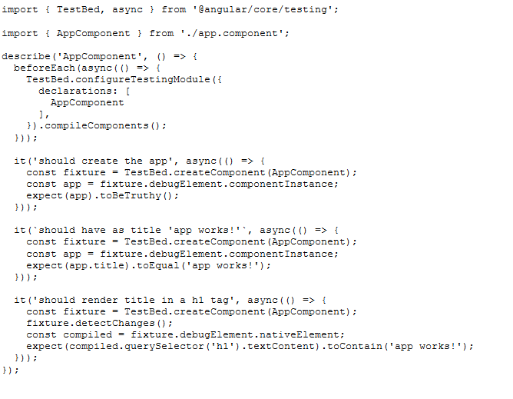
Simple Unit Test (app.component.spec.ts)

Slide 8
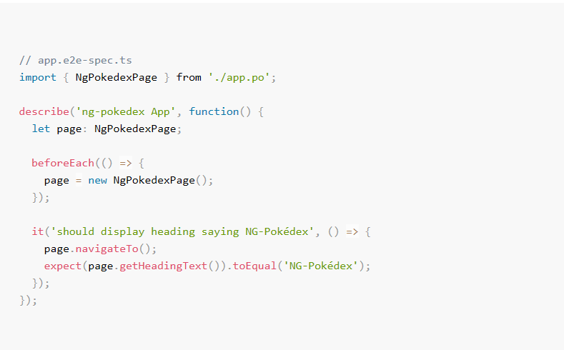
Now Sample End to End Test

Slide 9
Tools will be used for Exercise today
Webpack
popular module bundler, a tool for bundling application source code in convenient chunks and for loading that code from a server into a browser.
Selenium
Selenium allows us to automate browsers – Chrome, Firefox, Opera and yes, even Internet Explorer!
But we don’t need to use selenium directly. The Angular team gives a great tool that wraps around Selenium – Protractor.
Protractor
Protractor is the testing framework we’ll be using for our Angular 2 applications.
Using protractor is as simple as installing the command line tools, creating the configuration file and running the tests.
Jasmine
Jasmine is the framework we’ll be using for writing tests. Jasmines files are typically named something like filenameSpec.jsfilenameSpec.js
Karma
Test suite runner. Karma runs the Jasmine tests automatically.

Slide 10
Lab Exercise
Clone the source code from the Git repository.
Install packages/dependencies with npm –install.
Run a production build with npm –build.
Launch the App with ng –serve.
Write tests in the Spec file.
Launch the Tests with ng -e2e.

Slide 11
Questions?

