Slide 1


Brosu!
By: Branden Guevara
Garrett Eledui

Slide 2
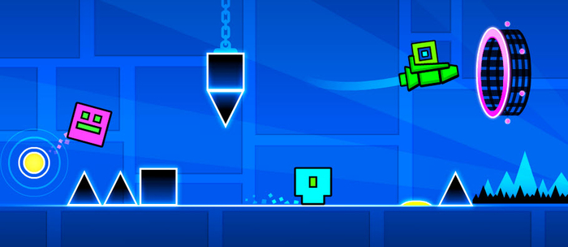
What is Brosu?
Rhythm game much like Tap Tap, Geometry Dash, and Osu
Tap along to the beat of a hype song
Enjoy the alluring effects of the background as it dances to the beat of your finger

Slide 3
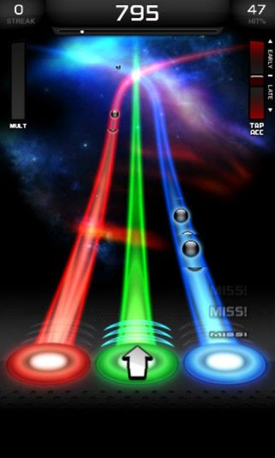
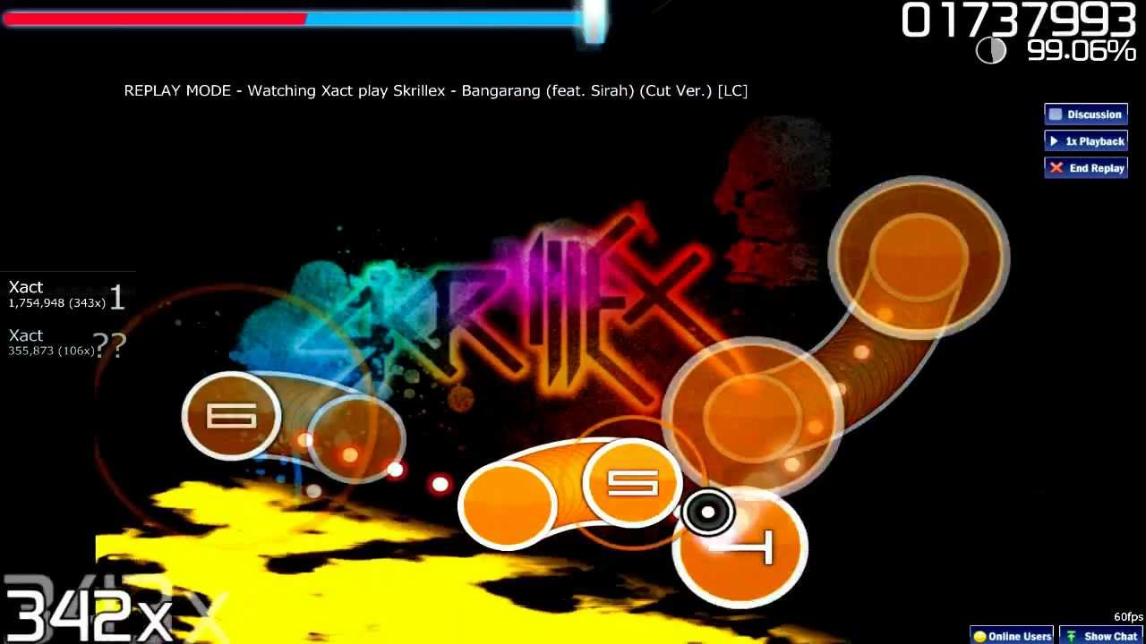
Target Audience
Rhythm Game enthusiasts
All ages
People who like to tap along to their favorite song

Slide 4
What to Expect
Touch screen interaction
2D shape-shifting graphics
Preloaded songs that can be selected to play immediately

Slide 5
Game Flow

Slide 6
Screen Flow

Slide 7
Targeted Platforms
iPhone 6s Plus
iPhone 7 Plus
Kindle Fire

Slide 8
Features
During a song, graphics will appear that the user must interact with as close to the beat as possible
Scoring is based on how many beats were tapped correctly
Combo effects can occur during a playthrough causing much more elaborate graphics

Slide 9
What We Need
Songs to work with
Corona SDK
Ourselves

Slide 10
Future Considerations
Add more songs for multiple genres
Allow the user to add their own songs
Only if its possible to create a beat time table for a random song
Multiplayer Mode?

