Slide 1
Robot-Assisted Machine Shop Safety
Aaron Fineman
Prof Sonia Chernova

Slide 2
Why
People still get hurt
2010 statistics (courtesy of Brookhaven National Laboratories)
18,000 injured
800 dead

Slide 3
What
Camera
Industrial Robot
Safe

Slide 4
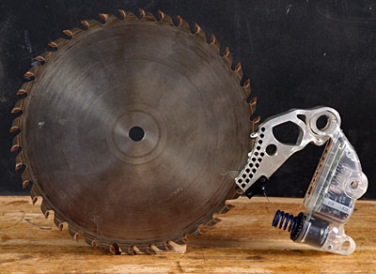
Who Else?
External safety tools → None
Safety features → SawStop
http://www.finewoodworking.com/media/w00188_02.jpg

Slide 5
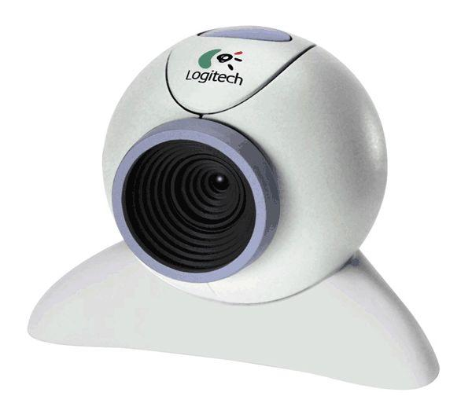
How
FANUC LR Mate 200iB 6-axis arm
Webcam
OpenCV + Haar classifier cascades
http://podcast.njit.edu/webcam.jpg

Slide 6
Results
Bad
Slow
Haar CC’s are inaccurate
Still some time before cameras can keep your fingers safe

Slide 7
Movie

Slide 8
Questions/Discussion

