Slide 1
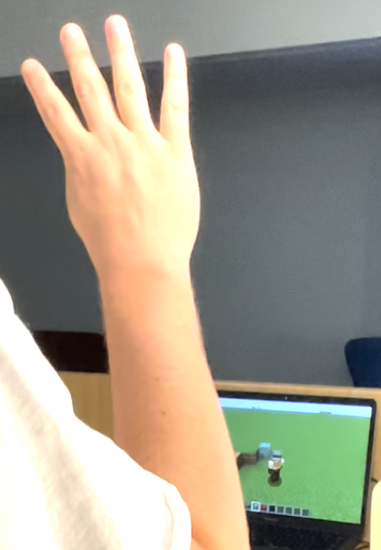
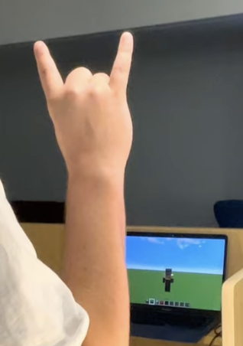
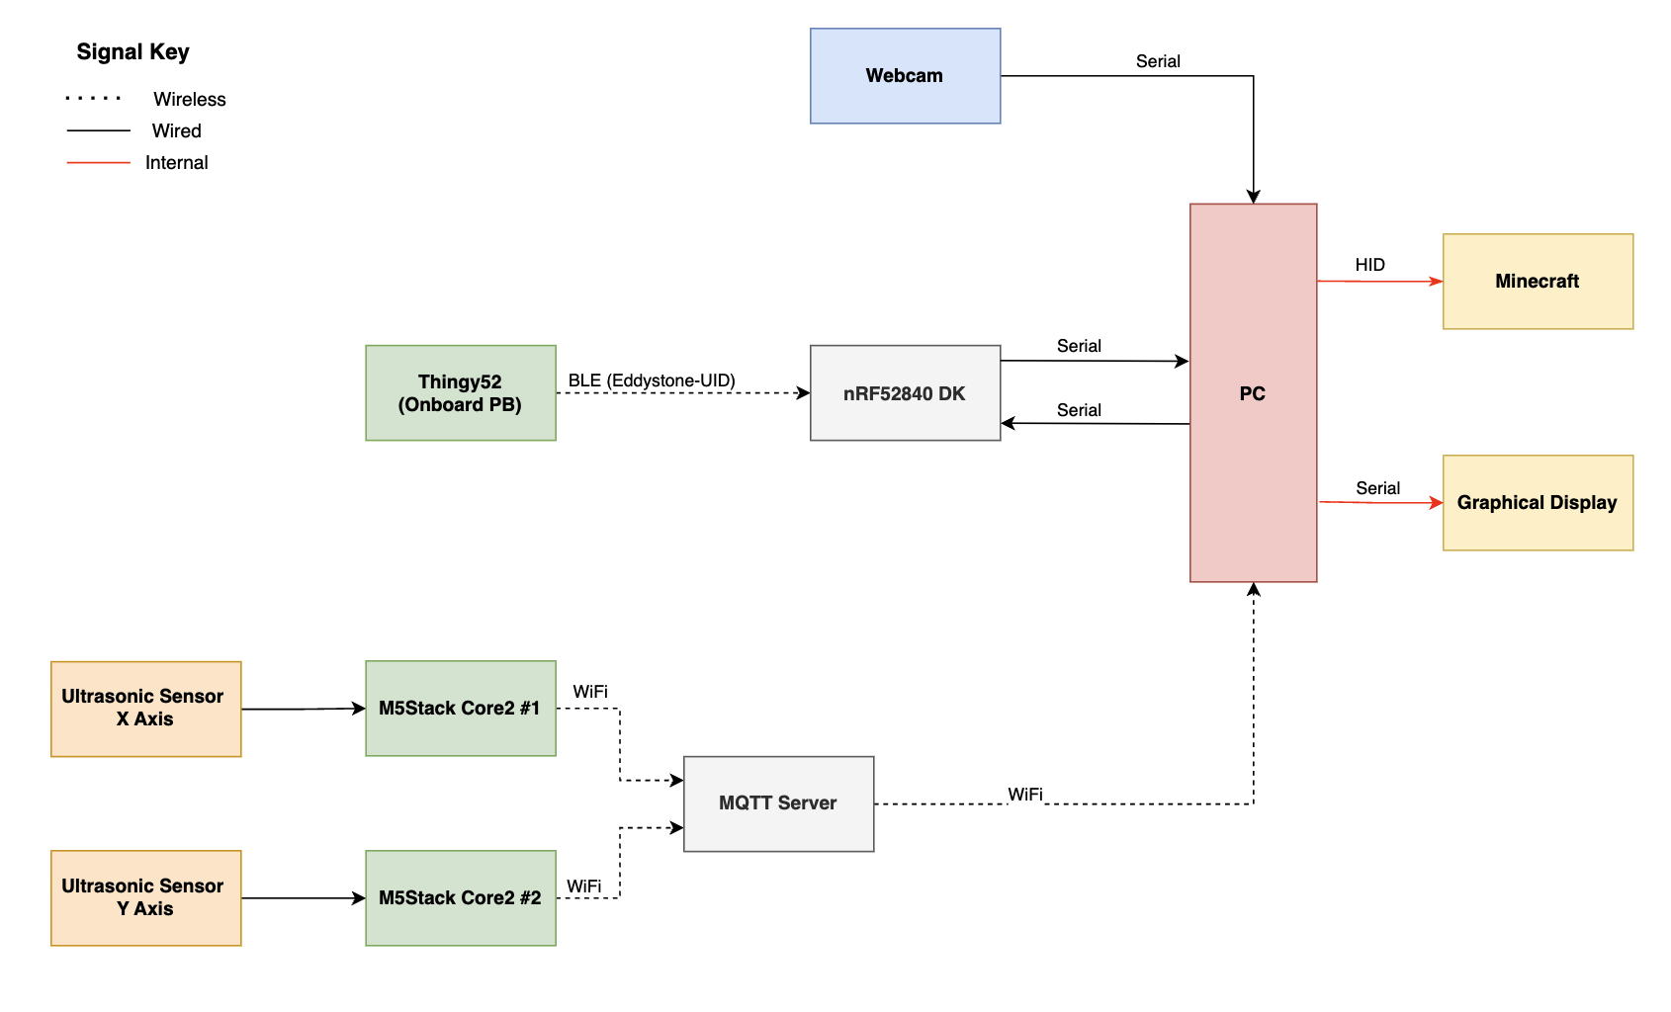
Minecraft Gesture & Movement Recognition
Tellus-Teal: Lewis Luck, Lewis Young, Brianna Hoffman, Jake Holland
SYSTEM OVERVIEW
RESULTS:
The ML gesture recognition was about 90% accurate. Minimum 80% accuracy was achieved with the ultrasonic sensors. Similarly, minimum 95% accuracy was achieved with the Thingy:52.
The webcam gesture recognition operated at 8 frames per second. The latency achieved for the ultrasonic was 5 samples per second. The latency for the GUI and communications was fast and at most a 1s delay was observed between the sensor and the PC receiving the HID package.
The reliability of the program was consistent across users. The reliability of the sensors was best in an environment with adequate light and a plain background.
Hand gestures controlling Minecraft actions (see wiki for videos)
KPIs:
Accuracy: gesture and movement detection. Minimum 60% ML gesture accuracy, minimum 80% accuracy with ultrasonic sensors, 95% accuracy with Thingy:52 pushbutton.
Latency (sensors): Time taken for sensors. Ultrasonic sensors should operate at 10 samples per second, gesture recognition should run at 5 frames per second.
Latency (GUI & Communications): Time taken for the HID packets and information to appear on the GUI and Minecraft interface. Maximum 2 second latency should be exhibited during MQTT and Bluetooth packets delivery from sensor to base node to GUI.
Reliability: The ability of the system to measure gesture and movement for environmental robustness, particularly in low-light conditions, high-activity areas, and across a variety of different subjects. A minimum 20% variation between users should be accepted, and 30% variation for different environmental conditions.
Display: Measures the timely update rate of the GUI, and success of the Minecraft interface to detect all HID packets sent.
User Experience: Measures the user's satisfaction with the game and its interface. Measured using a collection of data from the review portion of the GUI.
CONCLUSION:
Through qualitative observation we found that all sensors performed at and above the desired accuracy. Special mention is given to the ML gesture recognition as this was proven to be much more accurate that what was expected. All devices had a good latency however the ultrasonic was slower than expected as we had to reduce the publish speed to improve accuracy.
With only a minor delay between the real-time action to the Minecraft character action, the display and usability goals were met.
The user has a range of actions they can perform in the game using the sensors. The available actions include: movement in the x and y direction, panning the view in the x and y direction, jump, break block, place block, change current inventory slot (1-5). Overall, the project successfully delivered a human Minecraft controller.

