Slide 1
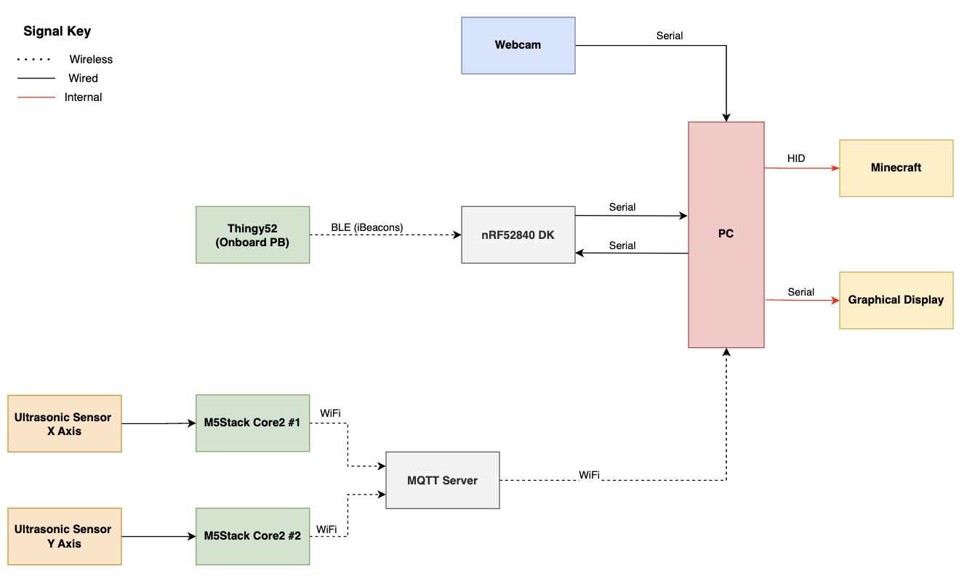
Minecraft Gesture & Movement Recognition
Tellus-Teal: Lewis Luck, Lewis Young, Brianna Hoffman, Jake Holland
SYSTEM OVERVIEW
Subheadings – Helvetica Neue Bold 14pt
Body Text – Helvetica Neue 14pt (min 12pt)
Don’t have the above fonts installed?
Substitutes for Bodoni MT:
Didot on Apple
or Times New Roman (Apple & Windows)
Substitutes for Helvetica Neue:
Helvetica (Apple)
or Arial (Apple & Windows)
KPIs:
Accuracy: gesture and movement detection. Minimum 60% ML gesture accuracy, minimum 80% accuracy with ultrasonic sensors, 95% accuracy with Thingy:52 pushbutton.
Latency (sensors): Time taken for sensors. Ultrasonic sensors should operate at 2 samples per second, gesture recognition should run at 5 frames per second.
Latency (GUI & Communications): Ttaken for the HID packets and information to appear on the GUI and Minecraft interface. Maximum 2 second latency should be exhibited during MQTT and Bluetooth packets delivery from sensor to base node to GUI.
Reliability: The ability of the system to measure gesture and movement for environmental robustness, particularly in low-light conditions, high-activity areas, and across a variety of different subjects. A minimum 20% variation between users should be accepted, and 30% variation for different environmental conditions.
Display: Measures the timely update rate of the GUI, and success of the Minecraft interface to detect all HID packets sent.
User Experience: Measures the user's satisfaction with the game and its interface. Measured using a collection of data from the review portion of the GUI.
RESULTS
CONCULSION

