Slide 1
我的生活 / 我的爱
wǒ de shēnghuó / wǒ de ài
我的生活
My life/ My l ove
wǒ de shēng huó

Slide 2
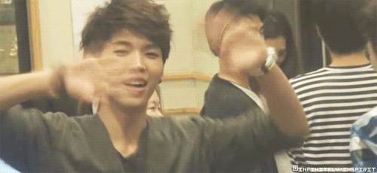
大家好，我是安娜。很高兴认识大家。
欢迎来看我的介绍，希望大家喜欢。
Hello everyone, my name is B riannah (Anna). It is nice to meet you. Welcome to my presentation, I hope you enjoy it.
Notes:
Dàjiā hǎo, wǒ shì Ānnà. Hěn gāoxìng rènshi dàjiā.
Huānyíng lái kàn wǒ de jièshào, xīwàng dàjiā xǐhuān.

Slide 3




! 我最喜欢的中国剧是”meteor garden”.
My favorite chinese drama is meteor garden.
我在加州出生。我住在加州，但是我快要搬到弗吉尼亚州了。
I was born in California. I live in California,but I am about to move to Virginia.
Notes:
Wǒ zài Jiāzhōu chūshēng. Wǒ zhù zài Jiāzhōu,
dànshì wǒ kuàiyào bān dào Fújíníyà Zhōu le.
Wǒ zuì xǐhuān de Zhōngguó jù shì "meteor garden".

Slide 4
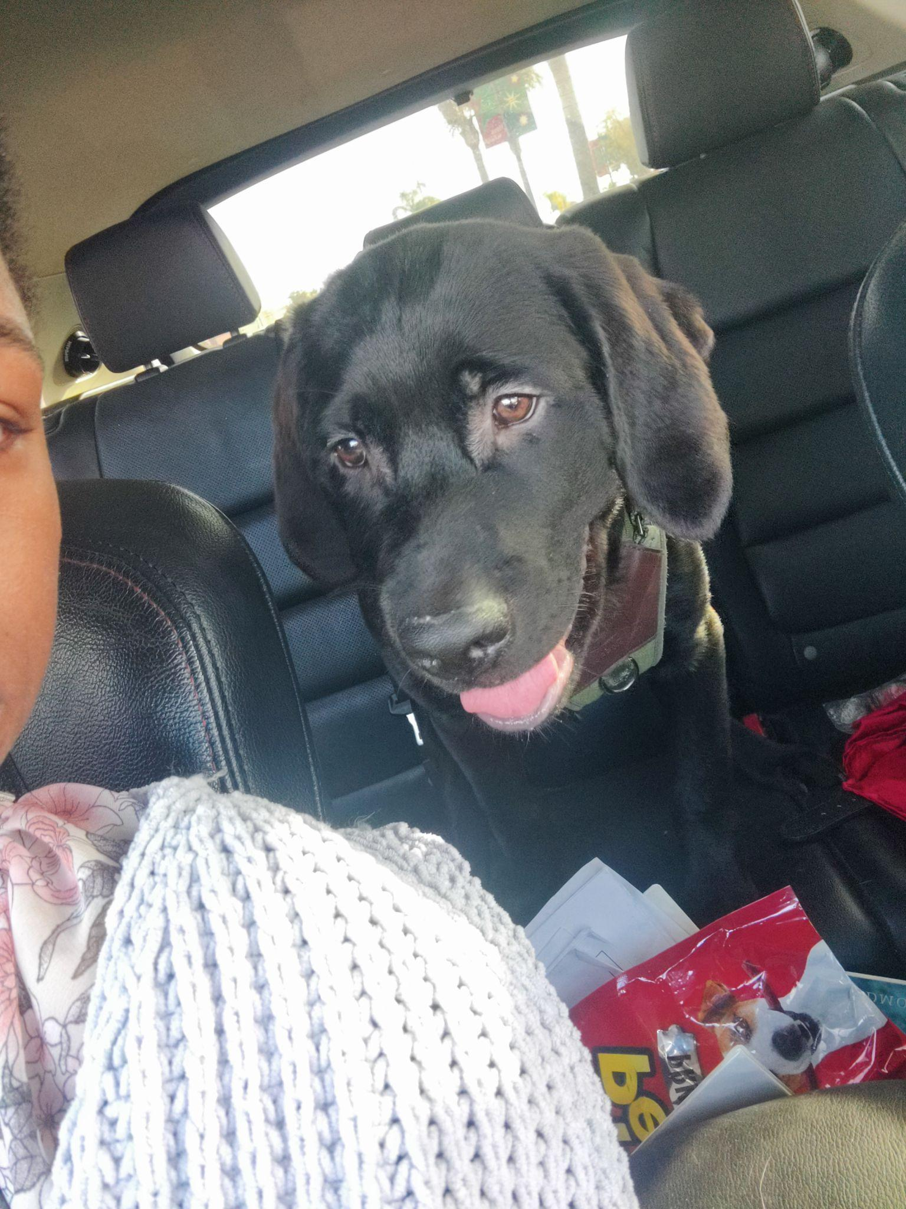
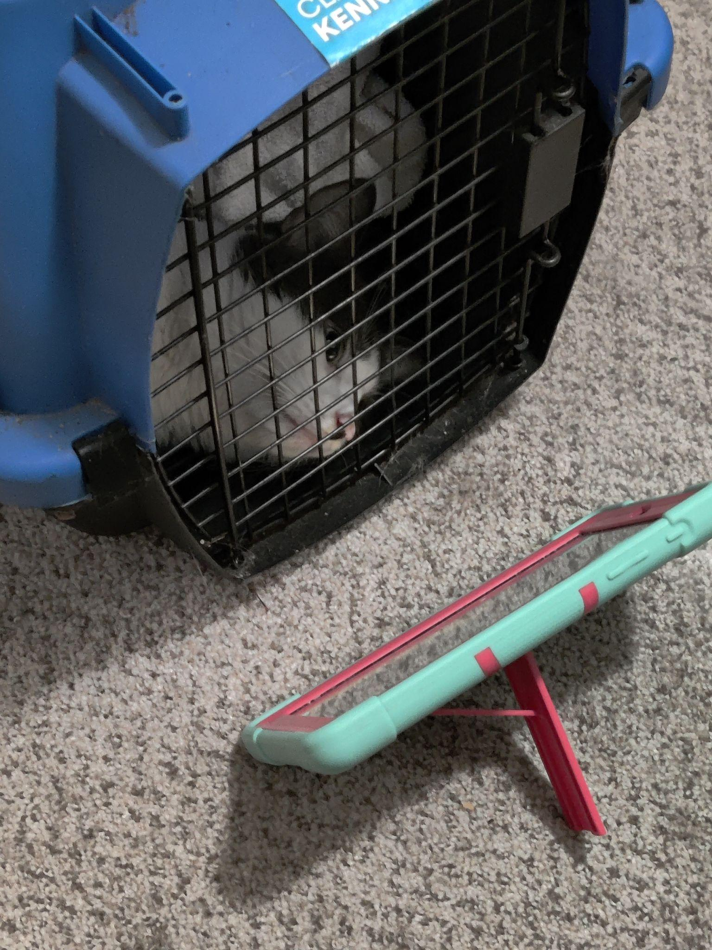
F amily and P ets
我家有两个人。
我妈妈以前在海军服务。我爸爸退休了，因为他有很严重的残疾。
My mom served in the Navy. My dad is retired
because he has a serious disability.
我有两只狗。
Notes:
Wǒ jiā yǒu liǎng ge rén. Wǒ māma yǐqián zài
hǎijūn fúwù. Wǒ bàba tuìxiū le, yīnwèi tā
yǒu hěn yánzhòng de cánjí.
Wǒ yǒu liǎng zhī gǒu.

Slide 5
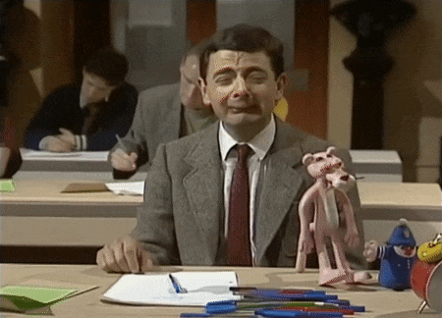
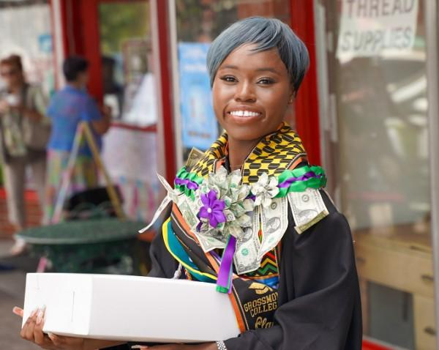
S chool and A ctivities
我是老多明尼昂大学的学生。
我学网络安全，中文是我的辅修。
I am a student at Old Dominion University.
I study cybersecurity, Chinese is my minor.
我以前在 Grossmont 大学
学过中文。
I previously studied Chinese
at Grossmont College.
Notes:
Wǒ shì Lǎo Duōmíngníáng Dàxué de xuésheng.
Wǒ xué wǎngluò ānquán, Zhōngwén shì wǒ de fǔxiū.
Wǒ yǐqián zài Grossmont Dàxué
xuéguò Zhōngwén.

Slide 6
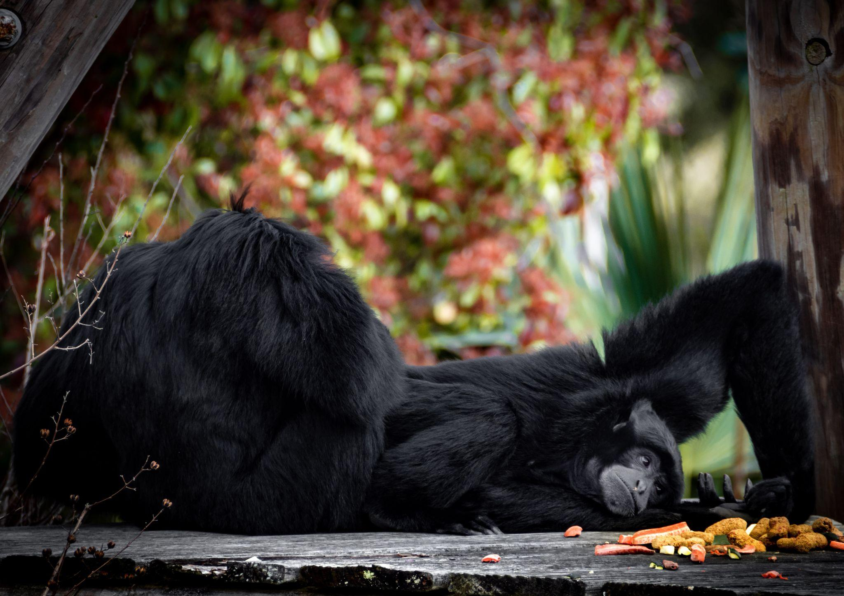


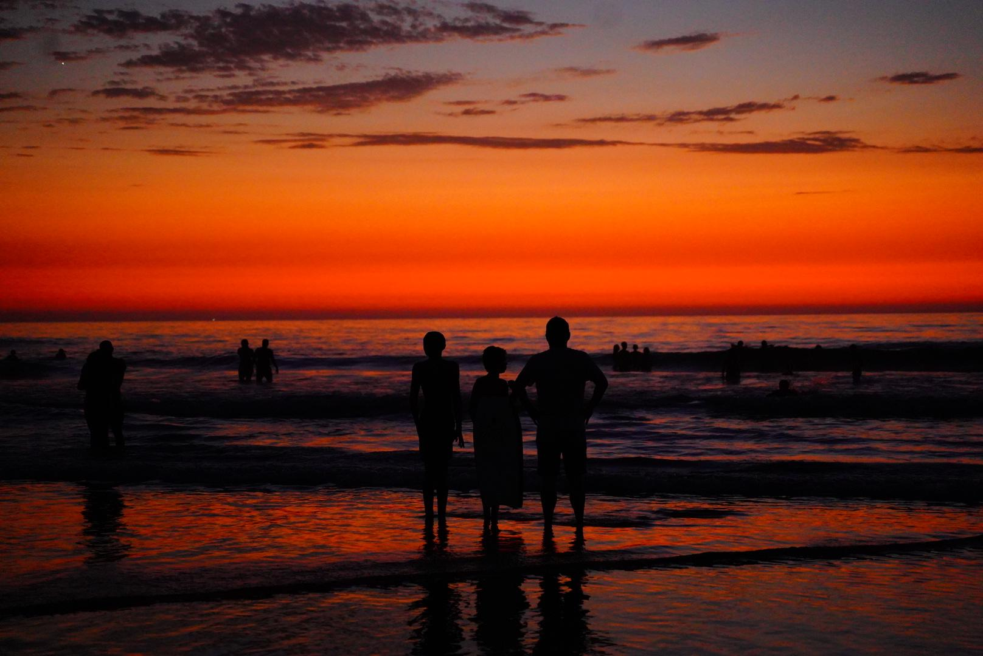
Hobby
我的爱好是拍动物和大自然的照片，我已经做了八年了
"My hobby is taking photos of animals and nature, I've been doing it for 8 years."
Notes:
Wǒ de àihào shì pāi dòngwù hé dàzìrán de zhàopiàn, wǒ yǐjīng zuò le bā nián le

Slide 7

我的偶像
Wǒ de ǒuxiàng
An Artist I Grew Up On
我从小就喜欢的歌手是 Chris Brown。
他是歌手，也是舞者。他唱歌唱得
很好，跳舞也跳得很好。
Chris Brown
歌手 · 舞者
An artist I've liked since I was young is Chris Brown. He is a singer and also a dancer. He sings very well, and he also dances very well.
Singer · Dancer
He has acted in many TV dramas, such as
Notes:
Wǒ cóngxiǎo jiù xǐhuān de gēshǒu shì Chris
Brown. Tā shì gēshǒu, yě shì wǔzhě. Tā chàng
gē chàng de hěn hǎo, tiào wǔ yě tiào de hěn hǎo.

Slide 8

中国演员
Zhōngguó yǎnyuán
A Chinese Actress
我也想介绍一位中国演员，她叫
赵露思。她演过很多电视剧，
比如《青囊传》。
赵露思
I also want to introduce a Chinese actress named Zhao Lusi. She has acted in many TV dramas, such as "Prodigy Healer."
Zhào Lùsī
中国演员 · Chinese Actress
"Prodigy Healer" (青囊传)
Notes:
Wǒ yě xiǎng jièshào yī wèi Zhōngguó yǎnyuán,
tā jiào Zhào Lùsī. Tā yǎn guò hěn duō diànshìjù,
bǐrú "Qīngnáng Zhuàn".

Slide 9

F inale
谢谢大家
再见！
Goodbye.
Notes:
Xièxie dàjiā

