Slide 1
Holidays
in
Mexico
By Briannah Greene y Xavier McInturff

Slide 2
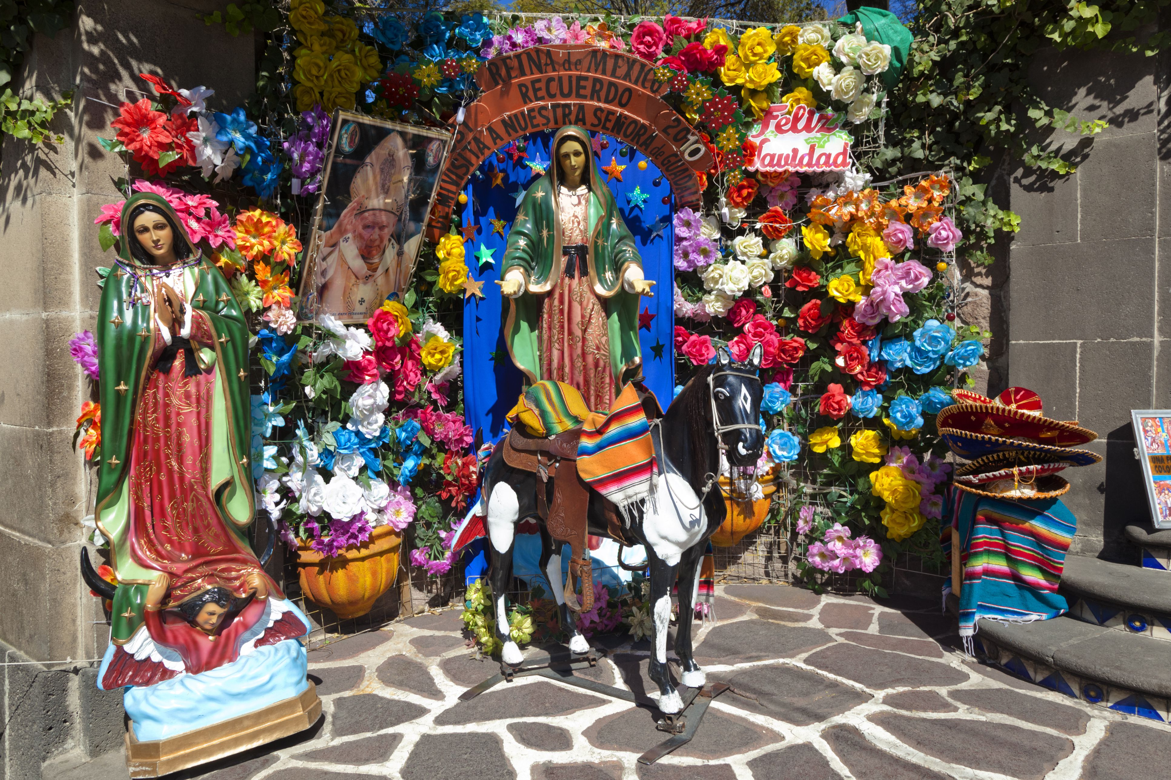
Las Posadas
The name of my holiday is Las Posadas, meaning “The Inns” in Spanish.
Las Posadas is typically celebrated between December 16th and December 24th.
-Briannah Greene-

Slide 3
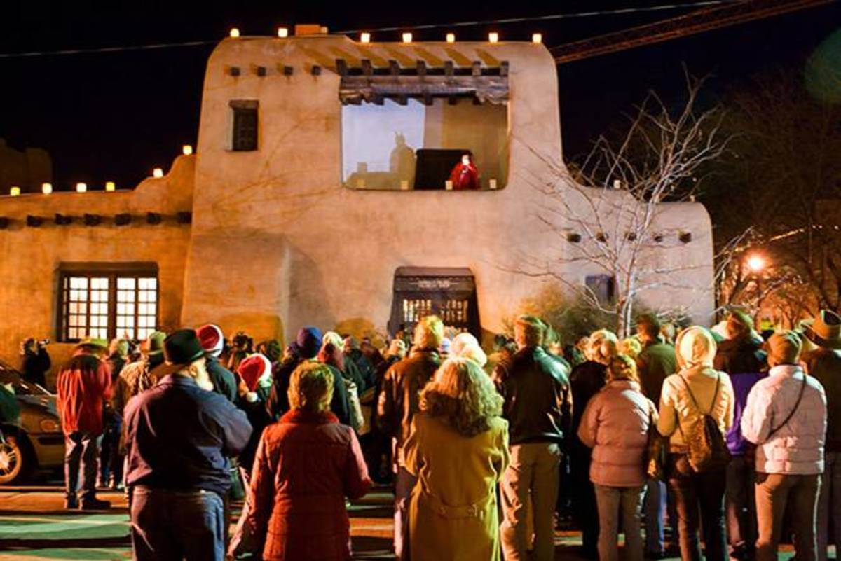
Traditions
Participants hold candles and sing Christmas carols.
During the singing of the traditional Posada song, the carolers take the role of Joseph (from the bible ) as they ask for shelter and the people receiving the carols respond by taking the part of the innkeeper saying there’s no room. Then they are let in after a lot of pleading.
There is a celebration inside the home after.
Different meditation is practiced on each of the nine nights.
The host serves tamales and ponche/atole. Then the guests break the piñatas, and give the kids the candy.
-Briannah Greene-

Slide 4
History of Las Posadas
Las Posadas is a Christmas celebration that came from the Catholic Church that originated in Mexico in the 16th century. The celebration was introduced by Spanish missionaries as a way to teach the story of Mary and Joseph's journey to Bethlehem to the people of Mexico.The celebration commemorates the journey of Mary and Joseph seeking lodging in Bethlehem before the birth of Jesus. It started in 1586, Friar Diego de Soria, the Augustinian prior, obtained a papal bull from Pope Sixtus V to celebrate what was called misas de aguinaldo "Christmas bonus masses" between December 16 and 24.
-Briannah Greene-

Slide 5
Sharing Culture
Celebrations
Las Posadas
In my community it is not celebrated in the same way. Africans will carol and have meals with one other but we don’t sing in a call and response about Joseph asking for shelter. We usually play music, sing carols, and eat but we don’t sing in that way. There is something that is similar, in christianity, a nativity scene reenacting the birth of Jesus christ is held. People in the community hold different parts and perform at the church, town hall, or central place in a city.
In retrospect I love to try new things but when it comes to religious and traditional practices I’d like to stick to my own. Of course if I had a friend who allowed me to join I’d be happy to participate but I love my own traditions as well. Christmas isn’t widely celebrated in Africa because it mainly originated in the North with European countries. We have our own traditions here that are so much fun that I wouldn't trade it for another tradition.
-Briannah Greene-

Slide 6
Works Cited
Barbezat, S. (2019) Learn about the Mexican christmas tradition of Posadas, Learn Religions. Learn Religions. Available at: https://www.learnreligions.com/christmas-posadas-tradition-in-mexico-1588744#:~:text=Posadas%3A%20A%20Traditional%20Mexican%20Christmas%20Celebration%201%20Asking,that%20the%20posadas%20originated%20in%20colonial%20Mexico.%20 (Accessed: March 19, 2023).
-Briannah Greene-

Slide 7
Group collaboration score
Our group score is __4___. We gave our group a score of __4__ because we communicated somewhat lightly as we only had two people to spread the work we had to do. I think we communicated enough and efficiently enough to get our work done in a timely manner and accurately.
Score | Description
1 | Never listens to, shares with, and supports the efforts of others. Not a good team player.
2 | Rarely listens to, shares with, and supports the efforts of others. Often is not a good team player.
3 | Often listens to, shares with, and supports the efforts of others, but sometimes is not a good team member.
4 | Usually listens to, shares, with, and supports the efforts of others. Does not cause \"waves\" in the group.
5 | Almost always listens to, shares with, and supports the efforts of others. Tries to keep people working well together.
-Briannah Greene-

