Slide 1

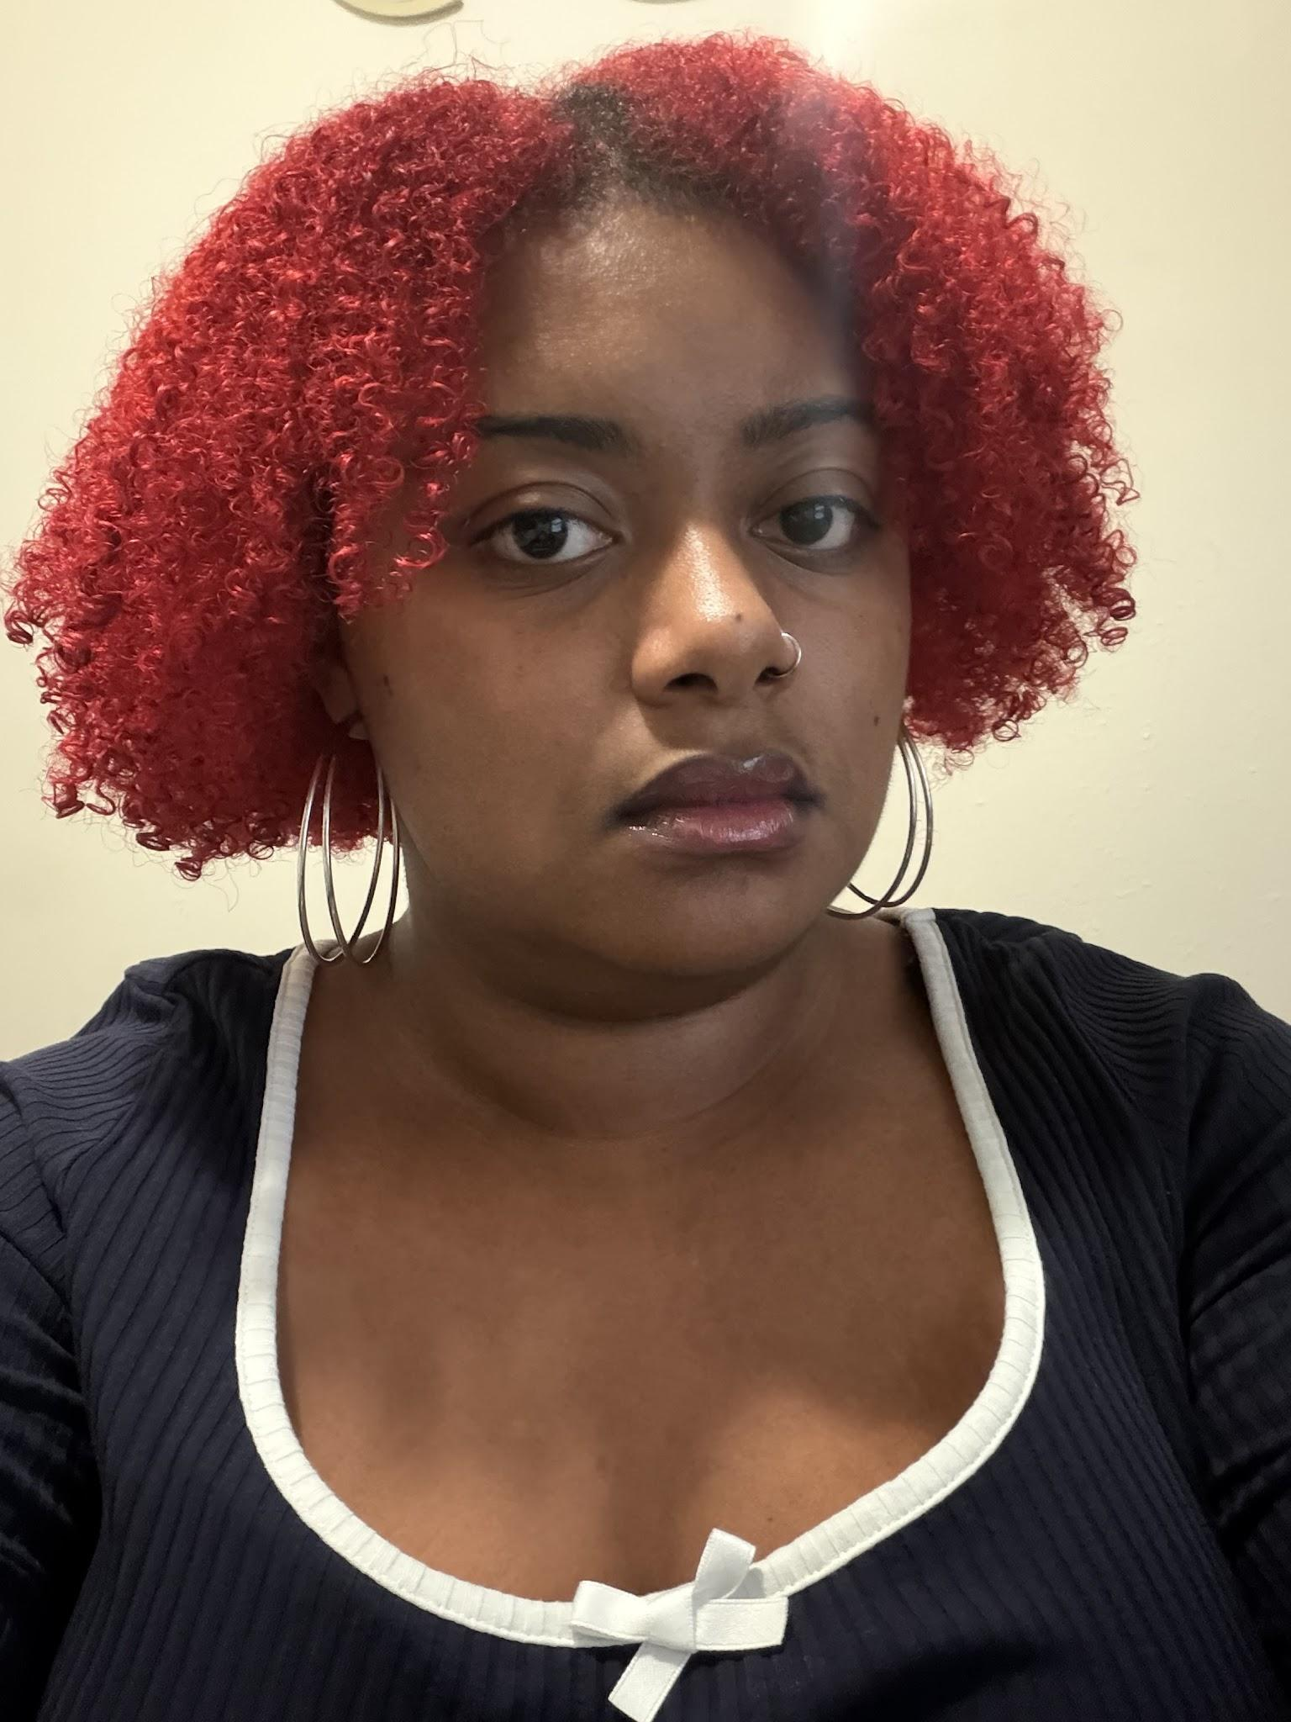



Attracting Residents to the
Newport News Housing Hub
Team 2: Andy, Cat, Christiney, & Jastiasia
Prepared for Jay Grant, Director of Housing & Neighborhood Services
August 6, 2026

Slide 2






Meeting Agenda
CITY LOGO
Our presentation flows through six connected stages to address the city's housing goals:
01. PROBLEM
02. INSIGHT
03. RESEARCH
04. SOLUTION
05. DELIVERABLES
06. PROTOTYPE

Slide 3

THE BUSINESS PROBLEM
The Business Problem
CITY LOGO
Despite ongoing positive redevelopment efforts, critical information regarding housing resources is not effectively reaching first-time homebuyers.
SUPPORTING FACTS
Residents don't know where to begin.
Younger residents aren't being reached through current communication methods.
Positive investments in Newport News often go unnoticed.
KEY INSIGHT
People don't know what they don't know, so many housing resources go unused.

Slide 4

The Guidance Lighthouse
CITY LOGO
HOUSING
RESOURCES
COMMUNITY
INFORMATION
CLEAR
COMMUNICATION
HOUSING HUB
FINANCIAL
EDUCATION

Slide 5





Supporting Research: Core Focus Areas
CITY LOGO
Safety & Community
Marketing & Outreach
INSIGHTS FROM
Mr. Grant
Interview
Financial Readiness
Navigation & UX

Slide 6





Our Solution: How To Keep People On The Hub
CITY LOGO
The Newport News Housing Hub serves as the centralized digital destination for prospective residents. We integrated five key features into the Hub that will get users to stay.
explore
Navigation
school
Education
payments
Financial
Tools
Newport News
Housing Hub
share
Social Media
Integration
groups
Community
Resources

Slide 7
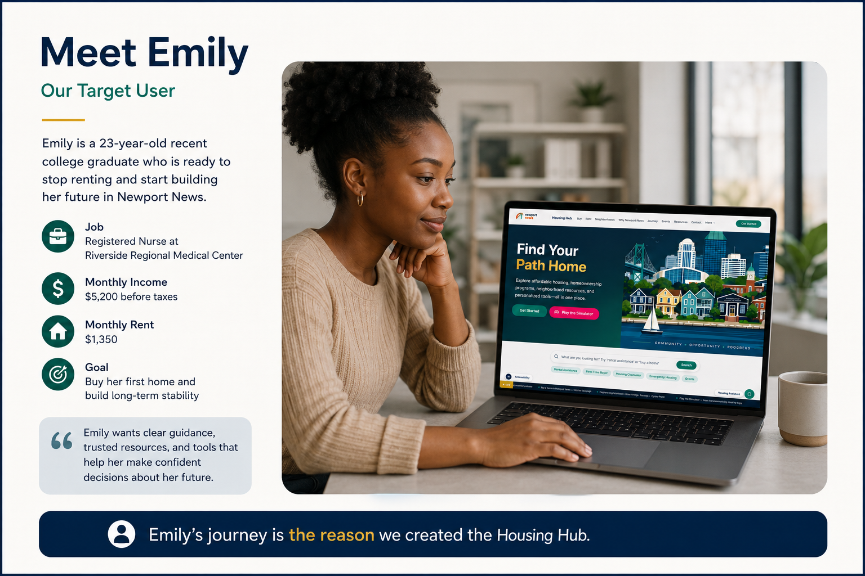
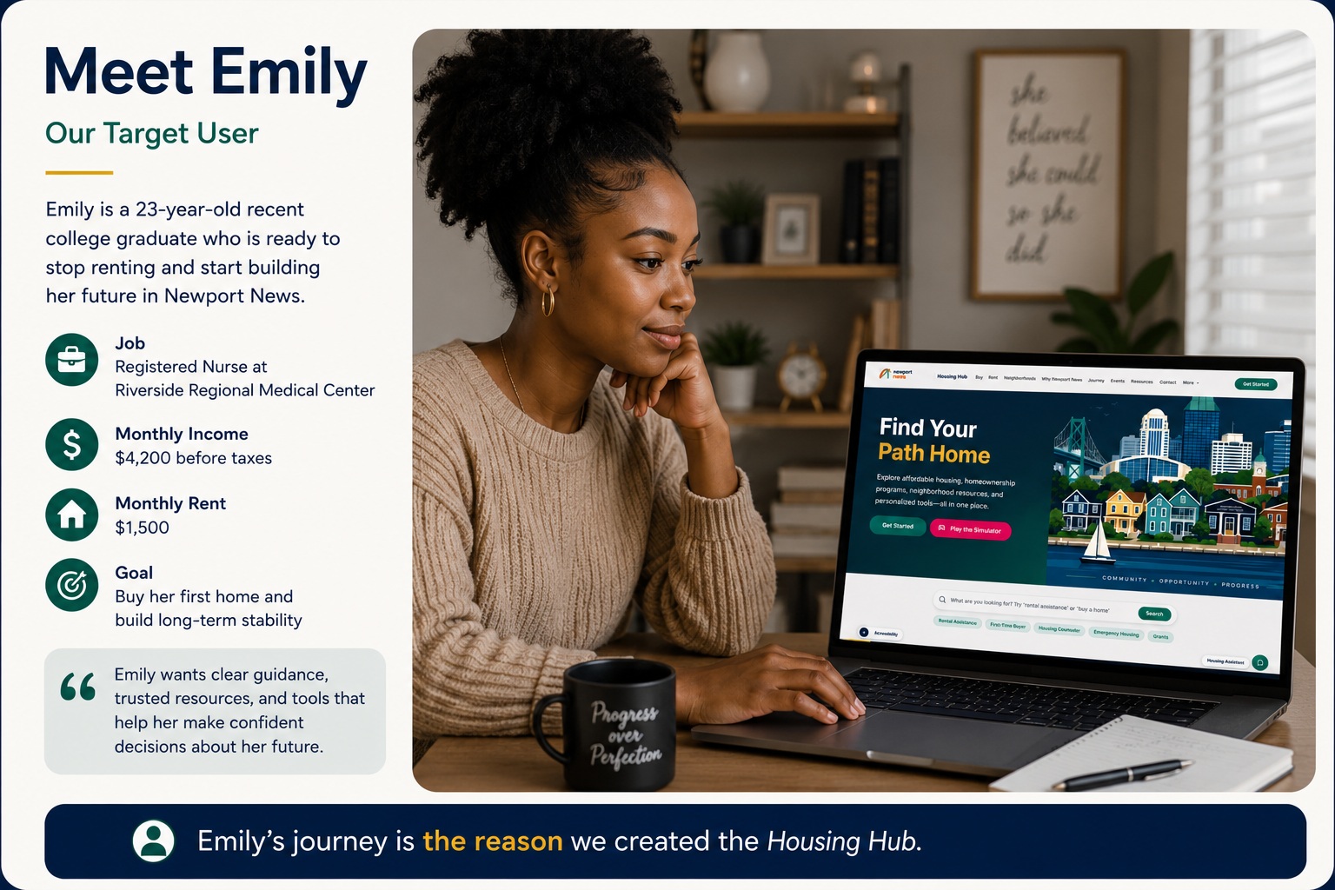
CITY LOGO

Slide 8



ANDY
Deliverable 1: Marketing Outreach Strategy
CITY LOGO
Core Campaign Strategy
Based off of the research made, younger residents aren't being reached through the city's current communication methods, so we focused on modern social media as a way to increase awareness of housing resources.
Target Audience Focus
Young adults, first-time homebuyers, and future Newport News residents (Ex: Emily)
Content should
Share positive community updates and new developments.
Highlight housing programs, workshops, and success stories.
Use short videos, Reels, and trending content to reach younger audiences.
@NewportNewsHub
REELS PREVIEW
FOLLOWER REACH
Engagement Dashboard
QR CODE INTEGRATION
Scannable connect to info

Slide 9
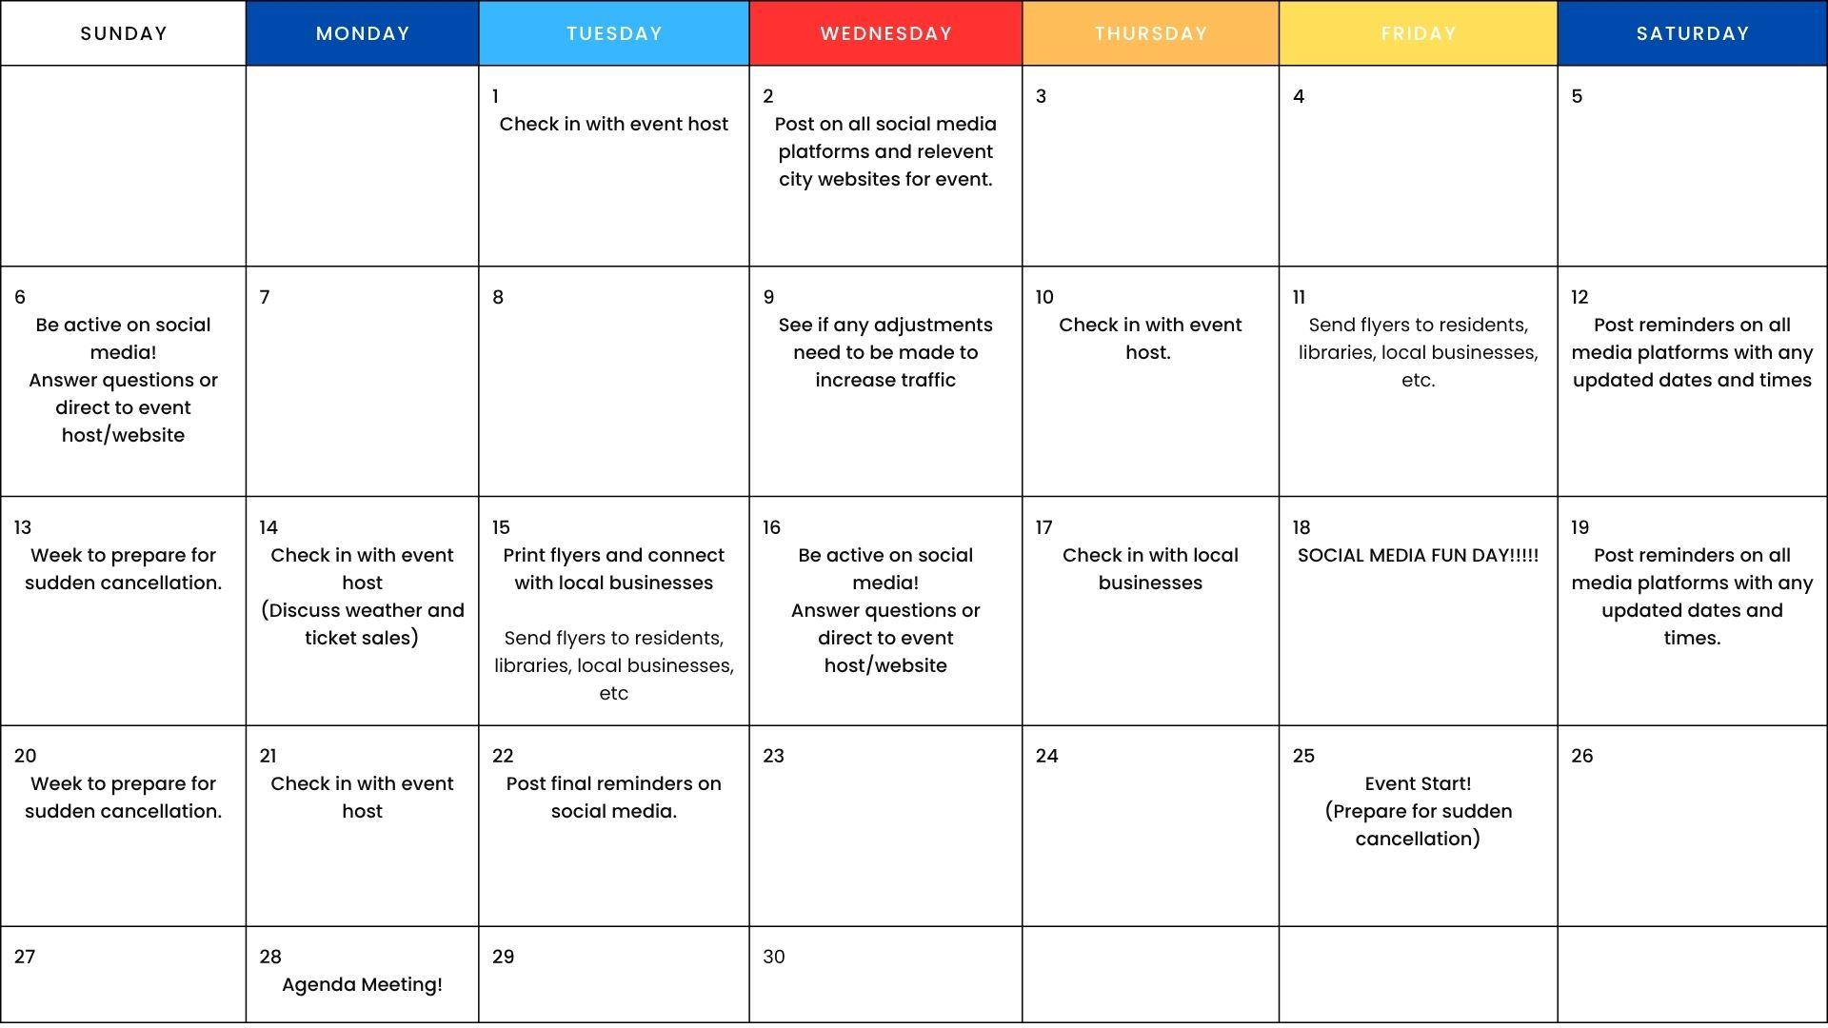
CHRISTINEY
Deliverable 2: Community Engagement Initiatives
CITY LOGO
People are more likely to stay involved in their community when they know what's happening. We created community outreach materials to help residents find local events, programs, and city resources.
WORKSHOP FLYER EXAMPLE
Homebuyer Seminars
Educational support for credit building, financial planning, and municipal grants.
Thursdays at 6:00 PM
EVENT CALENDAR
Engagement Schedule Preview
Community Safety
Blue Light Phones
Online Questionnaires
Hosting Neighbourhood Events.
Ways to build engagement
Using physical ads to connect with community (QR codes, flyers, bulletin boards etc.)
Community events that involve local businesses (free ads, coupons)
QUICK ACCESS
Digital Civic Portal
Scan to launch digital newsletters and interactive event maps.

Slide 10



JASTIASIA
Deliverable 3: Financial Education Dashboard
CITY LOGO
Overview
Empowering Buyers
Empowering buyers requires accessible financial literacy tools. This digital dashboard provides interactive resources to help users understand the true costs of homeownership.
Enabling proactive preparation for the complete mortgage process.
Portal Access
newportnews.gov/hud
Affordability Calculator
$385,000
Estimated Purchasing Power
Budget Worksheet
Housing (45%)
Savings (25%)
$4,200
Total
Other (30%)
Income: $75,000/yr
Current Target
Target: 30% Debt Ratio
Mortgage Estimate
6.5% Fixed
Homebuying Checklist
$2,150 / month
Credit Score & Pre-Approval
Budget & Down Payment Match
Principal & Interest
$1,650
Loan Application Submission
Taxes, Ins. & Fees
$500

Slide 11
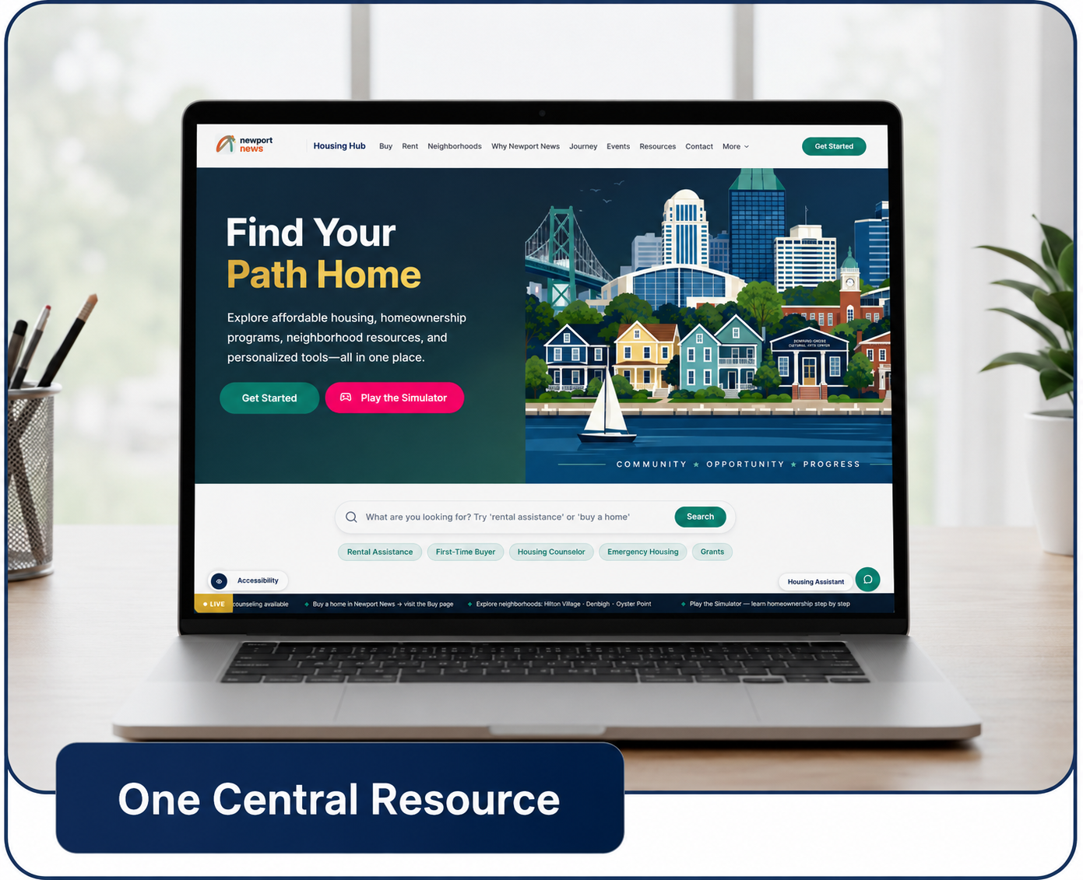
Prototype Demonstration
CITY LOGO
Interactive Walkthrough
Transitioning from concept to reality
A live look at the Newport News Housing Hub user experience.
PROTOTYPE DEMO
Newport News Housing Hub UX

Slide 12
Closing
CITY LOGO
1
Problem Identified
2
Insight Generated
3
Research Conducted
4
Solution Designed
5
Deliverables Created
6
Result: One Central Resource (Housing Hub)

Slide 13

Thank You
Questions, Comments or Concerns?
Team 2: Andy, Cat, Christiney, & Jastiasia

