Slide 1

Our AugestList
Check point:
Networking and WebService
By Yekun
Networking

Slide 2
Outline
points
Keypoints:
Socketactivitytrigger
Streamsocket
Websocket
Keypoints:
winSocket
httpClient
ControlChannelTrigger
Datagram sockets
SSL/TLS

Slide 3
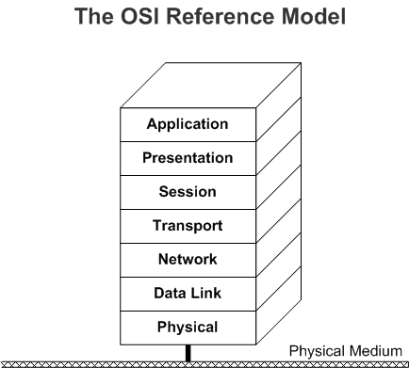
1.The physical layer defines the electrical and physical specificatios of the data connection. It defines the relationship between a device and a physical transmission medium.
6. The presentation layer establishes context between application-layer entities, in which the application-layer entities may use different syntax and semantics if the presentation service provides a mapping between them .
Network OSI Model
4. The transport layer provides the functional and procedural means of transferring variable-length data sequences from a source to a destination host via one or more networks, while maintaining the quality of service functions..
2.The data link layer provides node-to-node data transfer—a link between two directly connected nodes.
3. The network layer provides the functional and procedural means of transferring variable length data sequences (called datagrams) from one node to another connected to the same "network".
7. The application layer is the OSI layer closest to the end user, which means both the OSI application layer and the user interact directly with the software application.
5. The session layer controls the dialogues (connections) between computers..

Slide 4
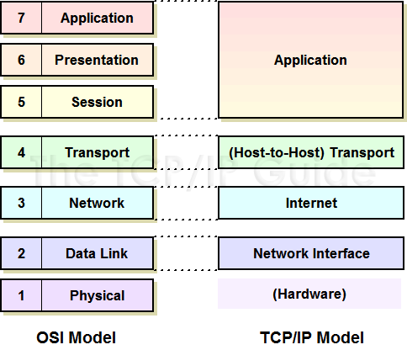
TCP/IP

Slide 5
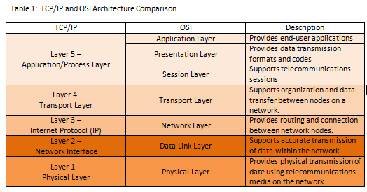
TCP/IP and OSI Architecture

Slide 6
Socket
add your text
network socket is an internal endpoint for sending or receiving data at a single node in a computer network.
It is one endpoint of a two-way communication link between two programs running on the network. A socket is bound to a port number so that the TCP layer can identify the application that data is destined to be sent to.

Slide 7
Socket Connection
add your text
Three Steps:
Create a Server Listener
The Client send a request
Connect ACK
Notes:
根据连接启动的方式以及本地套接字要连接的目标，套接字之间的连接过程可以分为三个步骤：服务器监听，客户端请求，连接确认。
（1）服务器监听：是服务器端套接字并不定位具体的客户端套接字，而是处于等待连接的状态，实时监控网络状态。
（2）客户端请求：是指由客户端的套接字提出连接请求，要连接的目标是服务器端的套接字。为此，客户端的套接字必须首先描述它要连接的服务器的套接字，指出服务器端套接字的地址和端口号，然后就向服务器端套接字提出连接请求。
（3）连接确认：是指当服务器端套接字监听到或者说接收到客户端套接字的连接请求，它就响应客户端套接字的请求，建立一个新的线程，把服务器端套接字的描述发给客户端，一旦客户端确认了此描述，连接就建立好了。而服务器端套接字继续处于监听状态，继续接收其他客户端套接字的连接请求。

Slide 8
StreamSocket
add your text
add your text
A介绍基本
实现代码
常用的方法
介绍我的实现

Slide 9
SocketActivityTrigger
add your text
介绍我的实现

Slide 10
BackgroundTask
add your text
为什么我的实现用到了后台任务

Slide 11
WebSocket
add your text
WebSocket is a computer communications protocol, providing full-duplex communication channels over a single TCP connection.
WebSocket is designed to be implemented in web browsers and web servers, but it can be used by any client or server application. The WebSocket Protocol is an independent TCP-based protocol. Its only relationship to HTTP is that its handshake is interpreted by HTTP servers as an Upgrade request.

Slide 12
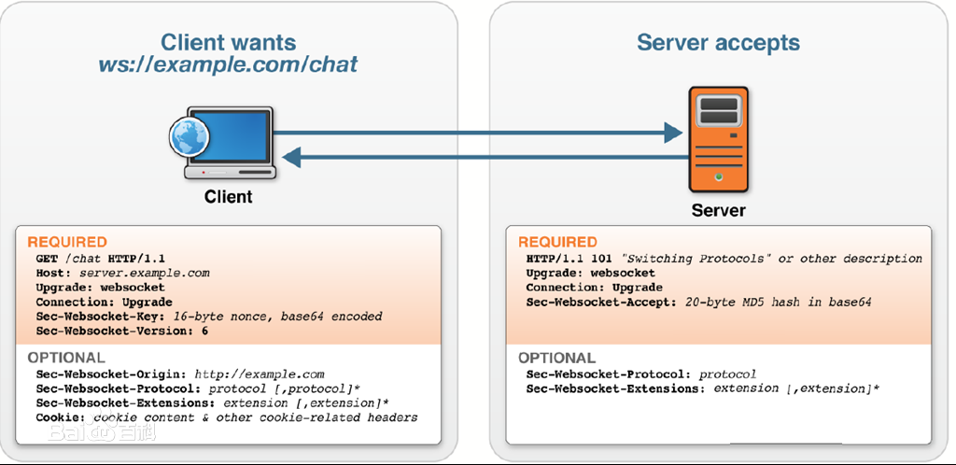
websocket 建立握手

Slide 13
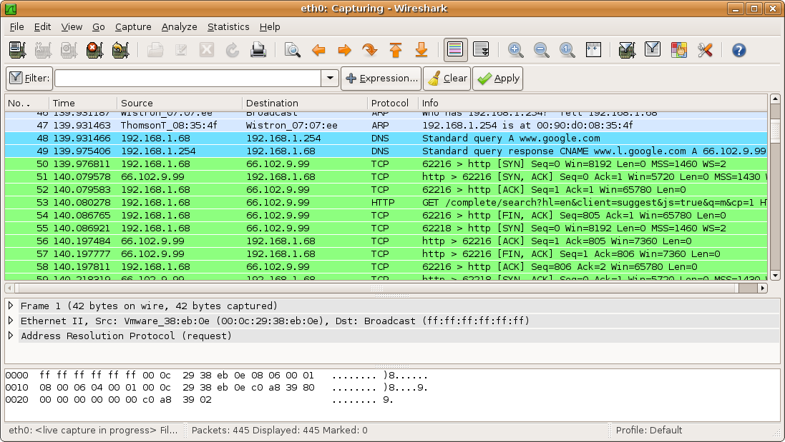
Wireshark introduction
add your text
Wireshark is a free and open source packet analyzer. It is used for network troubleshooting, analysis, software and communications protocol development, and education.

Slide 14
websocket hand shake

Slide 15
错误处理
add your text
加入wireshark共同分析
如时间有余裕

Slide 16
Thank your!

